Slide 1
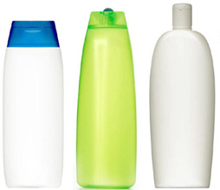
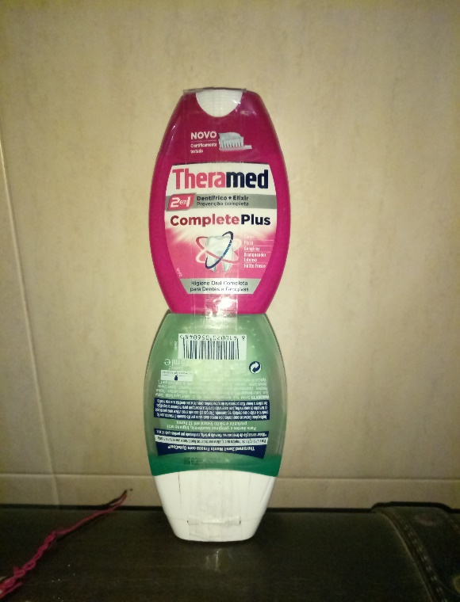
OnlyOne
“The best for all of us”
Escola Secundária de Albufeira
3rd TAGD
Bruno Santos

Slide 2
Reason for the choice of this product?
After many years practising sport, there were situations where I wasn’t happy with the fact of having to load with 2 or 3 packings of hygiene products (shampoo, softener and shower gel) for the shower. iIt was when appeared the idea to create the “OnlyOne”.

Slide 3
Description of the product
Characteristics;
To use only one packing with two different products becomes more practical and accessible.
Advantages;
Doesn’t take so much space Easy use
Price (3€)

Slide 4
Target
Who is going to buy this product?
“OnlyOne” was a product created especially for those who practice any type of physical activity; however any citizen will be able to use it .

Slide 5
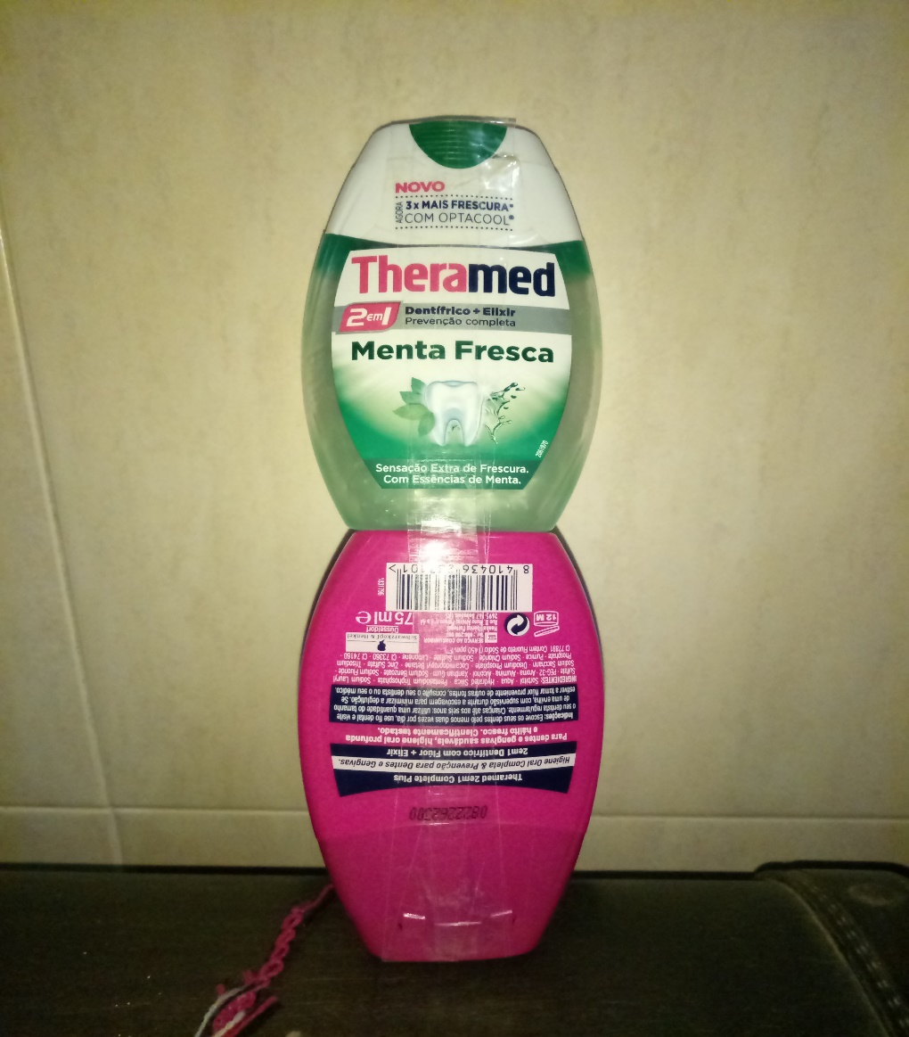
Prototypes
Shampoo
Softener

Slide 6
After Project
Offer a t-shirt when buying a pack
There will be 2 sizes for shampoo / softener
2 sizes for Shampoo / Shower Gel
Price
Small | Big
3€ | 6,49€
Smells
Apple
Peach
Mint
Cherry
Lemon
Orange flower
“The best for all of us”

