Slide 2
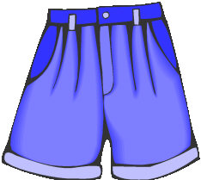
WHERE ARE YOU
Escola Secundária de Albufeira | Curso Profissional Técnico de Turismo

Slide 3
President: Ana Carolina
RP: Xavier Ventura
Marketing: Jack Campaniço
Designer: Iryna Semenyuk
Accountancy:Andreia Feliciano

Slide 4
Goals
Help people to find clothes;
It’s an easier way to find clothes,acessories,shoes and bags’ brands;
Show where people can buy what they’re looking for;

Slide 5
Description of the service
The service will be on the Play Store and App Store for 2,99€ and may have purchases inside the app;
The app is very easy to use:
1- Upload the app and create an account (you can use your facebook account);
2- Take a picture of the clothes, bags, acessories or shoes that you want to find;
3- The app will show you what the brand is and where you can have it and it also shows you the price;
You can purchase your own wardrobe- extra app, on the app for 1,99€.

Slide 6
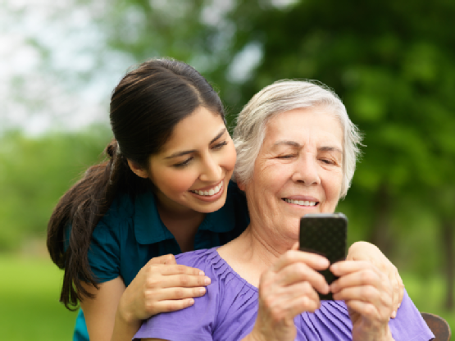
Target
All women and men can use it, if they have an Iphone or an android;

Slide 7
Financial studies
World’s population: 7.466.188.296
Born this year: 128.194.112
Born today: 360.906
Deaths this year: 53.684.198
Deaths today:152.138
Name | Population | App cost | Profit
Get the app | 70479649080 | 2,99€ | 210.734.150.749,20€
Get the extra app | 35239824540 | 1,99€ | 70.127.250.834,60€
Total |  |  | 280.861.401.583,80€

Slide 8
Prototypes

Slide 10
Extra App

Slide 11
Innovations
Show shops with similar clothes and acessories;
Show the nearest shop from the location you stand;

