Slide 1
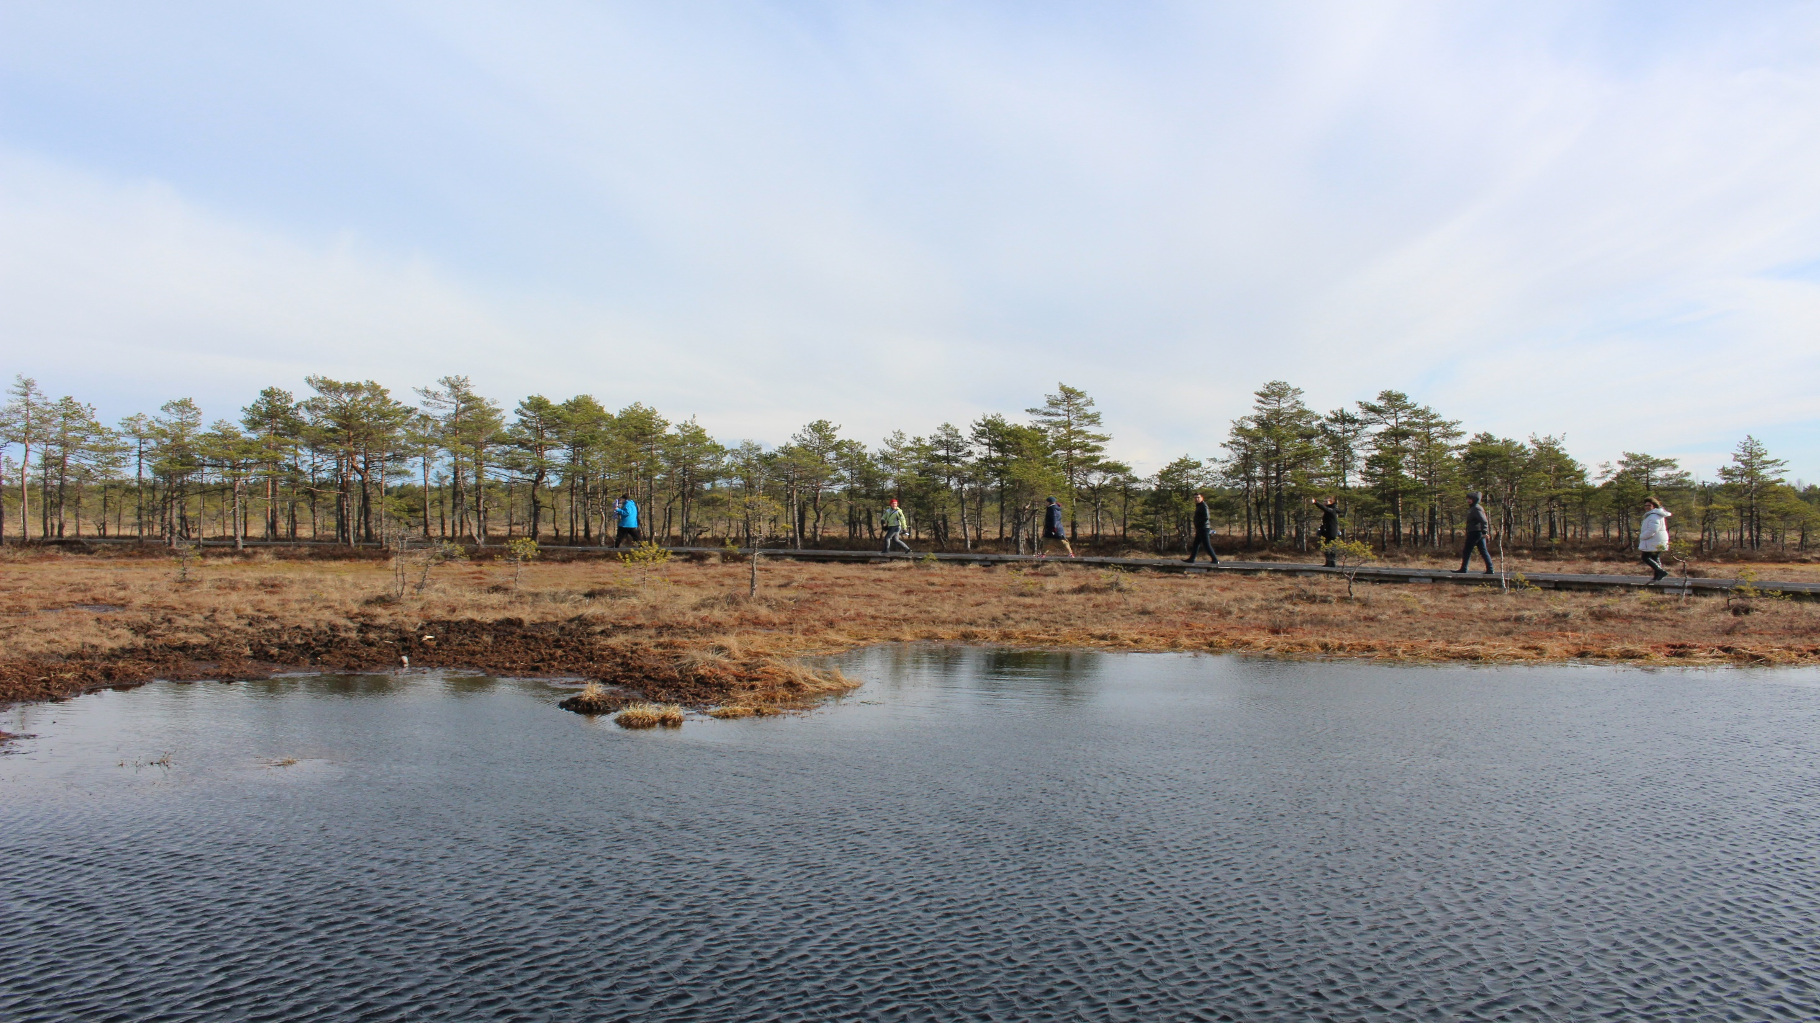

Our journey with Minientrepreneur program
Sandra Pügi
Anne Nukk
Eve Salundi
Albufeira, 2017

Slide 2
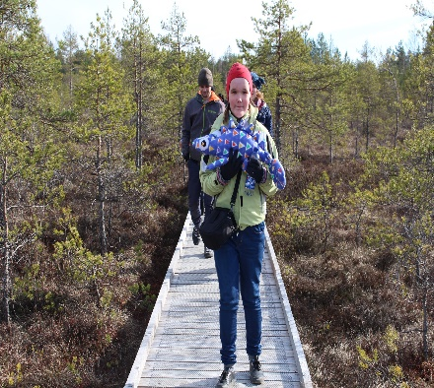
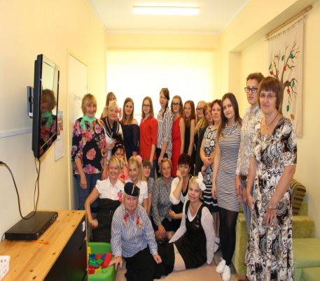
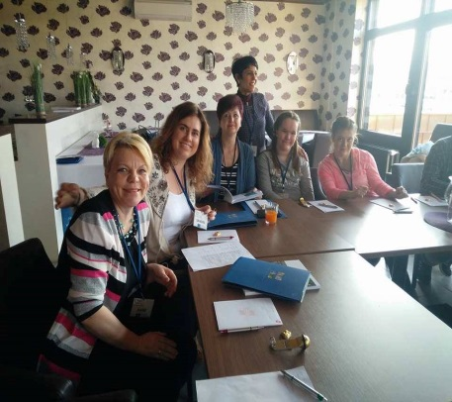
Us (travellers)
Schoolchildren
Our school
Minientrepreneur programm

Slide 3
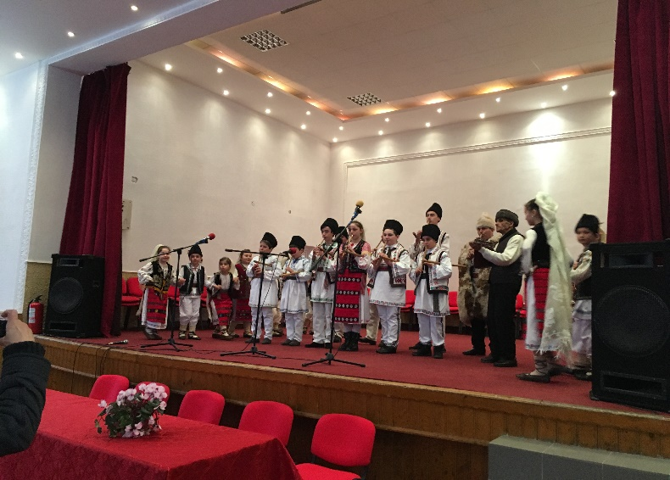
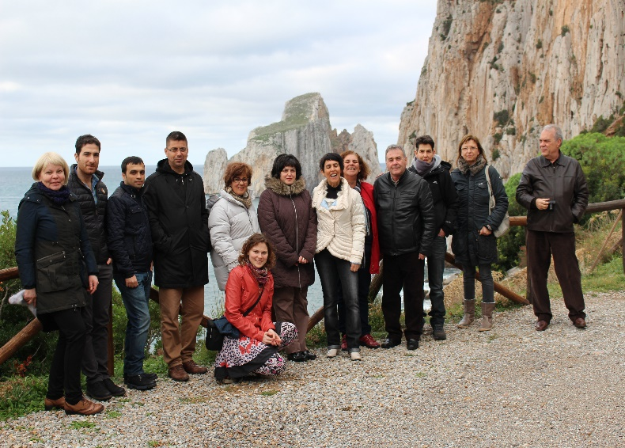
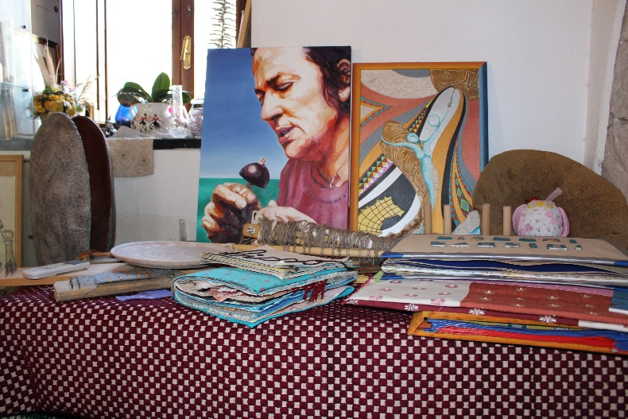
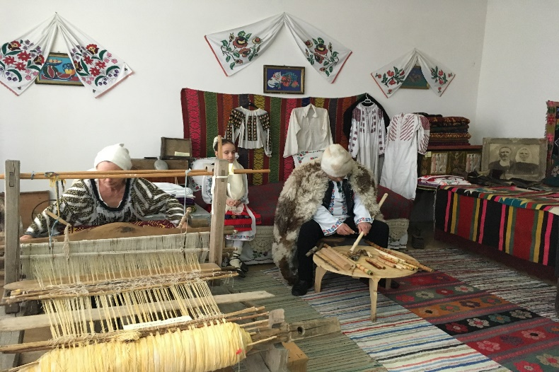
1. We could see different countries and their culture

Slide 4
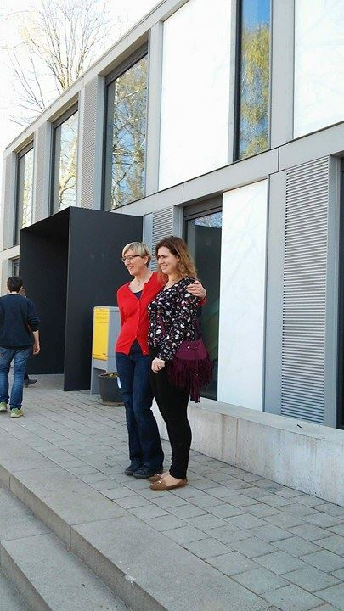
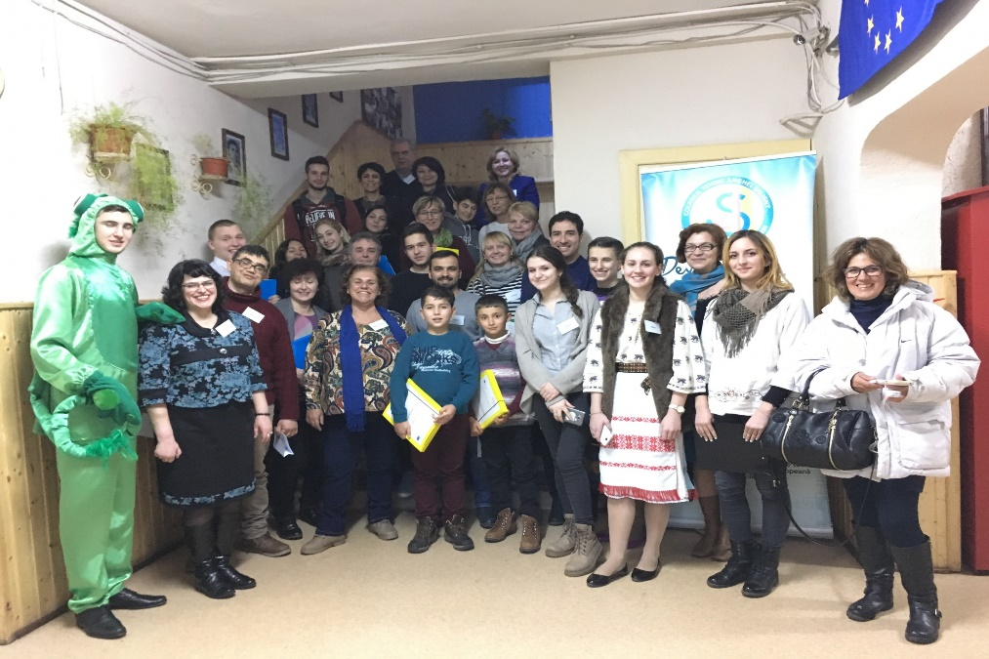
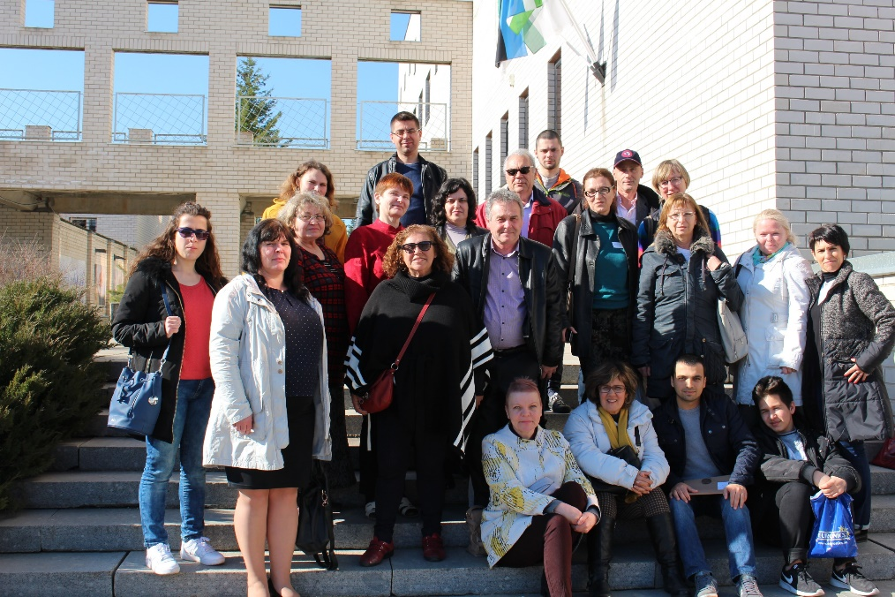
2. New contacts
We hoped to explore the world with our little school and to find partners to share experiences with.

Slide 5
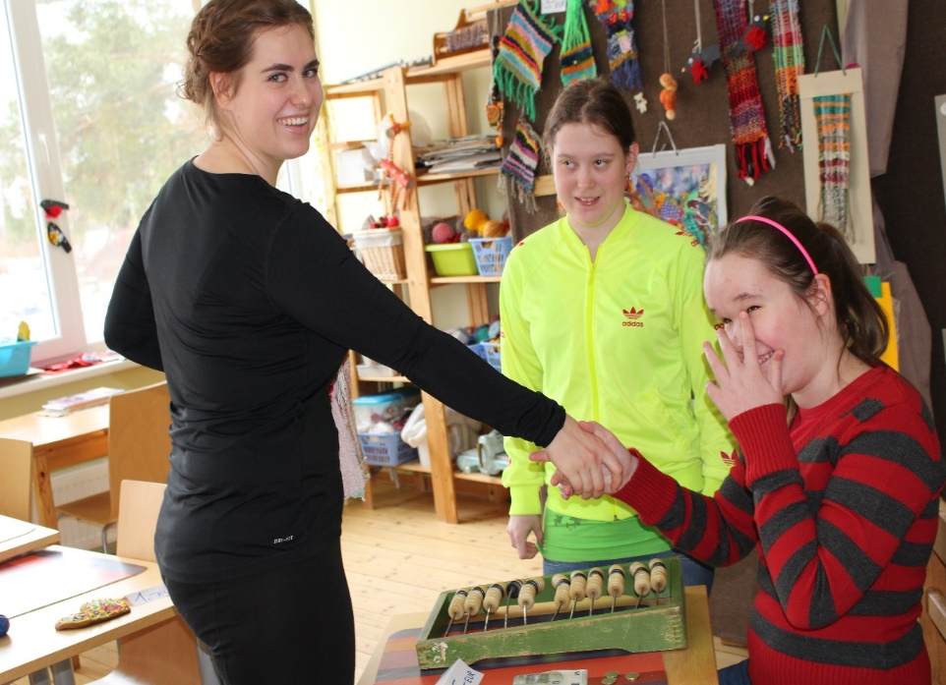

3. New ideas
For example: rules of etiquette
Selling is interesting for our schoolchildren. Now we can connect it with their curriculum

Slide 6
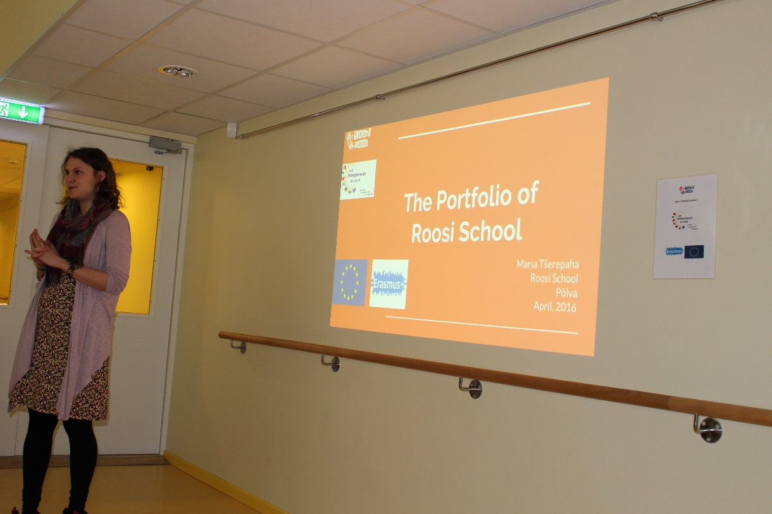
4. Making the portfolio
It is so interesting to see, what we have done!
We are going to continue making a portfolio!

Slide 7
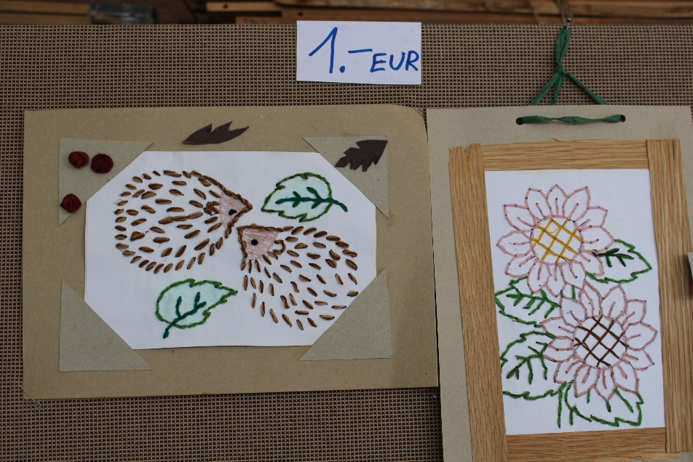
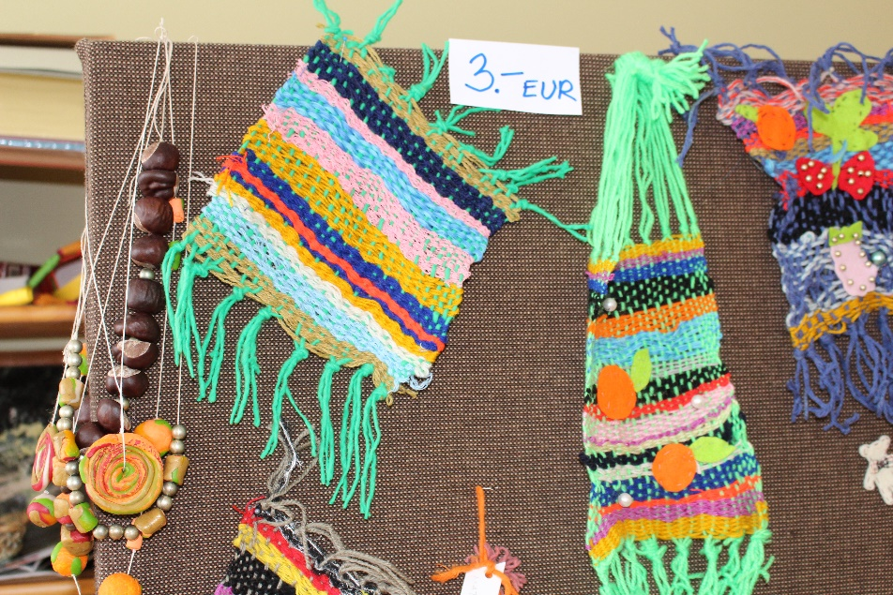
5. Starting our school enterprise
Everybody can see improvement, that even handicapped children can make different sellingproducts.

Slide 8
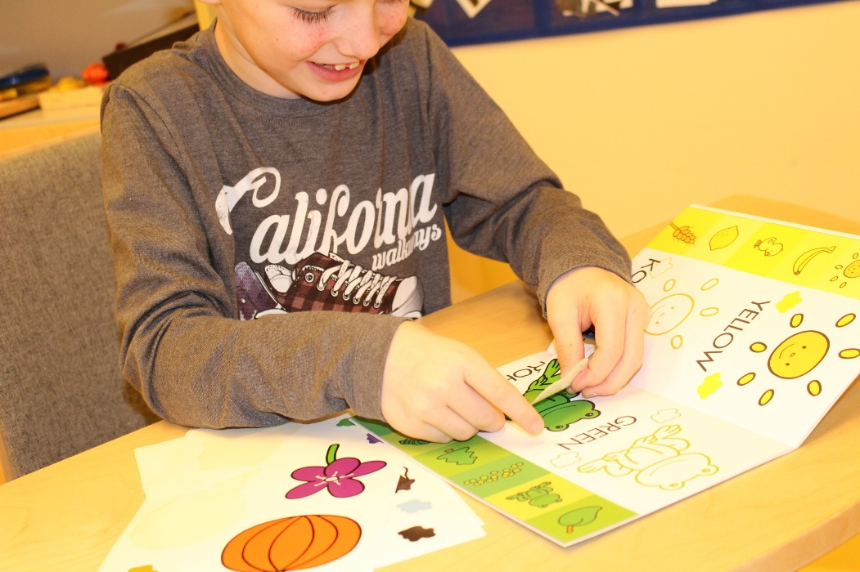
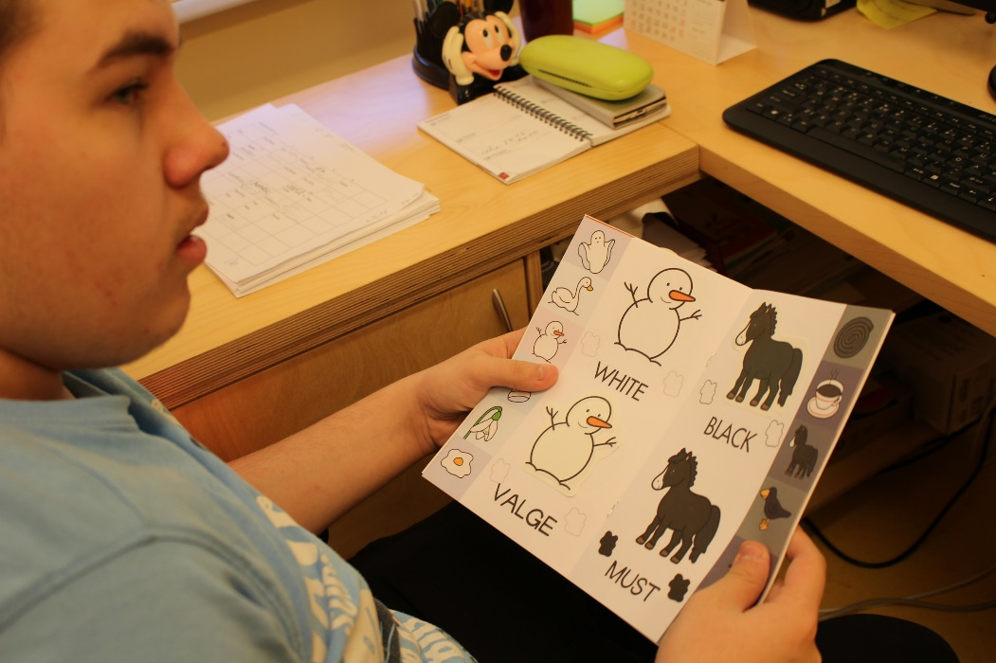
6. English to Roosi school
Minientrepreneur program brought English to our school!
https://www.youtube.com/watch?v=Xd5VIXb1esU&feature=youtu.be

Slide 9
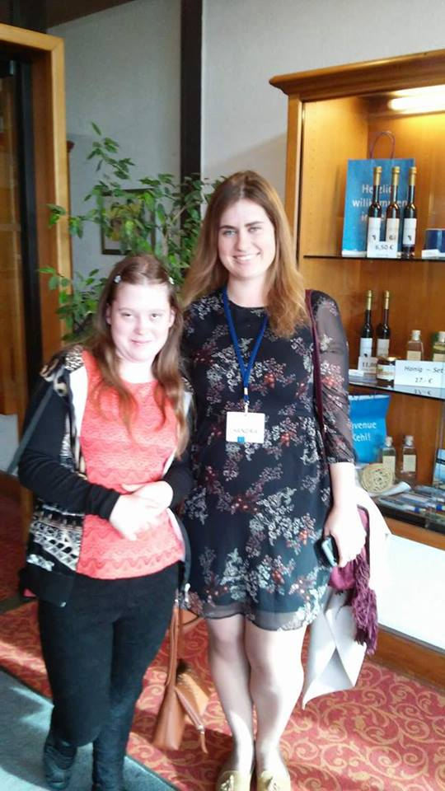
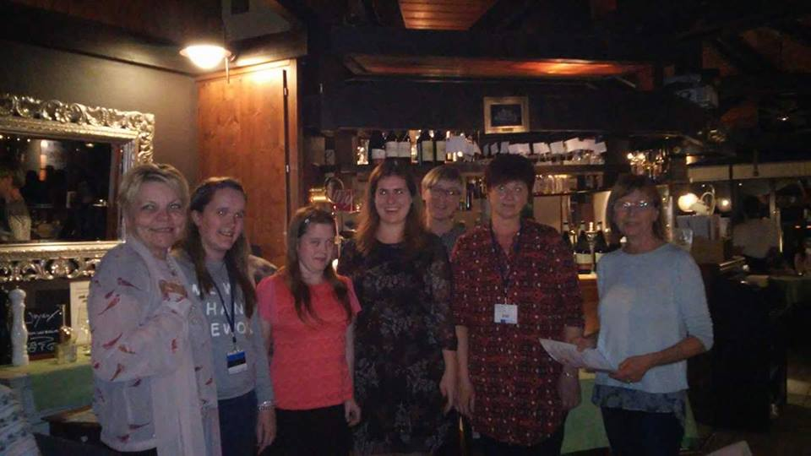
7. Travelling with children (to Germany)
Children went abroad for the very first
time in their life.
They enjoyed everything!

Slide 10
8. New activities
We came out of our comfort zone and started to dance!
https://www.youtube.com/watch?v=KvrWw_Ysx6I&feature=youtu.be

Slide 11
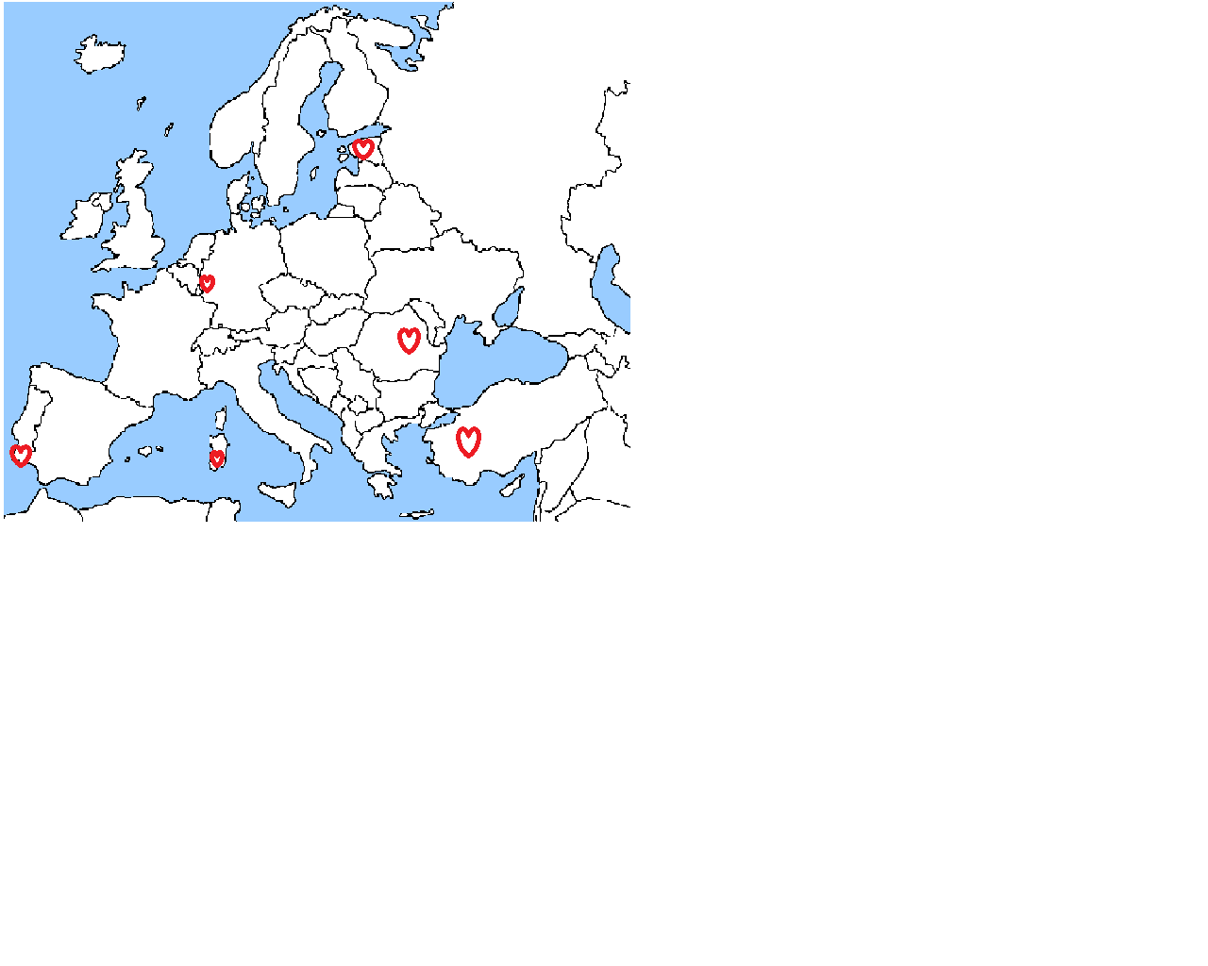
Now we can see Europa like this!

Slide 12
Thank you!

