Slide 1
Beauty Salon & Bar
Manicure – Pedicure – Gelish Nails – Acrylic Nails
Eyelashes – Relaxing Massages - Skin Cleansing
Snacks - Spirits – Cocktails – Juices – Hot drinks - Wine
Escola Secundária de Albufeira
Douglas Vieira - Rafaela Rodrigues

Slide 2
Beauty Salon
Beauty Salon is an establishment dealing with cosmetic treatments for men and women.
Provide more generalized services related to skin health, facial aesthetic, foot care, nail manicures, etc.

Slide 3
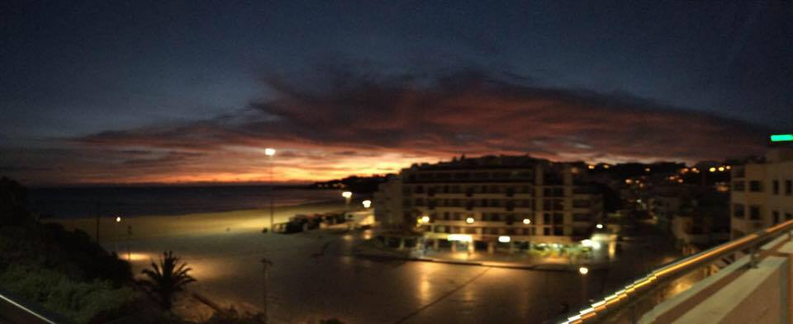
Albufeira
It has 40,000 (forty thousand) inhabitants and is a city in the south of Portugal.
It’s considered a tourism city.

Slide 4
Beauty Salon and Bar
Beauty Salon & Bar is a place where all Women and Men can enjoy the beauty services while tasting a good drink or just enjoy good times with friends or family.
The place would be at Albufeira Town and timetable would be from Tuesday to Sunday from 11am to 2am.

Slide 5
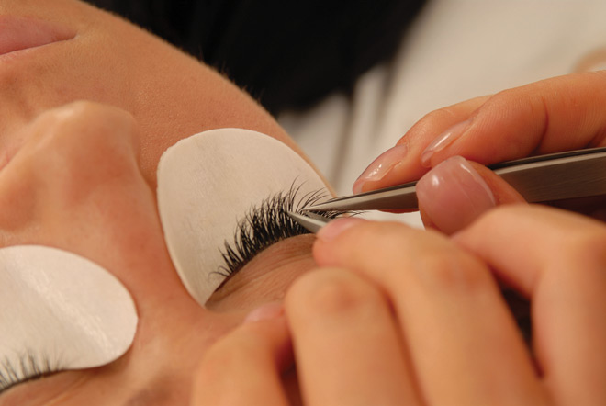
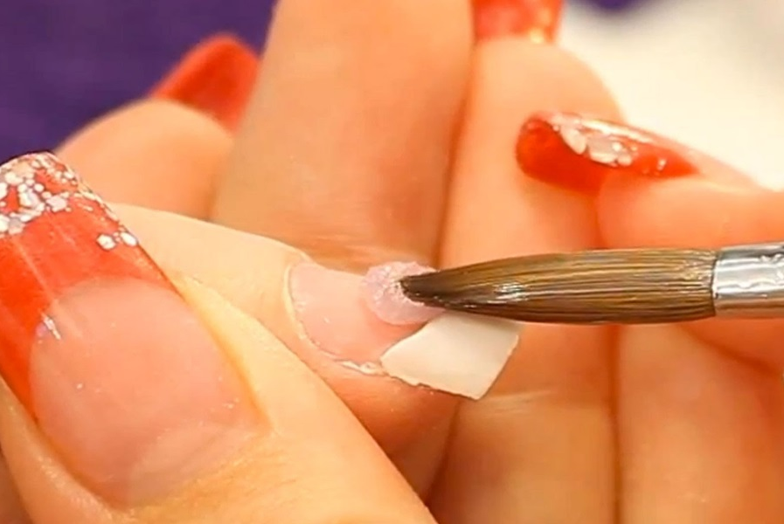
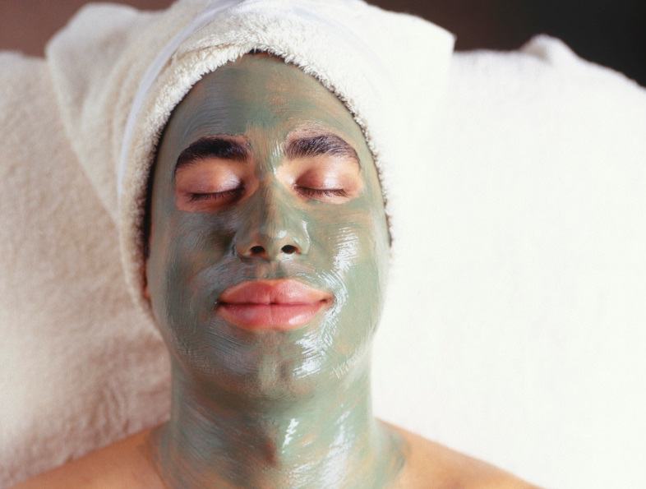
Treatments
Manicure/Pedicure
Gelish Nails
Acrylic Nails
Eyelashes: Classic / Russian 3D / Russian Express
Relaxing Massages: Hot stones / Therapeutic / Pregnant
Skin Cleansing: Face / Body

Slide 6
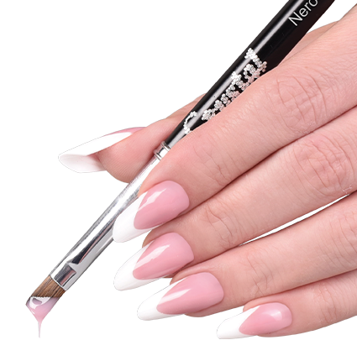
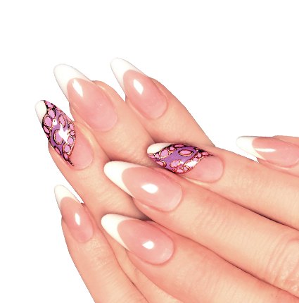
Treatments
Manicure/Pedicure: Is a cosmetic beauty treatment for the feet and hands. Can help prevent nail diseases and nail disorders.
Gelish Nails: Gel polishes are similar to nail polish - you have a base coat, polish color and top coat.
Acrylic Nails: Acrylics are applied using a liquid and a powder to create a hard protective layer over natural nails.

Slide 7
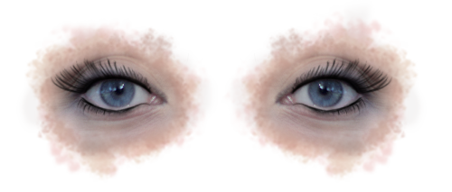
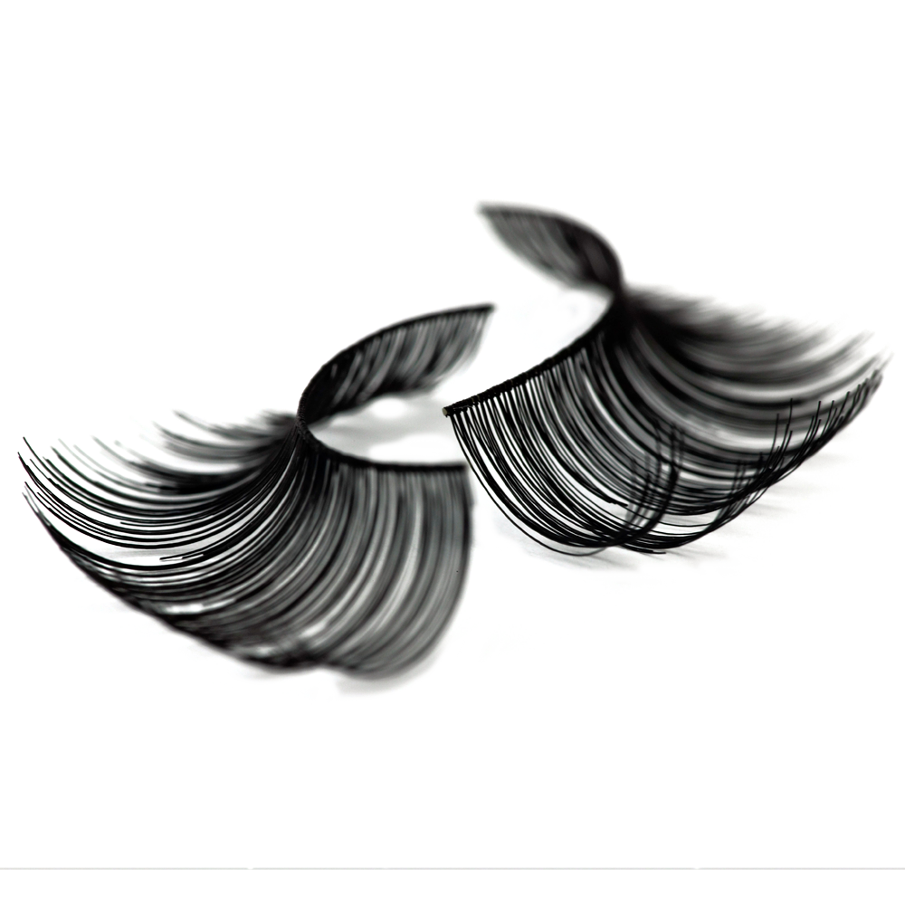
Treatments
Eyelashes: Applying extensions to the eyelashes is a practice that enhances the length, thickness and fullness of natural eyelashes.
Classic: One-by-one and the application takes aroud two hours and the duration is four weeks. The value ranges from forty to one hundred euros.
Russian Volume (2D to 6D): 2 – 6 extremely light-weight extensions are applied to each natural lash, creating intense volume with a soft, fluffy look. The application takes around two hours and the duration is four weeks. The value ranges between fifty to one hundred fifty euros.
Russian Express: 3 extensions are applied to each natural lash. The application takes one hour and the duration is two weeks. The value ranges around twenty five euros.

Slide 8
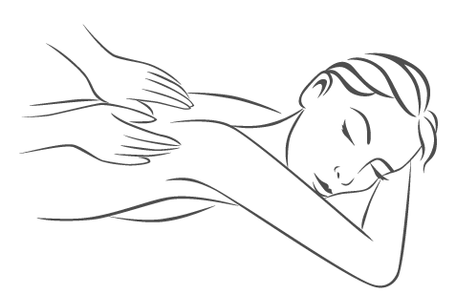
Treatments
Relaxing Massages
Hot stones: hot stones are used to massage the whole body for a deep and profound sense of relaxation. The heat of the stones heats the muscles, relaxing them completely as its therapeutic properties promote an energetic balance as they touch several vital points.
Therapeutic: eliminate muscle aches and localized tension, also for those who seek a Massage with a stronger pressure. With fragrance oils or cream.
Pregnant: Simulates blood and lymphatic circulation and reduces fatigue of the legs and feet.

Slide 9
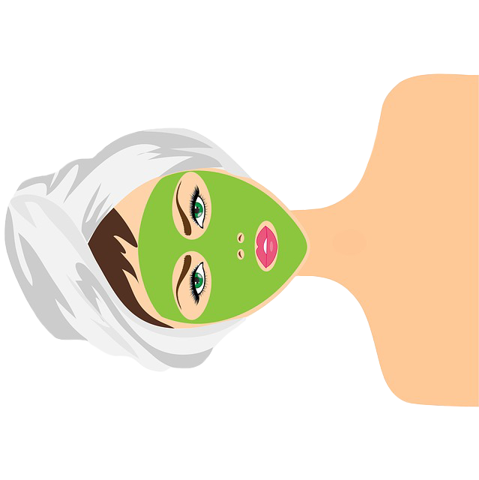
Treatments
Skin Cleansing
Modeling & Detox: Treatment to remove toxins, soften the skin and provide a unique sense of rejuvenation.
Reaffirming and Rejuvenating: This treatment is composed by cleaning, exfoliating, mask and final face cream. Promotes skin rejuvenation and elasticity.

Slide 10
Treatments Prices List
Nail Care |  |  | Massages
Manicure | 12,00 € |  | Hot Stones | 60,00 €
Pedicure | 12,00 € |  | Hot oils | 60,00 €
Gel Nails | 25,00 € |  | Therapeutic | 70,00 €
Acrylic Nails | 30,00 € |  | Pregnant | 75,00 €
Eyelashes |  |  | Skin Cleansing
Removal | 10,00 € |  | Scrub massage | 20,00 €
Maintenance 3w | 20,00 € |  | Purify and clean | 30,00 €
Maintenance 4w | 25,00 € |  | Rejuvenating | 40,00 €
Russian Express | 25,00 € |  | Lymphatic Drainage | 75,00 €
Classic | 40,00 € |  | Anti-Cellulite | 90,00 €
Russian Volume | 50,00 € |  | Modeling and detox | 110,00 €

Slide 11
With treatment - Prices list
Snacks |  |  | Spirits
Fruits mix | 1,00€ |  | Vodka | 4,00€
Salads | 2,00€ |  | Wisky | 4,00€
Sandwiches | 2,00€ |  | Gin | 5,00€
Juices |  |  | Hot Drinks
With gas | 1,00€ |  | Milks | 1,00€
Without gas | 1,00€ |  | Coffee | 1,00€
Natural | 2,00€ |  | Tea | 2,50€
Cocktails |  |  | Wine
Juices | 2,00€ |  | Red | 2,50€
Alcohol | 3,00€ |  | White | 2,50€

Slide 12
Without treatment - Prices list
Snacks |  |  | Spirits
Fruits mix | 2,00€ |  | Vodka | 4,50€
Salads | 2,00€ |  | Wisky | 4,50€
Sandwiches | 3,00€ |  | Gin | 6,00€
Juices |  |  | Hot Drinks
With gas | 1,50€ |  | Milks | 1,50€
Without gas | 1,50€ |  | Coffee | 1,50€
Natural | 2,50€ |  | Tea | 3,00€
Cocktails |  |  | Wine
Juices | 2,50€ |  | Red | 3,50€
Alcohol | 3,50€ |  | White | 3,50€

Slide 13
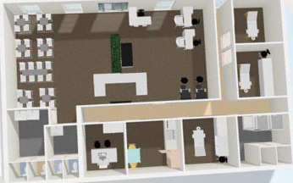
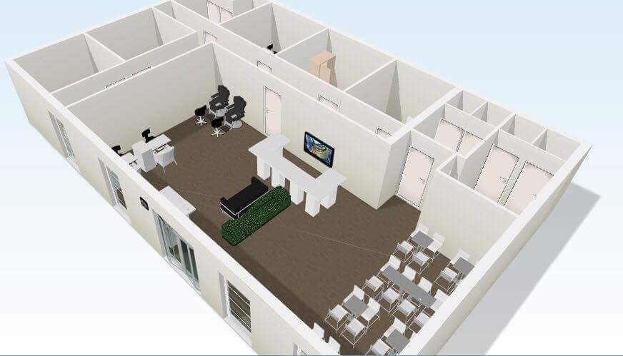
Building
- Nails Salon / Bar
- Wc’s (Female and Male)
- Massages, Skin treatments and eyelashes rooms
- Staff Room / Office

Slide 14
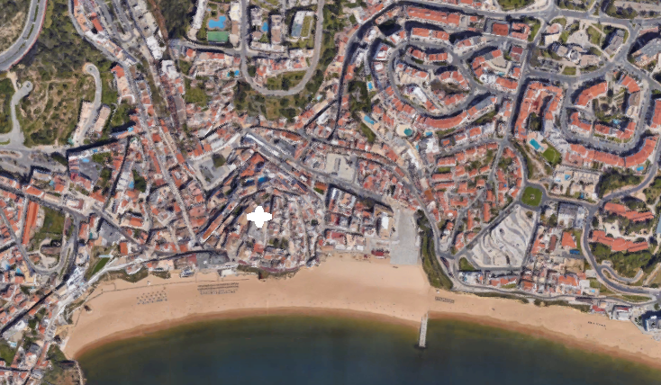
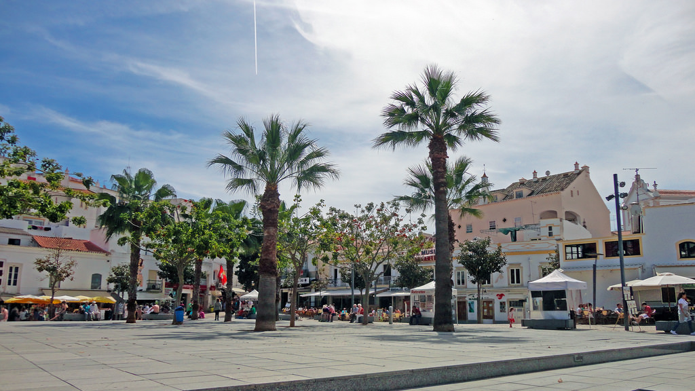
Location
Albufeira Town

