Slide 1
Selling...it´s a SERIOUS BUSINESS
Sandra Pügi
Anne Nukk
Eve Salundi
Mathilda Kerner
Mairi Haniott
Kehl, 2017

Slide 2
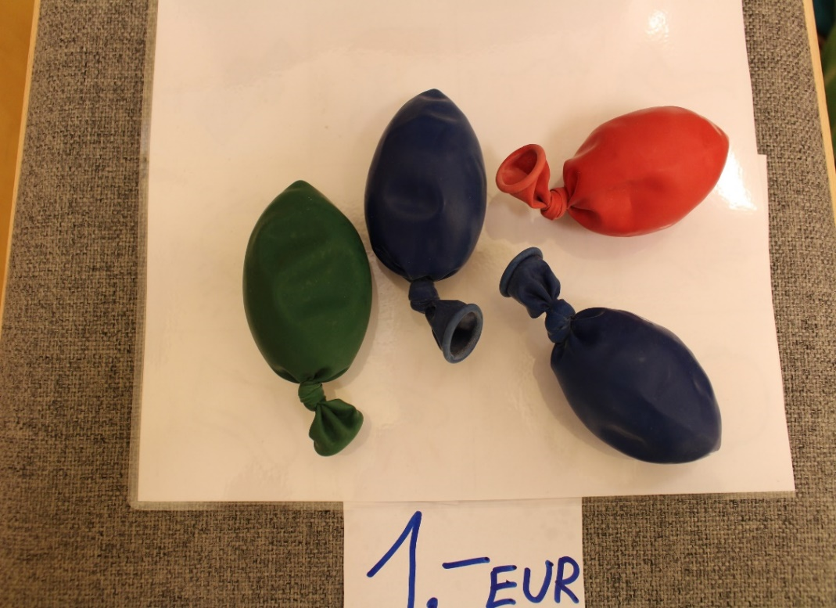
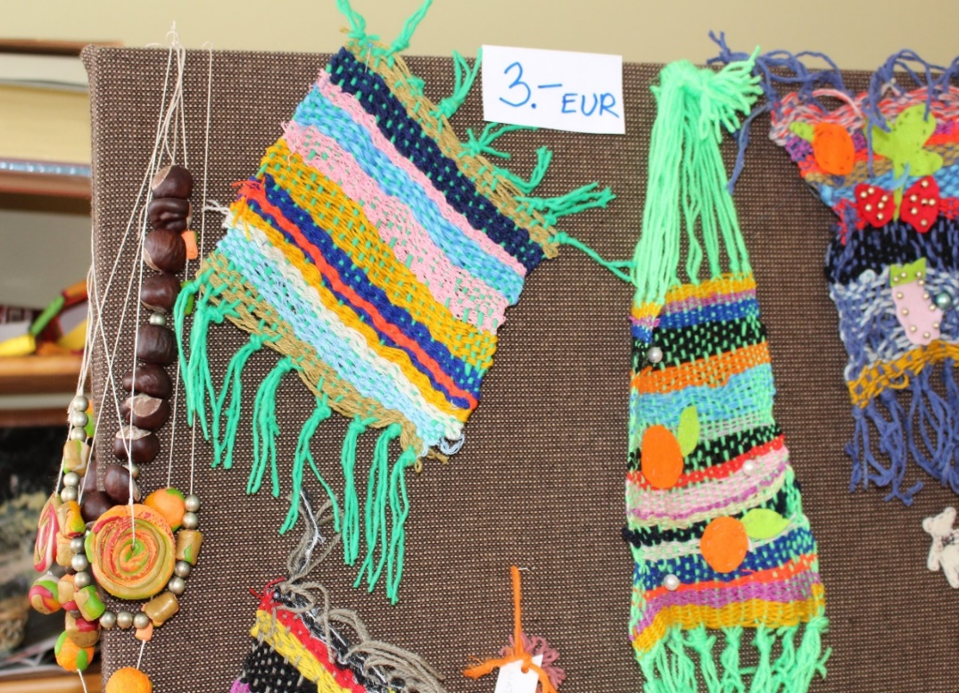
Preparation for school fair
4 time per year takes place school fair in Roosi´s school
Children make carpets, wall decorations, sweets and stress balls

Slide 3
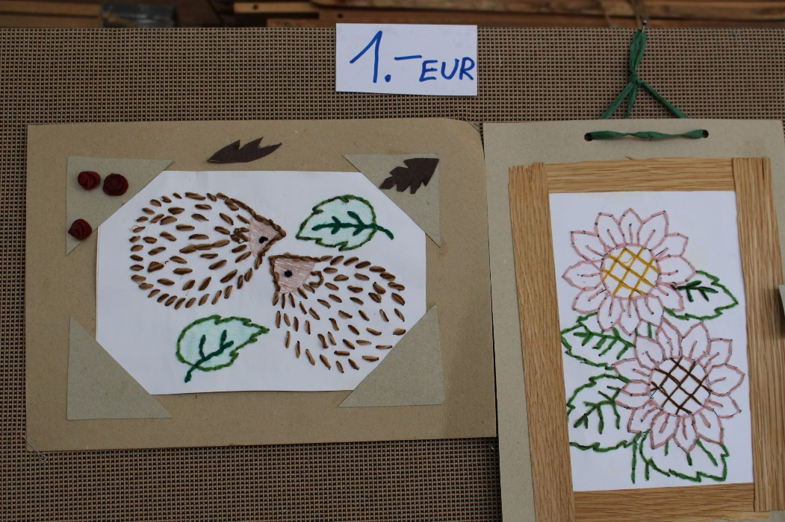
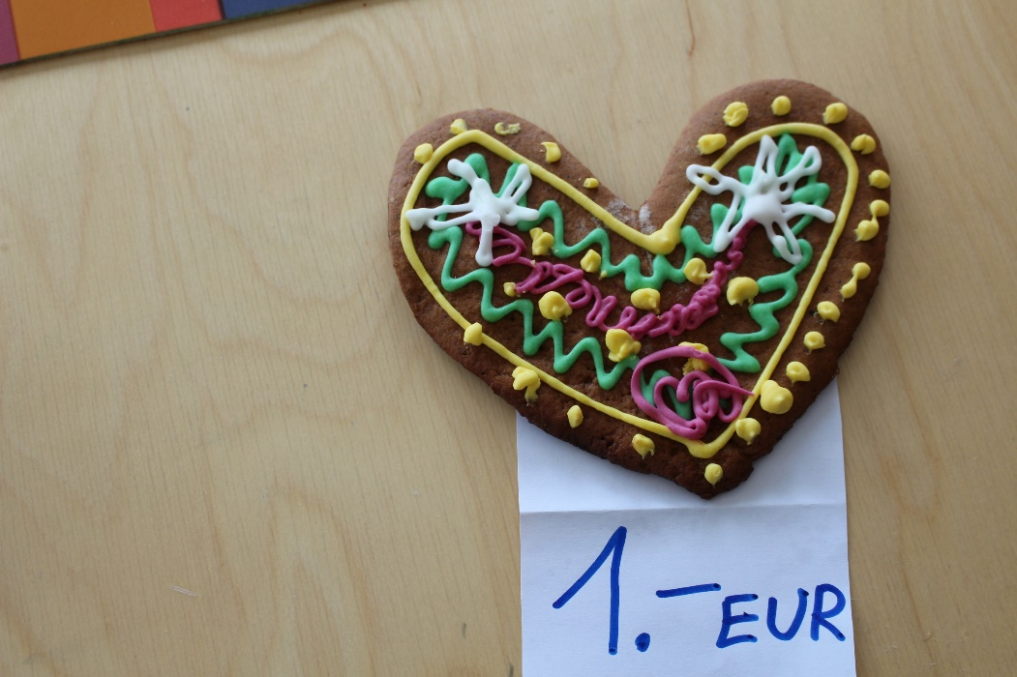
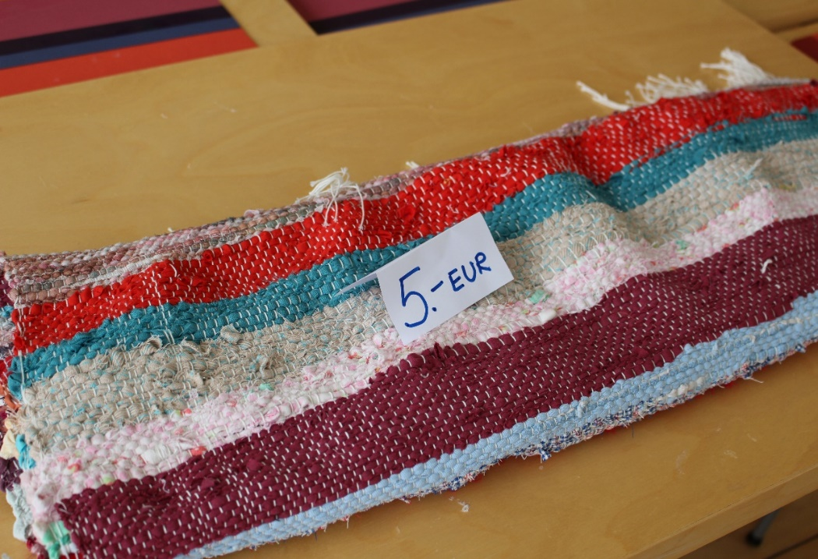
Wall decorations
Gingerbreads and cookies
Carpets

Slide 4
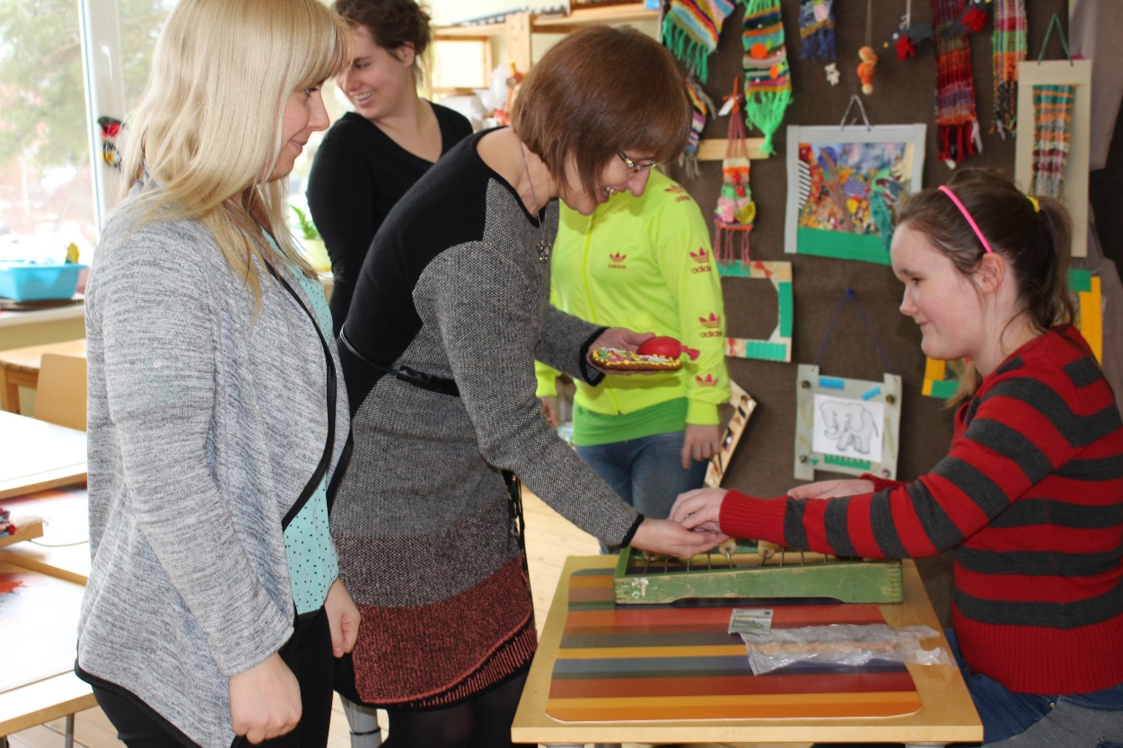
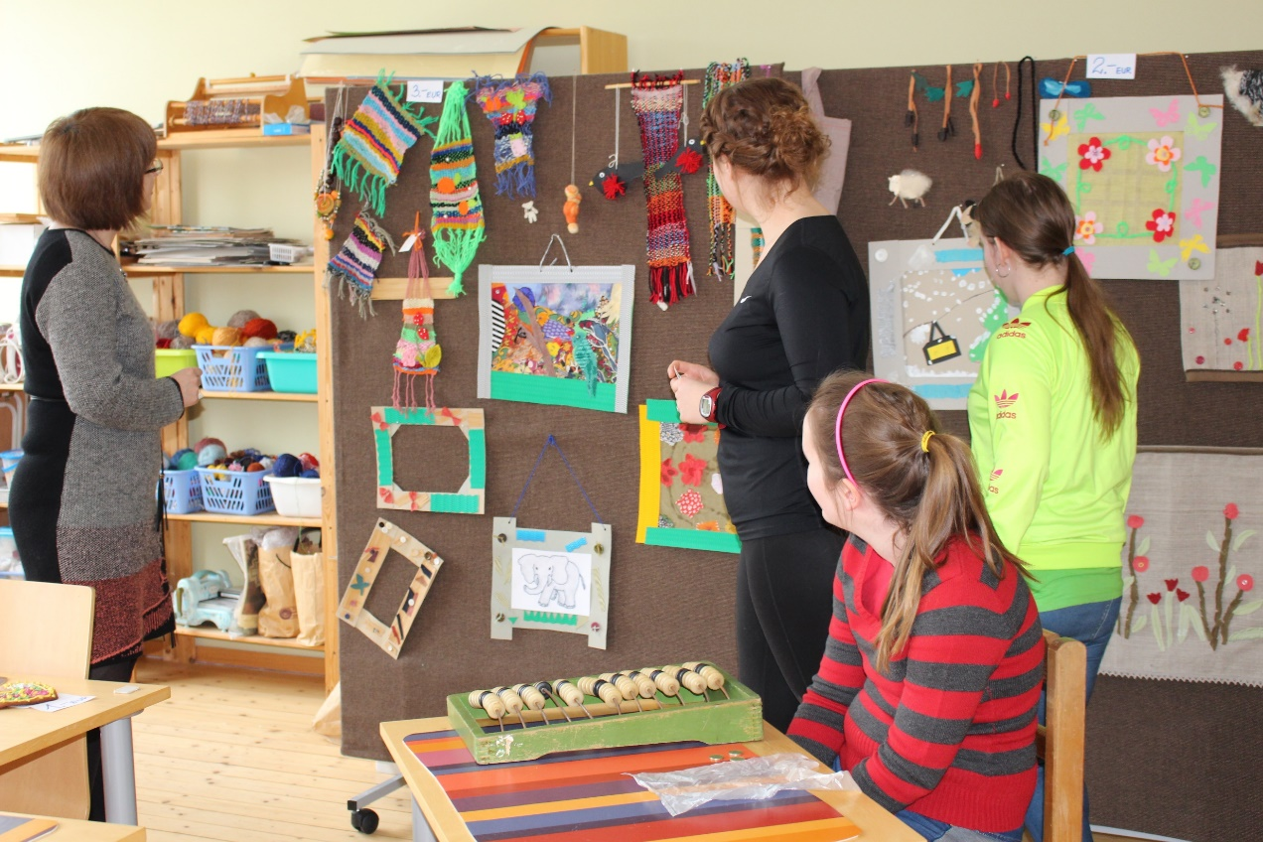
And then fair took place...
The customers are usually other students, teachers and parents

Slide 5
How do to Selling?
Children are offering their selling products for customers

Slide 6
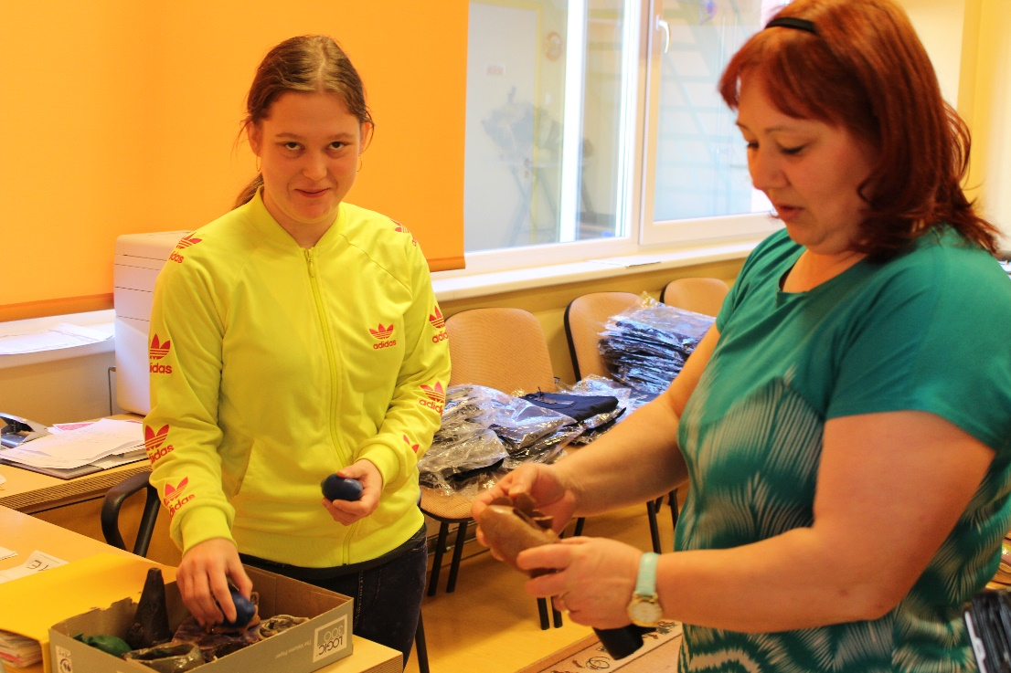
Children are excited and enjoyed selling
activity

Slide 7
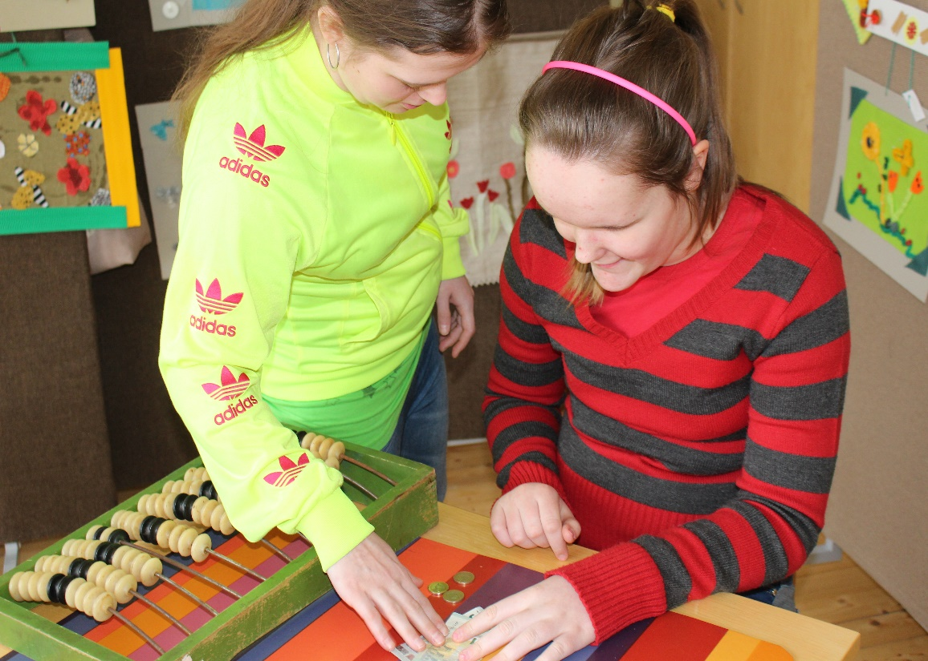
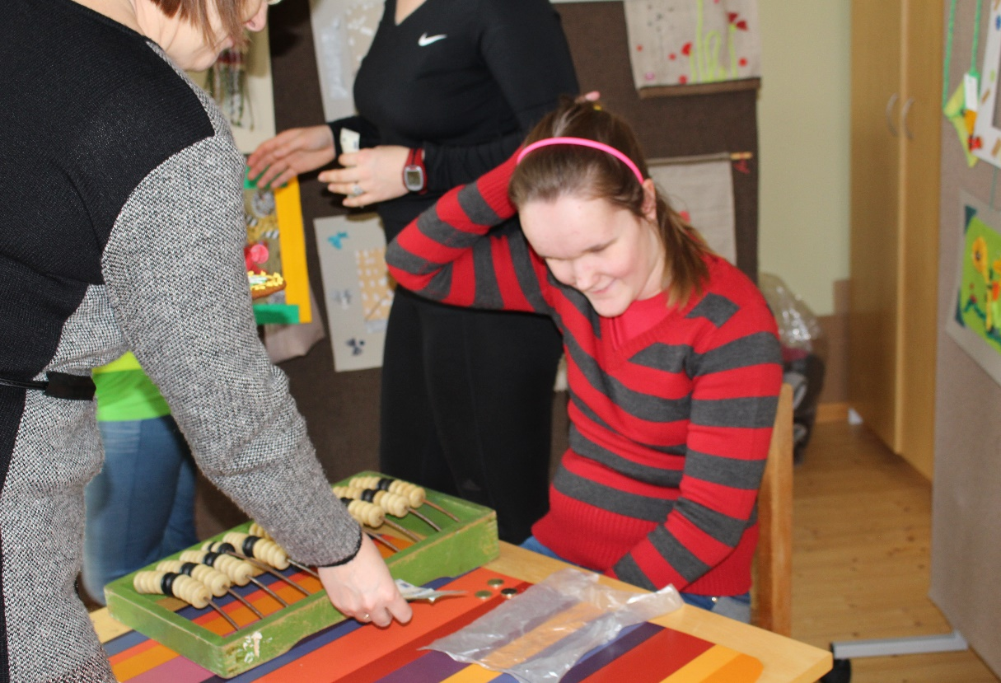
But it is not that easy...
Calculating the money is the most difficult part

Slide 8
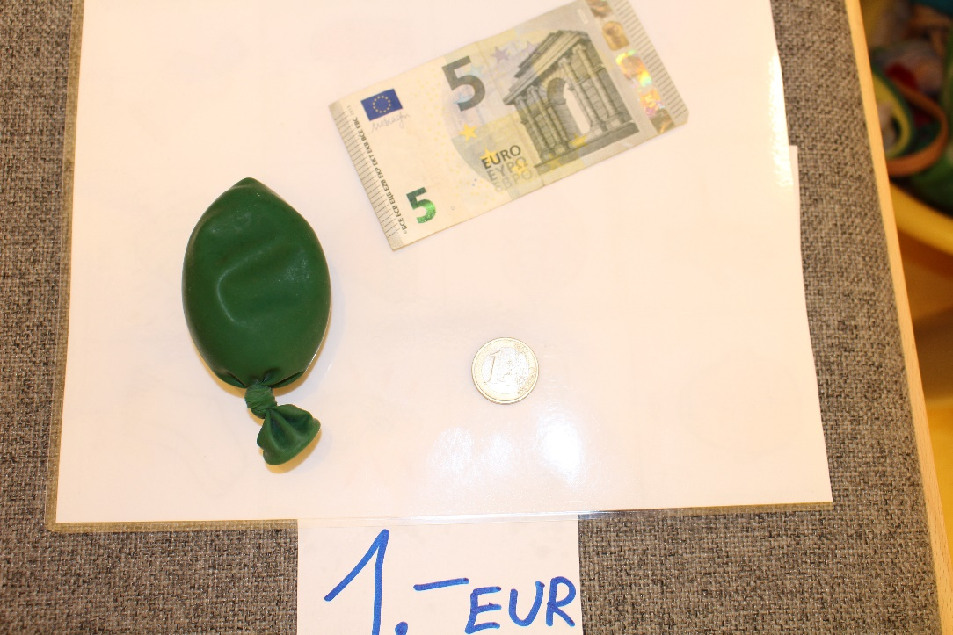
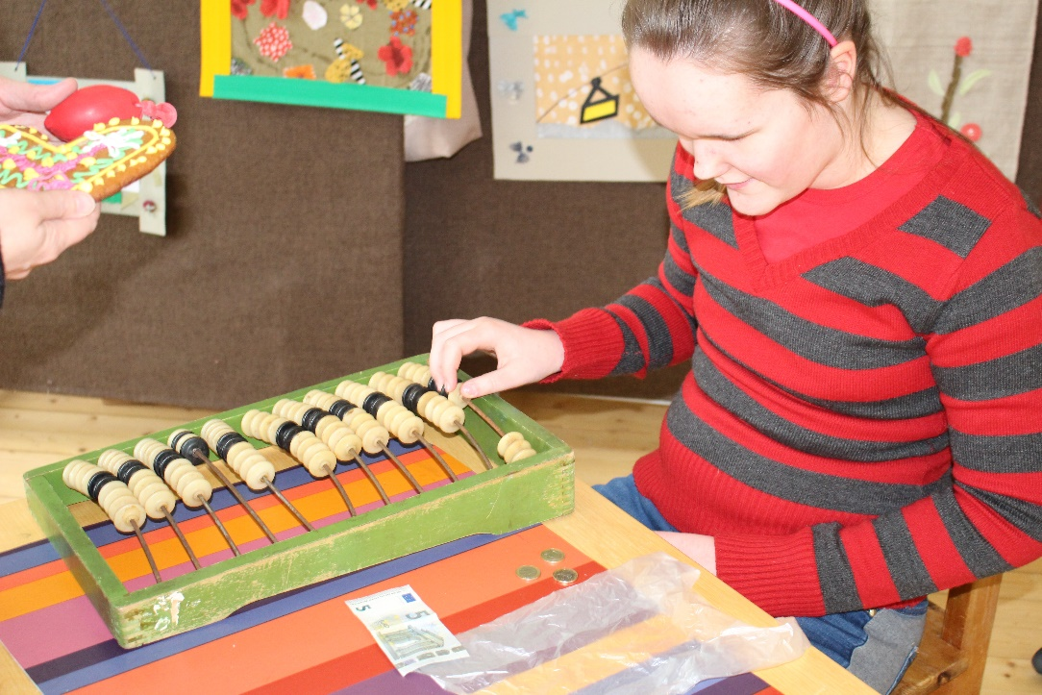
How much money i have to give back
They needed help to know, how much money they have to give
back for customer

Slide 9
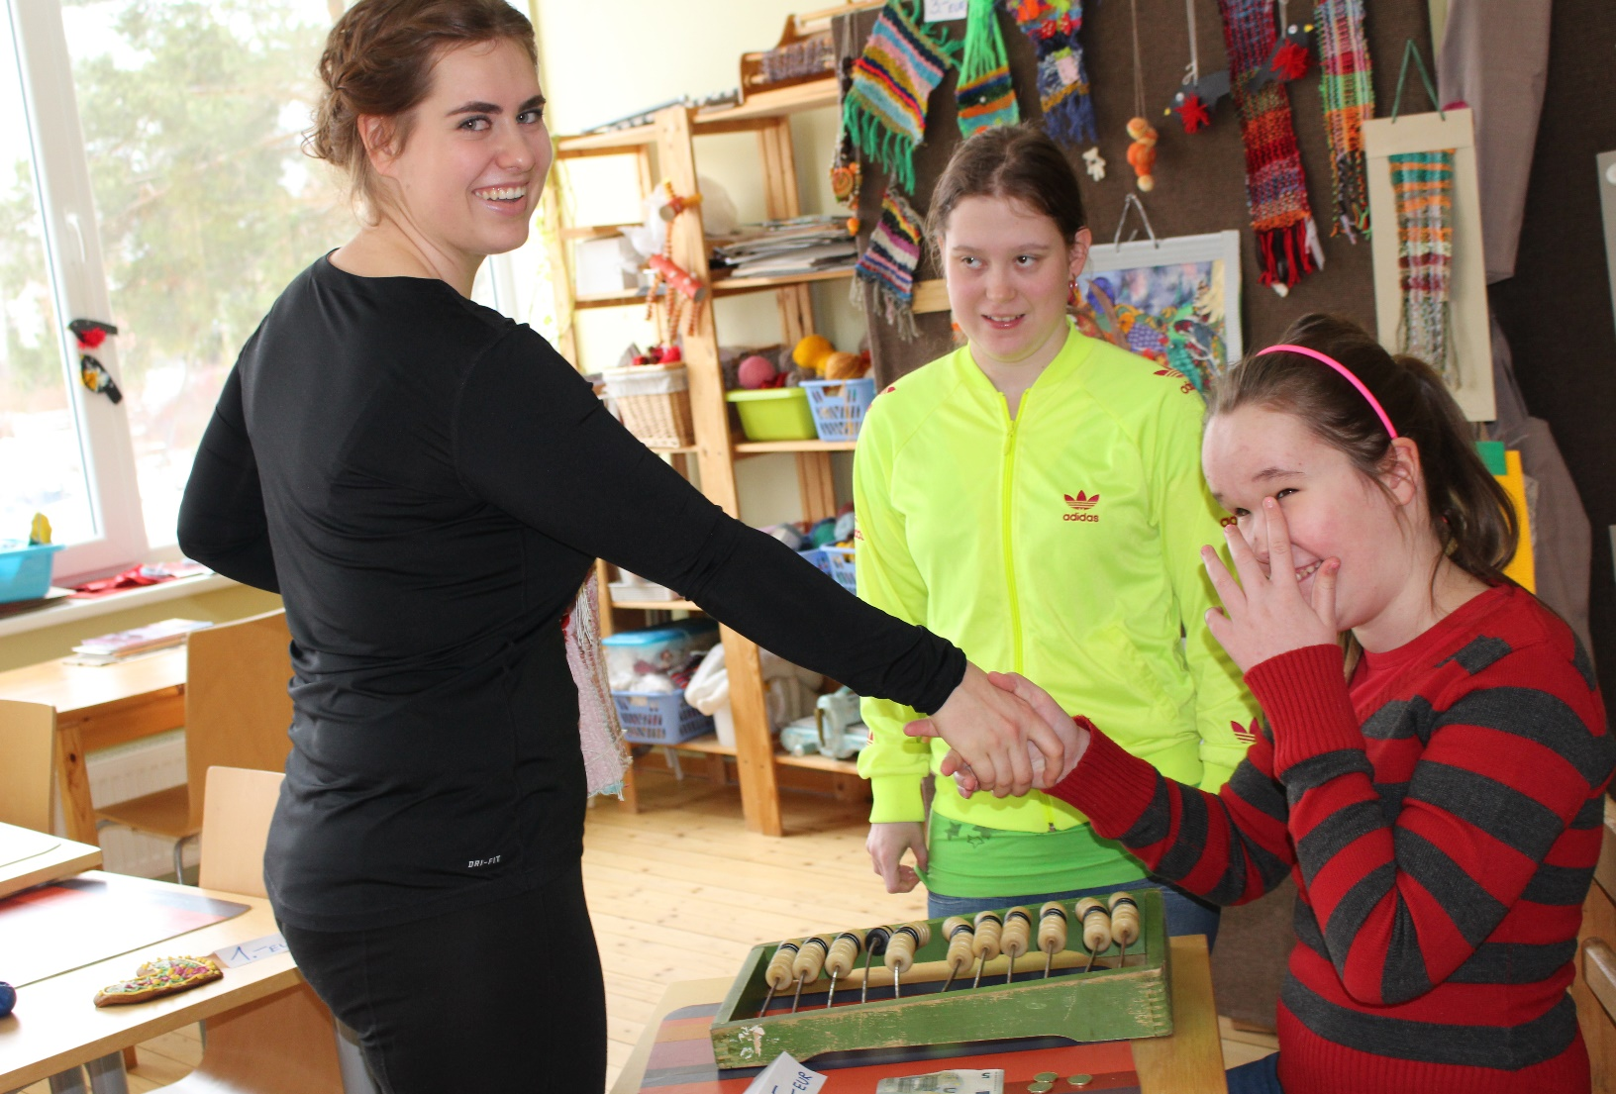
Everybody WAS happy and pleased

Slide 10
Thank you for attention! ☺

