Slide 1
Erasmus+
Strategic Partnerships for Schools Only (KA2)
Mini entrepreneurs at school
2015-1-PT01-KA219-012951_3

Slide 2
SPECIAL NEEDS EDUCATION IN TURKEY

Slide 3
Matters relating to people with special needs in Turkey are regulated by the Administration for Disabled ( The Ministry of Family and Social Policies).

Slide 4
In May 2009 Turkey adopted the UN Convention on the Rights of Persons with Disabilities
The Ministry of Education is responsible for providing children with special needs with education from age 3 to 14.

Slide 5
Education of the disabled children is a subject of concern for the Ministry of National Education, according to the principle of “Equality of Opportunity and in Education”

Slide 6
Turkish National Education, aims to:
Raise individuals with special needs as productive and happy citizens who realize their roles within the society,

Slide 7
maintain good relations with others,
work with others in cooperation,
adapt to their environment,

Slide 8
develop basic life skills for living independently within the society and becoming self-sufficient

Slide 9
prepare for higher education, professional and vocational fields, and life in line with their educational needs, capabilities, interests and talents through appropriate educational programs, special methods, personnel and materials.

Slide 10
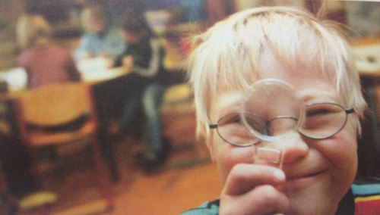
In Aydın there are 18 special education schools.
653 children with disabilities study at these schools.

Slide 11
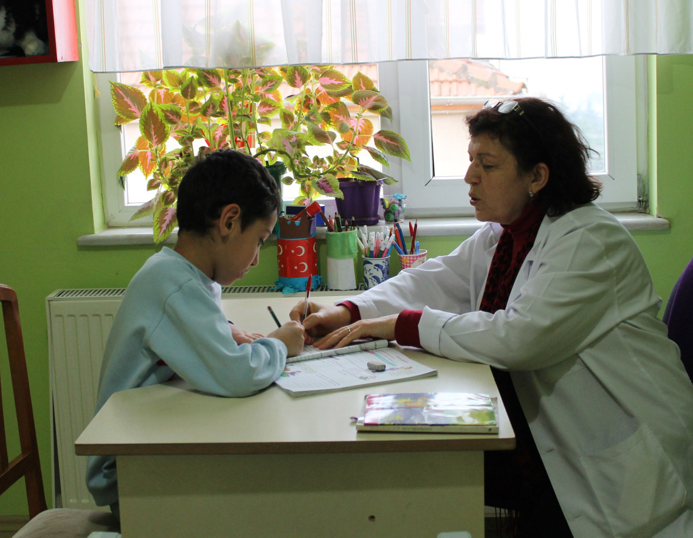
In Mersinbeleni Primary School, we have 11 students with disabilities.

Slide 12
In our school, we have inclusive classrooms where the students with and without disabilities learn together. We also have special classroom for children with disabilities.

Slide 13
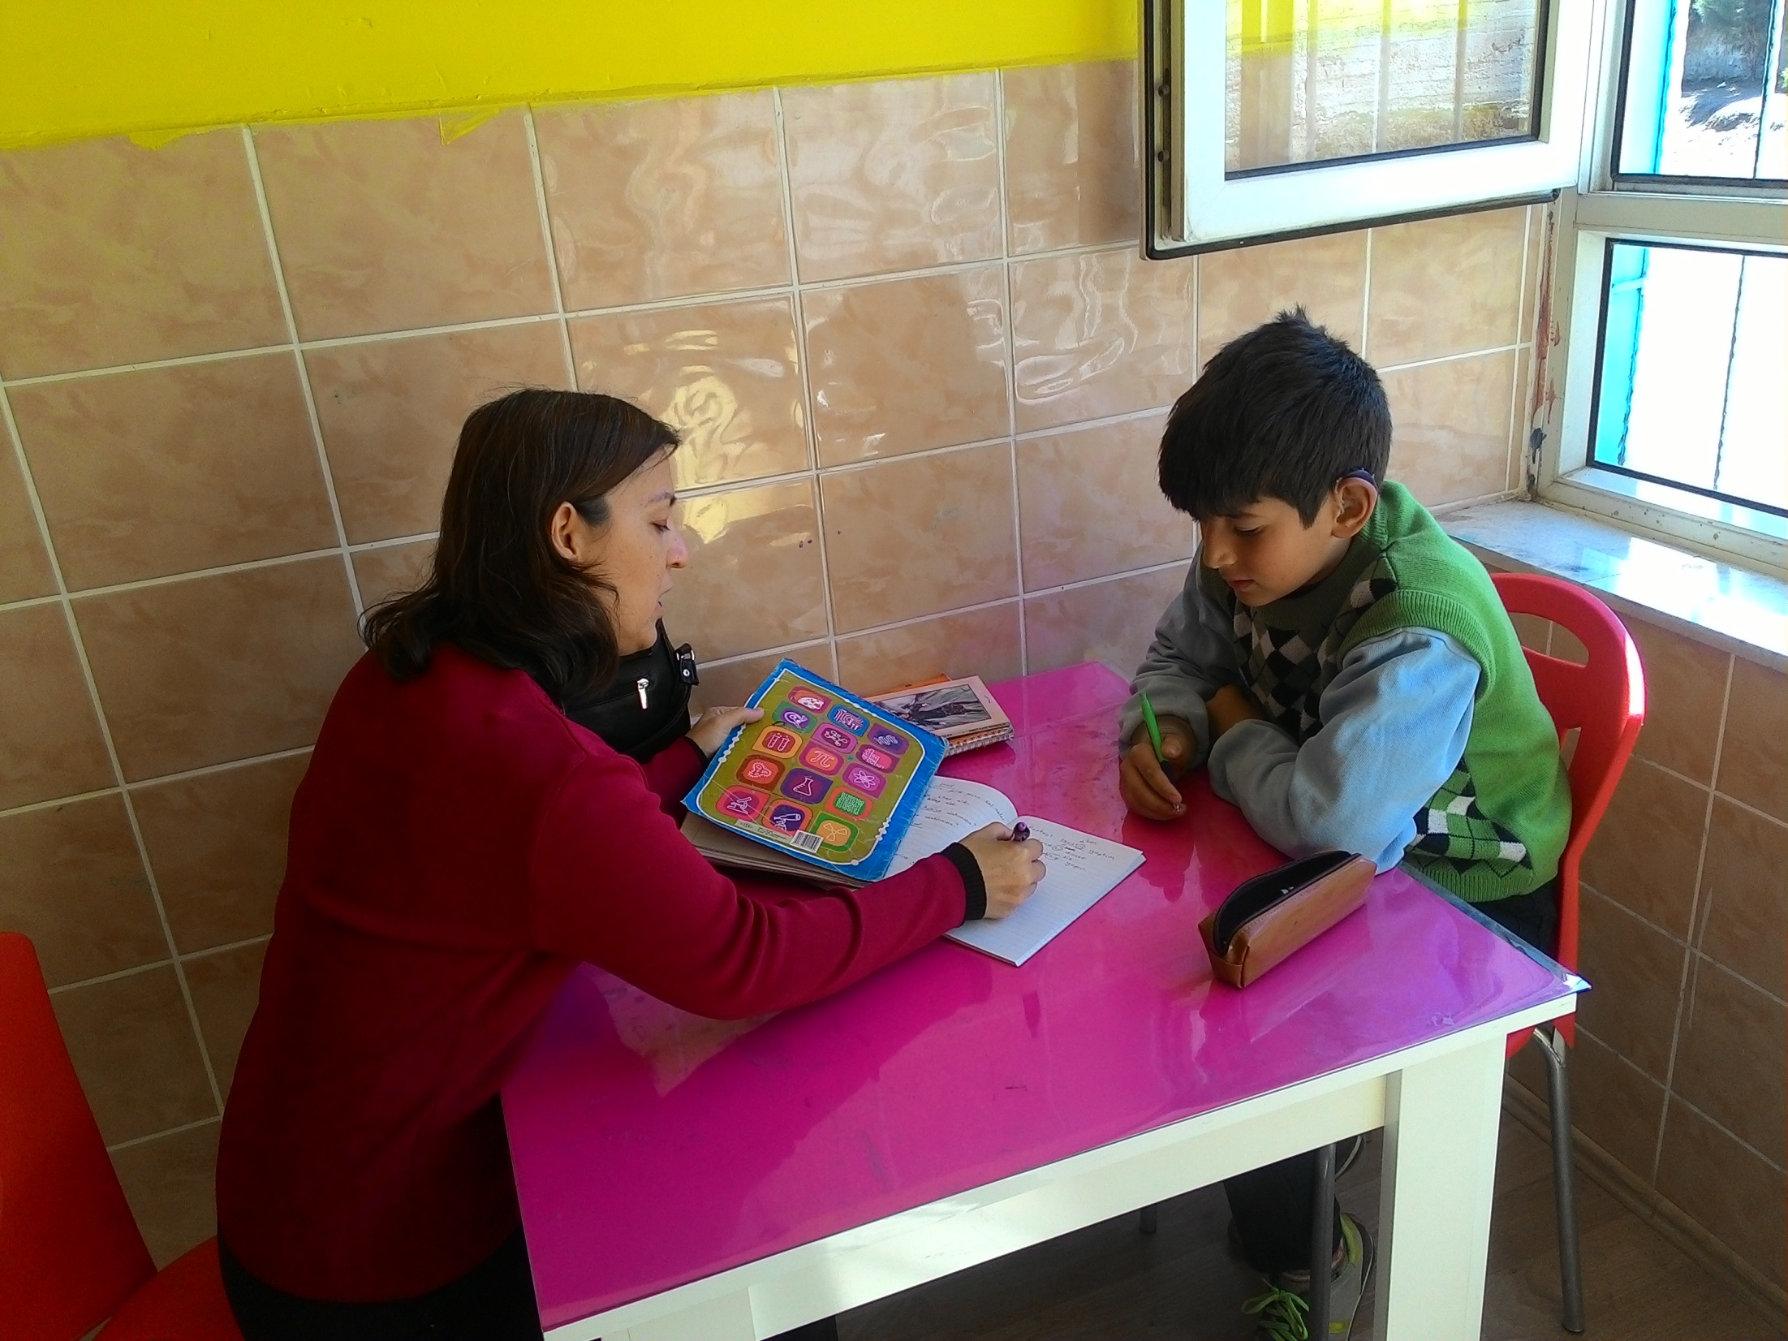

Slide 14
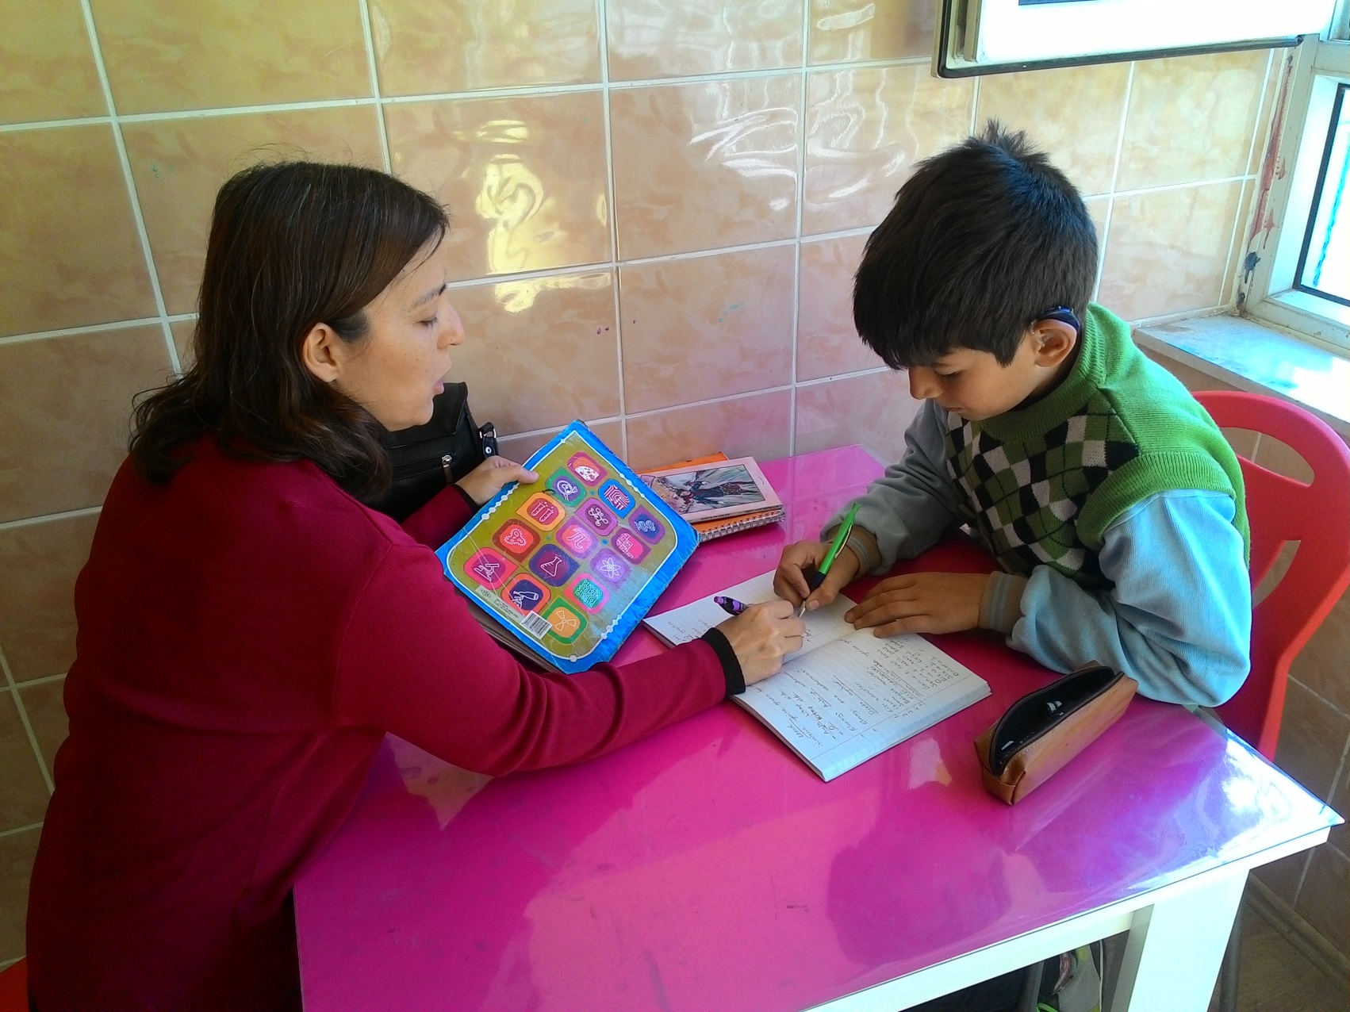
The necessary support are provided in this classroom. Each student has a tutor.

Slide 15
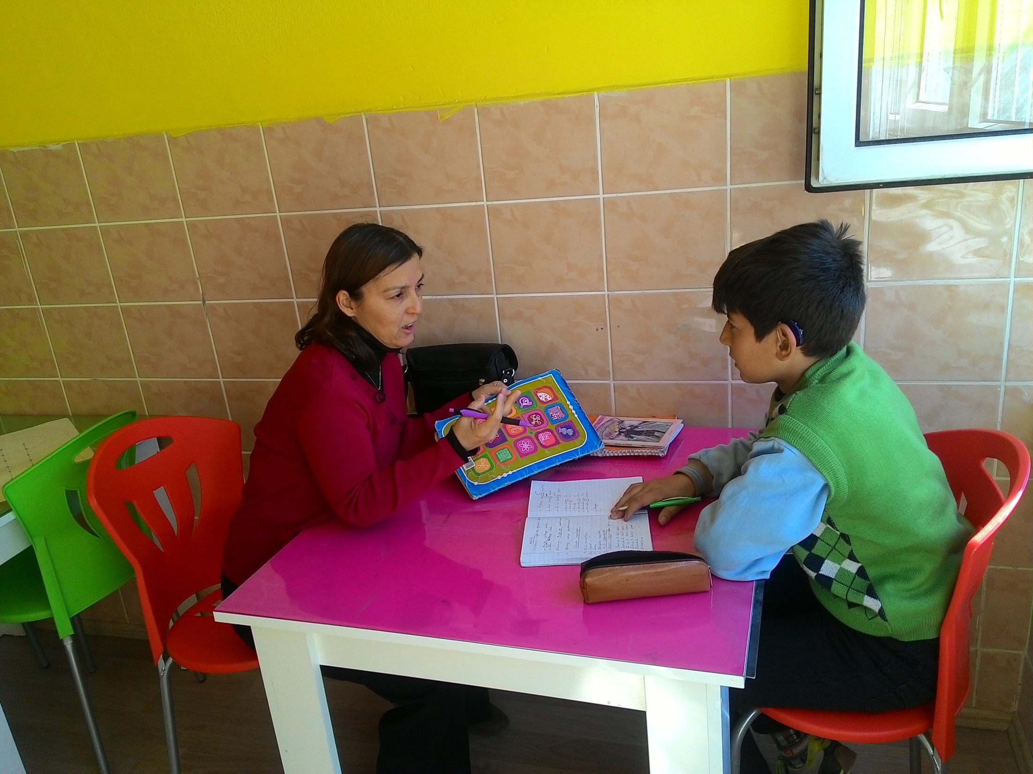

Slide 16
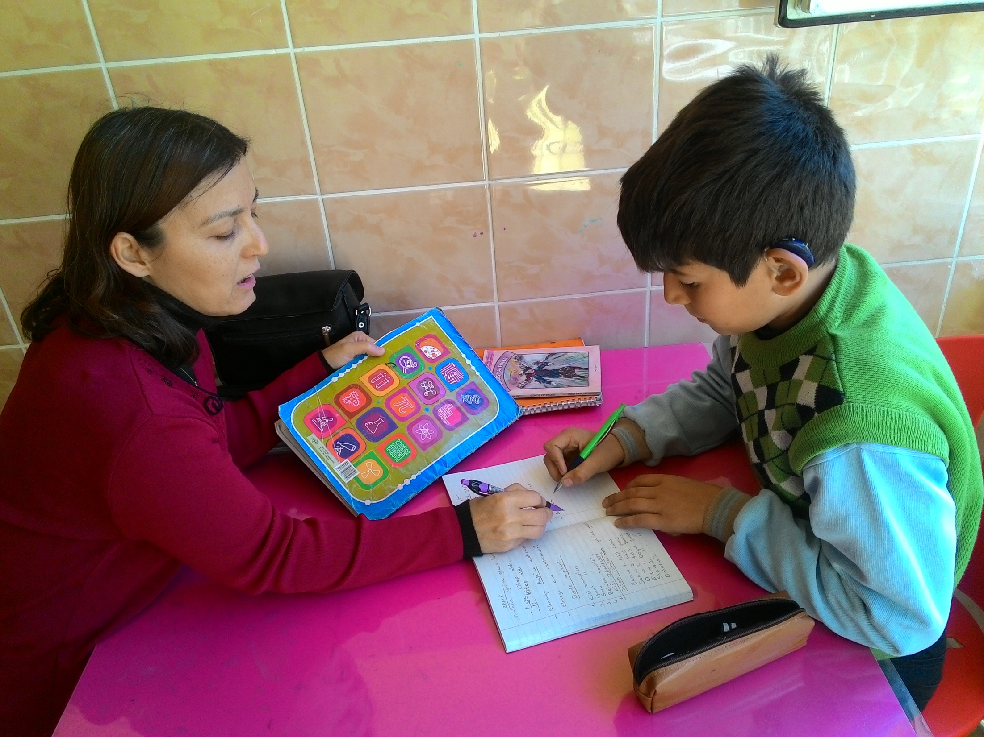

Slide 17
Our goal is to fill in the missing gaps in their knowledge, provide them with the skills necessary to be independent learners.

Slide 18
Mersinbeleni Project Team
Ali KIRCAN
Emrah SEVİM
Esin ŞEVİK
Selim ÇEKİN

