Slide 1
AYDIN
TÜRKİYE

Slide 2
Aydın Province is a province of southwestern Turkey, located in the Aegean Region.

Slide 3
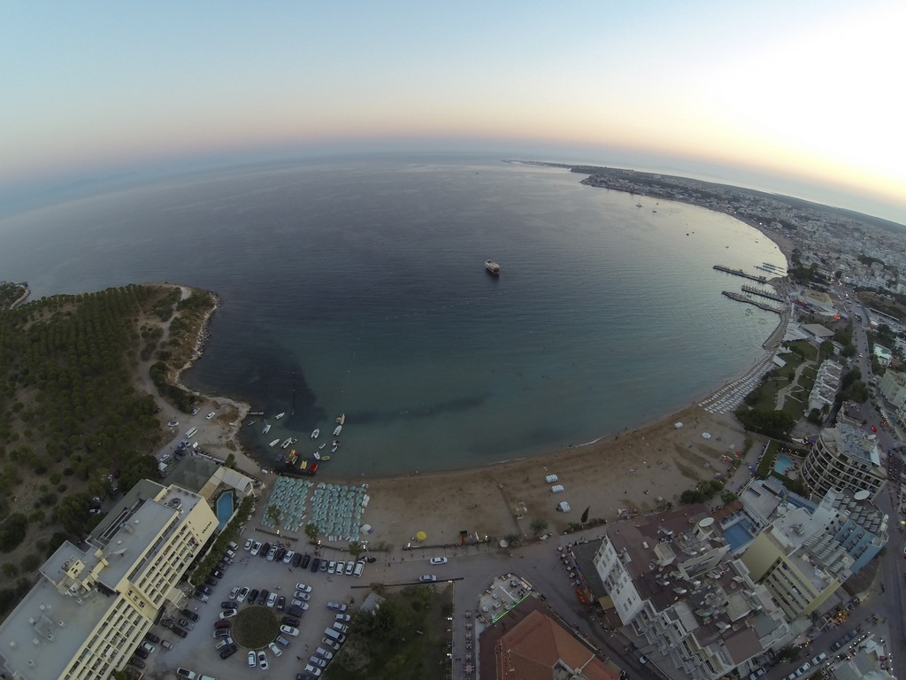

Slide 4
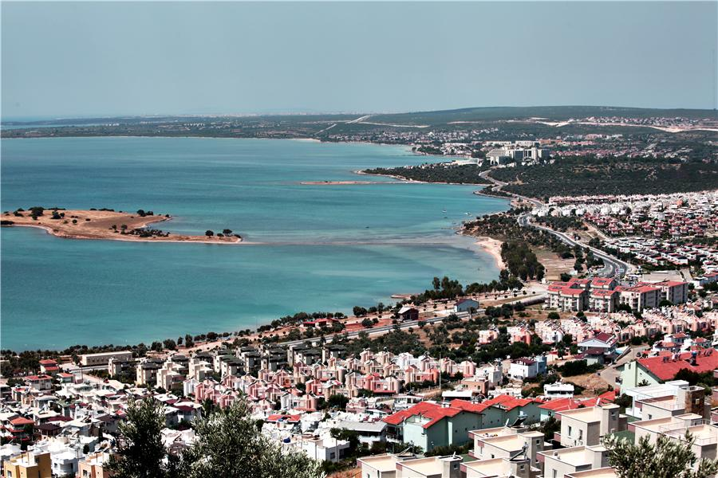
AYDIN RESMİ

Slide 5
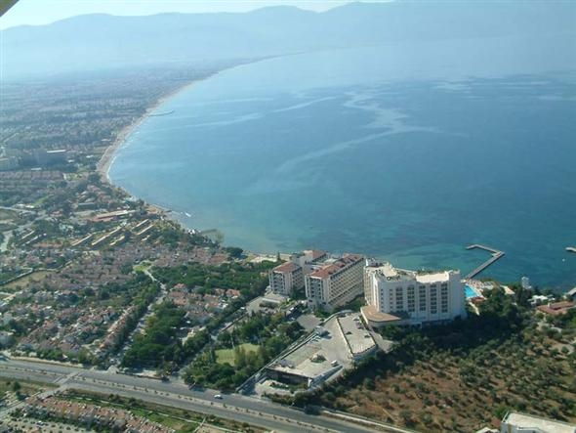
AYDINN RESMİ

Slide 6
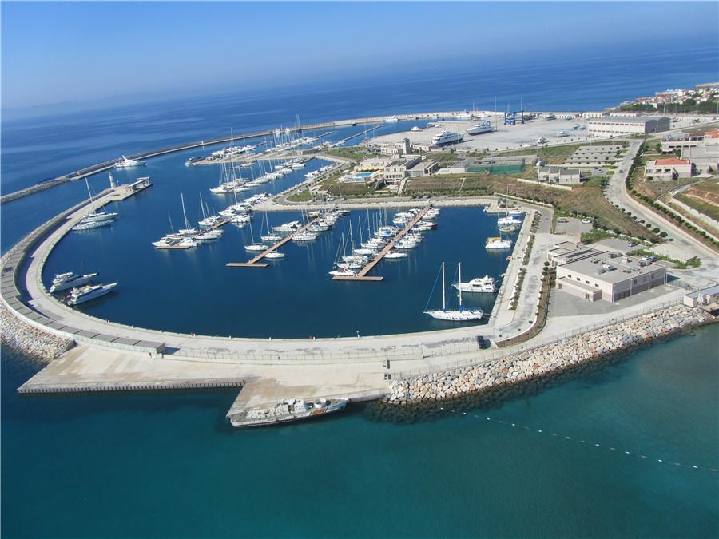
AYDIN RESMİ

Slide 7
ECONOMY The major sources of income are agriculture and tourism.

Slide 8
TOURISM
The coastal towns of Didim and Kuşadası in particular are tourist resorts. Kuşadası is near to the Dilek Peninsula - Büyük Menderes Delta National Park, while Didim has a temple of Apollo, beaches, and the ancient ruins of Miletos nearby. The province contains archeological sites, including the ancient Carian cities of Alinda and Alabanda.

Slide 10
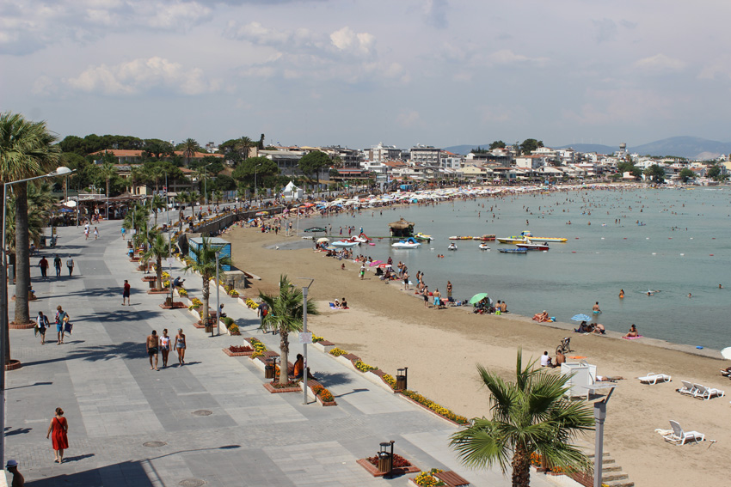

Slide 12
Aydın is the home of the Zeybek folk art. This involves a special type of war dance which is performed in a ring to resemble birds. The Zeybek is performed to sounds of the Kiteli and other Turkish folk instruments.
The cuisine features the typical Turkish pastries, köfte and kebab.

Slide 15
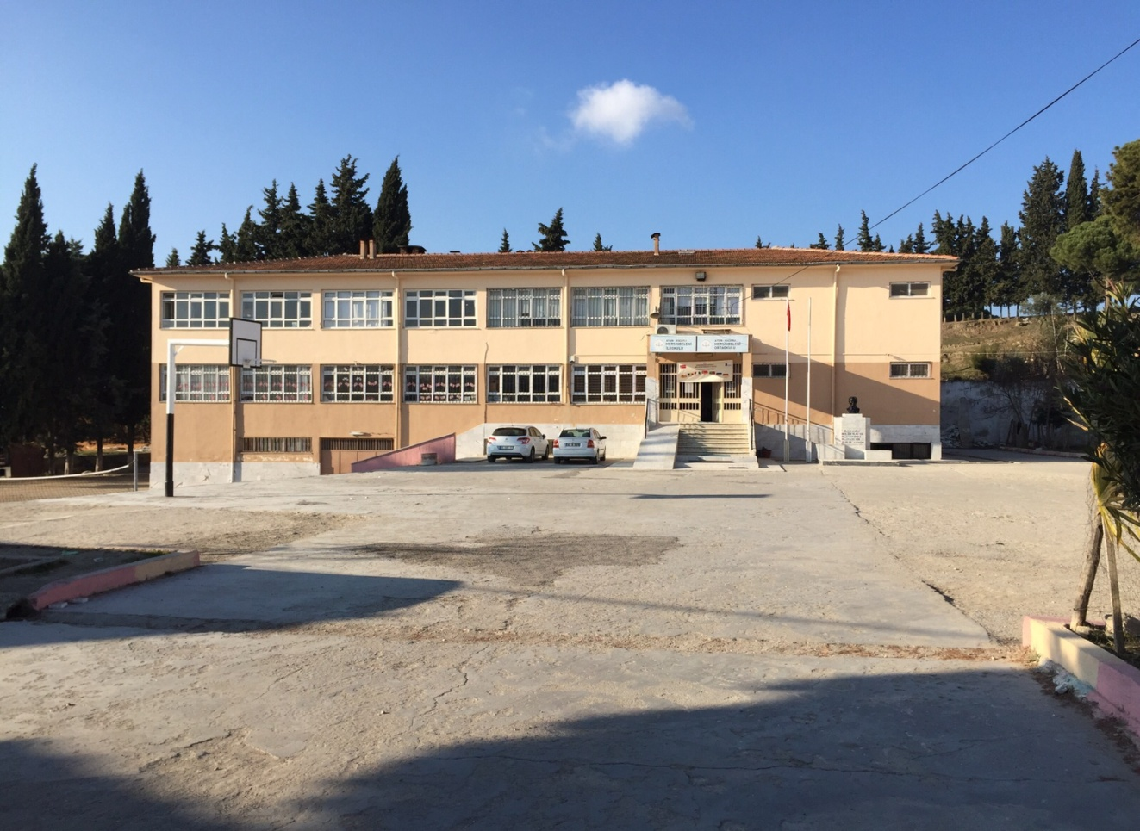
Mersinbeleni Primary School is located in Aydın province. The school which was built in 1998 is 47 km from the city center.

Slide 16
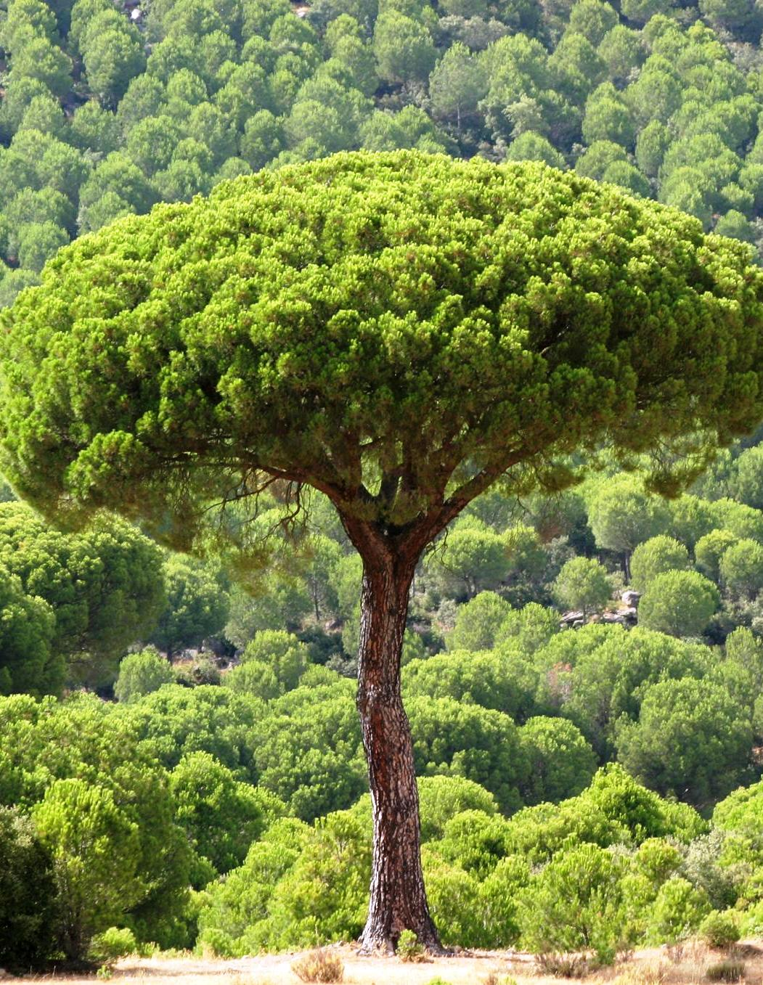
The parents of our students earn money from agriculture and animal husbandry.
There are so many pine forests surrounding our school. Pine nuts derived from this pine trees are one of the main sources of income of our parents.

Slide 17
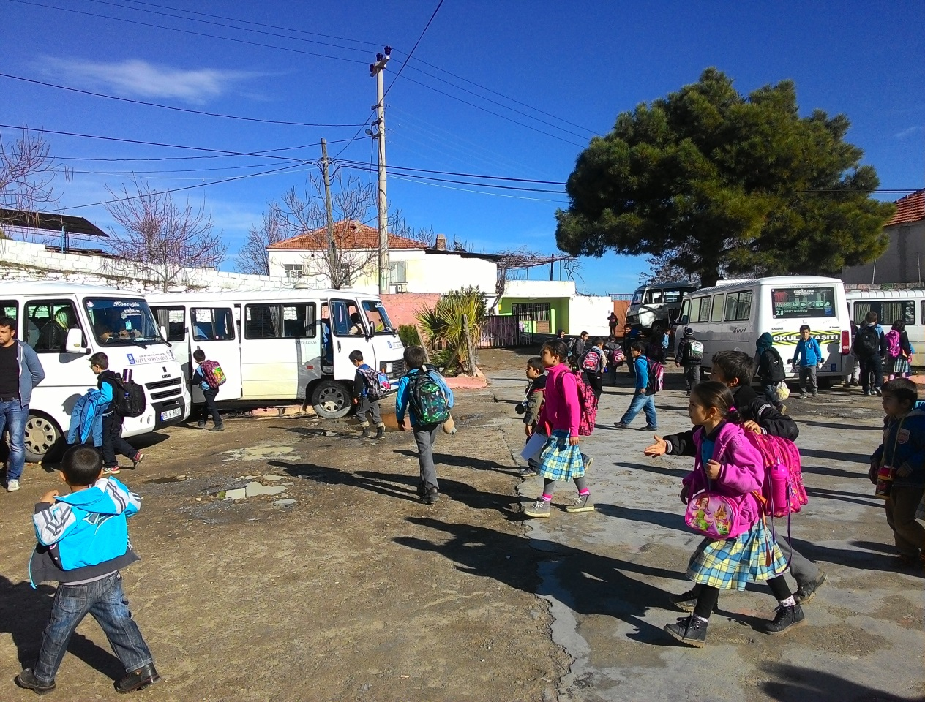
The age rank of our students is 6-11 and we have 121 students.
It is a school which provides transported education. The students who have not primary school in the location that they live come to our village with student shuttles. In total, we have students from 8 different villages.

Slide 18
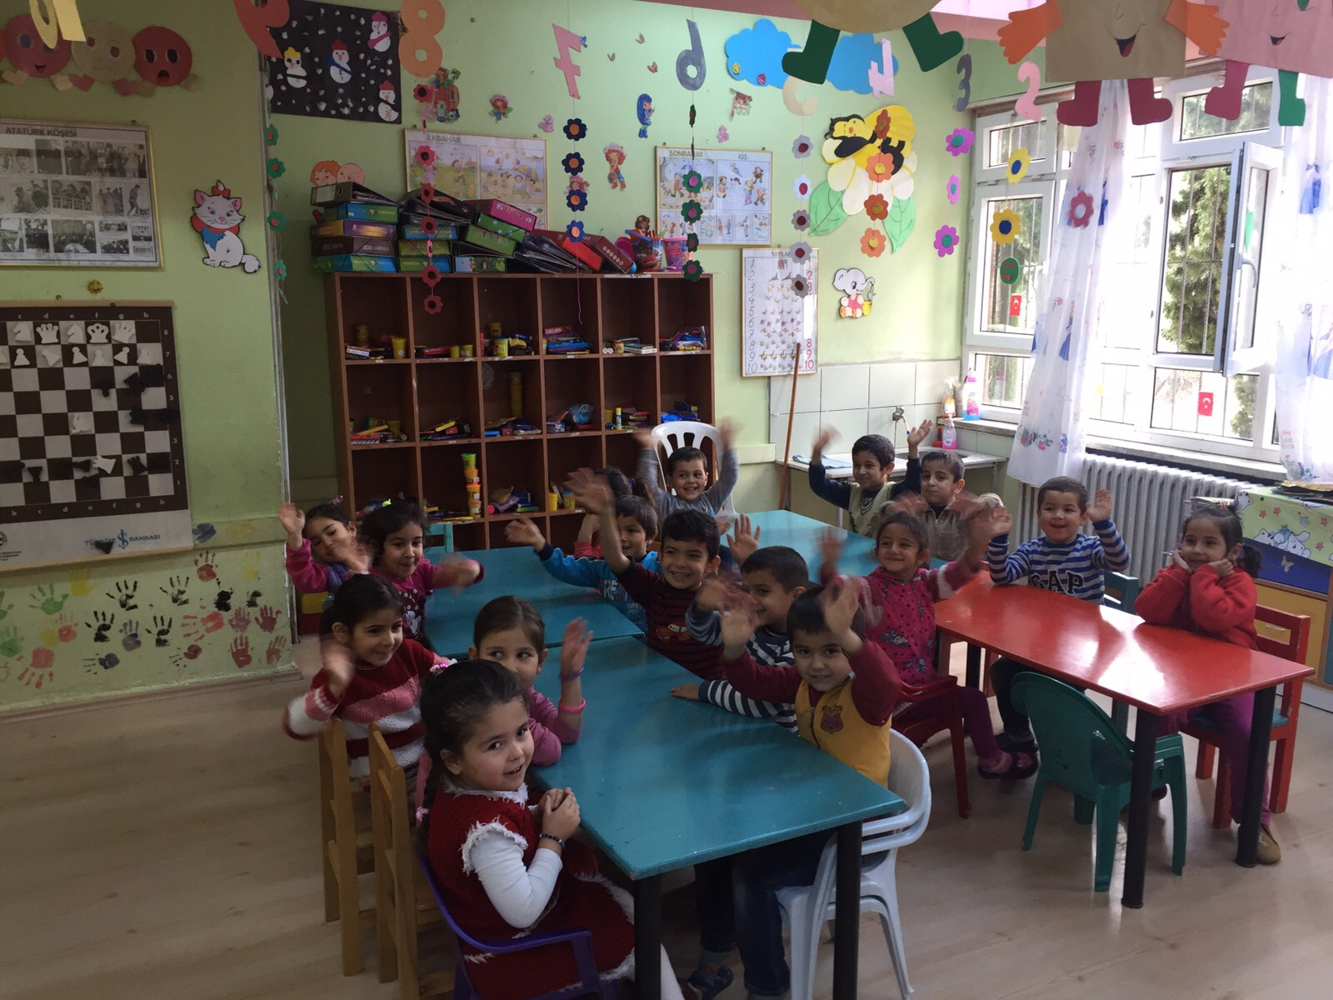

Slide 24
Our teachers

Slide 25
Our project team

Slide 26
The activities we have done so far!

Slide 27
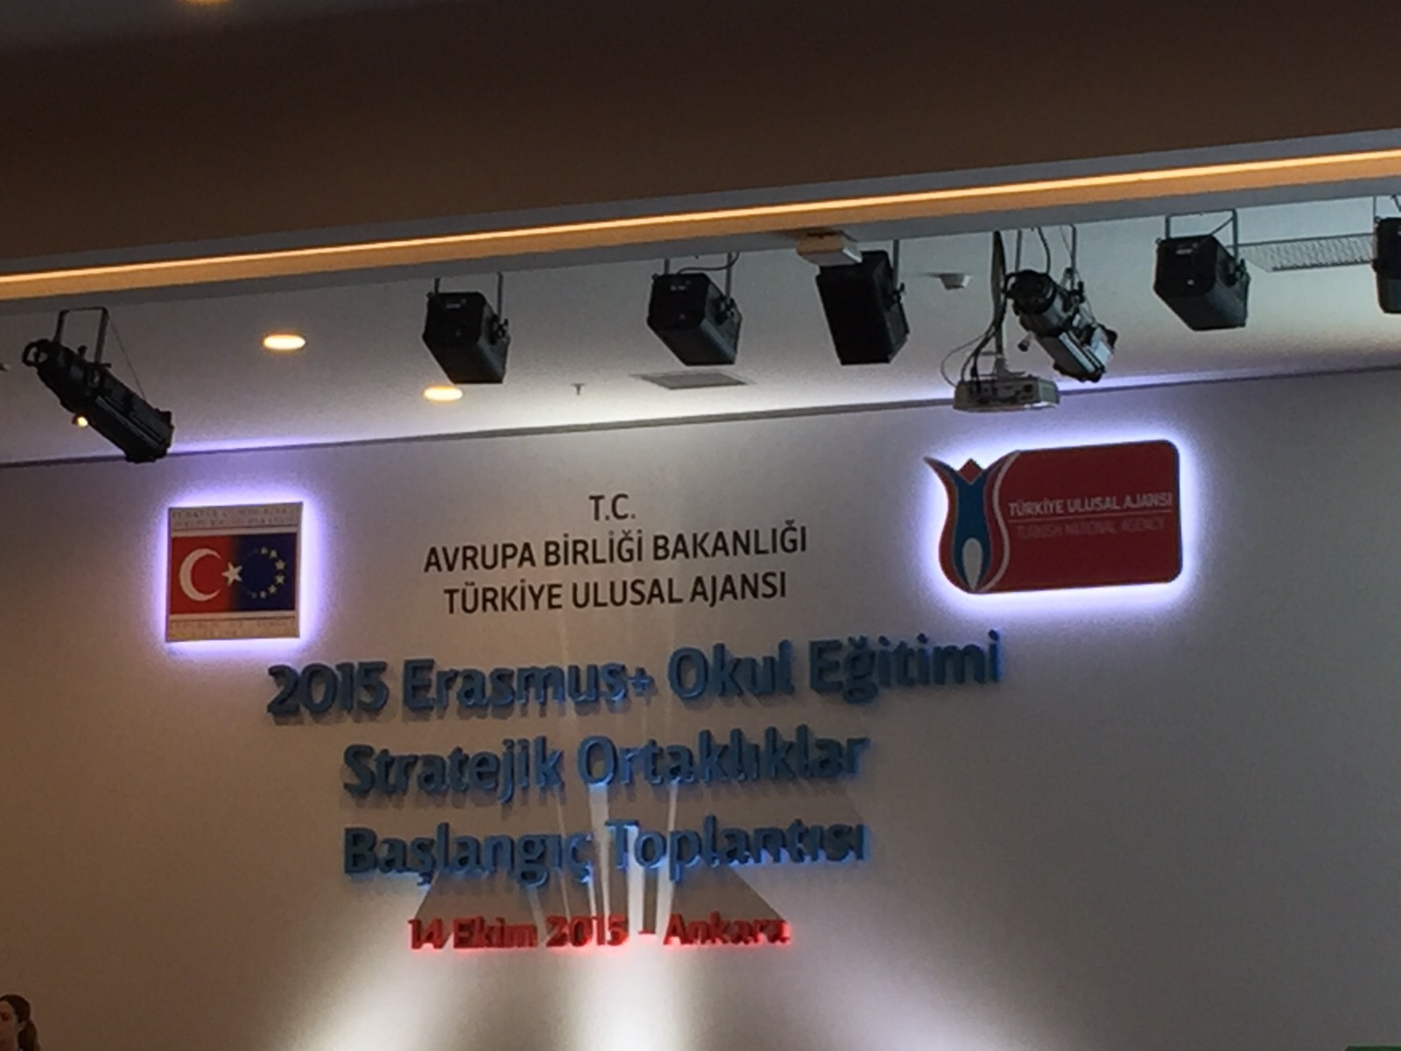
Our school manager and contact person participated in meeting which was organised by Turkish National Agency.

Slide 29
Hello day!
Skype meeting with Portugal and Italy.

Slide 31
We built a display board dedicated to Mini entrepreneurs at school project.

Slide 33
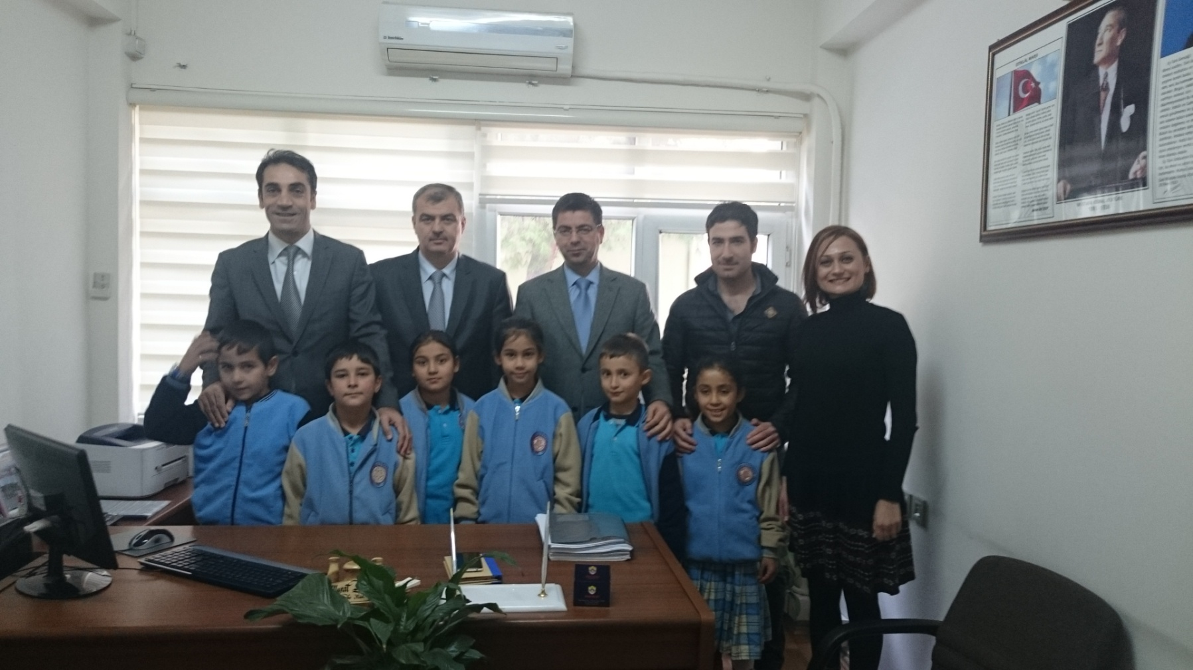
We visited Provincial National Education Directorate which is the biggest authority in the field of education in our province. We meet with authorities and present our Project.

Slide 37
We organised meeting for our porject. We informed participants about the Project objectives and activities. Our Governor, The Garrison Commander , representatives of NGO’S, school managers participated in our meeting

Slide 42
In order to determine the target group of the project, we prepared a questionnaire for students and parents. According to our analysis, we decided to choose all of our students as a target group.

Slide 43
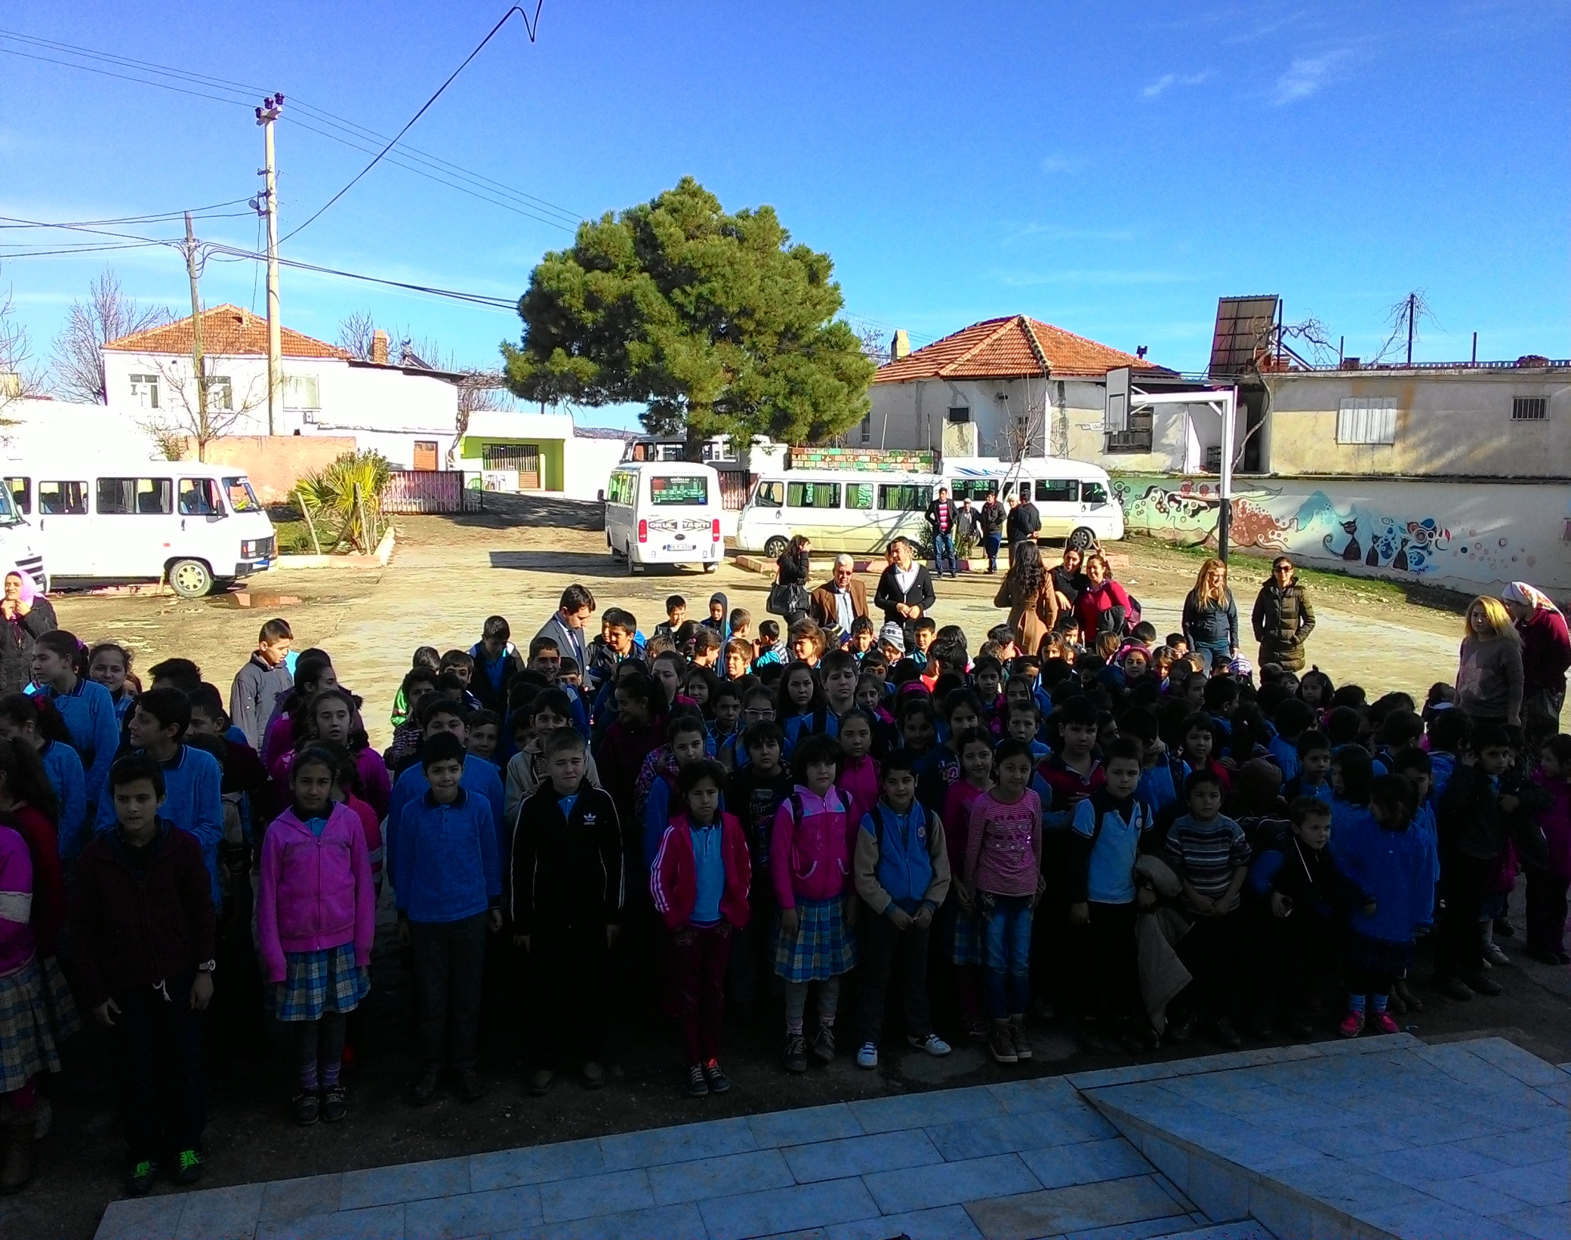

Slide 44
Students began analyzing their schools, towns and own culture.

Slide 45
Turkish Coffee

Slide 46
We dont enter our houses wıth shoes

Slide 47
We kiss our elder people’s hand and put ıt our forehead

Slide 48
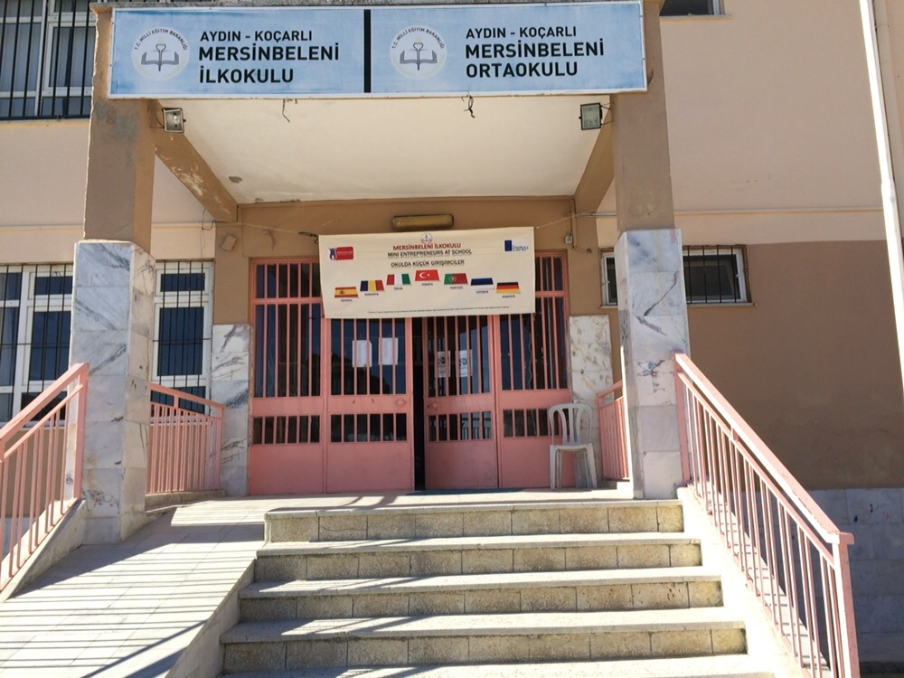
We designed a banner and made it prepared by publishing company. In order to disseminate our Project, we hanged it outside of our organisation.

Slide 50
We visited local mini enterprises

Slide 55
media

