Slide 1
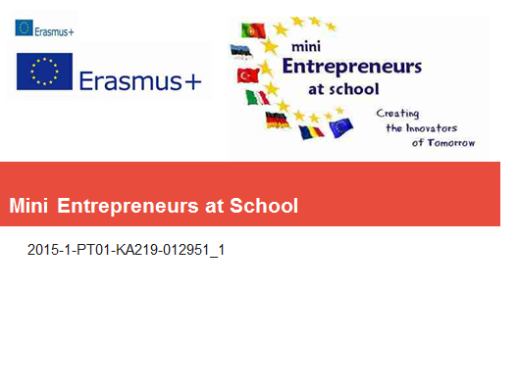

Slide 2
Student repeats the word that he hears from the computer and then he sees the picture of the word.
Working in the computer is every student´s favourite activity.

Slide 3
Learning English
Students have textbooks where are colours in Estonian and in English.
They have to find the right coloured picture and then they have to stick it on the textbook.
Some of the students managed to find right pictures quite quickly.
There is also a computer game with words in English at school.

Slide 4
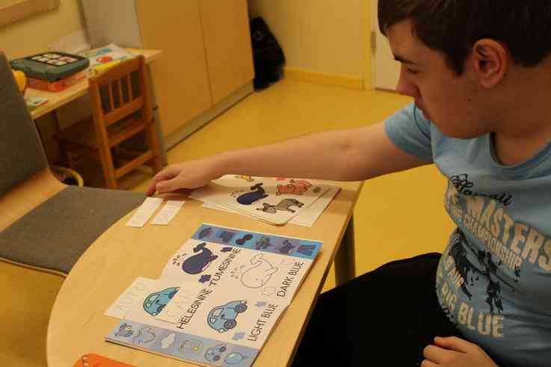

Slide 5
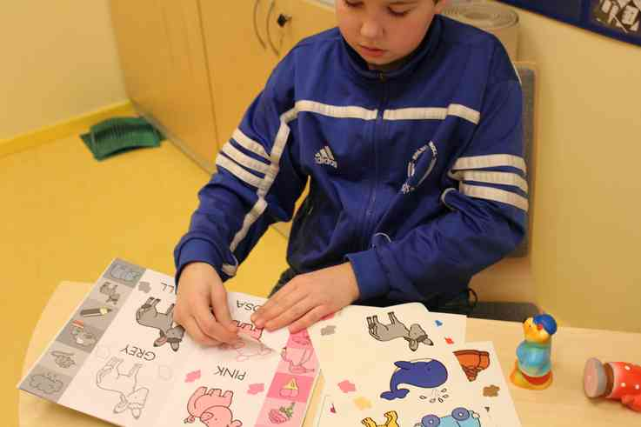

Slide 6
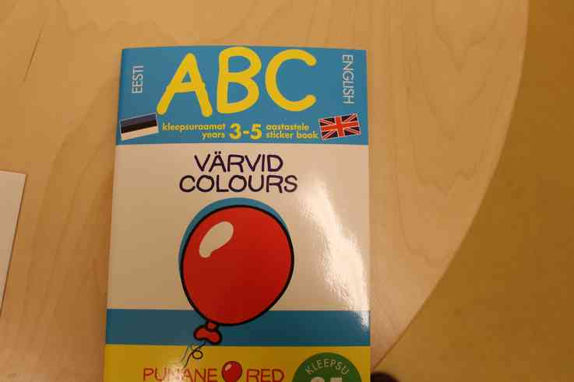

Slide 7
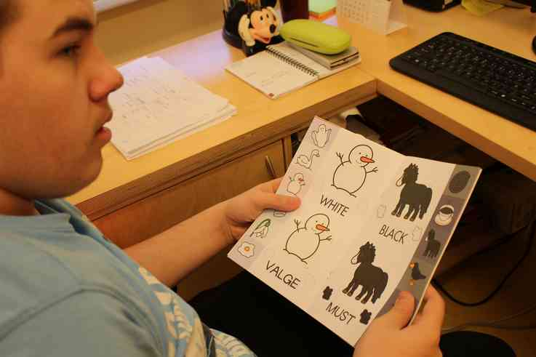

Slide 8
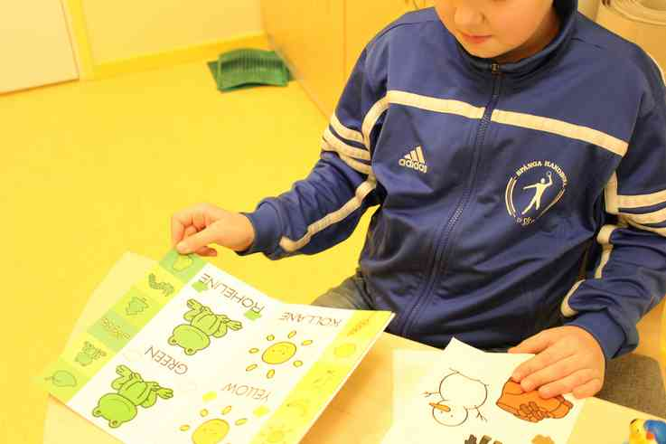

Slide 9
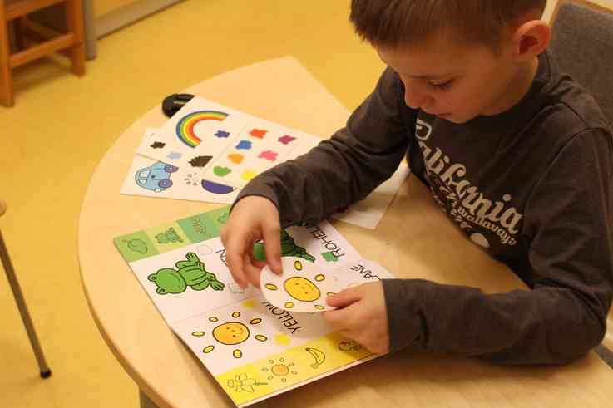

Slide 11
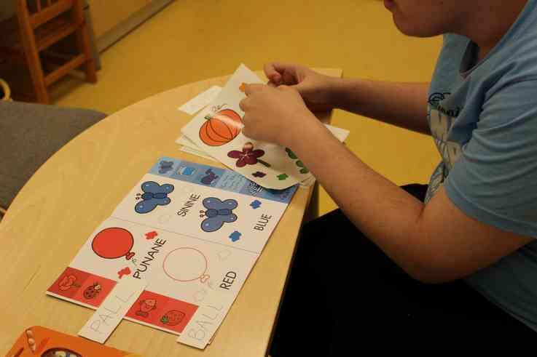

Slide 12
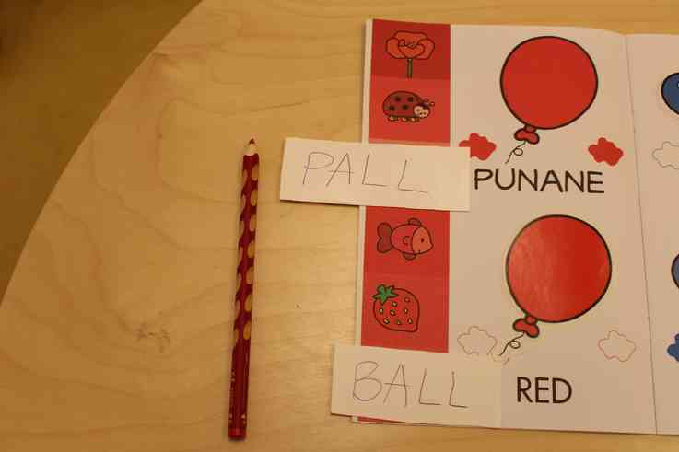

Slide 13
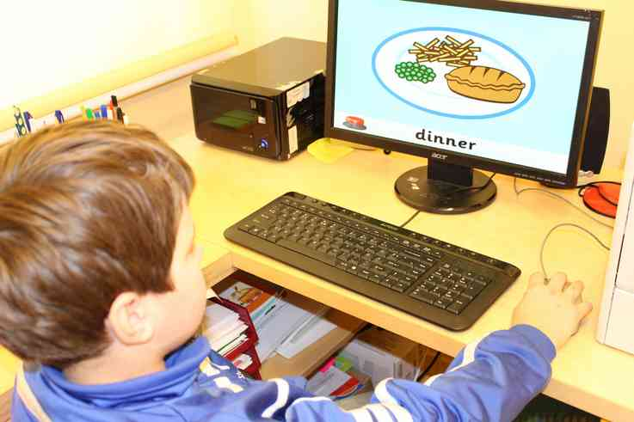

Slide 14
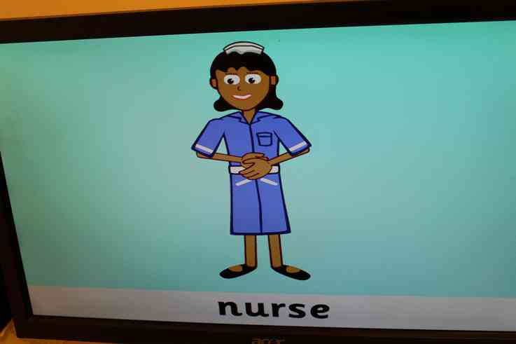

Slide 15
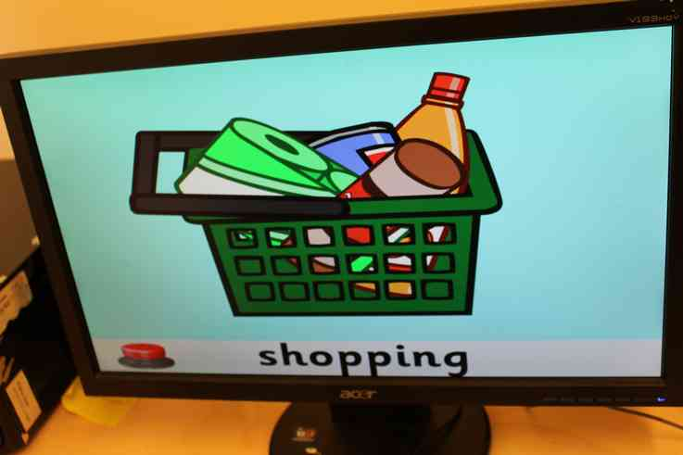

Slide 16
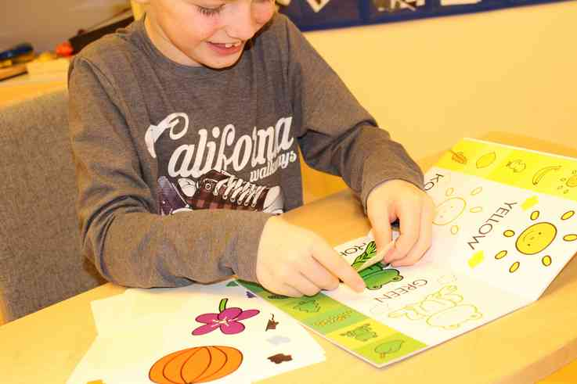

Slide 17
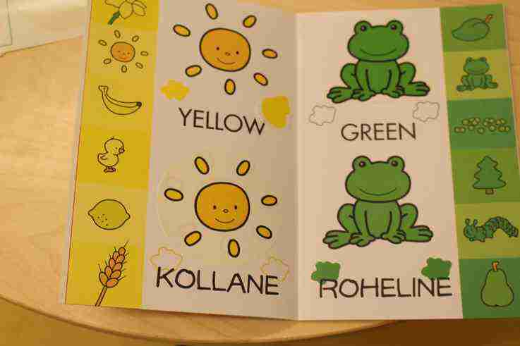

Slide 18
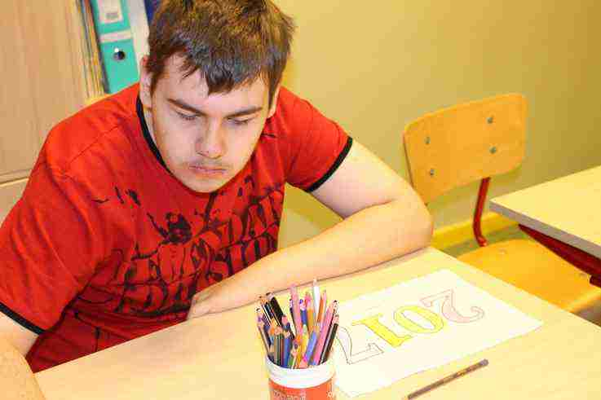

Slide 19
WORK DONE BY:
ROOSI KOOL
ESTONIA

