Slide 1
Erasmus+
Strategic Partnerships for Schools Only (KA2)
Mini entrepreneurs at school
2015-1-PT01-KA219-012951_3

Slide 2
What we did after Italy meeting?

Slide 3
We had meeting with other teachers in our school. We gave information about Italy meeting, project partners, shared our experiences. ( Dissemination inside our school)

Slide 4
Okuldaki tüm öğretmenlerle toplantı resmi
( sen ,ali hoca ya da emrah anlatırken olabilir)

Slide 5
At the beginning of the project, we applied a questionnaire to our students in order to determine the target group of the project.
We reviewed the results, planned the activities which are supposed to be carried out until Estonia mobility. We shared tasks and responsibilities.

Slide 7
For the activity A4 (Students begin analyzing their schools, towns and own culture. ) We visited old people in our village.

Slide 9
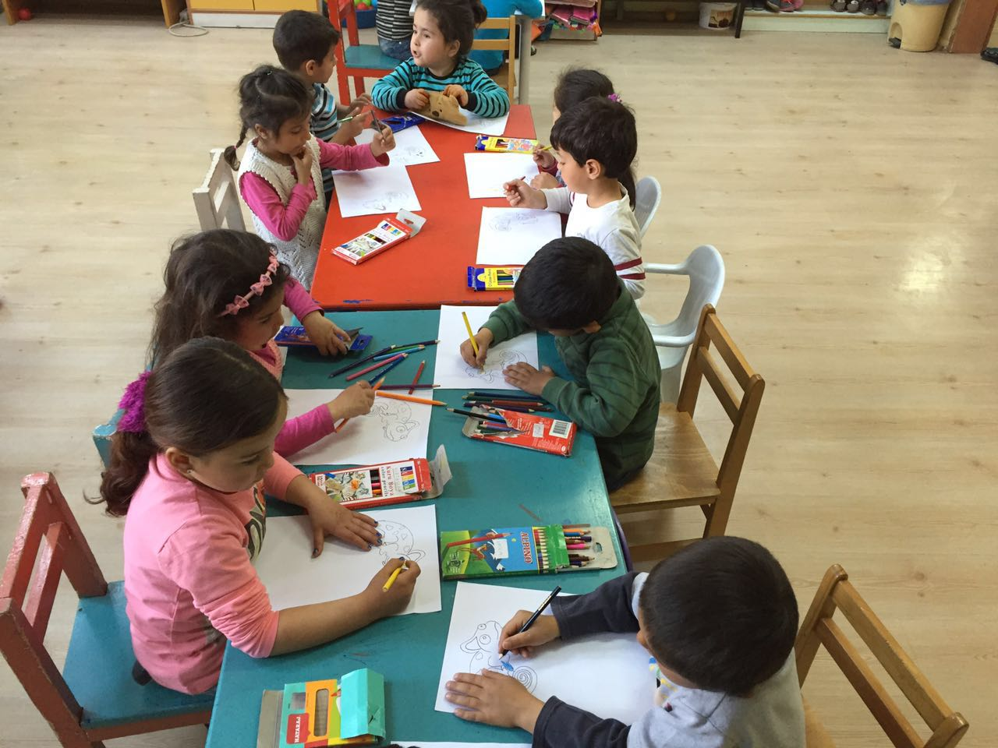
We set up working groups for the stories about adventures of E&S.

Slide 11
We shared the activities about teaching English (presented by the coordinator partner) with other teachers.
We introduced them and gave information about new technologies and methods on teaching English.

Slide 12
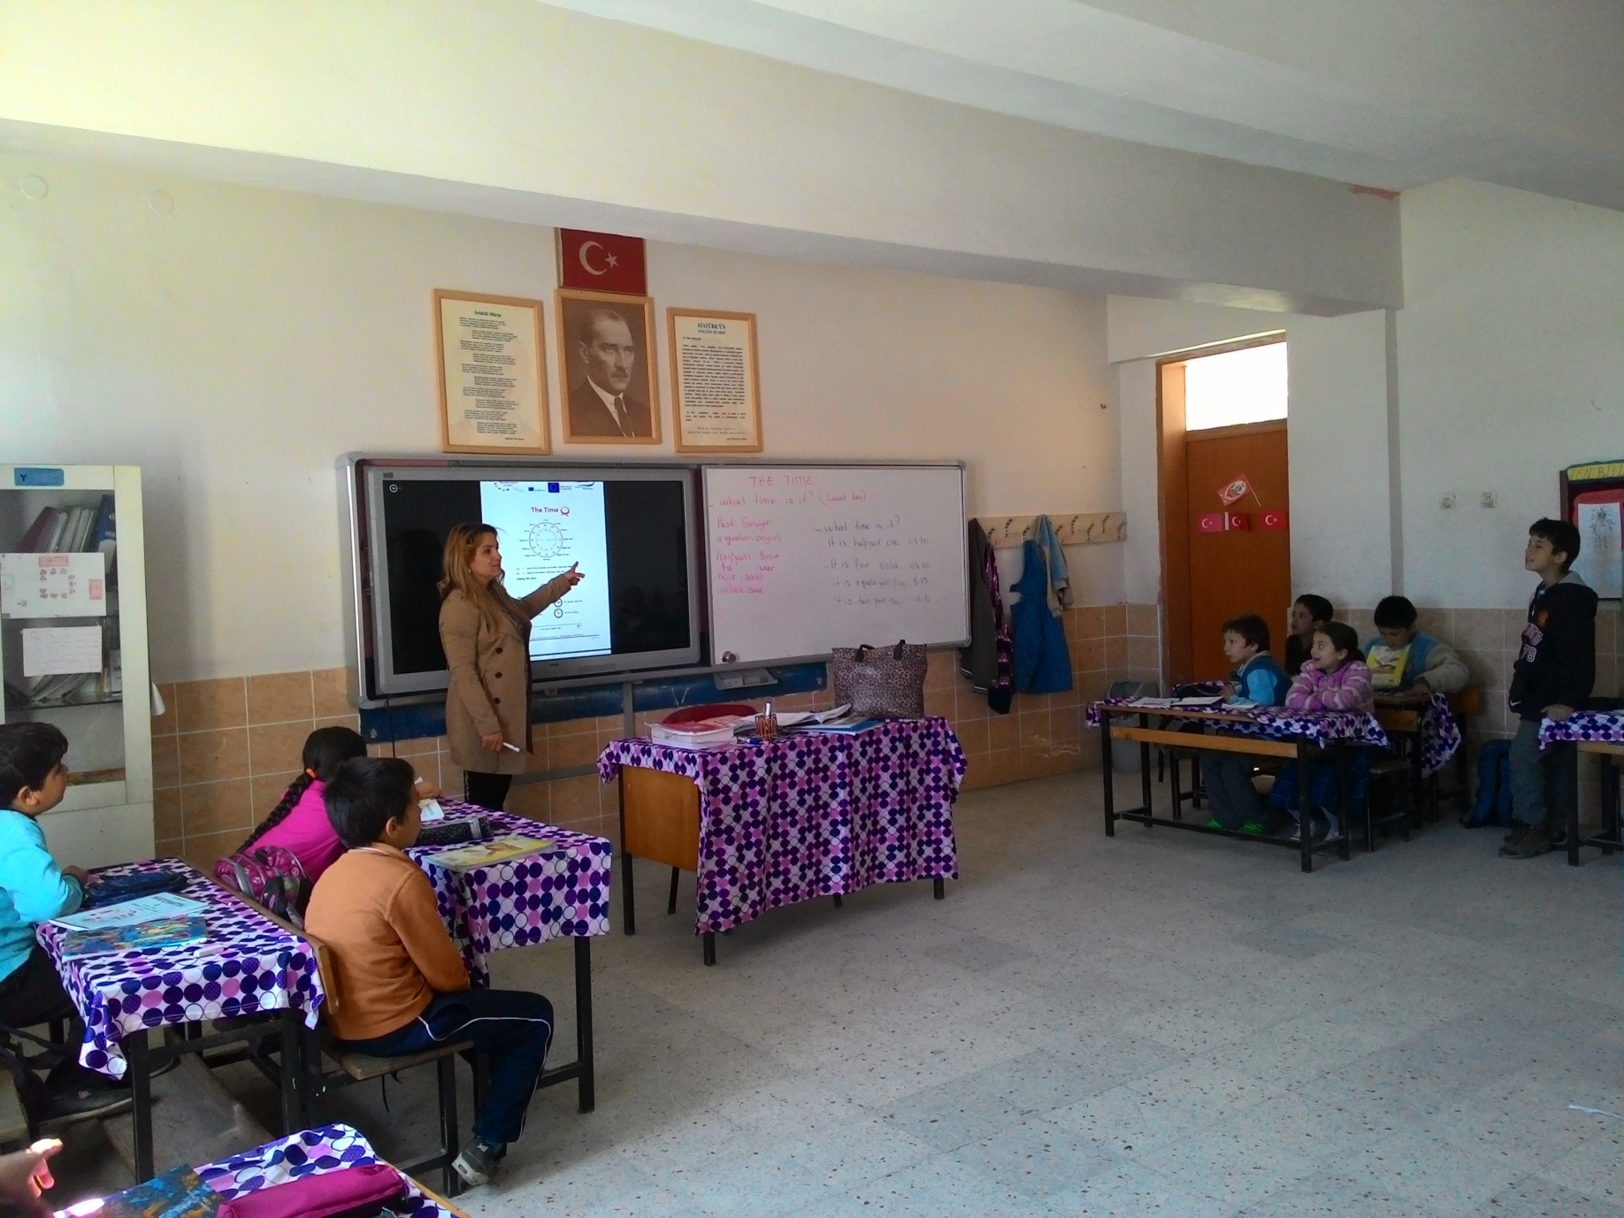
They applied them in their lessons

Slide 14
Thanks to the assessment questionnaires, we evaluated them

Slide 15
These activities improve our students’ knowledge of English grammar and their ability to use it with confidence, through visuals.

Slide 16
Unfortunately;
Most of our students dont have computer at their homes.
It means that they dont have any opportunity to review them after school.

Slide 17
Dissemination outside our school
One of the project team members and English Language Teacher in our school, Esin Şevik organised a meeting in Aydın Provincial National Education Authority, Research and Development Unit.
She informed about Mini entrepreneurs at school project and the activities which had been carried out .

Slide 21
We visited local authorities (District National Education Directorate)
We gave our report about the local and international activities of the project.

Slide 22
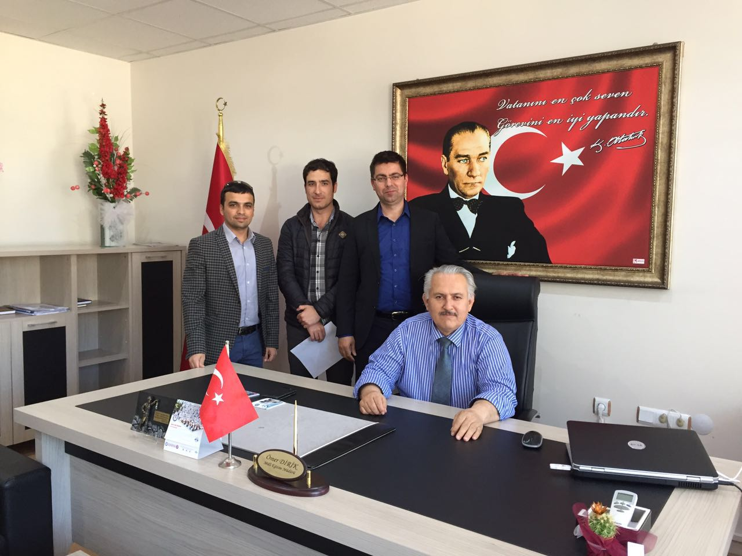

Slide 24
We uploaded all documents on etwinning platform

Slide 25
We took a video about our task (New Ideas and New Tends) with our students.

