Slide 1


Slide 2
To make a project is similar to create a mini enterprise
Learning Process

Slide 3
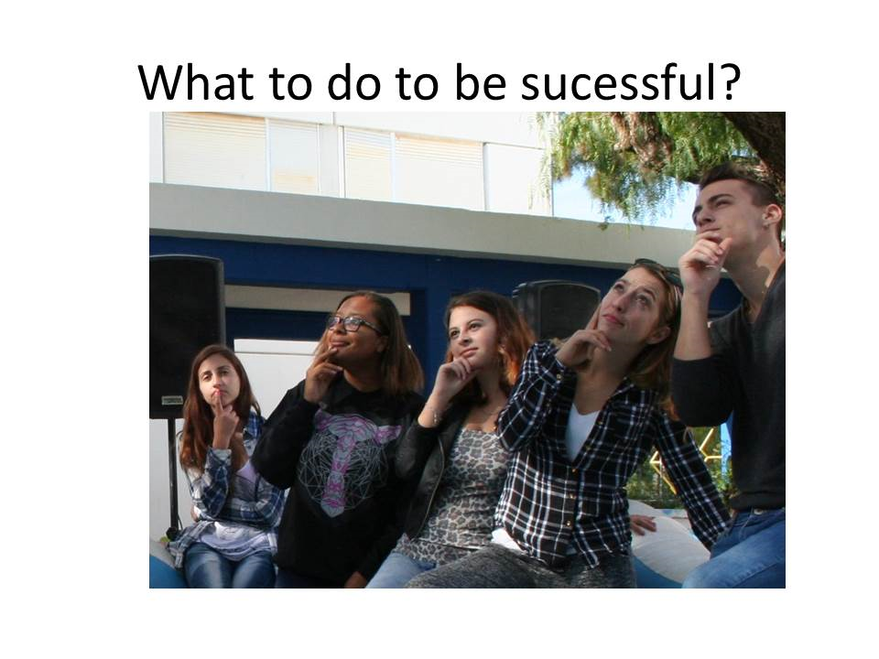

Slide 4
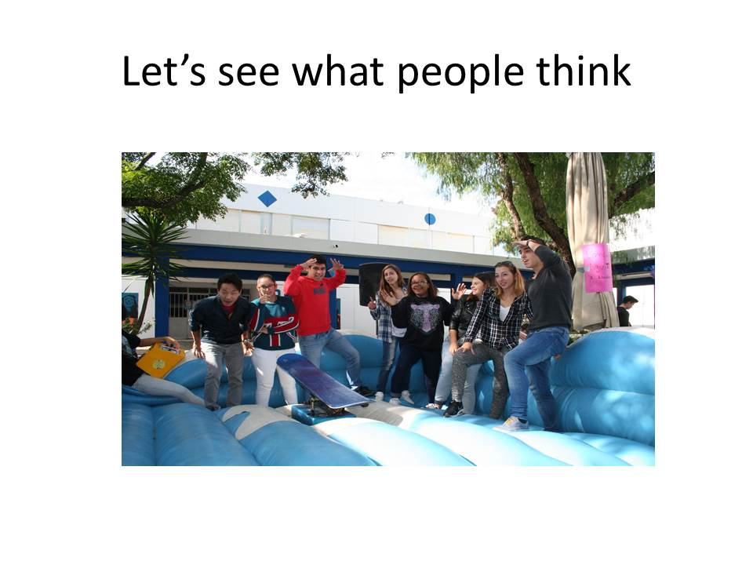

Slide 5
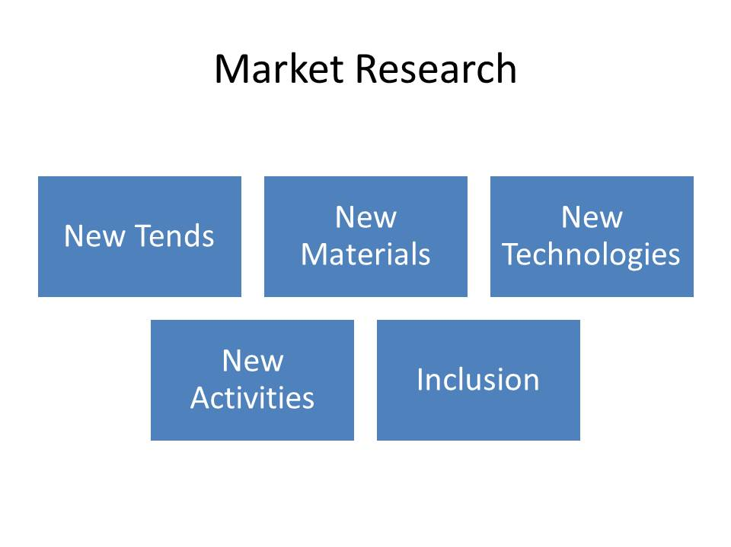

Slide 6
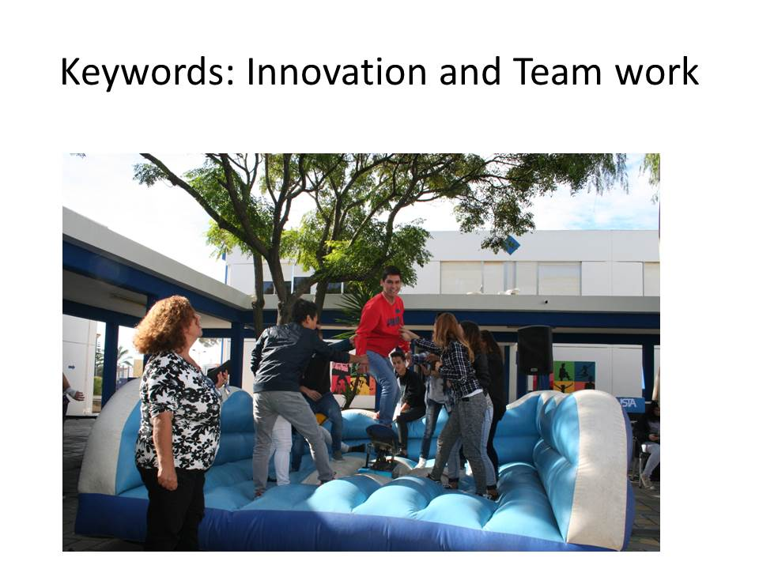

Slide 7
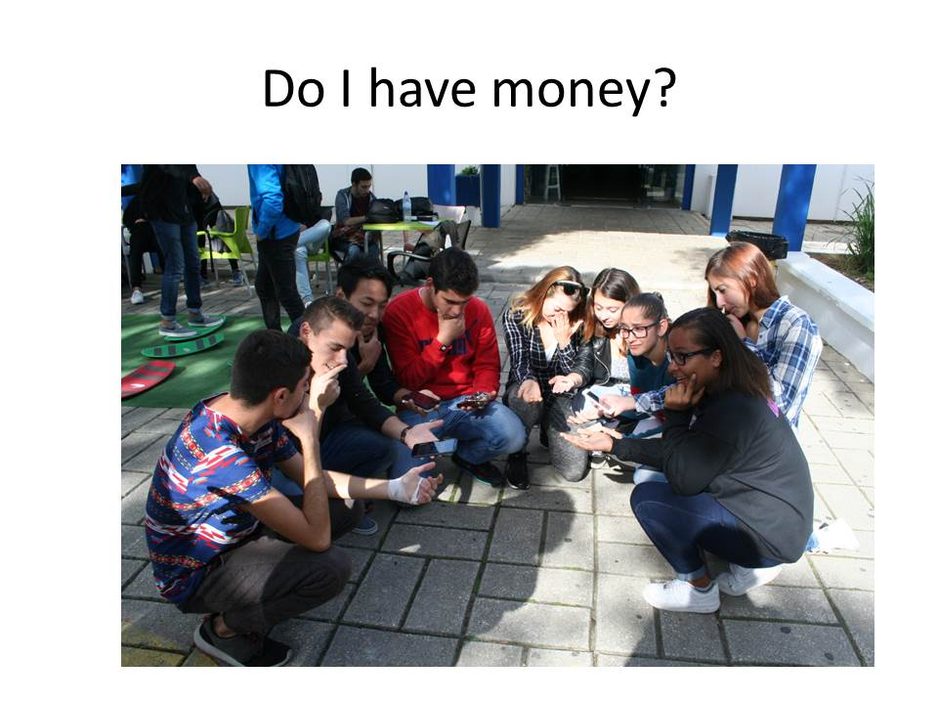

Slide 8
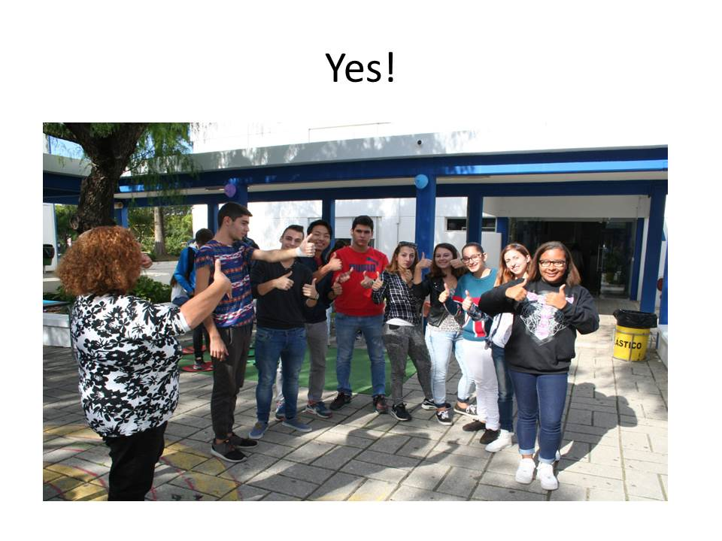

Slide 9
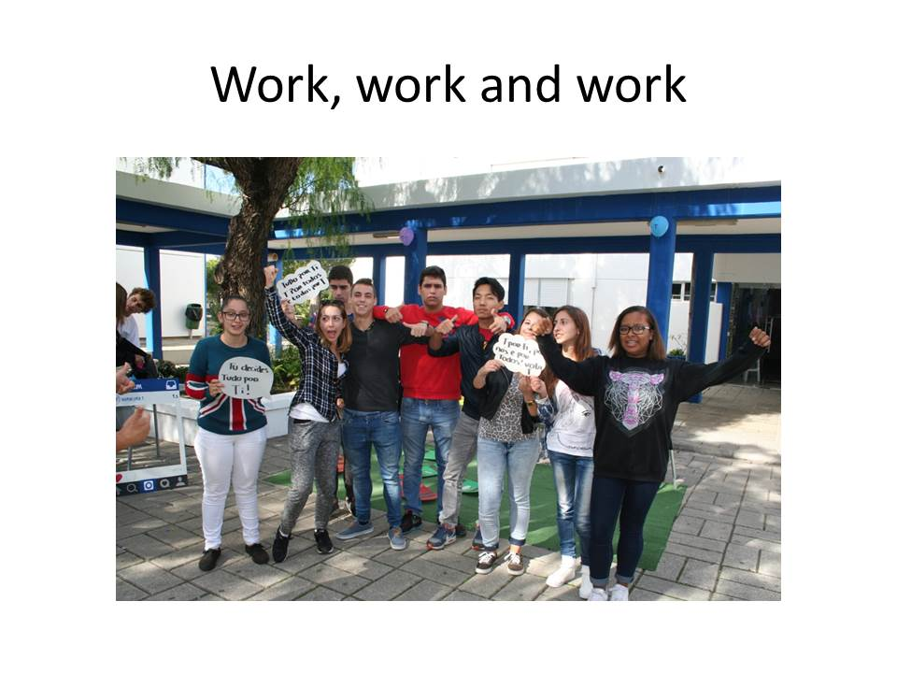

Slide 10
New Project
Coordinator
ICT
New Activities
New Tends
Inclusion

Slide 11
The Role of the Coordinator
Defines goals and elaborates a good team plan;
Garantees team work;
Motivates the others;
Delegates so that everybody participate;
Represents the project;
Assures that partners are satisfied – active role in the evaluation process;
Councels and supports the other partners.

Slide 12
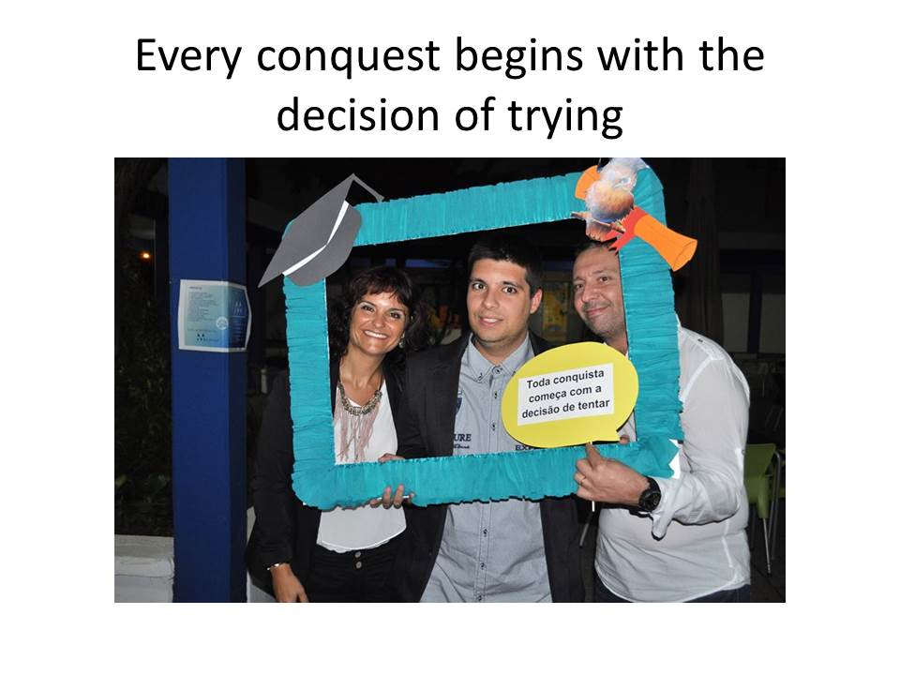

Slide 13
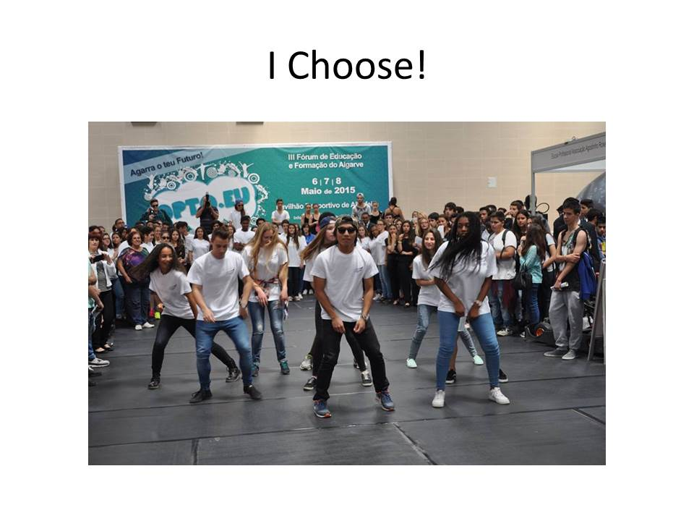

Slide 14
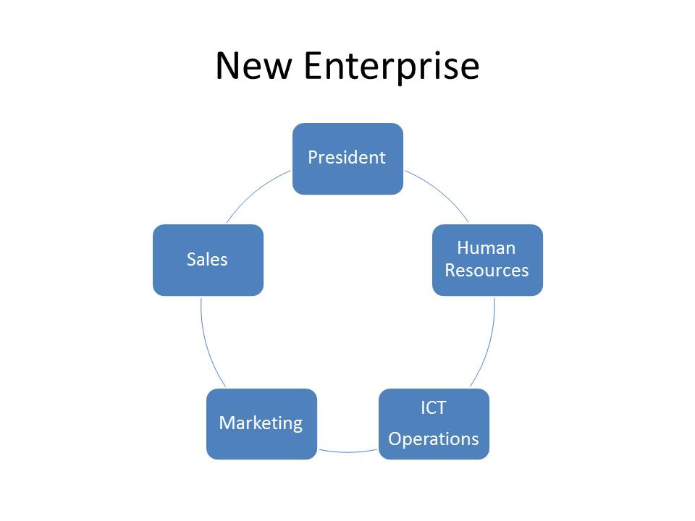

Slide 15
The Role of The President
Defines goals and elaborates a good business plan;
Garantees team work;
Motivates the others;
Delegates so that everybody participate;
Represents the enterprise;
Assures that clients are satisfied – active role in the evaluation process;
Councels and supports the other directors.

Slide 16
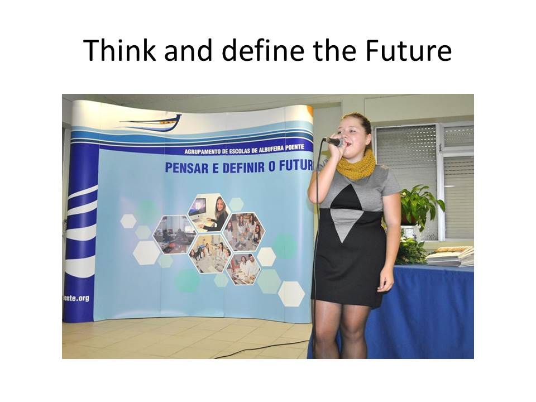

Slide 17
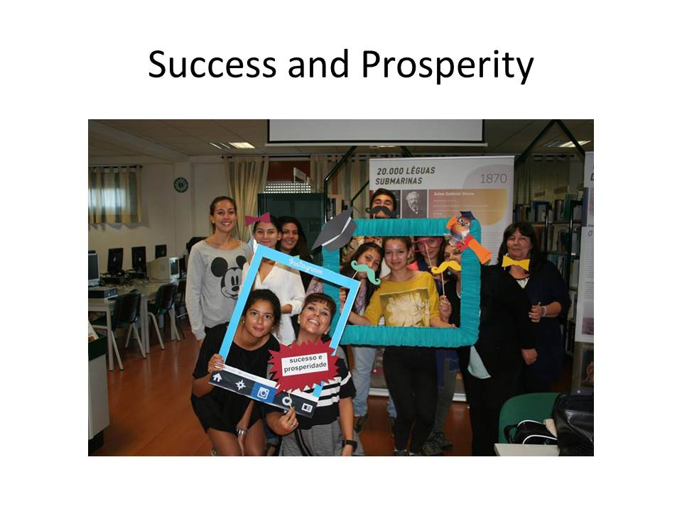

Slide 18
