Slide 1
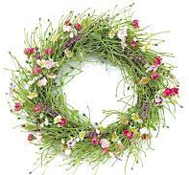
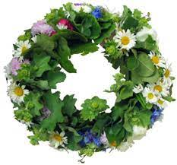
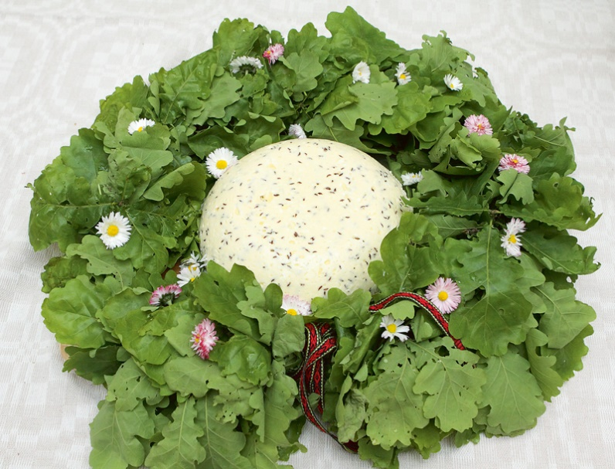
Līgo/Jāņi The Midsummer celebration on the Summer solstice

Slide 2
Celebrations Solstices in Latvia
The Spring Solstice – Easter /Lieldienas
The Summer Solstice – Midsummer/Līgo and Jāņi
The Autumn Solstice – Michaelmas/Miķeļi jeb Miķeļdiena
The Winter Solstice – Christmas Eve/Ziemassvētki

Slide 3
Midsummer celebration traditions
Līgo is a widely celebrated holiday in our country. It is the night from 23rd to June 24th This is time when Latvians participate in many joyful festivities just like their ancestors used to do a long time ago
Midsummer has always been the biggest and most important festival of all Latvian celebrated days, because during this time the sun is at its highest point
Some of the traditional things we do during this celebration are the very same traditions that out ancestors used to take part in and that have been well preserved

Slide 4
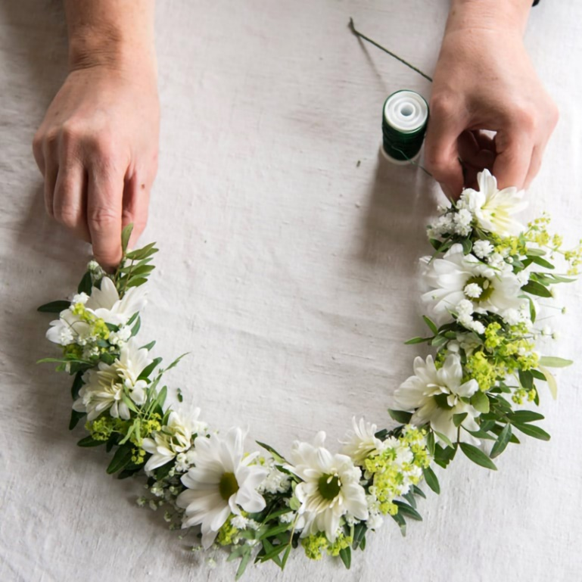
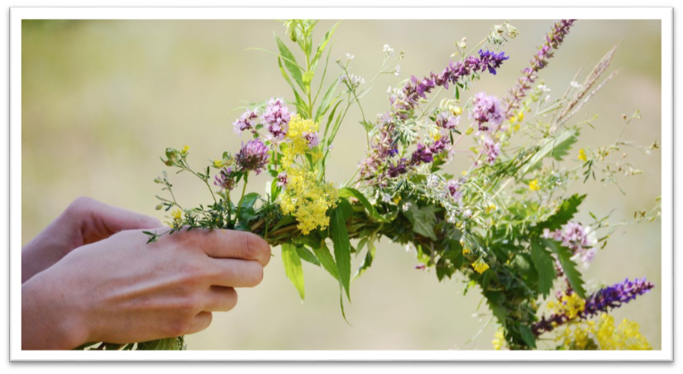
Wreath weaving
The wreaths of herbs are intended for daughters and wives, but the wreaths of oak leaves are intended for boys and men, and especially for men who are named Jānis.
These flower crowns are in the shape of a circle because it symbolizes the Sun. The crown has not only a symbolic meaning, but also a magical power that depends on the grass and trees woven into it.

Slide 5
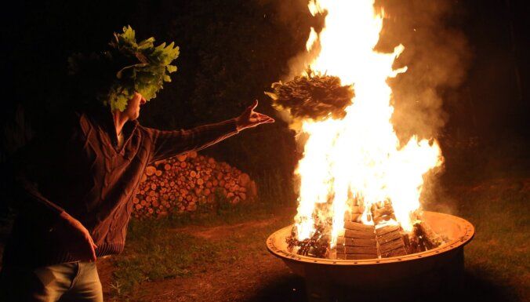
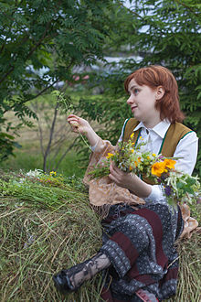
Men's wreaths are always made of oak leaves, but women's wreaths are weaved from a variety of meadow flowers, married wives also add oak leaves.
There is also the tradition of burning the last year’s weaved crown so that one could get rid of the negative energy accumulated last year.

Slide 6
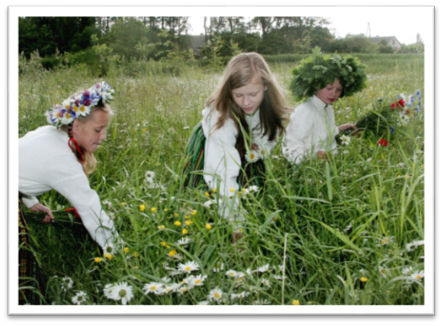
Jāņuzāles
«Visa laba Jāņu zāle, ko plūc Jāņu vakarā» – is one of the most known Latvian folksong, it is said any herbs or flowers gathered on the Midsummer celebration day is good enough when weaving your own wreath.
On Līgo and Jāņi celebration, the rooms are decorated with birch, oak and mountain ash branches, ferns, daisies and bent-grass. Nettles and thistles can be stuck on the door so that evil could not come in.

Slide 7
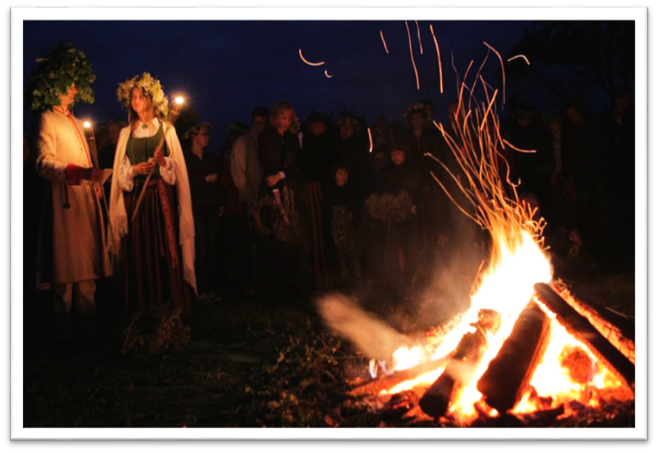
Bonfire
It is a famous tradition of Līgo to jump over a small bonfire
Young people also do it while holding hands together with someone, so that the magical force of the flames can bind them together

Slide 8
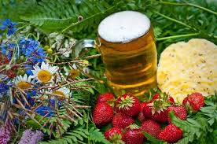
Typical food
Must haves for celebration - beer and cheese!
Plenty of food is a must as celebrations last all day and night!
Traditionally, cheese, pies, home-baked bread, buns, beer, meat etc. are placed on the festive table.

Slide 9
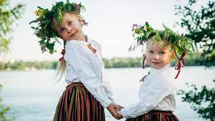
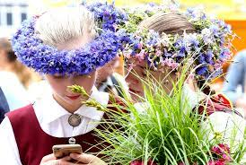
Singing Līgo songs
Singing Līgo songs is
an inseparable part of summer solstice celebration!

Slide 10
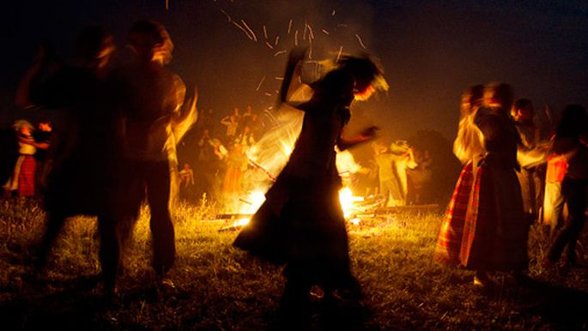
Looking for fern flower.. It is an old belief that the night from Līgo to Jāņi (from June from23rd to June 24th) is the only time of the year when one can see the mysterious and mythical fern flower.
Generaly, it was believed that Midsummer night is so short that it is not worth sleeping and it is even a shame to sleep in it and not see the sun rising, which is a symbol of this celebration.

Slide 11
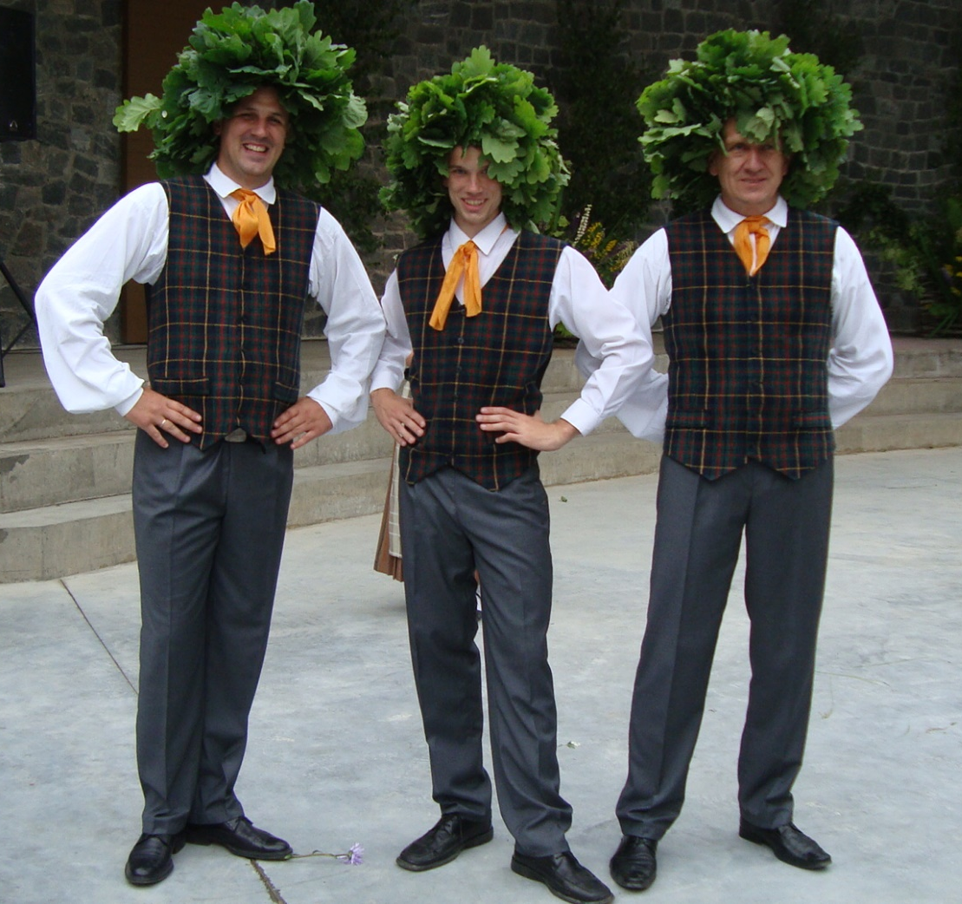

Slide 12
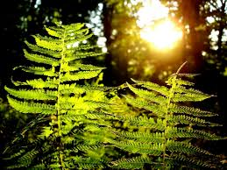
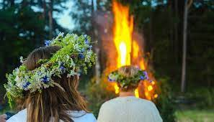
COME!
ENJOY
OUR LATVIAN CELEBRATIONS!

