Slide 1
COLLEPARDO ROUTE
Frosinone

Slide 2
THE COLLEPARDO CAVE, OPEN ON THE SOUTH SLOPES OF THE EMICI MOUNTAINS, OPENS ON THE SLOPES OF A GORGE AT THE BASE OF A TOWER CALLED RUPE DEL MARGINATO WHICH ORIGINATES FROM THE EROSION OF A STREAM, DUE TO THE UNIQUENESS OF THE SHAPES OF THESE FORMATIONS SIMILAR TO HUMAN AND ANIMAL FIGURES WAS KNOWN FOR A LONG TIME AS GROTTA DEL BAMBOCEL, A NAME THAT WAS REPLACED IN 1904 BY GROTTA REGINA MARGHERITA DI SAVOID MEMORY OF THE HISTORICAL VISIT OF THE FIRST QUEEN OF ITALY

Slide 3
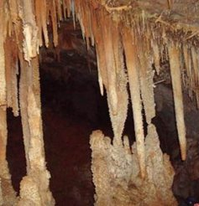
STALACTITES AND STALACMITES
The cave is characterized by ore vaults of stalactites some of which are connected to the stalagmites in a still active process. The main hall extends over 90 meters for a width that ranges between 30 meters and 60 meters. The hoveda, between 14 meters and 20 meters high, is divided into three sectors by stalagmite columns. The triangular entrance, 7m high by 11m wide, leads into a vast downhill environment characterized by stalactites, collapsed vault blocks and stone combits.

Slide 4
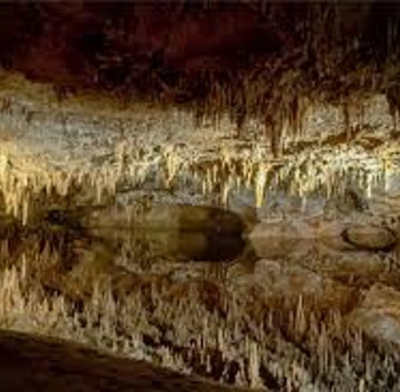
PETRIFIED FOREST
In the most depressed part, the hypothesis has been raised that there could be a pond or astagnant wetland that collected water from underground streams. From here the height risesuntil reaching the highest sector called Palco. The ground slopes back to the northwestwhere the Petrified Forest room opens, thus defined by the grandeur of the staloginesstalactites join

Slide 5
How are stalactites and stalagmites formed?
We will analyze the formation process of both deposits. As mentioned above, they are formed by a chemical precipitation process. These precipitating minerals are dissolved in water. These formations are formed because the CO2 dissolved in the rainwater forms calcium carbonate when it comes into contact with the limestone rock. Depending on the rainfall regime and the level of water infiltration, these formations will occur sooner or later.It is the rainwater which filters through the soil and dissolves the calcareous rock. As a result, these droplets shape these deposits. Calcium bicarbonate is very soluble in water and is what forms after contact with the CO2 carried by rainwater. This bicarbonate produces an outcrop where the CO2 escapes, which, when reacting, precipitates in the form of calcium carbonate.The calcium carbonate begins to cause certain concretions around the point where the drop falls. This only occurs in stalactites, since the drops fall due to the force of gravity that drives them to fall to the ground. Therefore, the drops end up pouring towards the ground.

Slide 6
Thanks for everything
Frosinone

