Slide 1
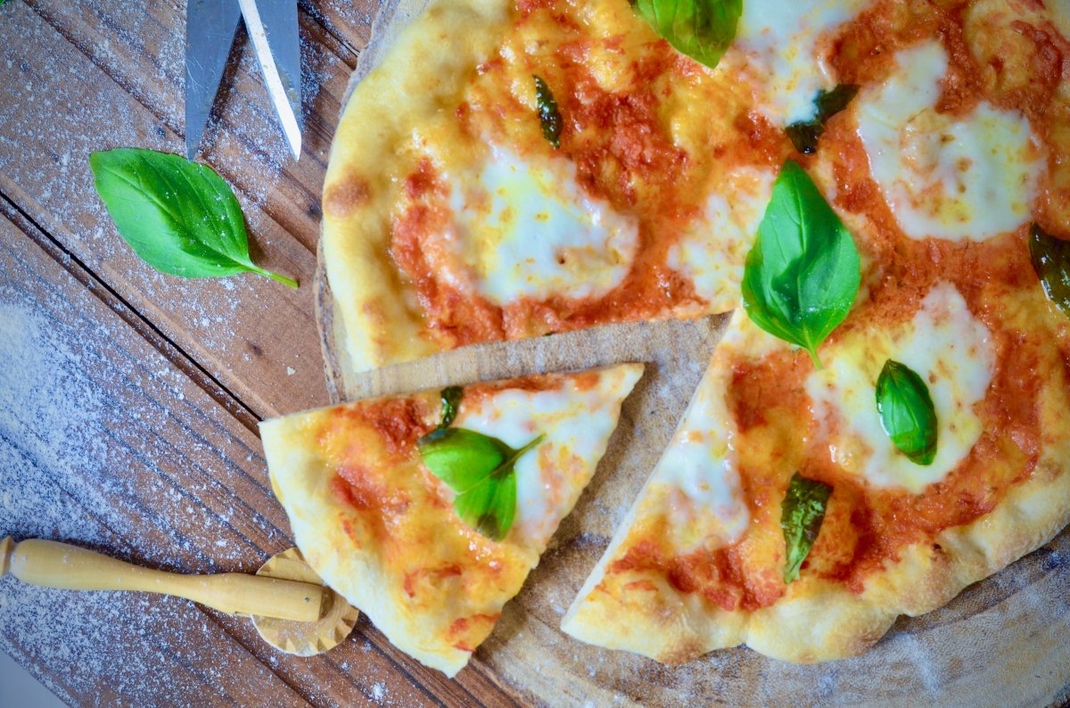
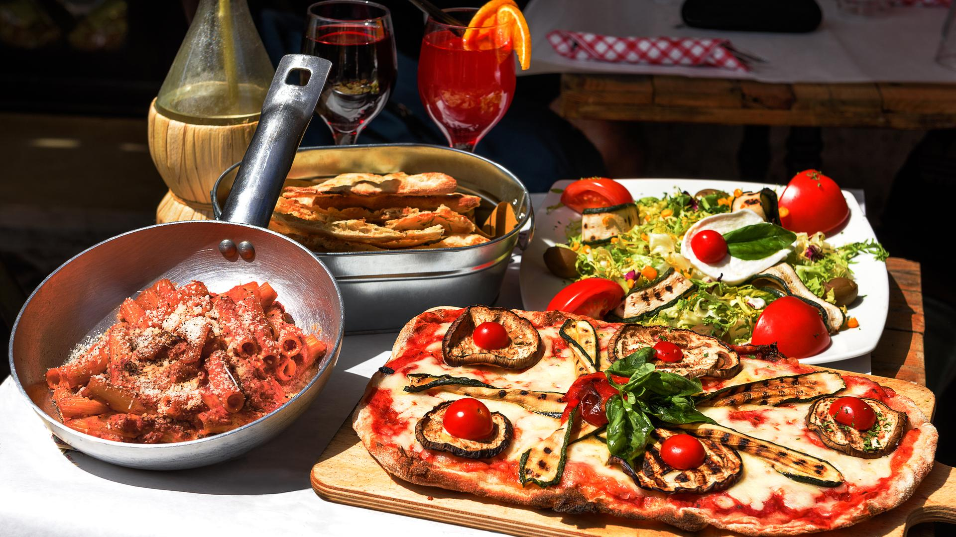
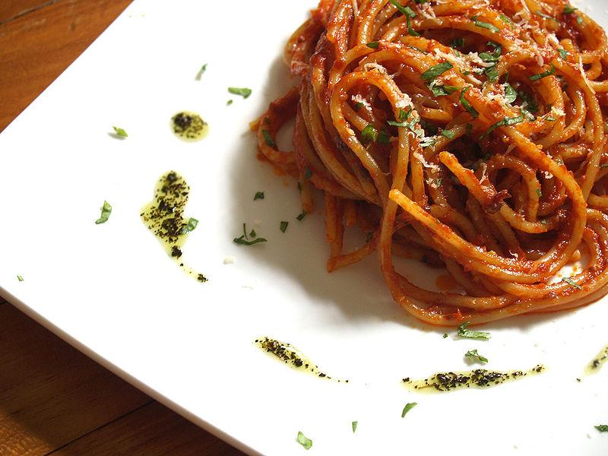
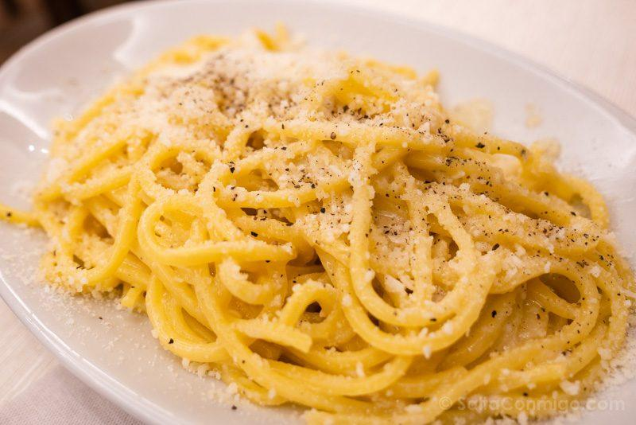
GASTRONOMY OF ROME

Slide 2
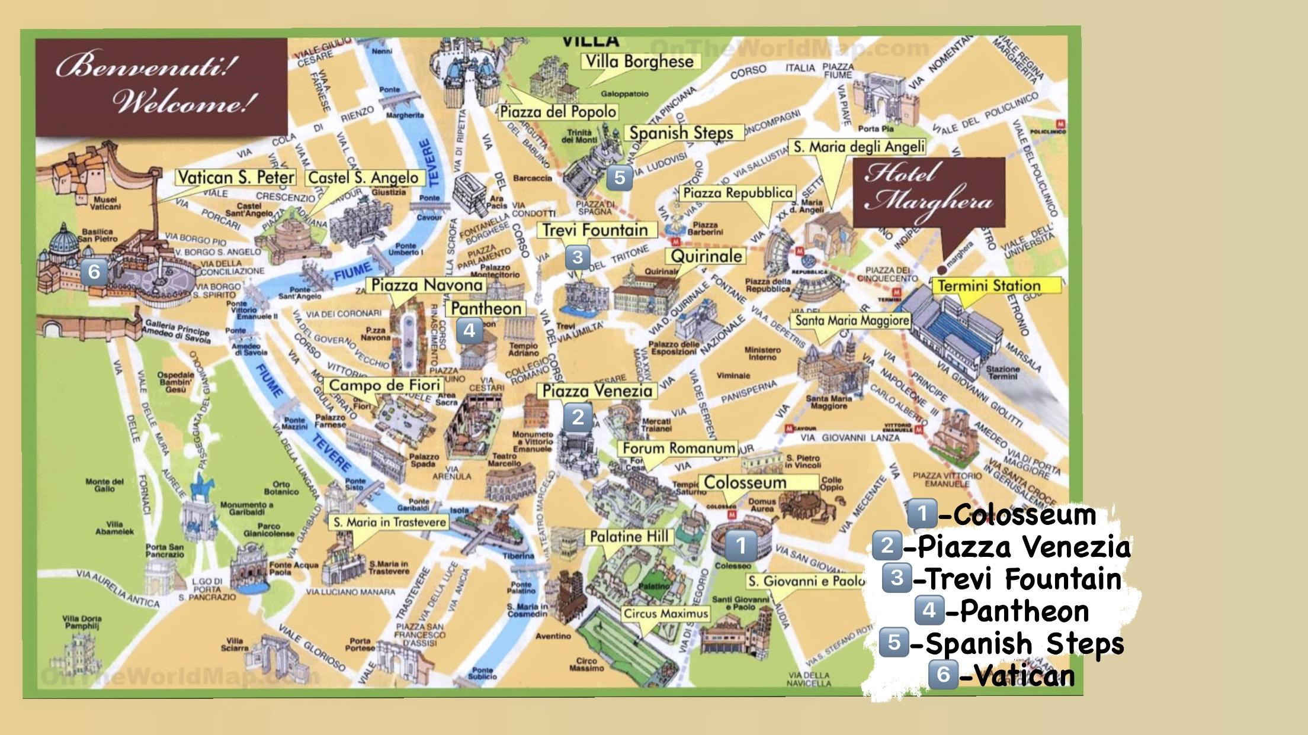

Slide 3
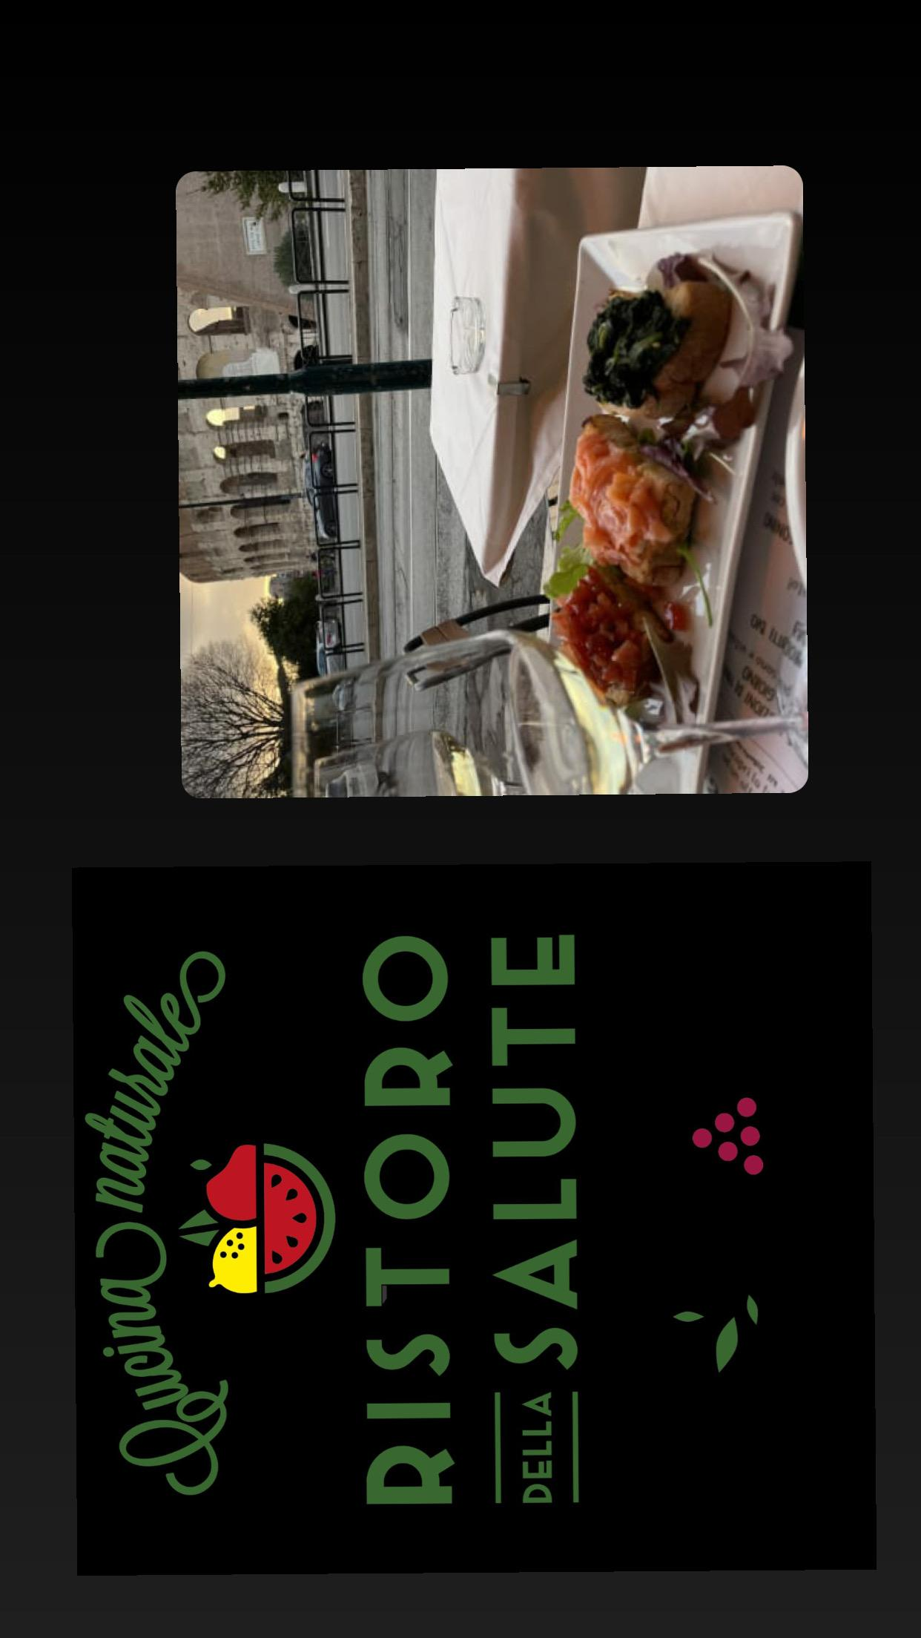
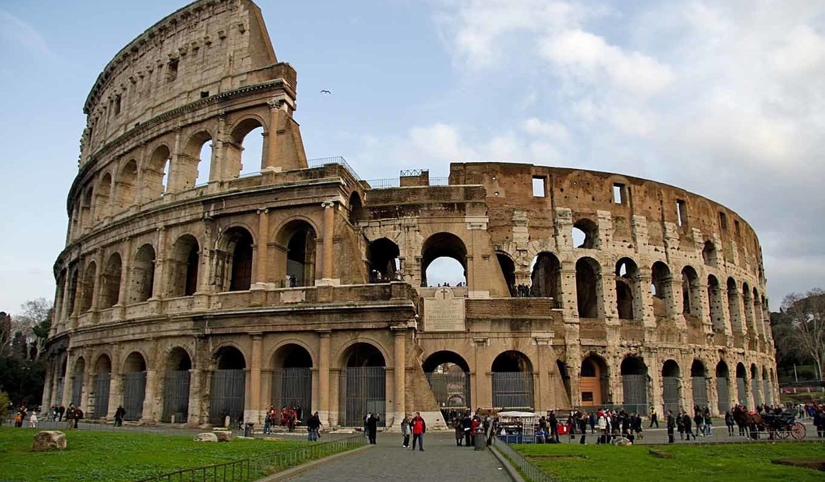
Colosseum
RISTORO DELLA SALUTE IS A RESTAURNT NEAR THE COLOSEUM WHERE YOU CAN TRY DIFERENT KIND OF DESERTS LIKE:HOMEMADE TIRAMISU,CHOCOLATE LAVA CAKE,PROFITEROL,PEAR MOUSSE IN RED WINE WITH CHOCOLATE AND RED WINE, AND MORE DESERTS LIKE THIS YOU CAN EAT THEM WHILE YOU ARE WATCHING THE COLOSSEUM.

Slide 4
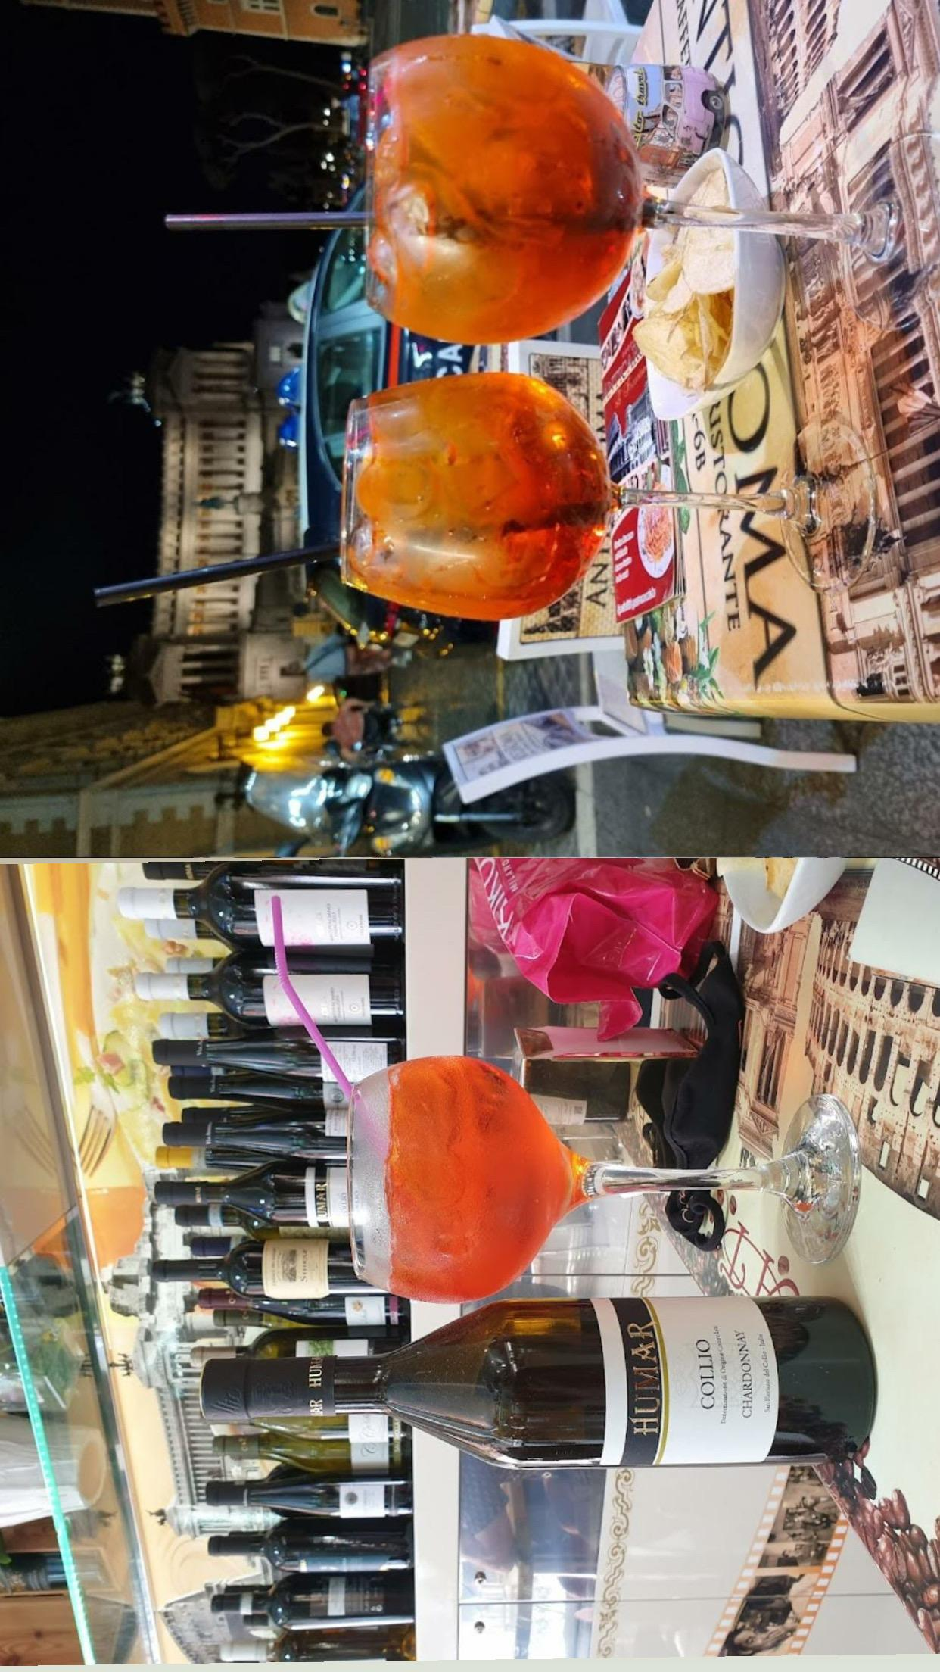
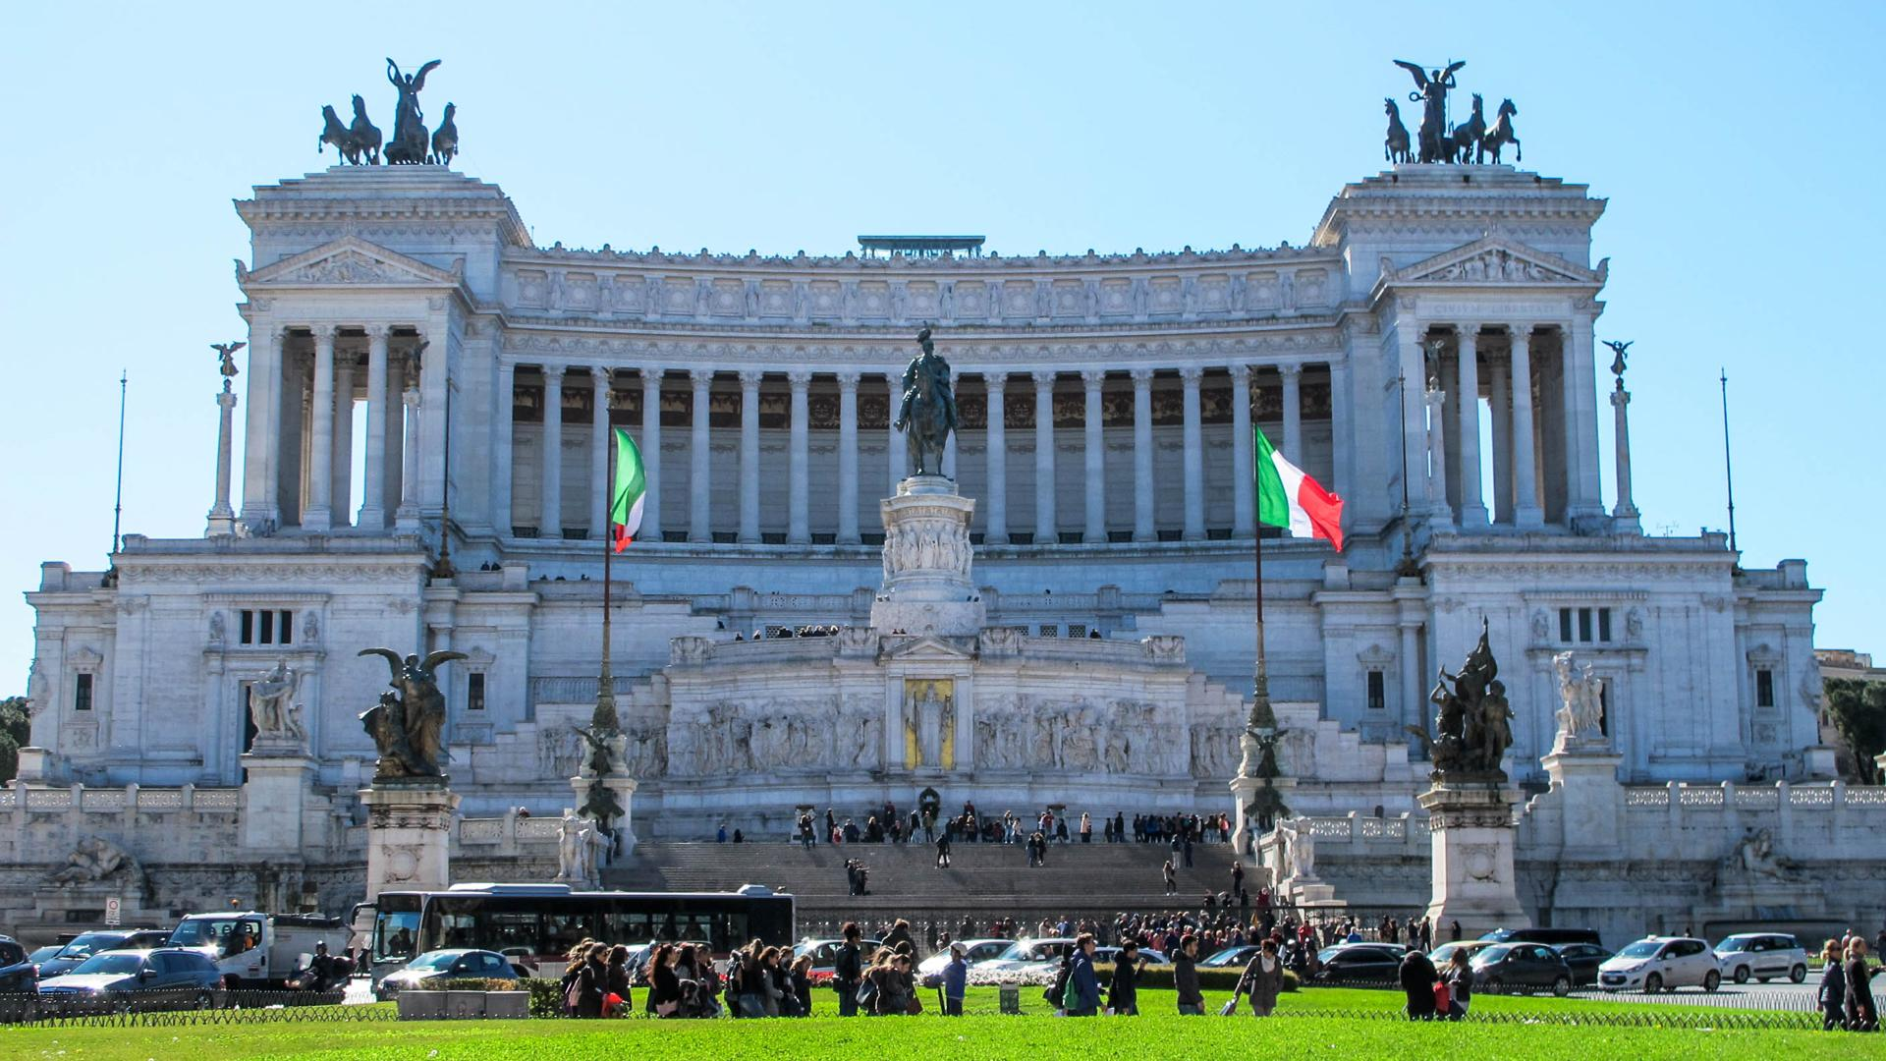
Piazza Venezia
ANTICA ROMA IS A RESTAURANT LOCATED IN FRONT OF THE PIAZZA VENEZIA.HERE YOU CAN TRY A TYPICAL DRINK SIMILAR TO WHITE WINE COMING FROM ITALY.

Slide 5
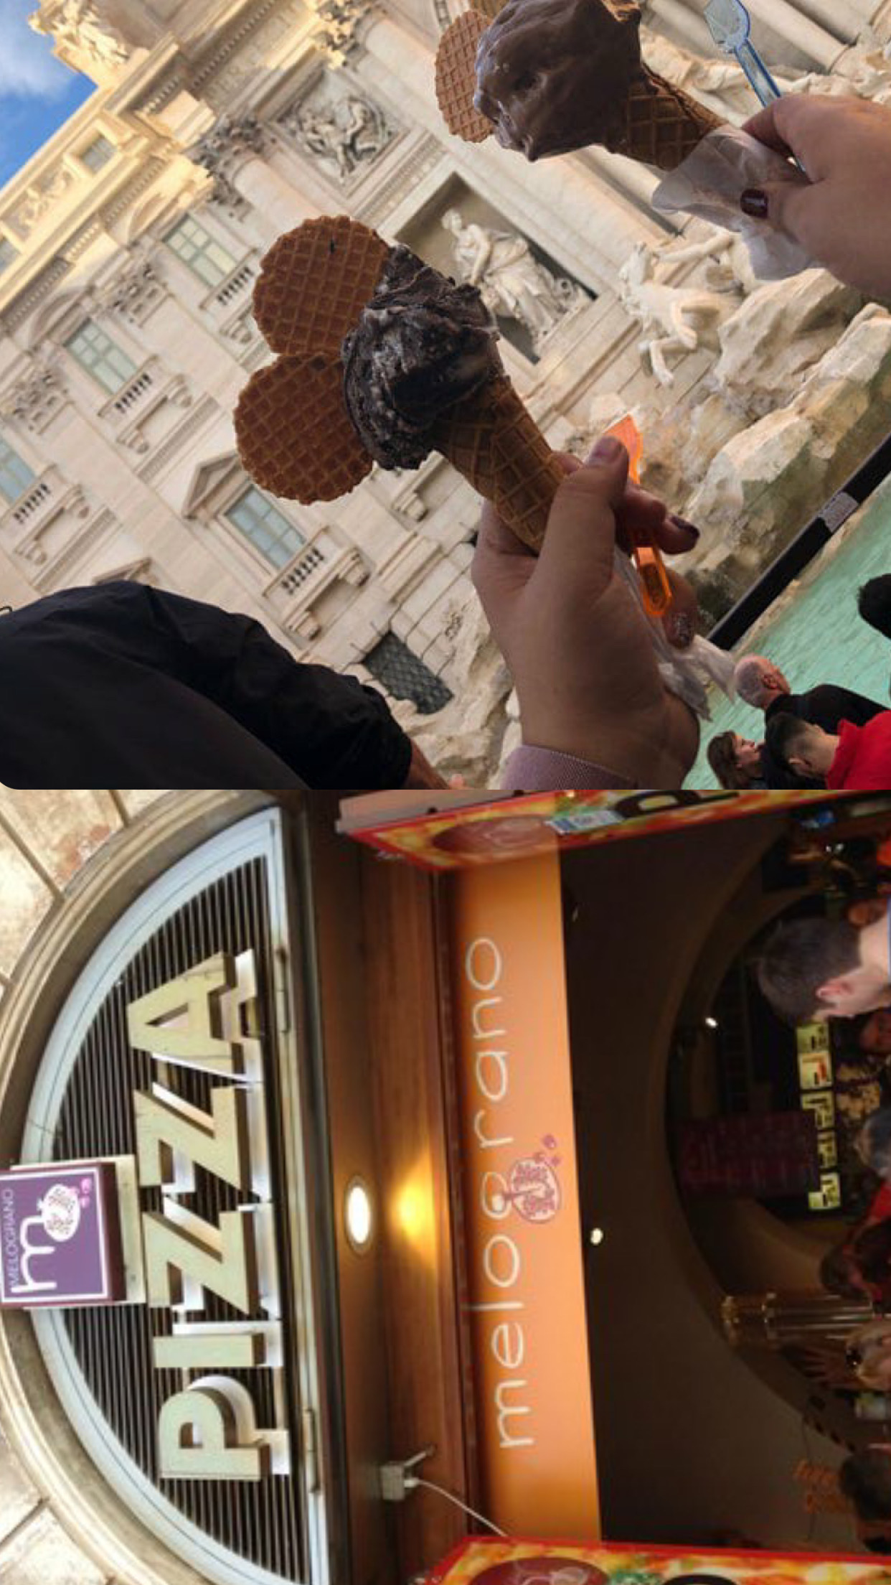
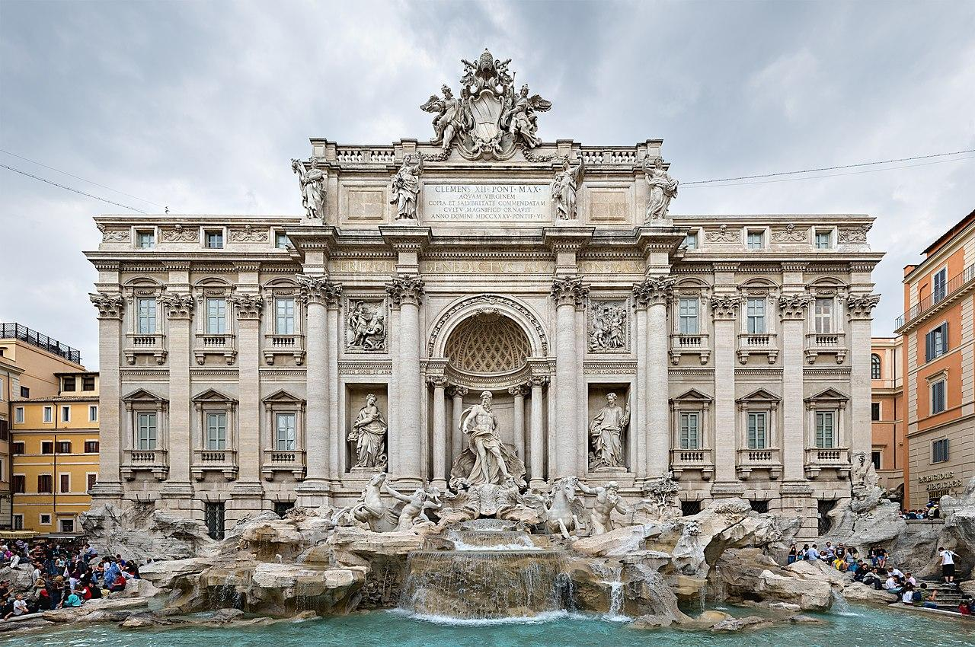
Trevi Fountain
MELOGRANO IS A ICE CREAM PAULOUR LOCATED IN FRONT OF THE TREVI FOUNTAIN.IT IS A GOOD OPTION TO TRY THE BESTS ICE CREAMS FROM ROME THERE ARE MANY DIFFERENT KIND OF FLAVORS FROM WHICH YOU CAN CHOOSE THE ONE YOU LIKE THE MOST.

Slide 6
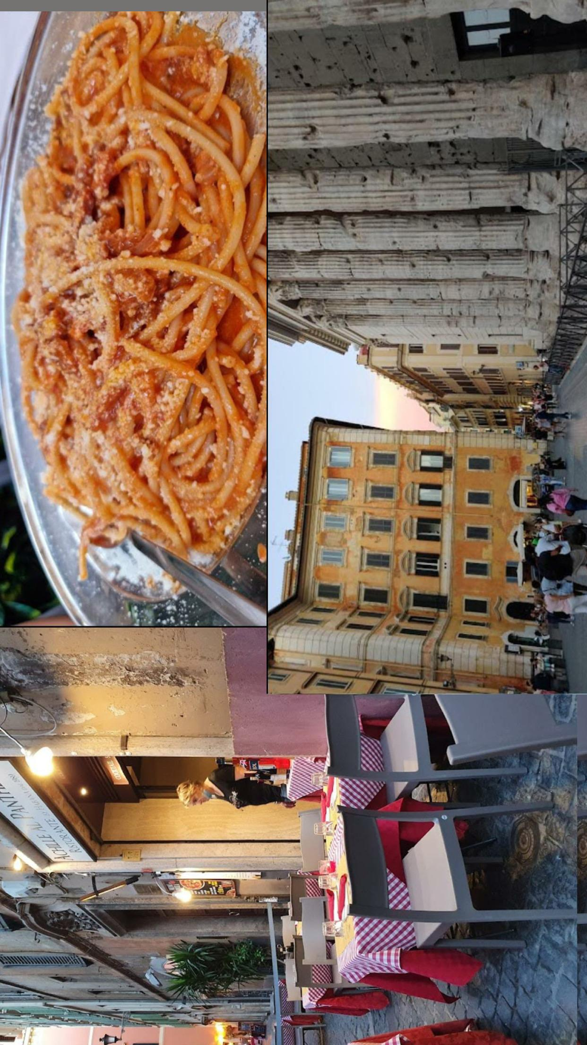
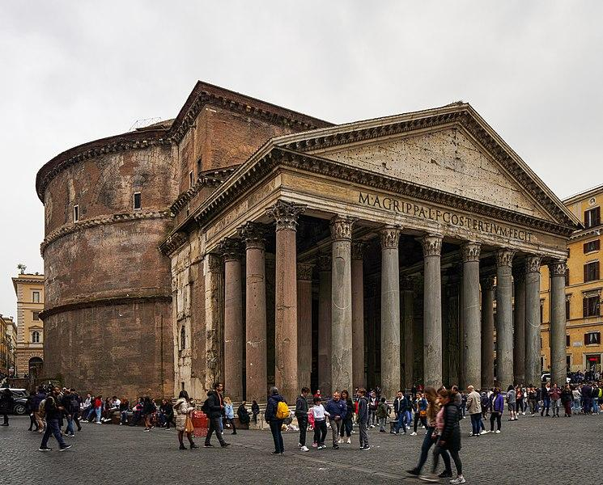
Pantheon
ACHILLE AL PANTHEON DI HABANA IS A RESTAURANT LOCATED NEXT TO THE PANTHEON BUILDING WHERE YOU CAN TRY THE BUCATINI SPAGHETTI AND MORE VARIETY OF SPAGHETTIS.BUCATINE ARE SPAGHETTIS WITH TOMATOE AND SOME CHEESE.

Slide 7
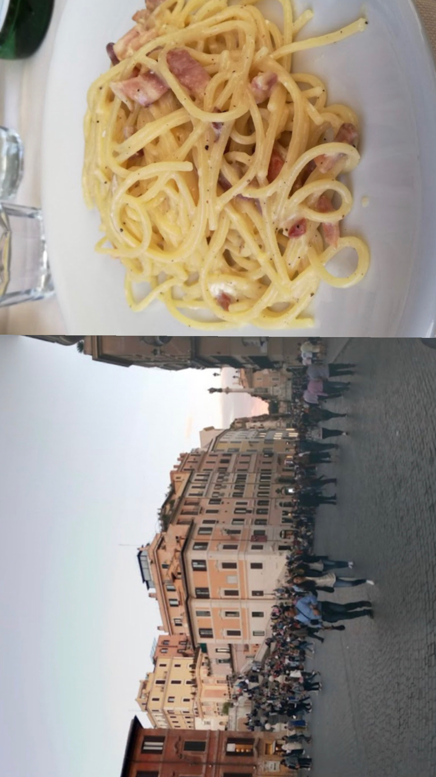
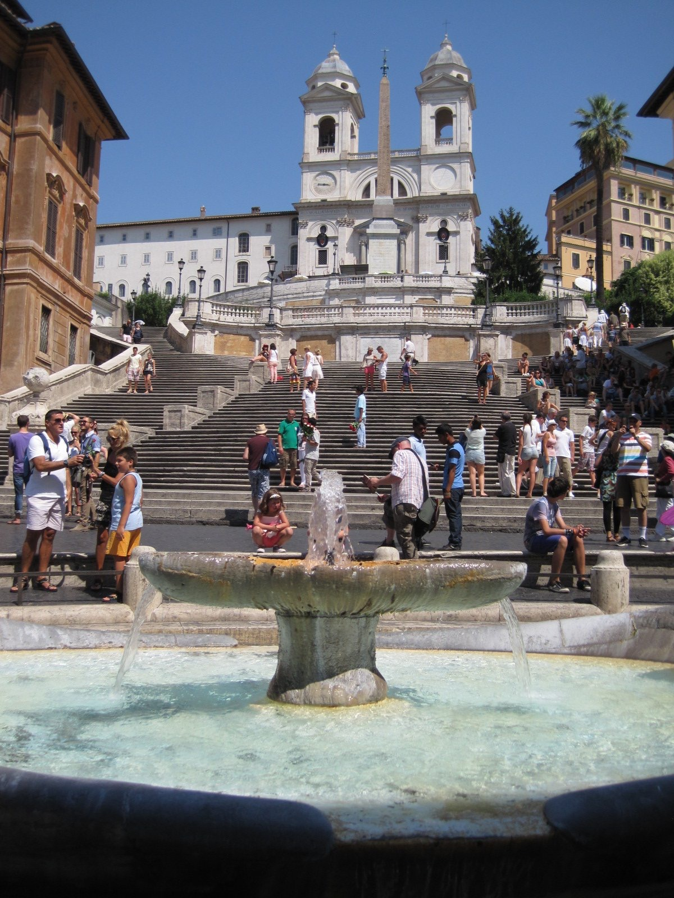
Spanish Steps
AT GIGGIA IS A RESTAURANT NEAR THE SPANISH STEPS WHERE YOU CAN ESAT DIFFERENT KINDS OF PASTA LIKE:PASTA CARBONARA,CLAM SPAGHETTI,PASTA AL RAGOU,SPAGHETTI CON VONGOLE BIANCO…

Slide 8
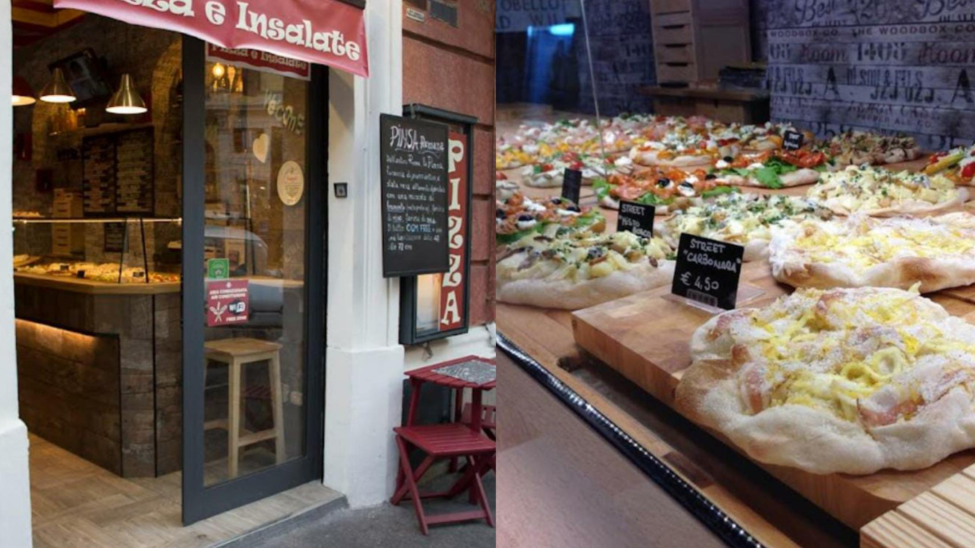
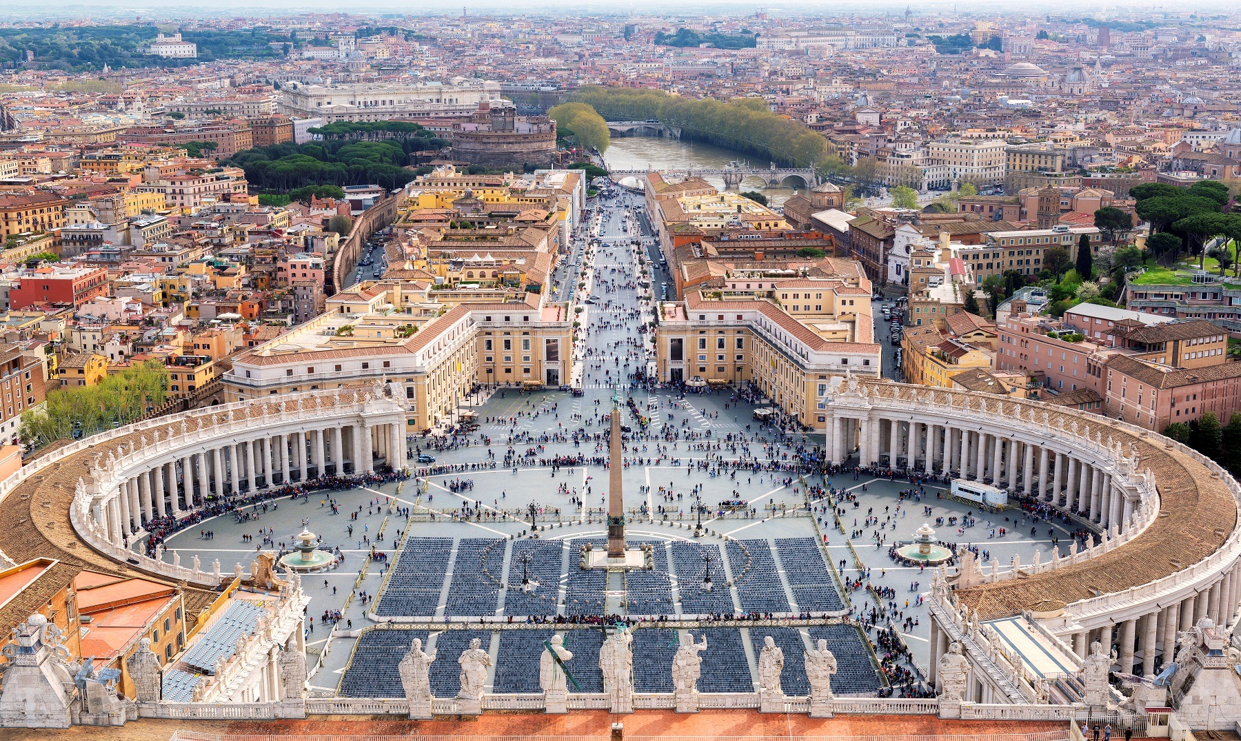
Vatican
PINSA ‘MPÒ IS A RESTAURANT LOCATED IN THE VATICAN WHERE YOU CAN TRY MANY KIND OF DIFFERENT PIZZAS THE MOST FAMOUS FOOD IN ITALY.

