Slide 1
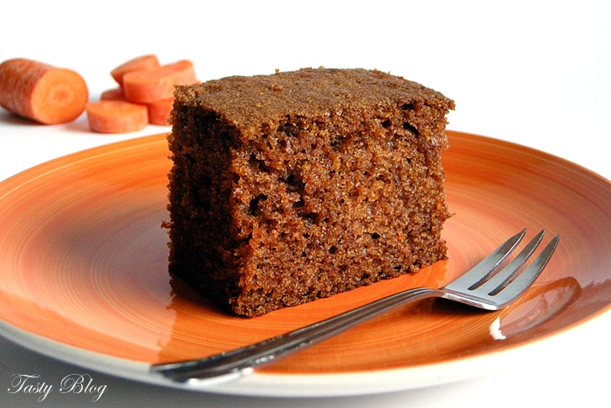
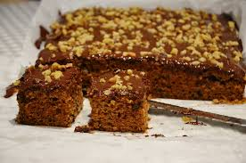
Carrot cake
I invite !

Slide 2
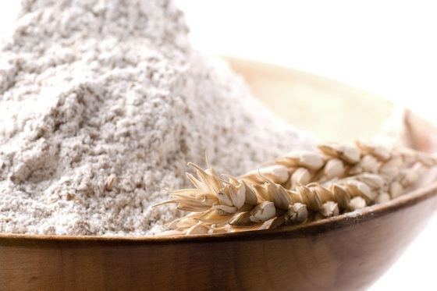
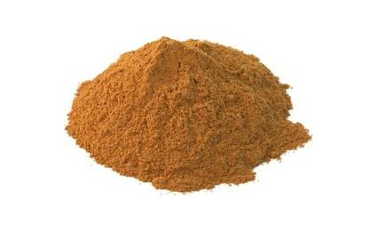
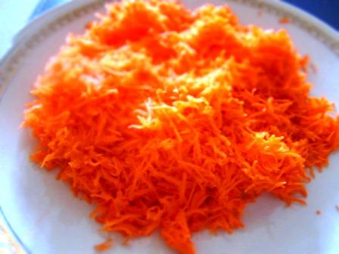
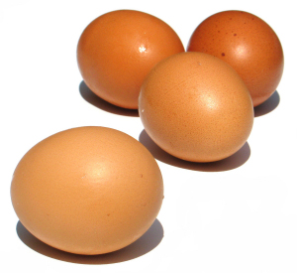
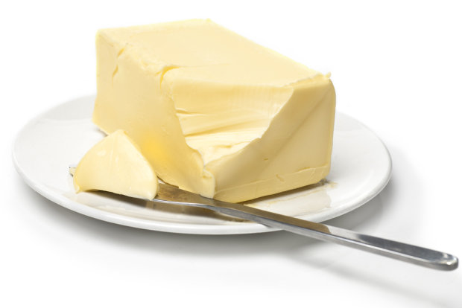
Ingredients:
Flour (150 g)
Powdered sugar (150 g)
Peled carrot (150 g )
2 Eggs
Butter (100 g)
1,5 teaspoon of gingerbread Spide or cinnamon
1 teaspoon of soda kitchen
1 teaspoon of baking powder

Slide 3
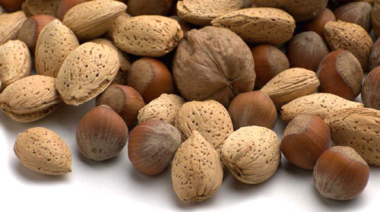
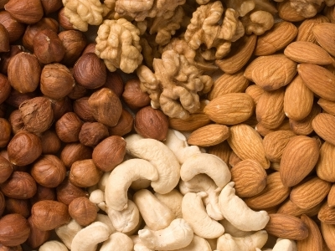
And…
Some nuts (cut them) and raisins

Slide 4
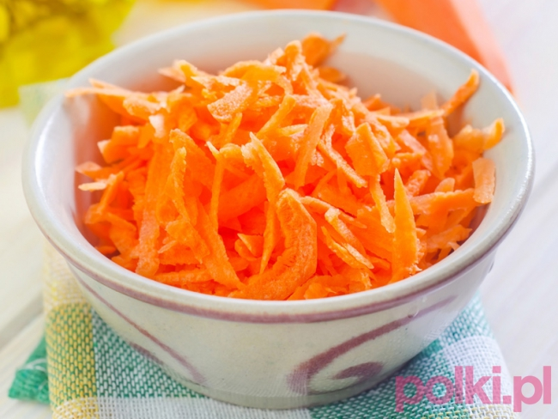
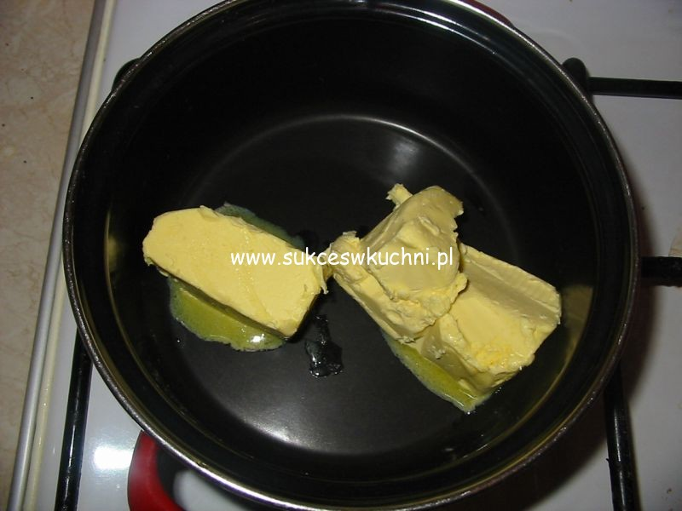
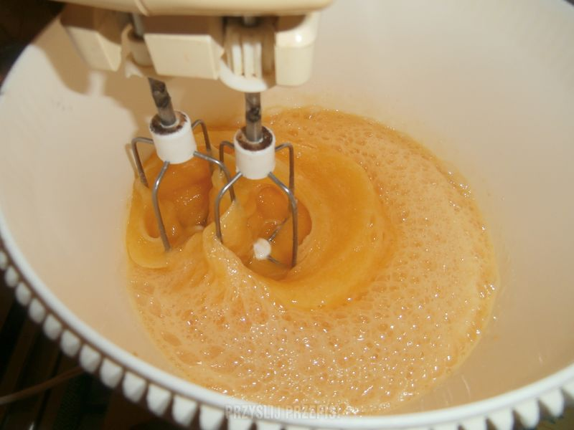
Cake Preparation :
Rirst, wipe carrot on a coarse mesch (squeeze out the juice before adding to the rest of ingredients)
Then, melt the butter and mix with beaten eggs.

Slide 5
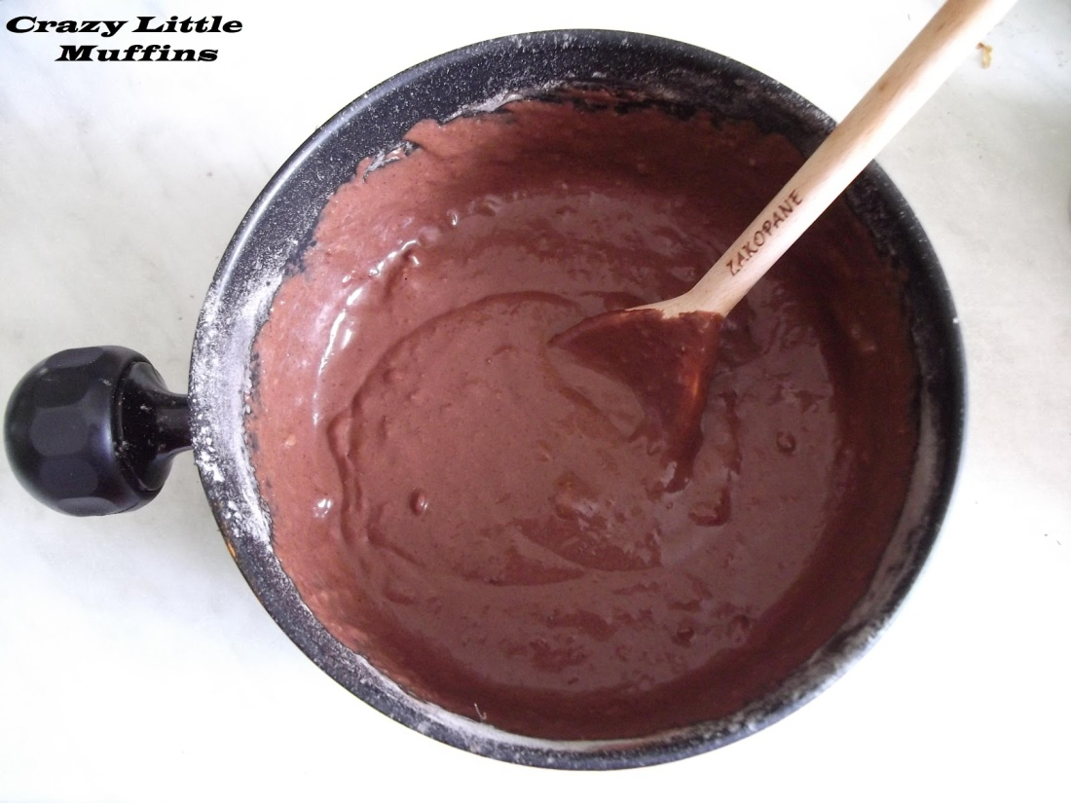
To be continued…
3.After that, mix toghether dry ingredients like: flour, powder sugar, gingerbread spice or cinnamon, baking powder and kitchen soda
4.Next,add butter witch eggs and mix it

Slide 6
5.Finnally, add wipe carrot, nuts and raisins. Strit (mix) them all and put into the baking mold
6.Bake about 45 minutes, 180 C
7.Fresh but cold cake can be decorated by powdered sugar or molten chocolate

Slide 7
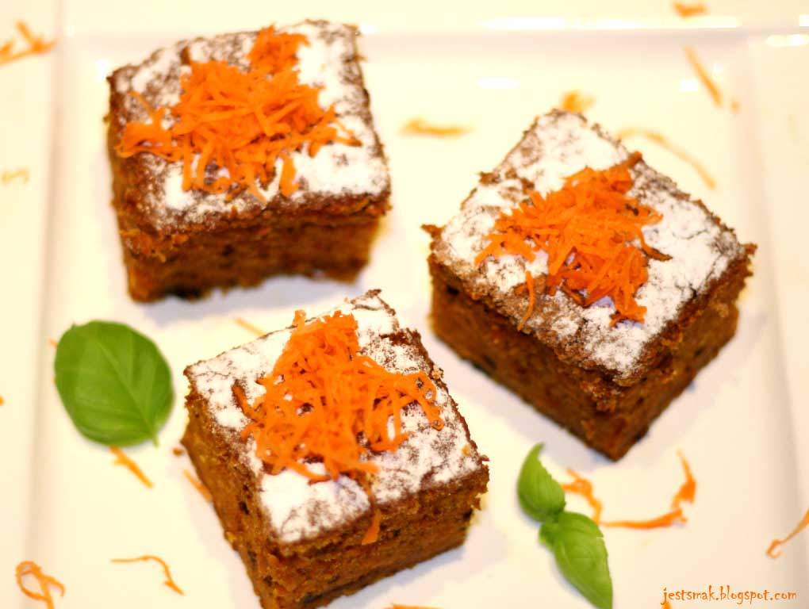
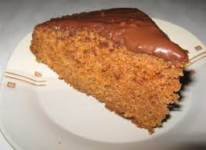
☺ Yummy ☺

