Slide 1
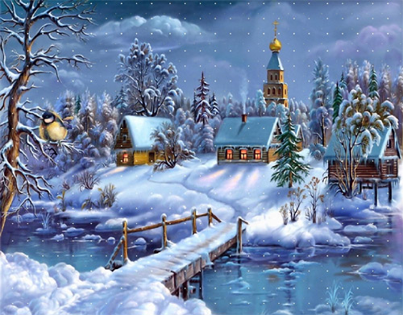
Christmas Time
in Poland is very special

Slide 2
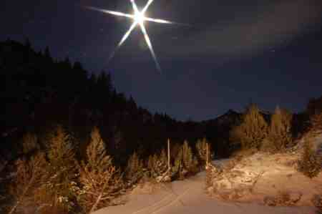
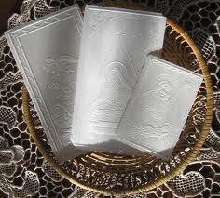
Polish Xmas Tradition
Look out the first star on the sky and when it appears we start Xmas supper
We share the Christmas wafel with all family and wish health and luck

Slide 3
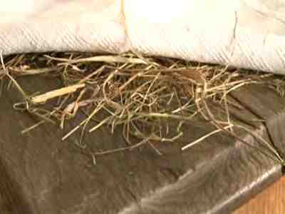
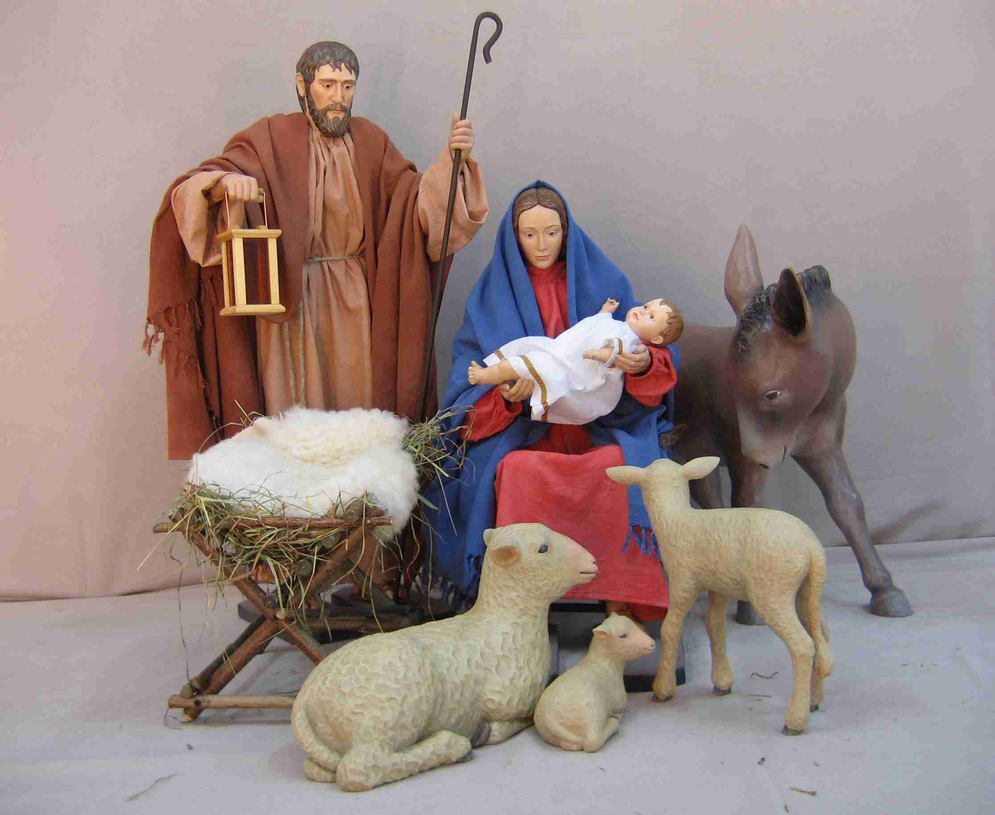
Polish Xmas Tradition
We put some hay under Xmas tablecloth
We make beautiful Christmas crib at home and at the church

Slide 4
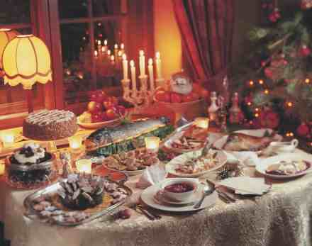
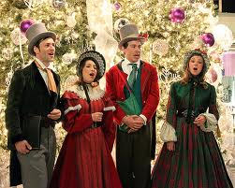
Polish Xmas Tradition, the most important day of Xmas time is 24 December. We meet all family members and we eat special Xmas supper together
Xmas carols singing
Twelve dishes

Slide 5
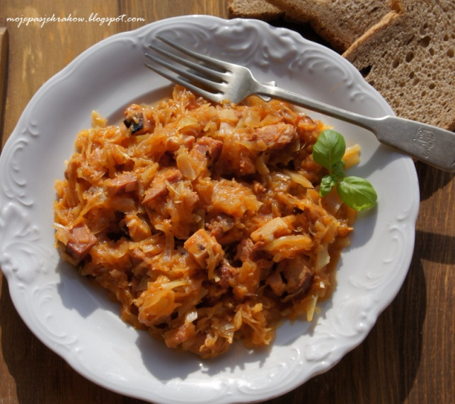
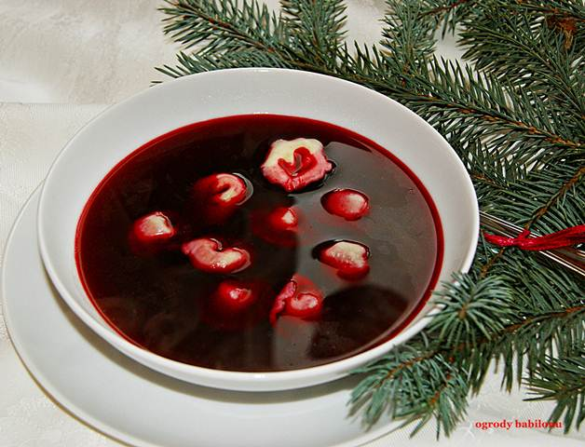
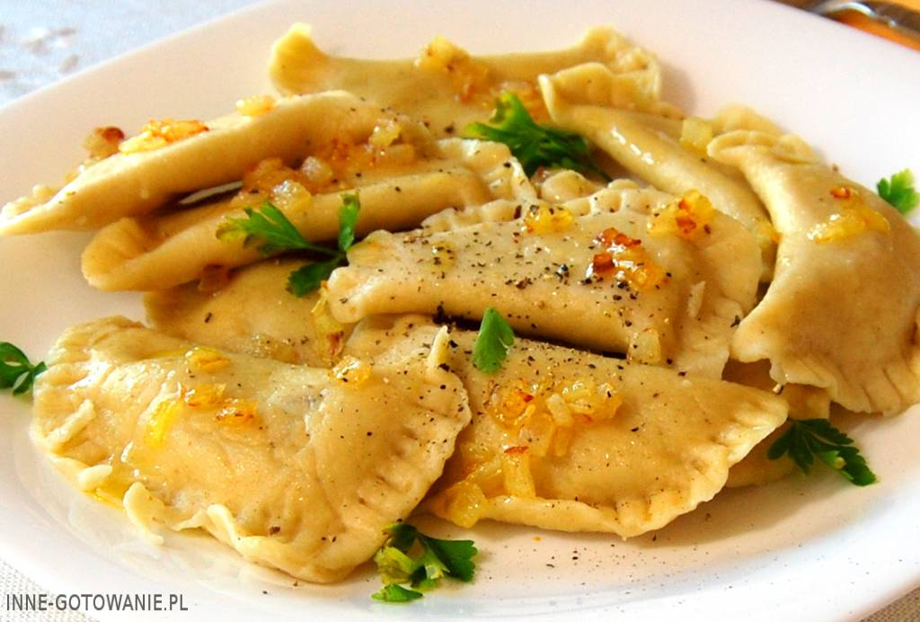
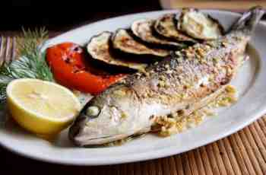
Christmas food
Borstch with dumplings
Sauerkraut stew
Fish
Dumplings with cabbage and mushrooms

Slide 6
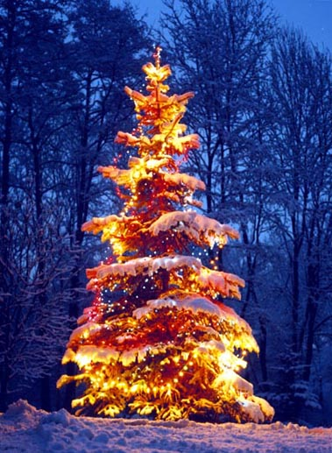
Christmas tree

Slide 7
All members of the family get presents after Xmas Eve, on 24th December

Slide 8
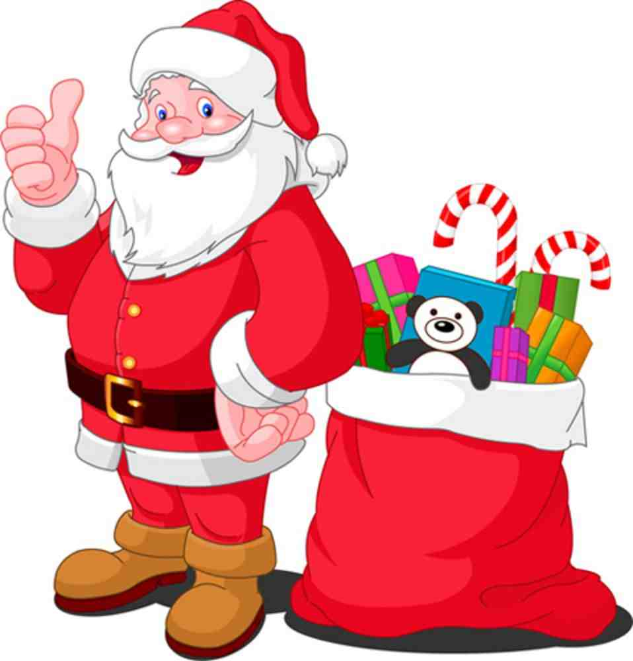
Santa Claus

Slide 9
We wish you
MERRY CHRISTMAS!!!
Czapury, Poland

