Slide 1
1st public speaking
Czech Republic
Romania
Turkey
Bulgaria
Let Us Speak

Slide 2
Videocards
2nd project activity

Slide 3
SKYPE CONFERENCE

Slide 4
ROMANIA + CZECH REPUBLIC
15 STUDENTS FROM EACH COUNTRY
COMMUNICATOR – SKYPE, FB
INTERNET CONNECTION
FEEDBACK

Slide 5
TOPICS
1 Free Time and Entertainment
2 Family and Friends
3 School
4 Christmas
5 My House
6 My Day
7 Sport
8 Weather, Seasons
9 Transport

Slide 6
Pross
NEW FRIENDS
INFORMATION ABOUT PARTNER´S COUNTRY
COMMUNICATION
Cons
PROBLEMS WITH INTERNET AND WITH COMPUTERS

Slide 7
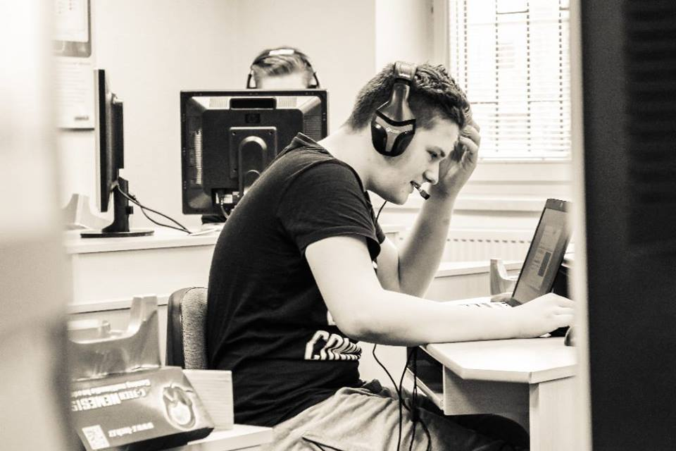
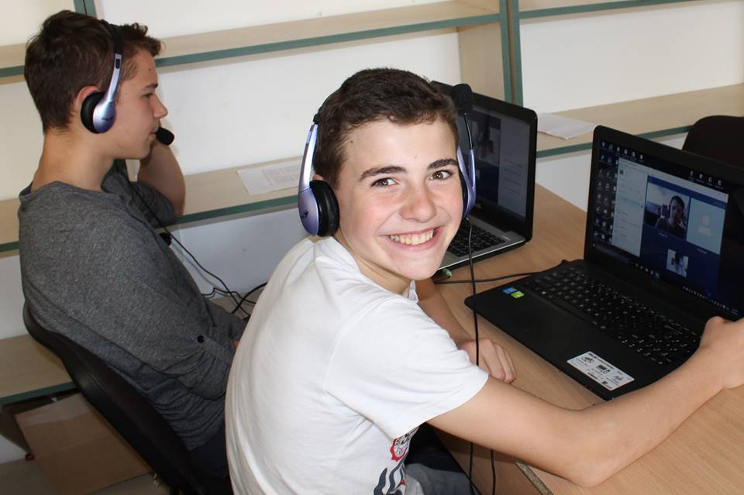
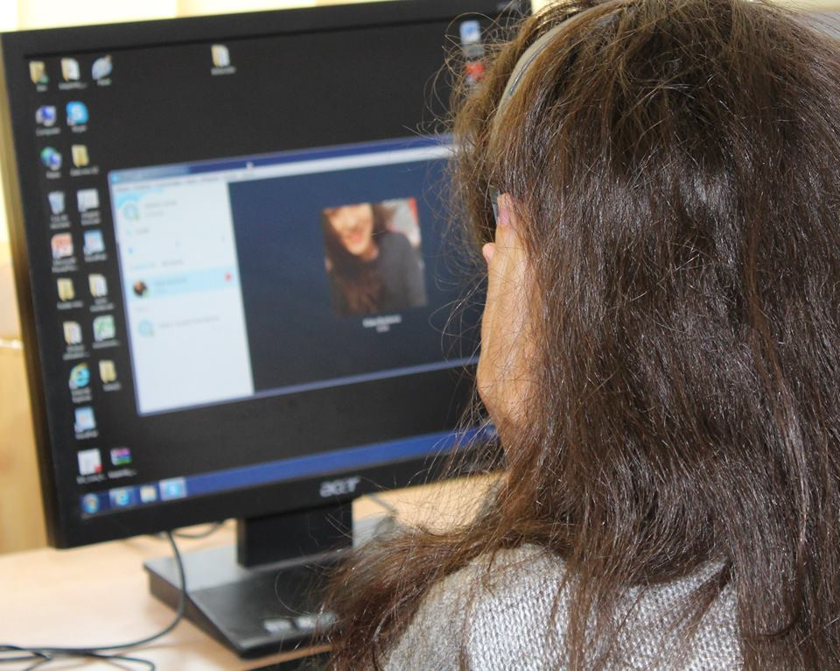
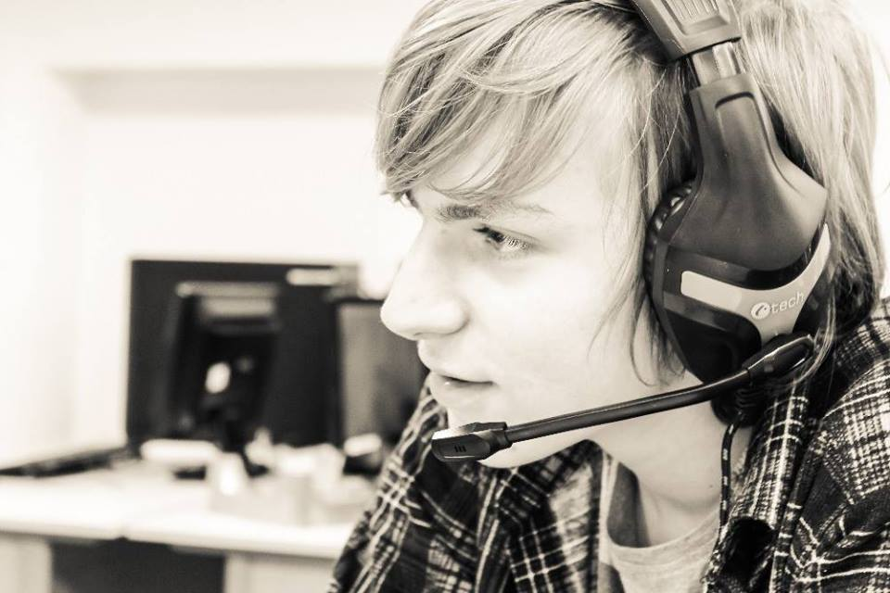

Slide 8
Thank you for watching our presentation

Slide 11
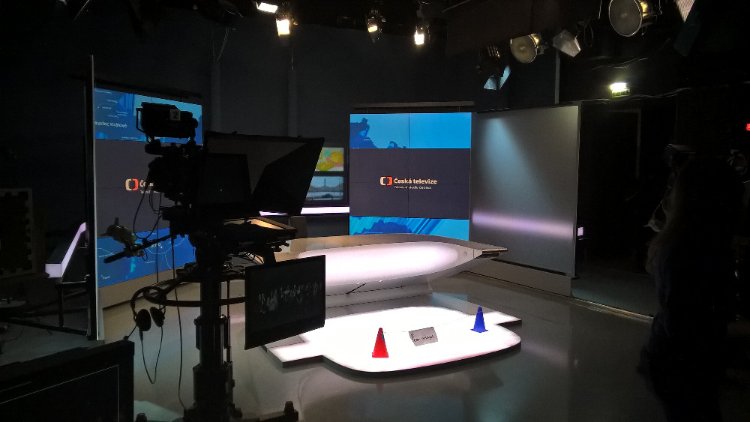

Slide 12
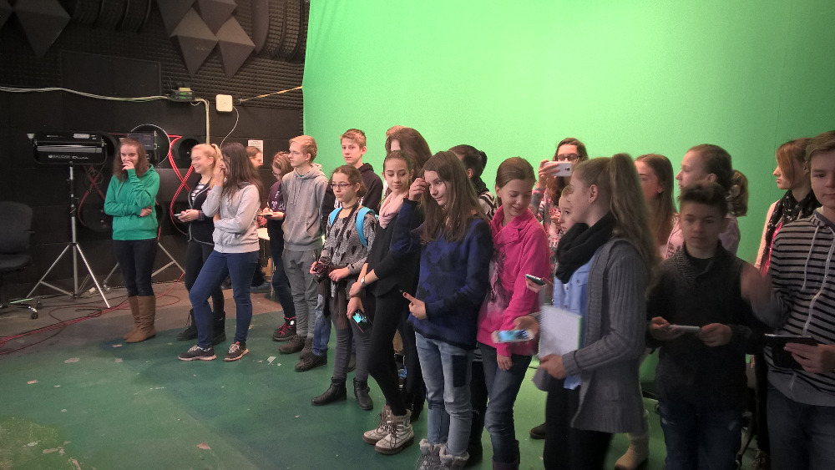

Slide 13
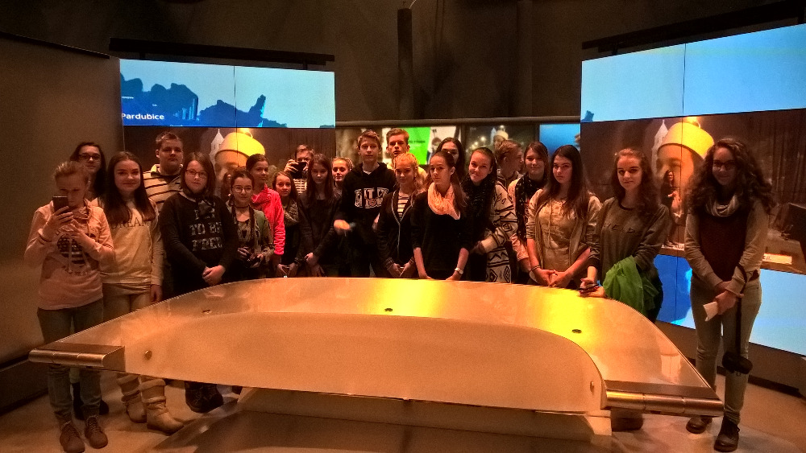

Slide 14
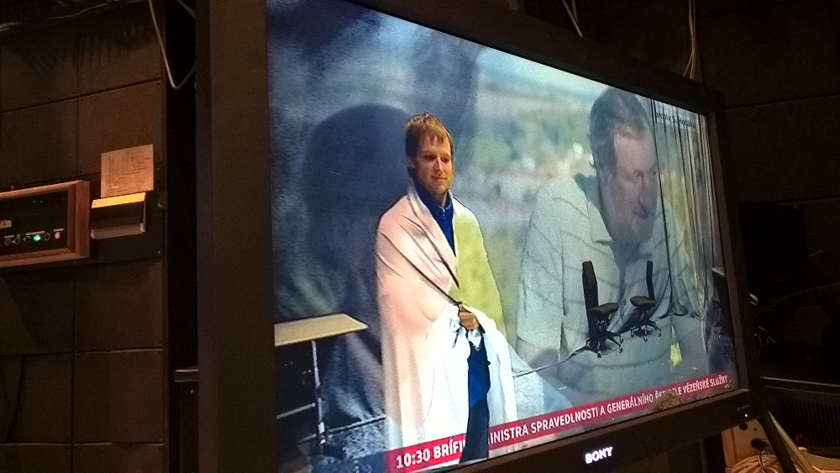

Slide 16
Bulgaria 13.3. – 21.3.
Mgr. Martin Raška Sára Schlesingerová Petr Durstin Prokop Szuscik
Mgr. Jan Nowak Ph.D. Klára Bocková Adéla Nogová Jan Byrtus

Slide 17
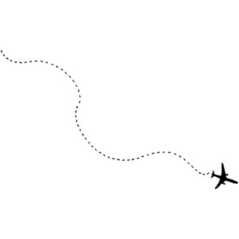
1st teambuilding camp in Chelopech, Bulgaria.
24 students and 8 teachers

Slide 18
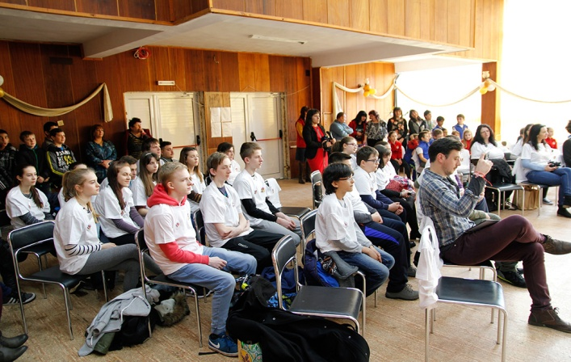
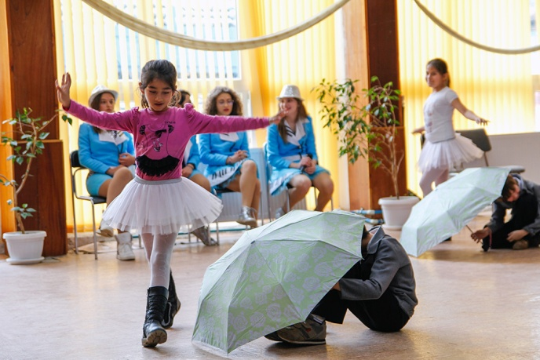
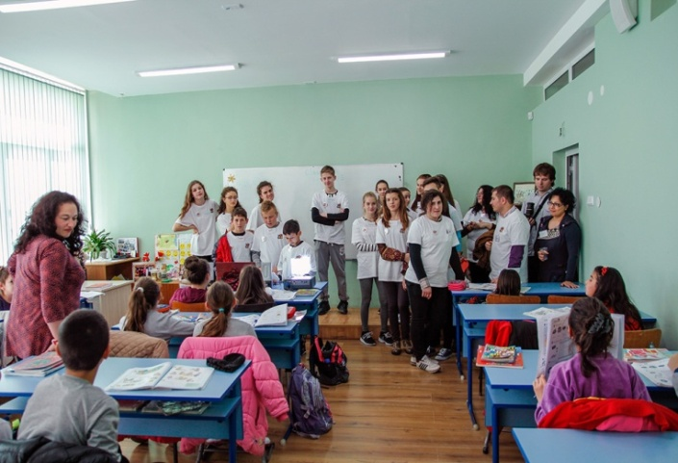
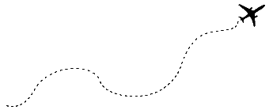
Day 1 – visit school
the visit of our partners´ school in Chelopech.
ice-breaking games

Slide 19
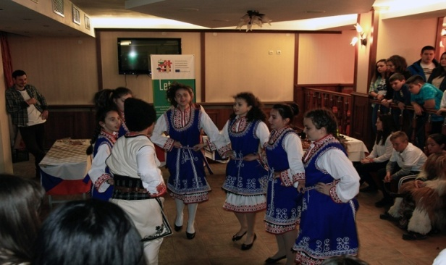
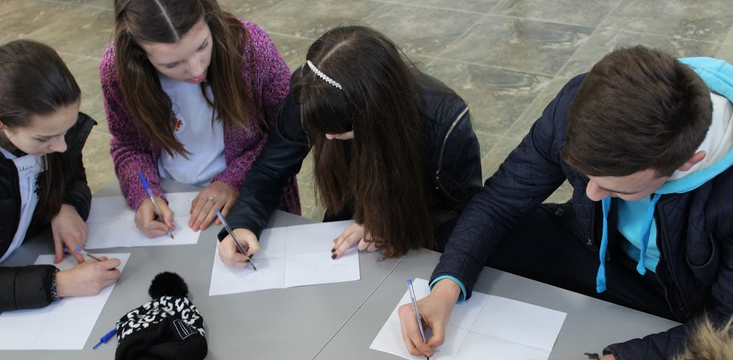
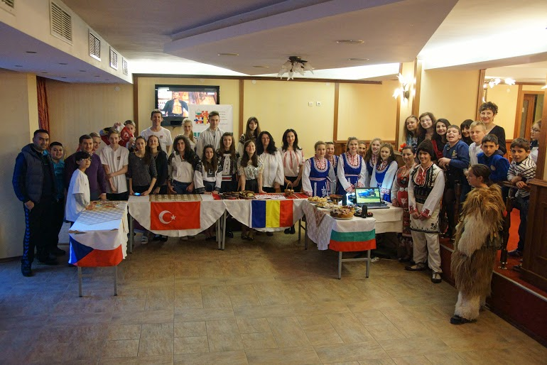
visit of one of the oldest neolithic places in Europe
welcome party
each country presented their homeland, town and school.

Slide 20
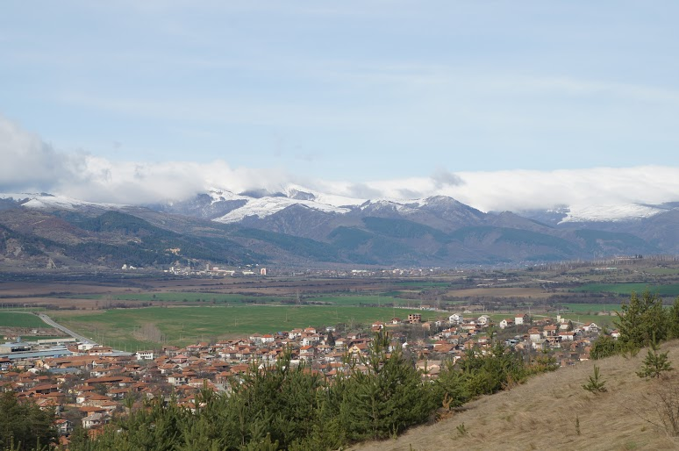
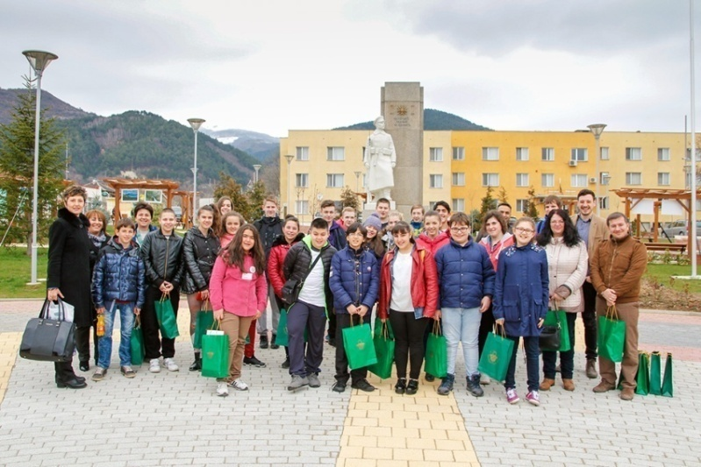
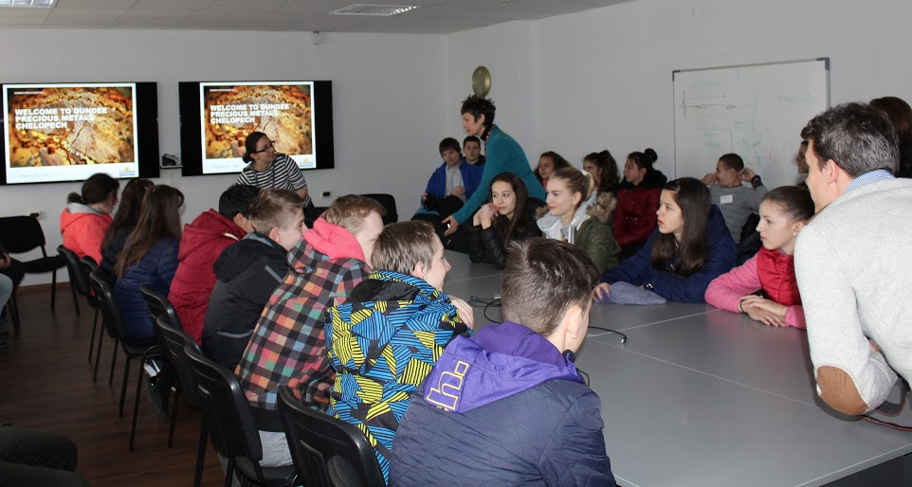
Day 2 – Exploring town Chelopech
visit of municipality of Chelopech
visit of a local mine copper company

Slide 21
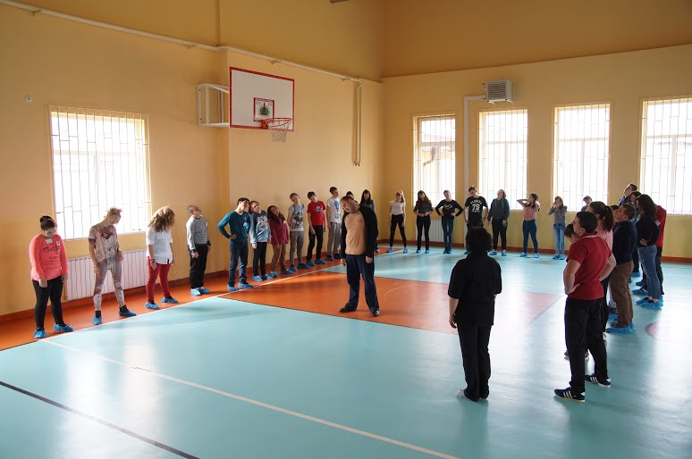
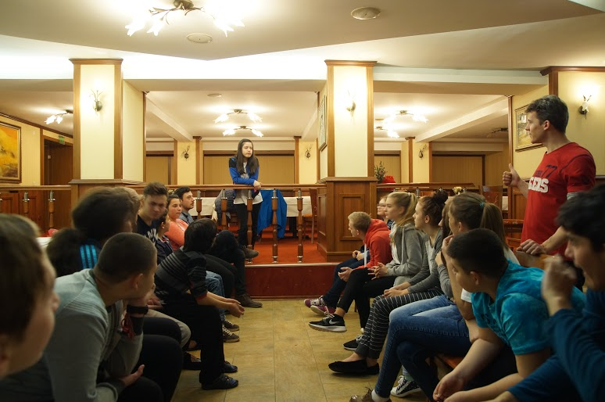
Day 2 – try Bulgarian traditions
traditional dance class
team building games

Slide 22
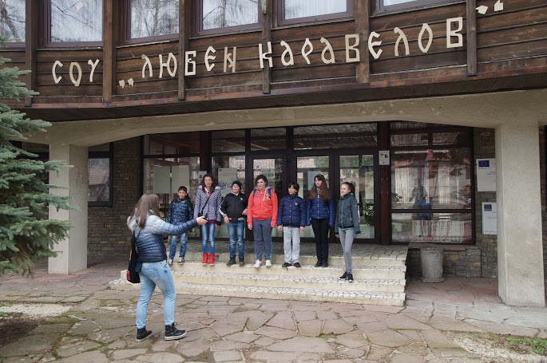
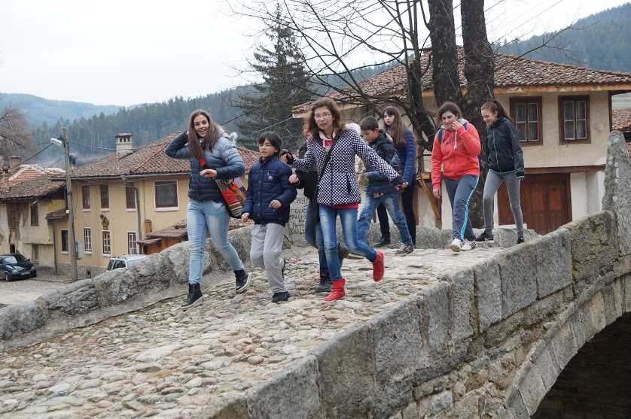
Day 3 - search through the city
visit of town Koprivshtitsa
playing game Get to know Koprivshtitsa

Slide 23
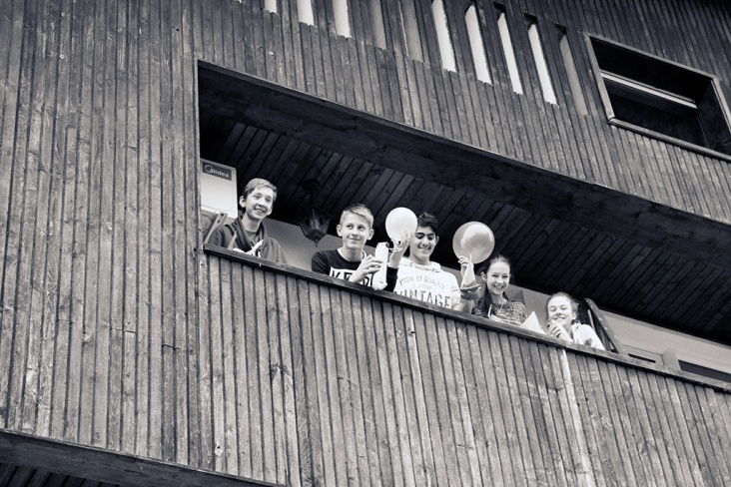
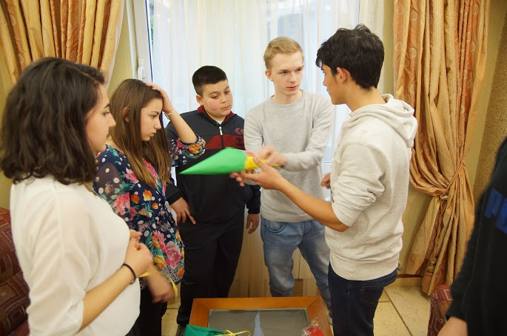
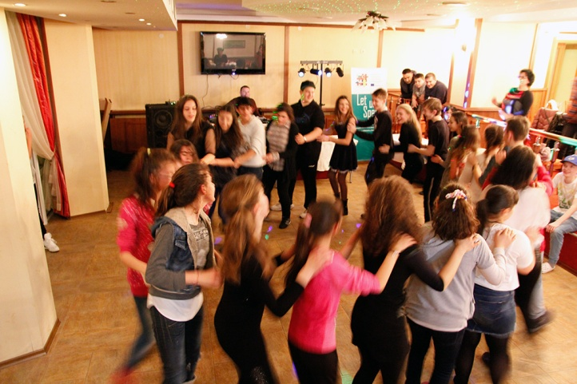
Day 3 – teambuildings games
Playing other interesting games
Party

Slide 24
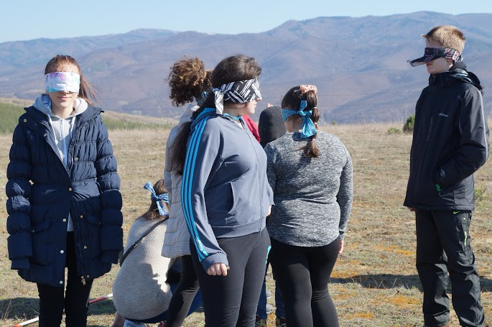
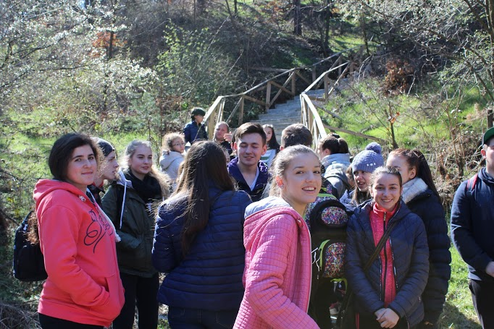
Day 4 - hike the mountains
hiking trip
"The shepherd and blind sheep"

Slide 25
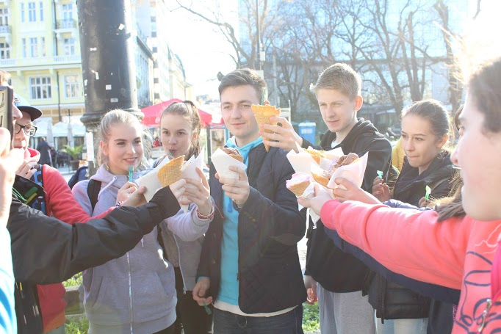
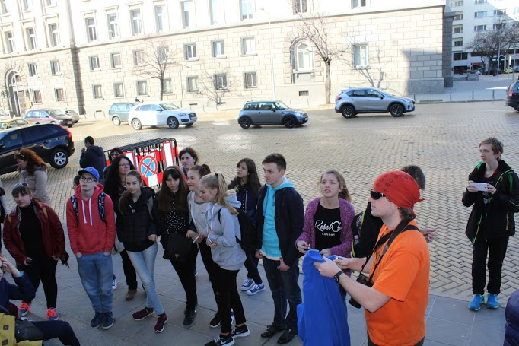
Day 5 – beautiful Sofia
trip to Sofia
"Музейко - Muzeiko"

Slide 26
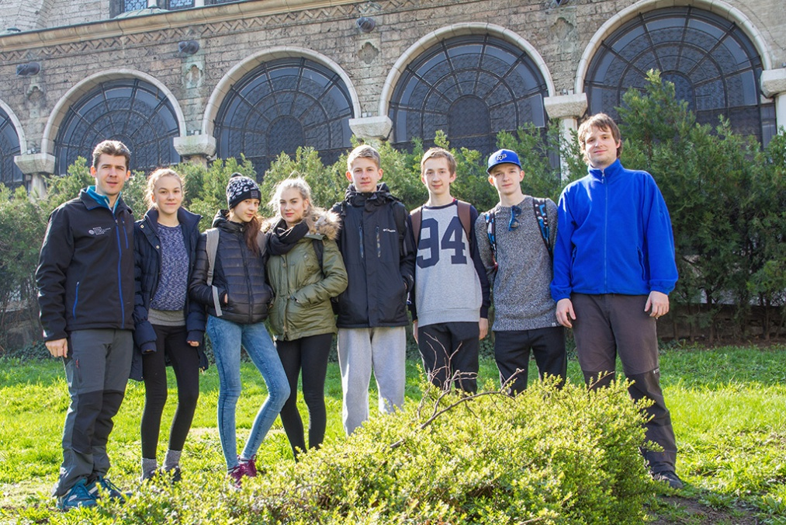
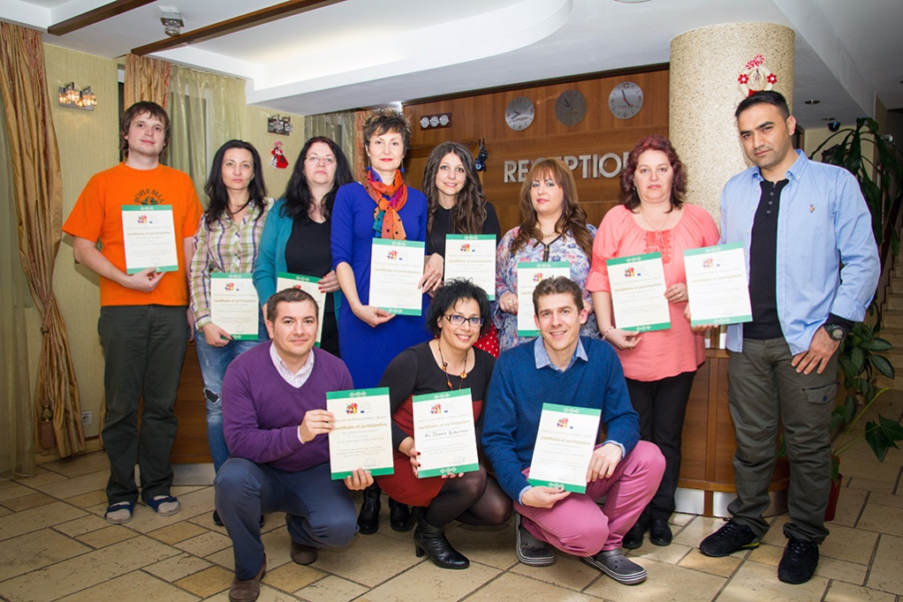
Day 6 – last goodbye
this is the end of our trip!

Slide 27
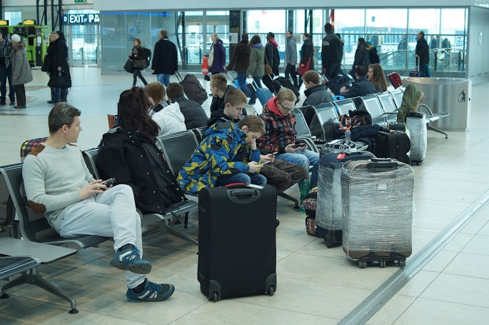
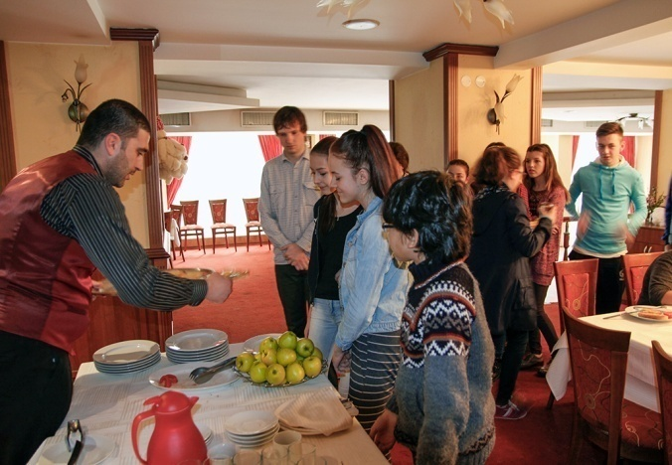
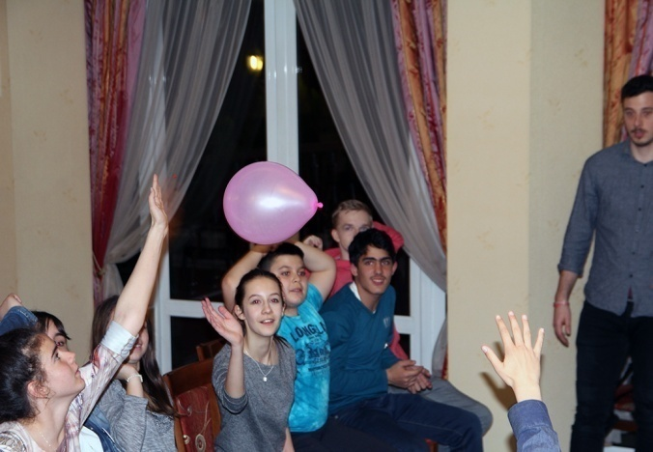
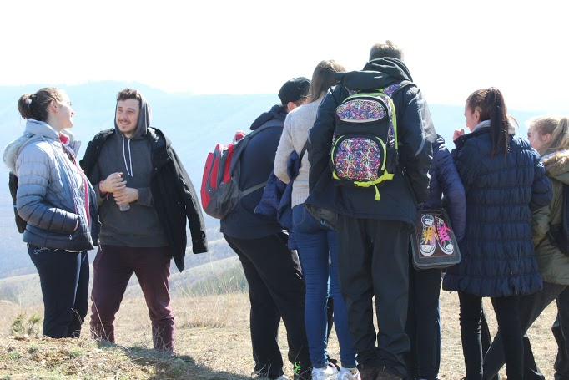
Photos from Bulgaria

Slide 28
Pass it further (April Fools' Day)
Petr Bezruč Elementary School, Třinec, Czech Republic

Slide 29
Written by Klára Bocková and Adéla Nogová
Narrator - Adéla Nogová
Number of students – 9 students
Teachers- Marian Rybka, Adam Olszar
Music, mixing, effects - Jan Nowak

Slide 30
Every Friday afternoon with Mr. Nowak.
From 24th February to 2nd March
It was very funny, but sometimes we had some problems.

Slide 31
THANK YOU
FOR YOUR ATTENTION!

Slide 32
Czech team building camp
23.5.-27.5.2016
Chata Beskydka
Gold Rush

Slide 33
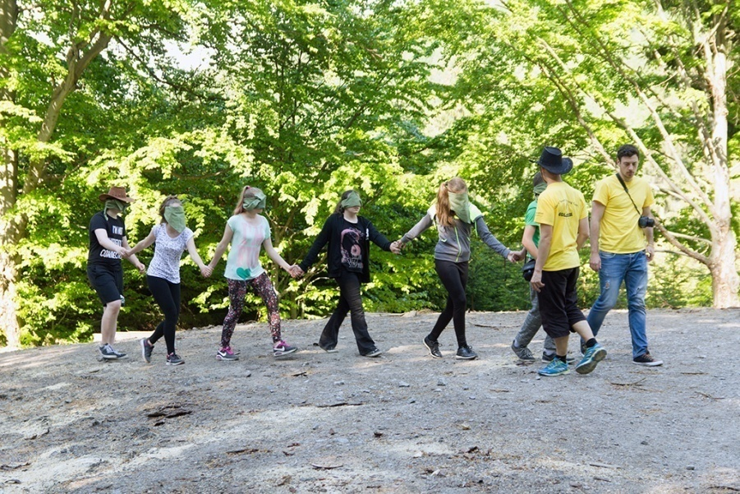
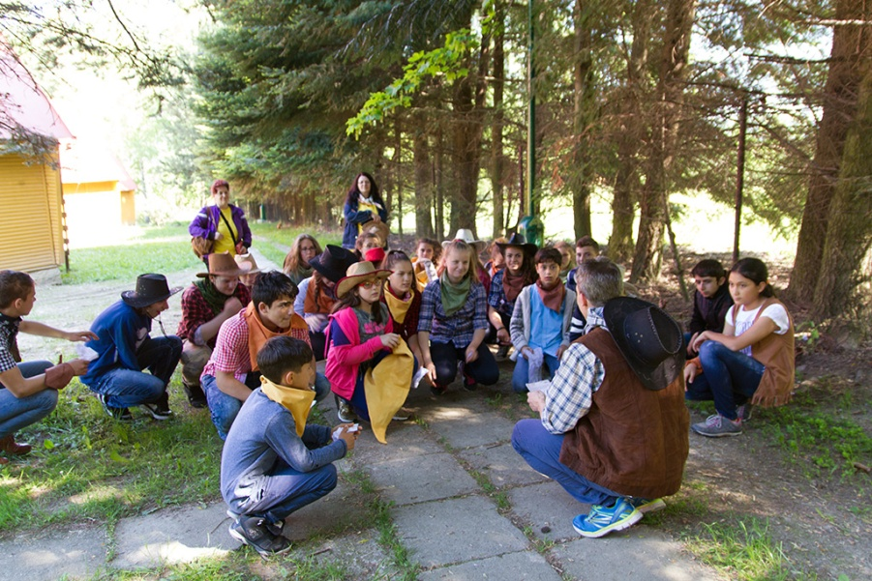
Monday
Arrival at Chata Beskydka
Introducing each other
Playing „ice-breaking games“
In the afternoon we went to the forest and played games there

Slide 34
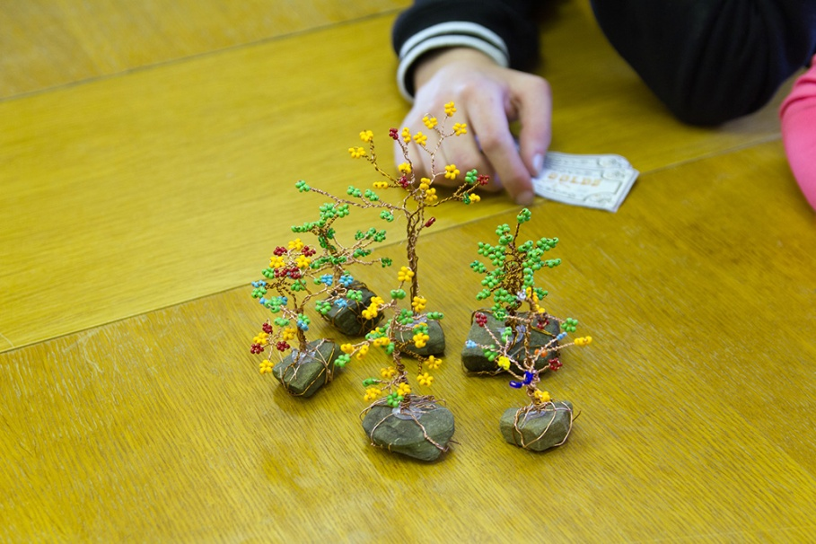
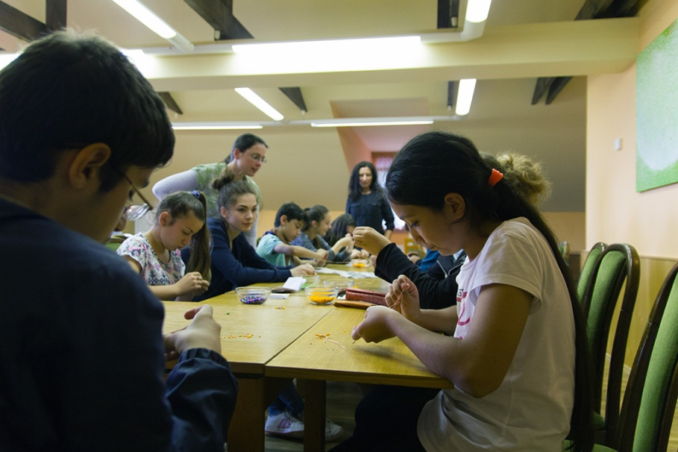
Tuesday
Team building games : „stamp hunt“, „western games“, „trees of luck“

Slide 35
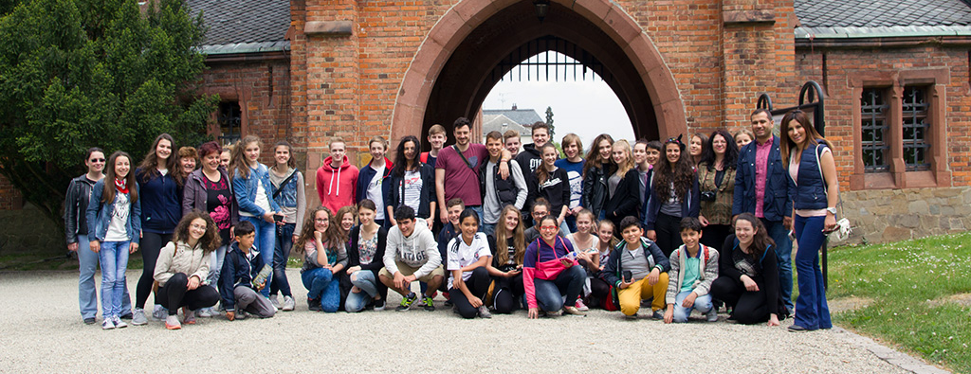
Wednesday
One day trip to Hradec nad Moravicí & Ostrava – shopping centre and U6 technical centre

Slide 36
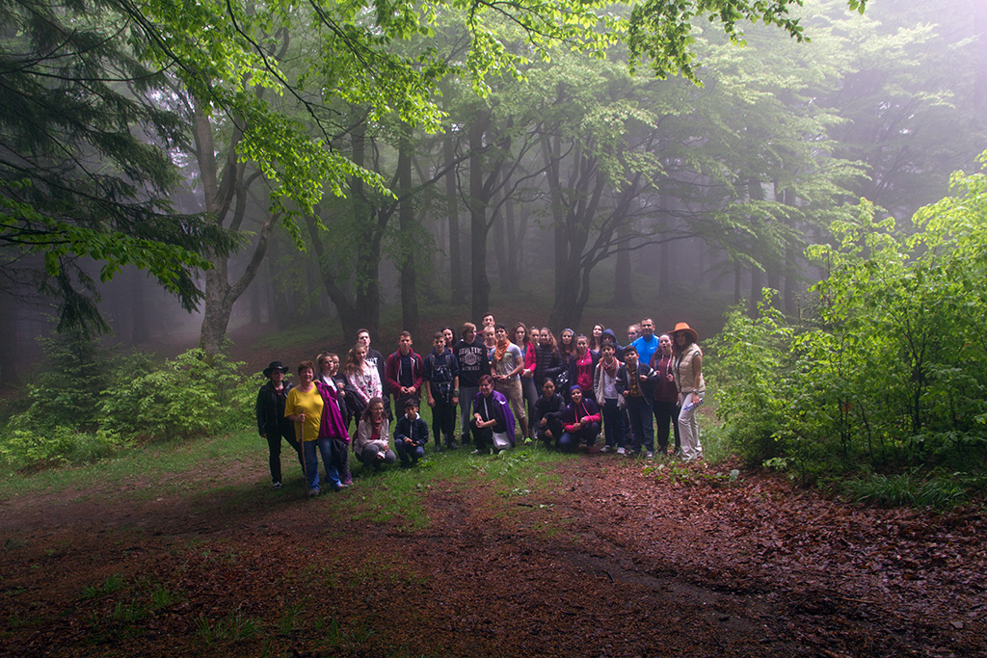
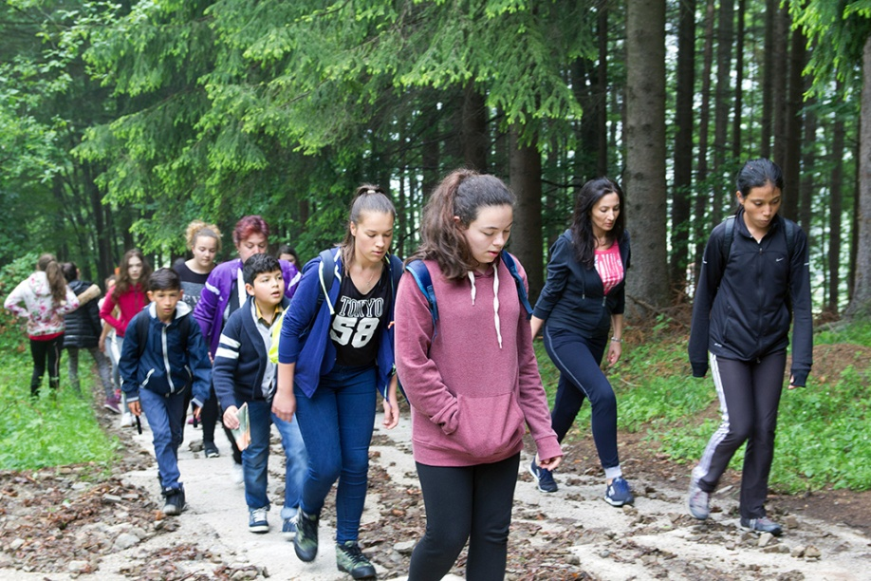
Thursday
Trip to Skalka and playing games like „Under the attack“ or „Rain“

Slide 37
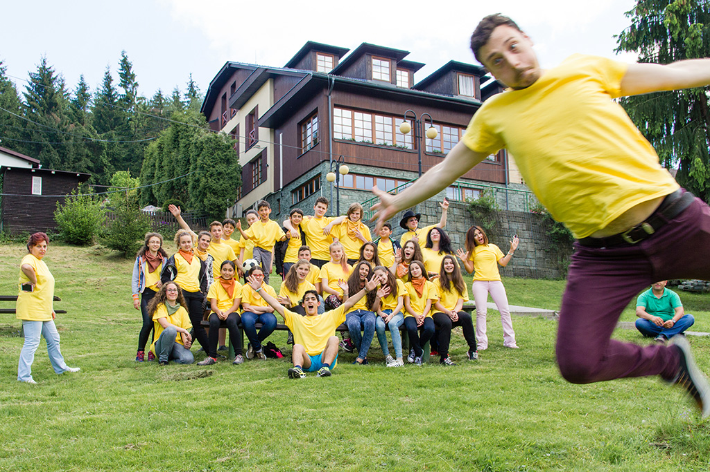
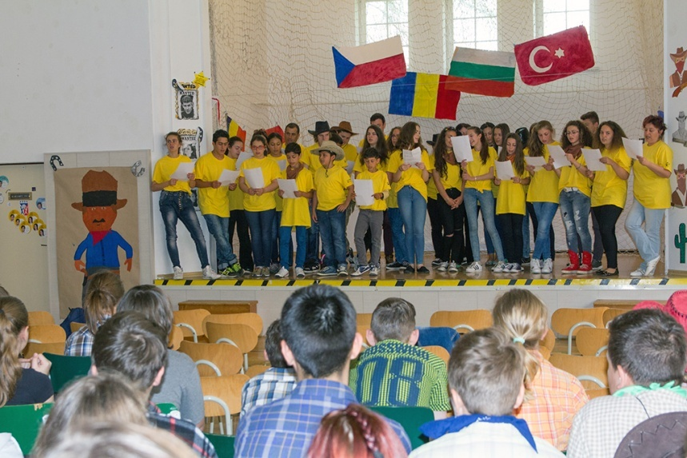
Friday
Trip to Třinec school and showing presentations
Panning for gold in the river
Announcement of the winners & disco

Slide 38
Thank you for your attention

Slide 39
Pes
Kočka
Žádné
Křeček

Slide 40
1st public speaking
Czech Republic
Romania
Turkey
Bulgaria
Let Us Speak

