Slide 1
REBECA VÁZQUEZ

Slide 2
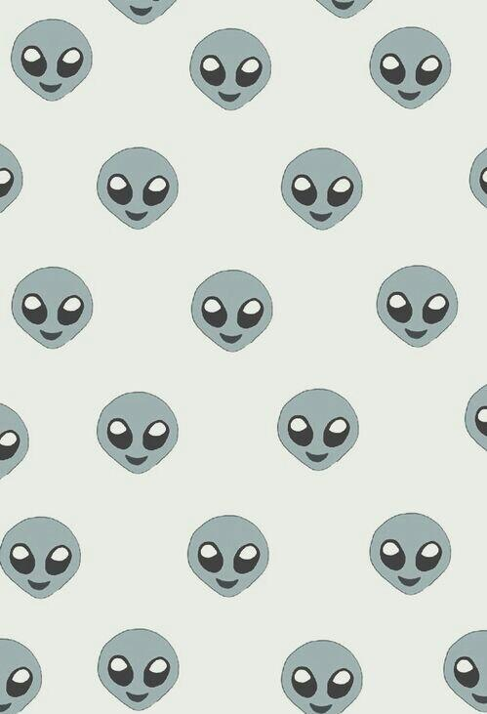
I’m short
I have got big green eyes
My hair is long and brown.

Slide 3
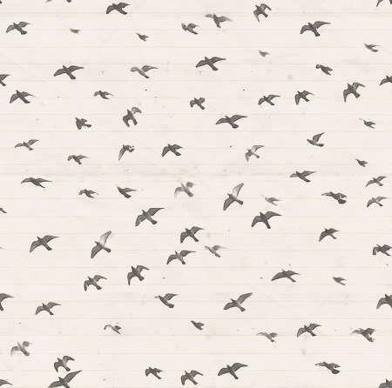
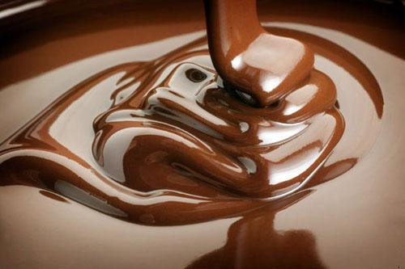
I like recording films for Sofía Aguín’s YOUTUBE CHANNEL. It is very funny
Chocolate is my drug

Slide 4
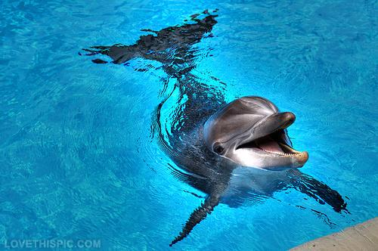
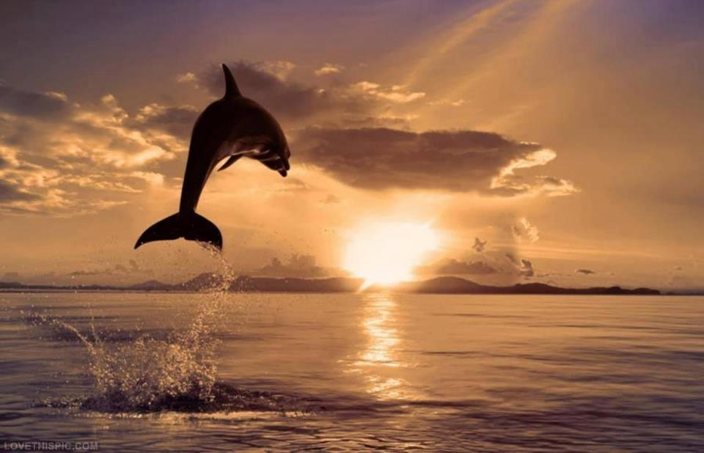
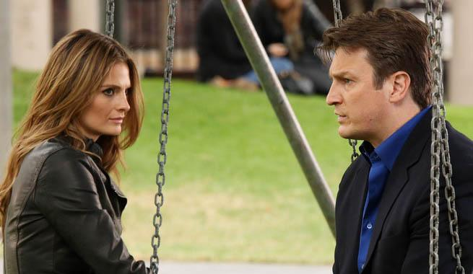
My favourite animal is the dolphin.
My favourite TV programme is “Castle”.

Slide 5
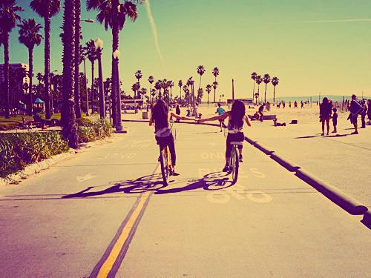
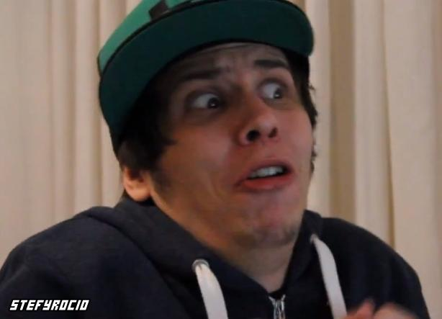
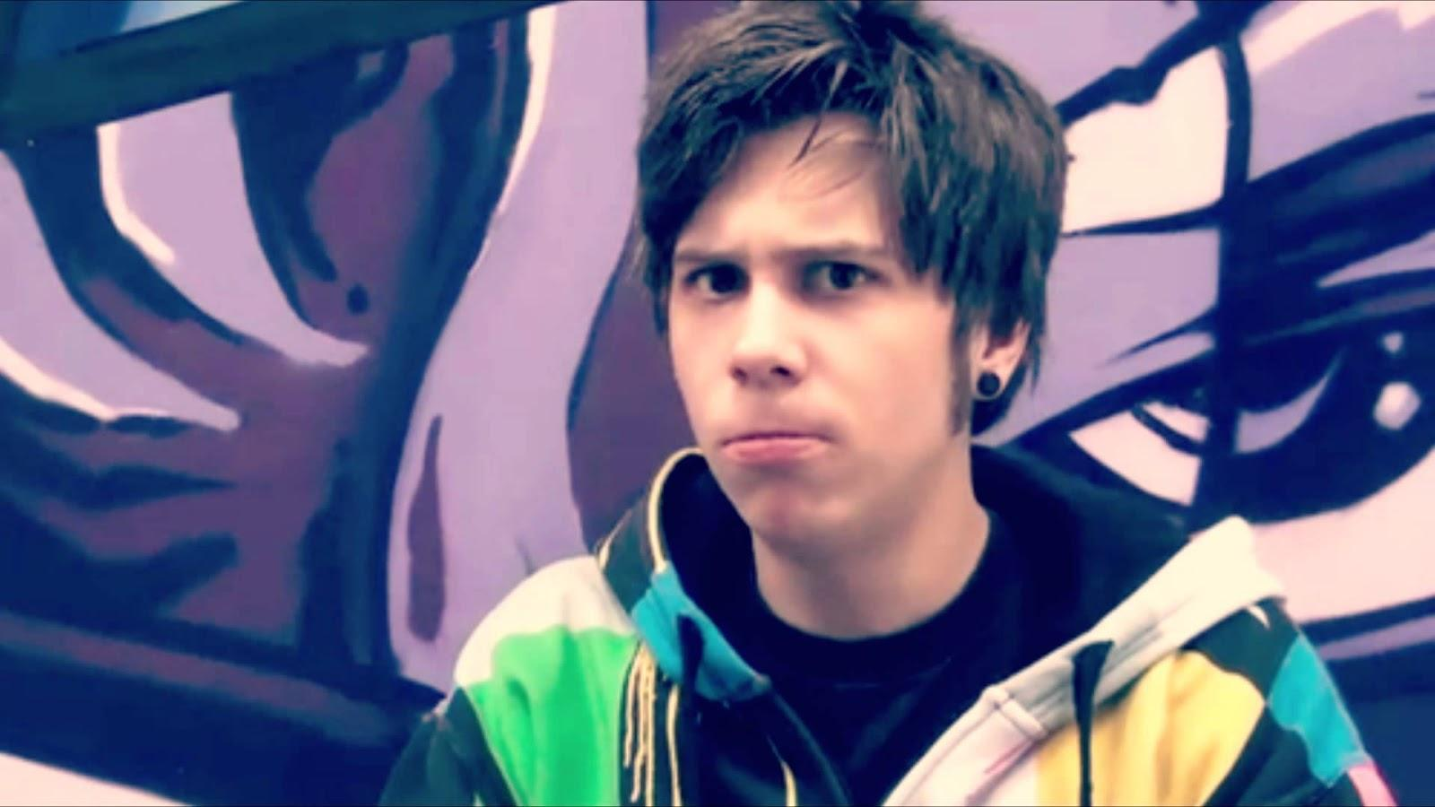
One of my best friends is Sofía Aguín.
I love ElrubiusOMG,
a Spanish Youtuber.

Slide 6
