Slide 1
MY HOME AND MY FAMILY
Marcos Otero

Slide 2
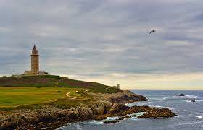
My home
I live in a city of Galicia, in Spain.
My home is very big and yellow. It has three floors and I have a small lake with a lot of fish, one turtle and three frogs.

Slide 3
My family
I have got a sister. My father is a civil servant and my mother is a drawing teacher. I help my father and my grandmother with the field work.

