Slide 1
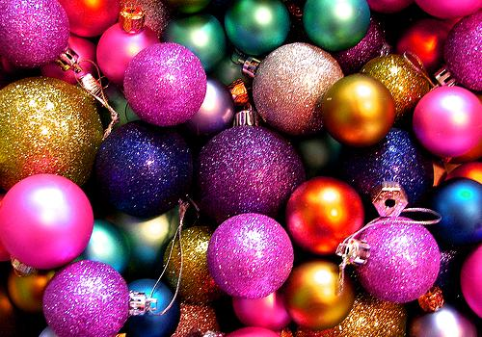
MY CHRISTMAS TRADITIONS

Slide 2
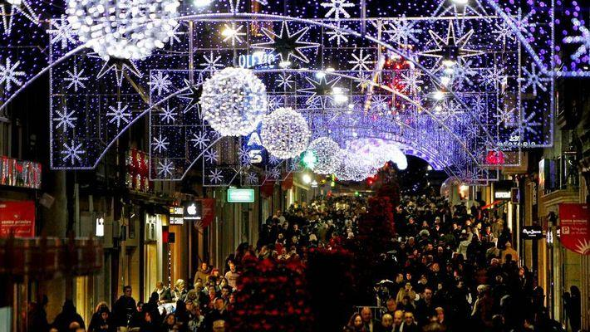
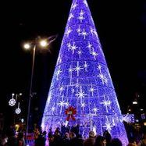
When it is Christmas in Vigo, where I live, all the city is illuminated with Christmas lights.

Slide 3
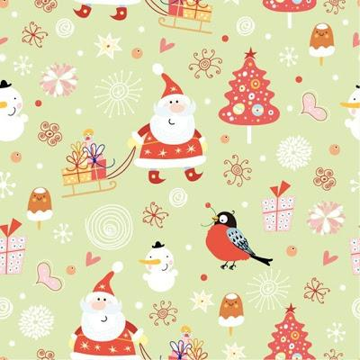
At Christmas I spend some days with my mother and others with my father because they are separated.

Slide 4
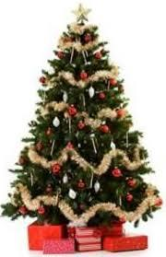
At home I put up a Christmas tree. This year my mother made a snowman with plastic cups.

Slide 5
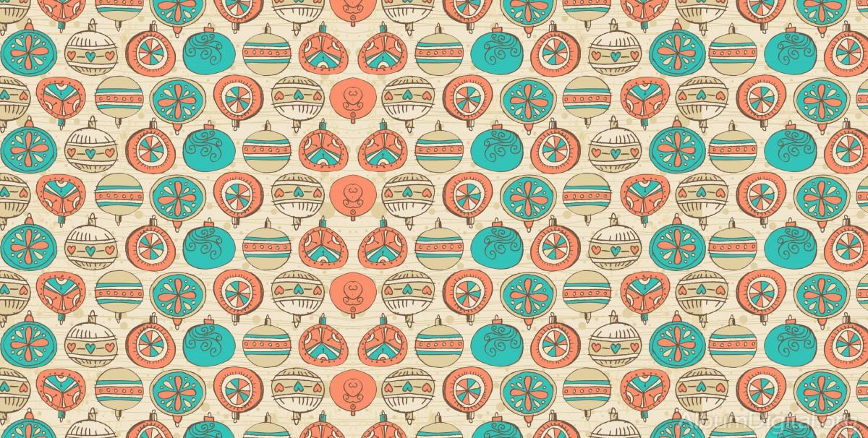
At Christmas I eat dinner with my family at my grandmother's house. We always eat seafood as a first course, meat with potatoes as a second and we eat dessert at the end and nougat, marshmallows ...

