Slide 1
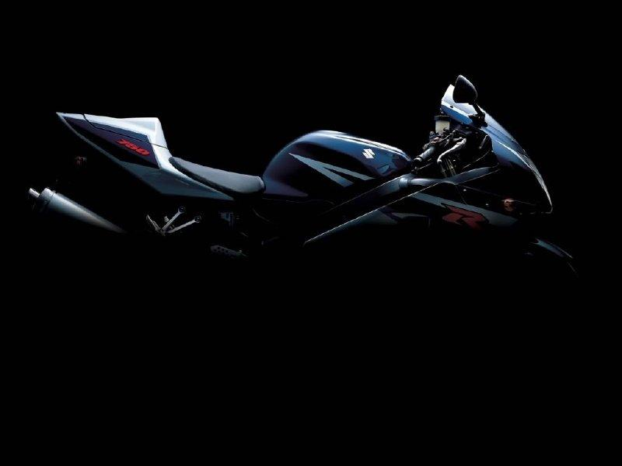
MY PERSONAL DESCRIPTION
Hello, my name is Zulema. I’m 15 years old. I'm tall, blonde and have got blue eyes.

Slide 2
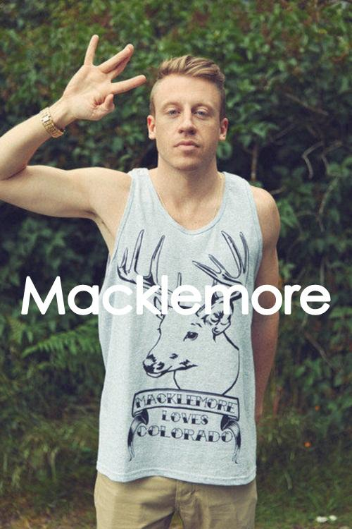
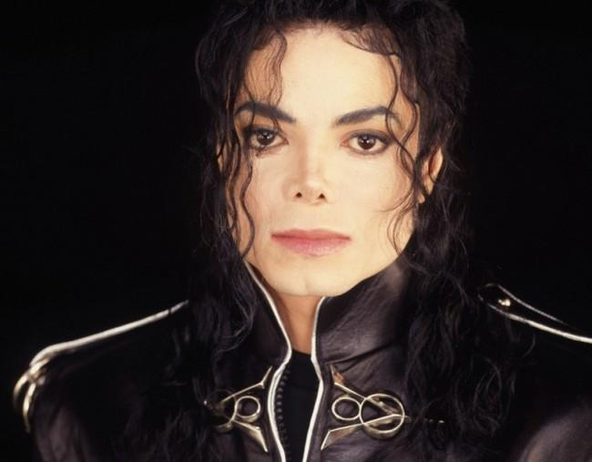
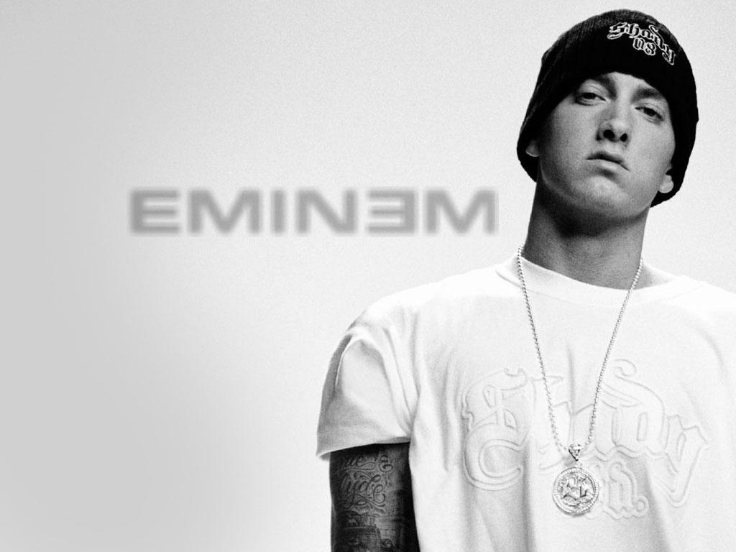
I like rock, pop and rap. My favourite band is AC / DC and my favourite singers are Michael Jackson, Eminem and Macklemore.

Slide 3
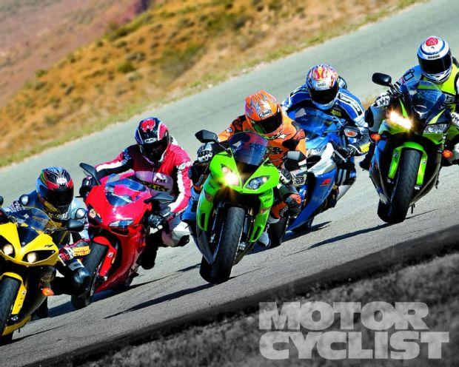
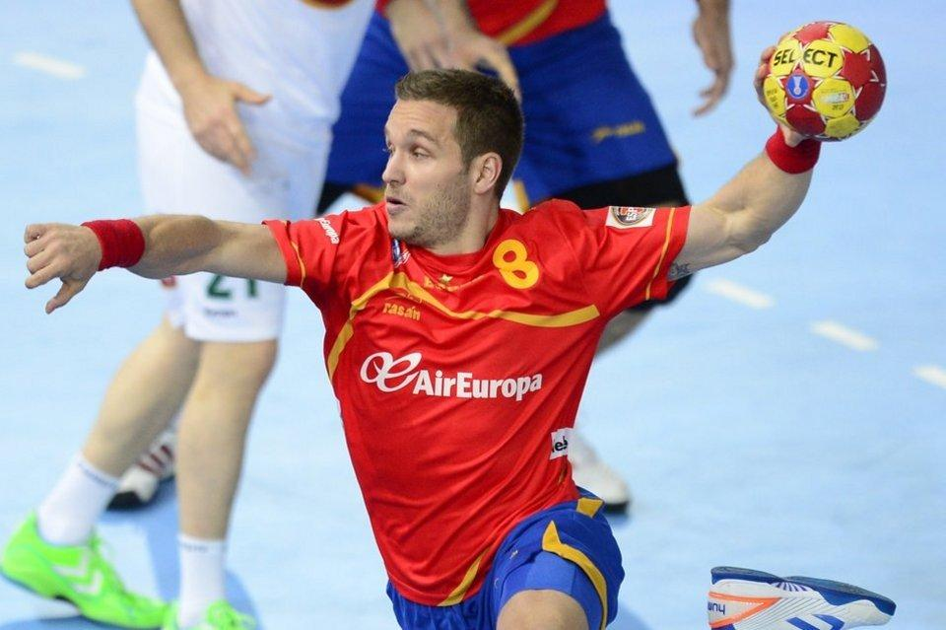
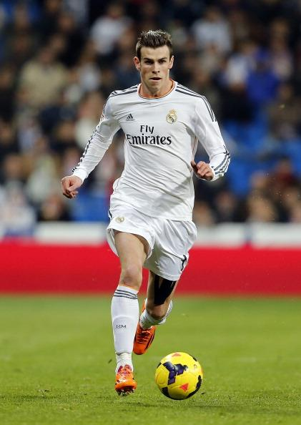
My favourite sports are motor racing and handball. I play handball in a team called A.D. Carballal. I also love football. My favorite team is Manchester United but I also like Real Madrid and my favorite player is Gareth Bale.

Slide 4
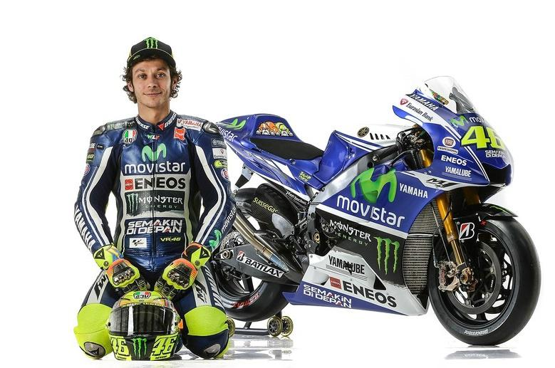
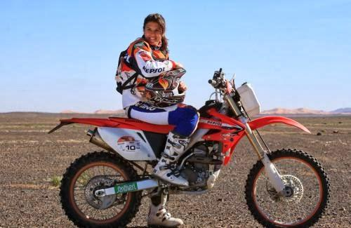
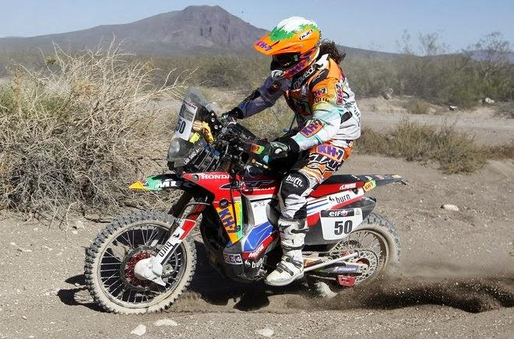
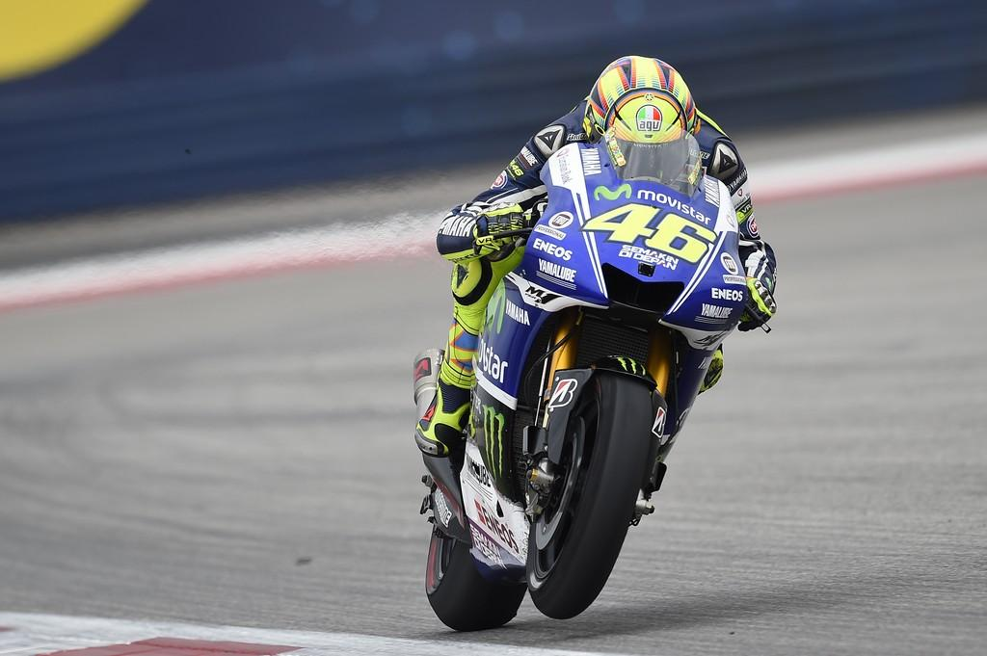
My idols are Valentino Rossi, who is a motogp pilot, and Laia Sanz, a Spanish trial pilot, thirteen times trial world champion and three times world champion enduro.

Slide 5
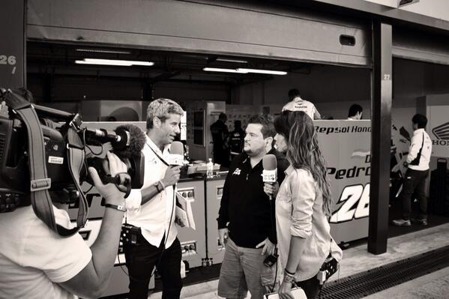
I would like to be a veterinarian because I love animals, or A sports journalist because I am passionate about sports.

