Slide 1
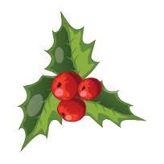
Christmas traditions
Sofía Aguín

Slide 2
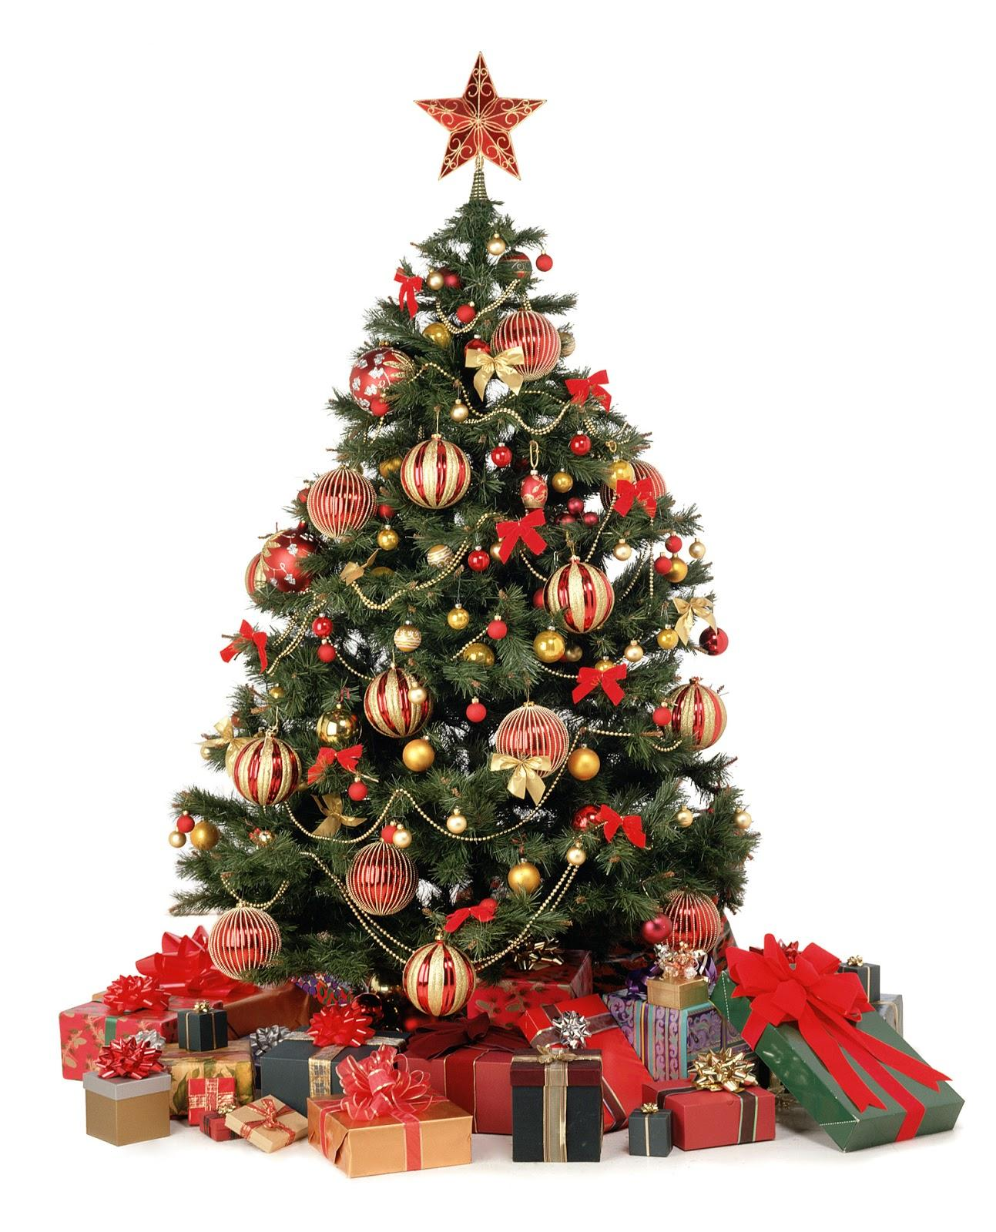
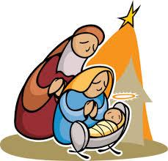
In my house, my family and I decorate the house with a Nativity scene and a Christmas tree

Slide 3
We decorate the outside of the house, too, with lights, wreaths...

Slide 4
On Christmas Day, my brother, my sister and I, open the presents. At lunchtime we eat special food all together.

