Slide 1
My home and my family
Matías Cabaleiro Lago

Slide 2
My home
My home is a house in the foot of a mount near Candeán. It’s not very big, but it is homely. It was made with granite, parquet and tile. It has got 3 bedrooms, a kitchen, a living room, 2 bathrooms, an old chimney that we use in cold days of winter, and a penthouse where I play videogames like GTA V or Formula 1 2013.

Slide 3
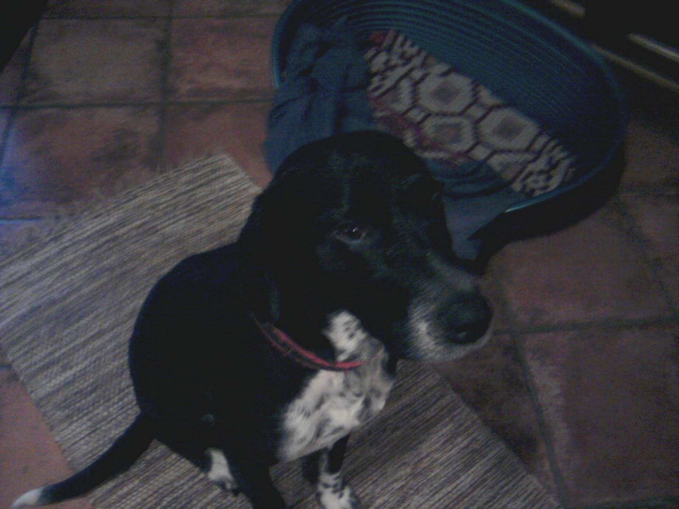
My family
I live in my house with my father Roberto (he’s a teacher), mother María Luz (she’s a clerk), my sister Mariana (she’s a student), and with my dog, Tomás (I play with it every day and I feed him).

Slide 4
This is the end. Goodbye.

