Slide 1
MY PERSONAL DESCRIPTION

Slide 2
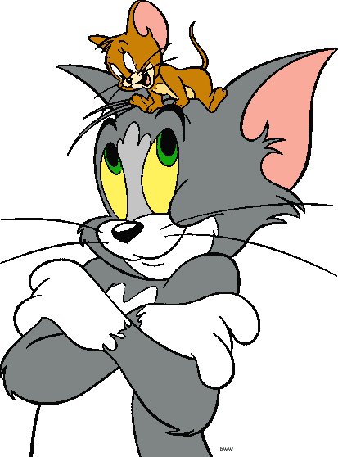
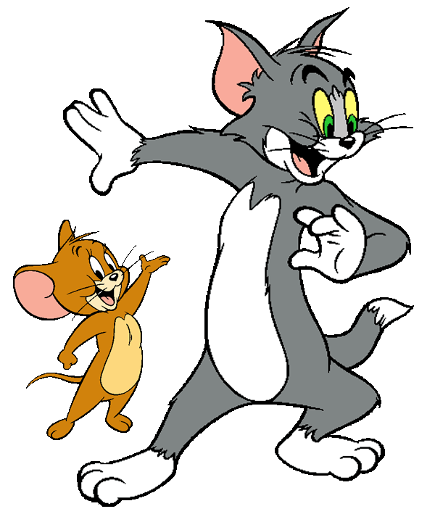
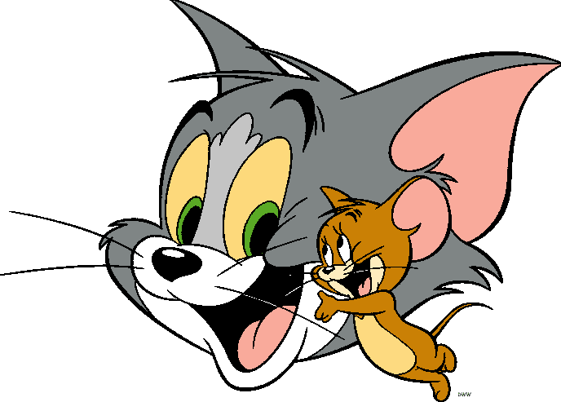
My name’s ANDREA and am 13 years old. I have got ONE SISTER and her name’s Raquel.

Slide 3
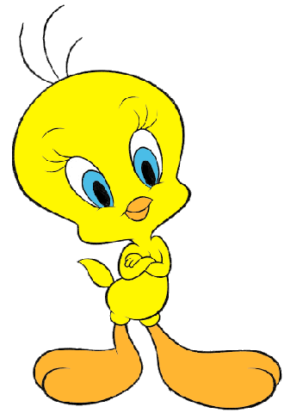
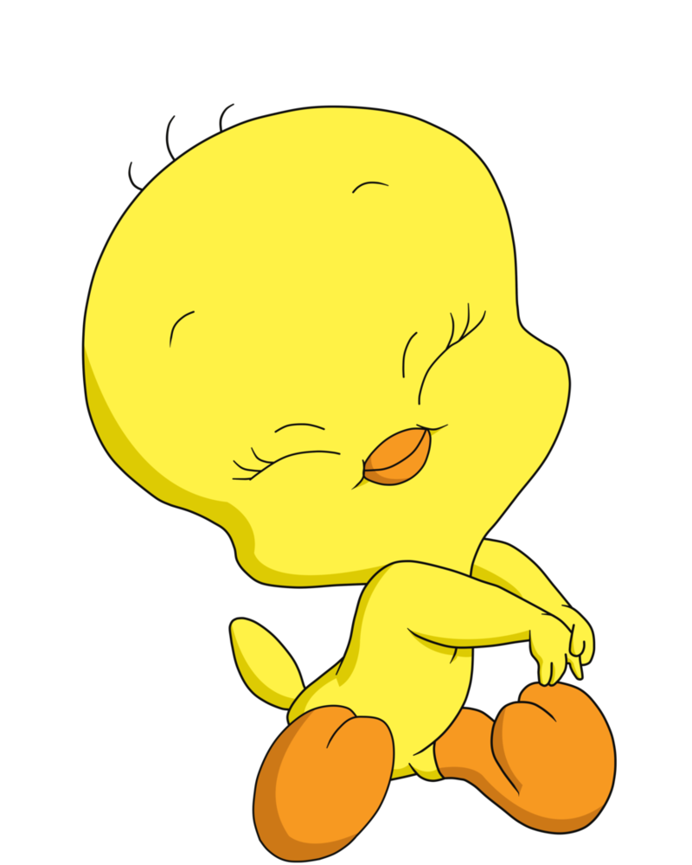
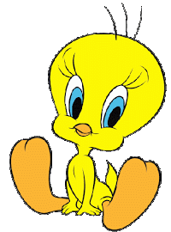
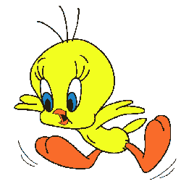
I have got BROWN eyes AND long brown hair. I am SHORT, THIN and BRUNETTE.

Slide 4
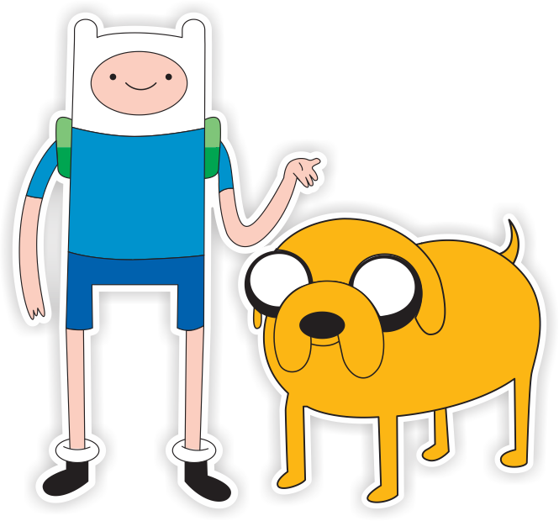
I am SHY, TIDY and very LAZY.
I LIKE watching TV, using MY mobile phone, eating SWEETS and listening the MUSIC. I HATE eating fish and lentils and DOING HOMEWORK.

Slide 5
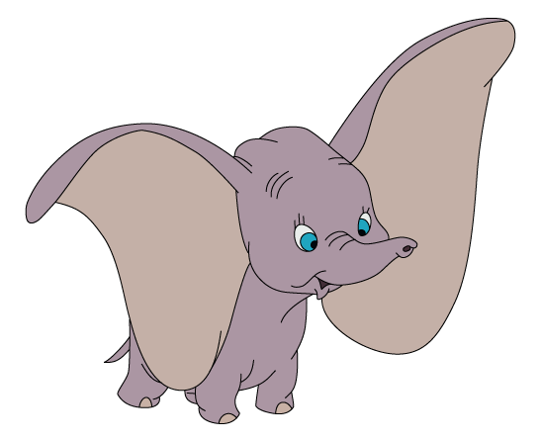
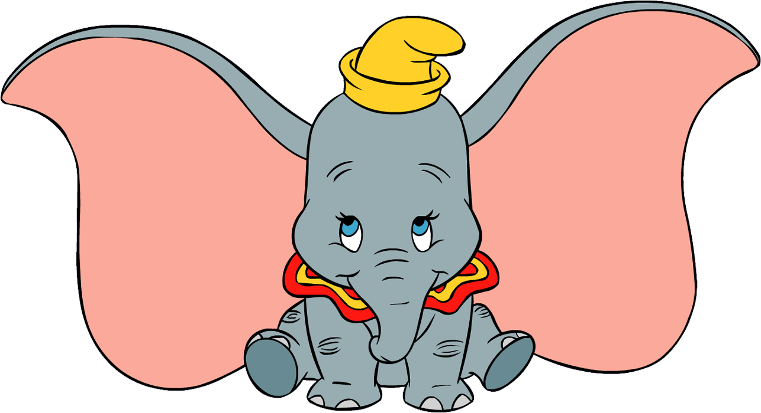
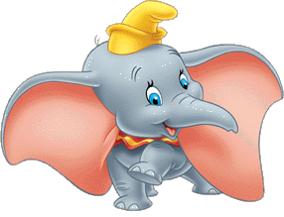
My favourite tv SERIES are “Hawaii 5.0”, “Aída” and “Entre FANTASMAS”.
My FAVOURITE song is ``la muerte de la magia´´ BY Jp.
My favourite COLOURS are pink salmon and AQUAMARINE.

Slide 6
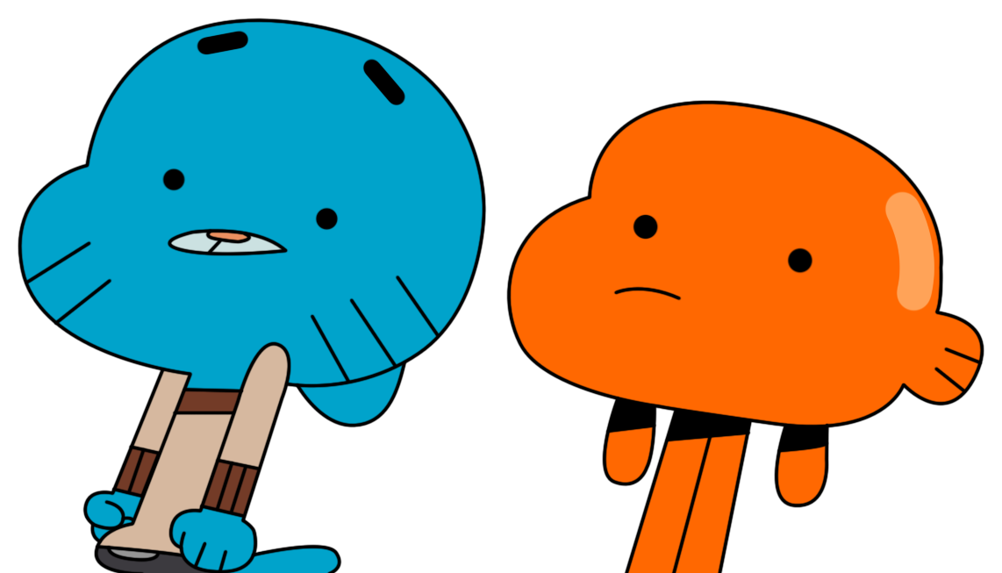
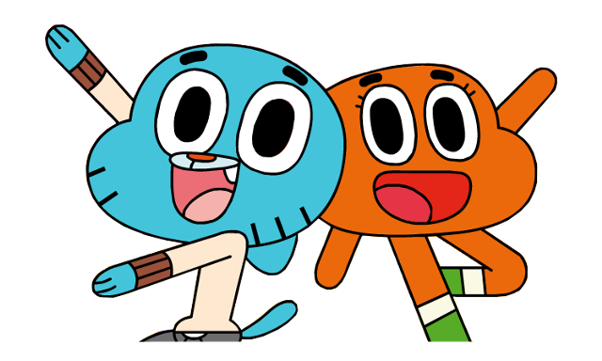
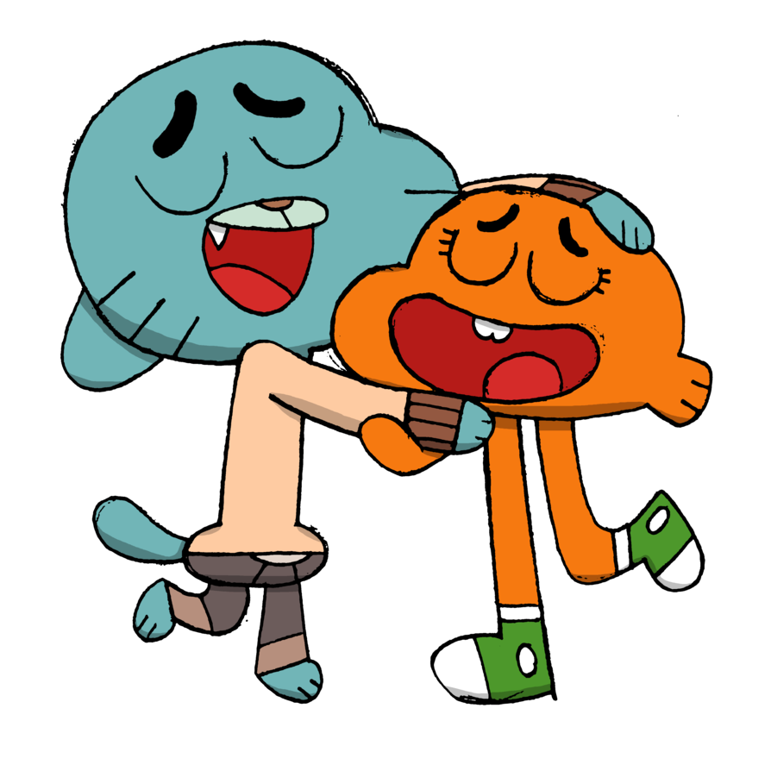
I have got a DOG WHOSE name’s NEVA, two turtles, ONE rabbit whose name’s Tambor and a lot of COLOURED FISH.

