Slide 1
My home and my family
Carlota Pérez Álvarez

Slide 2
I have a family that loves me
and makes me happy
My family is with me in the best of times and the worst.
My father's name is Fran.
My mother’s name is Monica.
My sister’s name is Alba

Slide 3
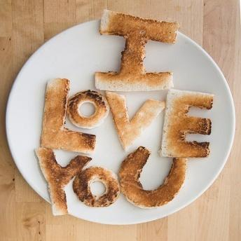
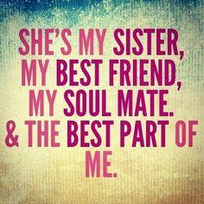
My mother has long black hair and beautiful dark green eyes. She is thin and pretty. She is very good, sympathetic, tolerant, kind, loving .... and always comes to me and teach me the best that she has.
My father has short dark brown curly hair. He is tall with green eyes like me. He is a great person, affectionate and very good to me.
I don’t have any brothers. I have a little sister that is 9 years old. She is very pretty, adorable, clever, creative, smart ... She has got light brown hair, green eyes and she is tall and thin.

Slide 4
My home
I live in Vigo with my parents and my sister. I live in an apartment during the week. It is very cozy: it has three bedrooms, a bathroom, a dining room, a kitchen and a terrace that is closed and that it’s where I study. It’s illuminated and I am very comfortable there; at night, I pull down the blinds and turn on my lamp to study. At the weekend I go to Carballino, a small town in Orense, where my grandmother and my great-grandmother live. The house has two floors; below is the garage and upstairs there are four bedrooms, two dining rooms, two bathrooms and a kitchen. Downstairs there is a bathroom and a kitchen. In winter it is great: we skate, ride our bikes, play badminton, tennis ... and assemble the swimming pool in the summer.

Slide 5
THE END

