Slide 1
“My home and family”
Andrea Vázquez

Slide 2
My house
I live in a house with three floors. On the top floor live my twin sister, my mother, my little sister and me.
On the floor below my house live my grandparents and my grandfather's sister and downstairs my uncle lives with his girlfriend and son.

Slide 3
My home
My house has three bedrooms: mine, my mother’s and my sister’s. I have a dressing room, two bathrooms (one for me and my twin sister and one for my mother), a living room and a kitchen.

Slide 4
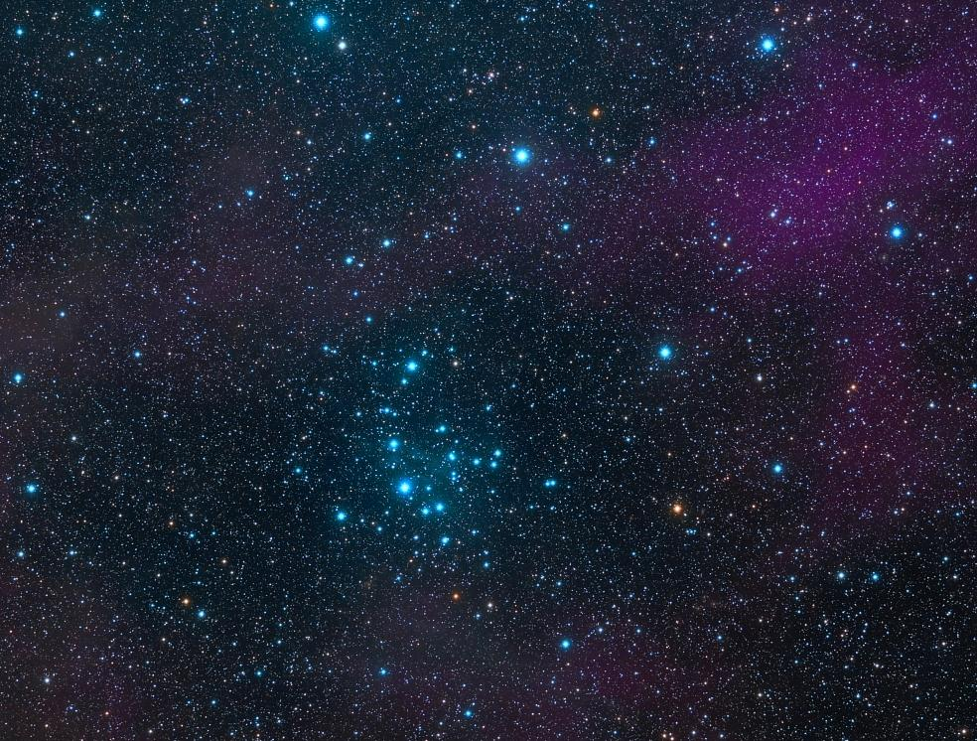
My family
My parents are divorced.
On my father's side I have a grandfather and a grandmother, two uncles and an aunt. My first uncle has two sons, one is seventeen and the other is twenty years old. My second uncle has no children and my aunt has a sixteen year old son and a daughter who is nineteen.
My father has a girlfriend and has a son, seven months old.

Slide 5
My family
On my mother's side I have a grandfather and a grandmother and an uncle.
My uncle has a girlfriend and a child of ten months.
And my mother has a daughter who is a year old.

Slide 6
“The end”

