Slide 1
“CHRISTMAS TRADITIONS”

Slide 2
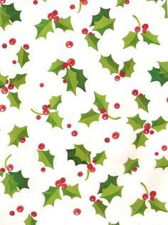
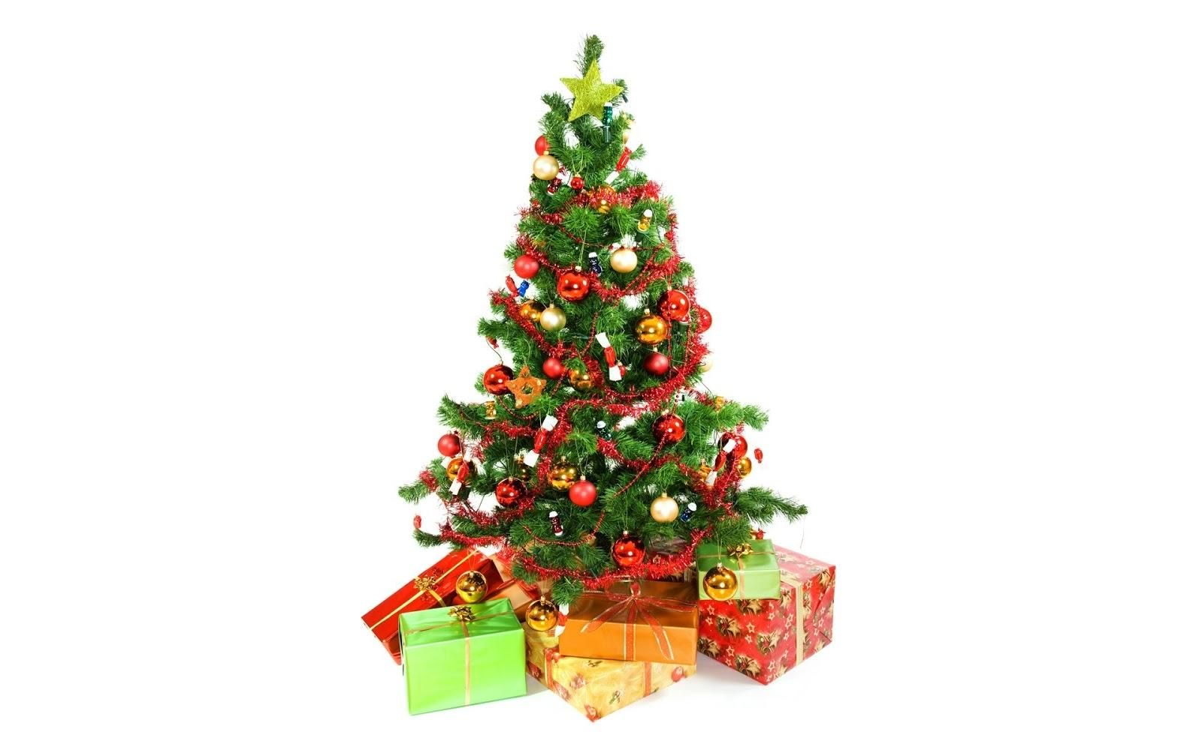
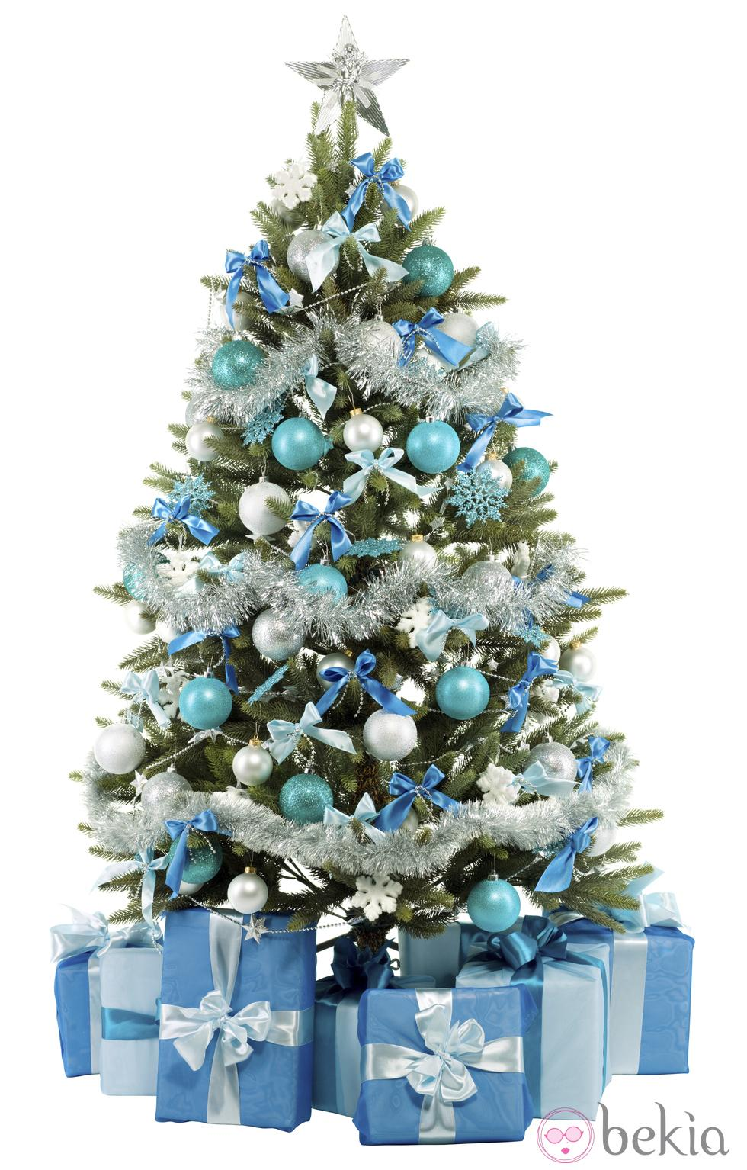
At Christmas I put up the Christmas tree, I decorate the house. At Christmas dinner I usually eat seafood, meat and potatoes. At the end I have nougat and sweets and I am given gifts. I am sometimes with my mother and sometimes with my father because they are separated. On the morning of 25th some relatives come to my house or I go to theirs.
Andrea

