Slide 1
My personal
description

Slide 2
My name is María and I am 13 years old. I’ve got brown eyes, my hair is brown and long. I’m short. I’m a coeliac.

Slide 3
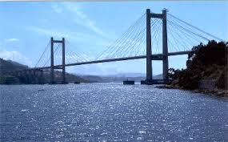
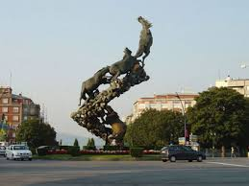
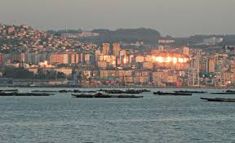
I go to the school Alborada, and I live in Vigo.

Slide 4
I like reading
in my free time

Slide 5
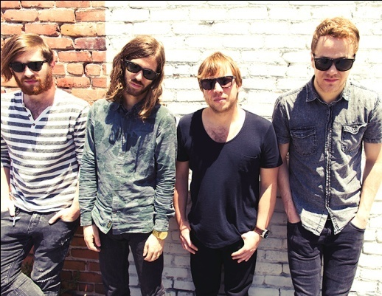
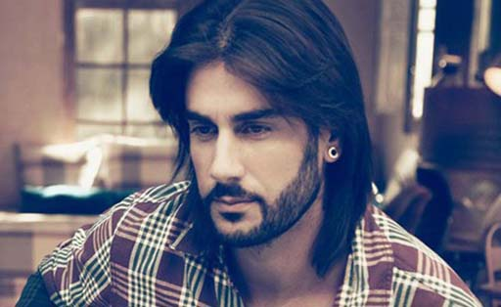
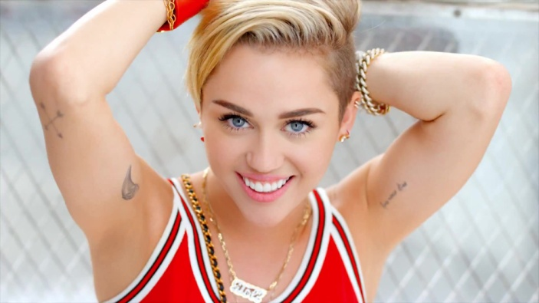
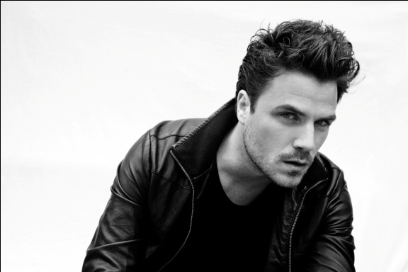
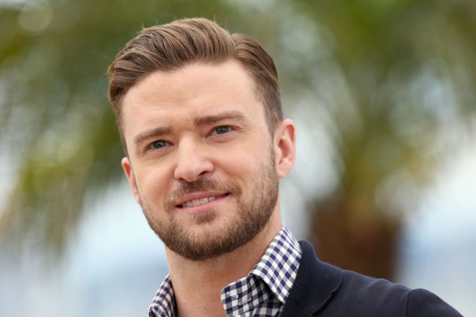
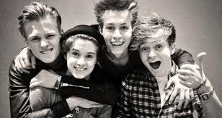
My favorite singers are Melendi, Dani Martín, Miley Cyrus, Justin Timberlake and my favourite bands are Imagine Dragons, and The Vamps.

