Slide 1
My home and family
María Fernández

Slide 2
My house isn’t very big, but it has two floors.
On the first floor is the kitchen, one bathroom and one garage, and on the second floor there are four bedrooms, one bathroom and the living room.
We have a garden too.

Slide 3
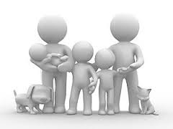
In my house live: my mother Pili, my sister Belén, my grandma Gloria and me.

Slide 4
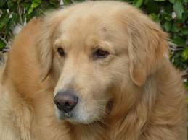
In my family we have a dog called Brando. He is outside all the time.
And I have fish, too.

