Slide 1
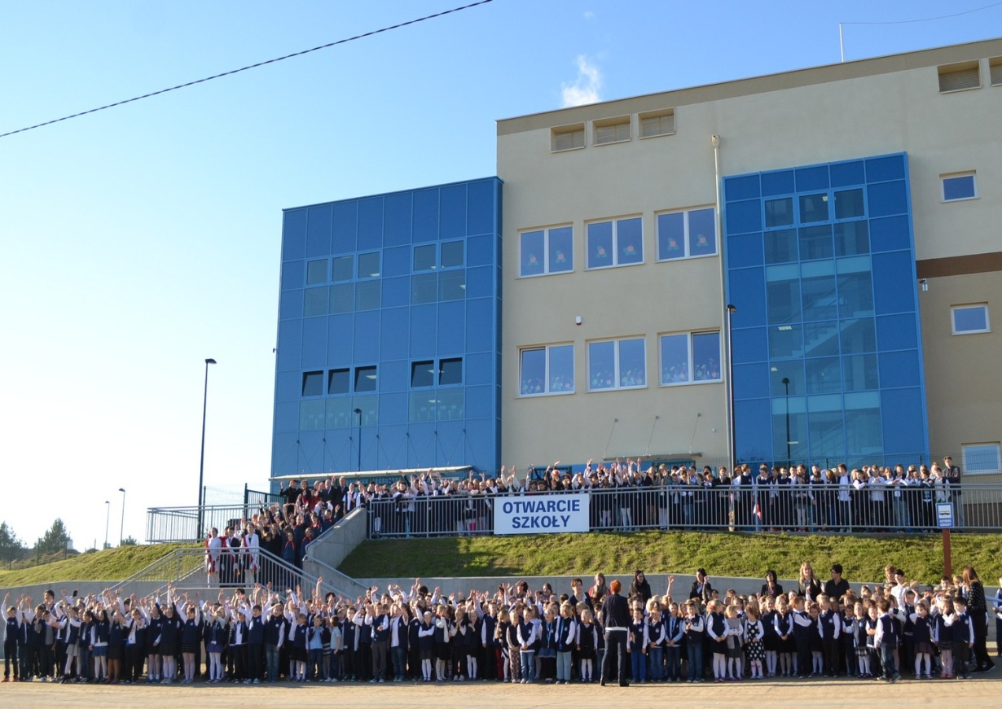
Etwinning presentation
From Banino Poland

Slide 2
Hello! Nice to meet you!!!
Here we are together!
We are 4d from Primary School in Banino.
These are our photos and pictures☺
Try to guess where we are! Good luck!

Slide 3
PHOTO 1 Julia Małgosia Mateusz Piotrek

Slide 4
PHOTO 2 Marta Marysia Mateusz Piotrek Kinga Wiktoria Piotrek Michał

Slide 5
PHOTO 3 Arek Klaudia Tomek Zosia Julia Natalia Basia

Slide 6
PHOTO 4 Oskar Igor Julek Julia

