Slide 1
EASTER TRADITION IN FRANCE
https://www.completefrance.com/food-and-drink/

Slide 2
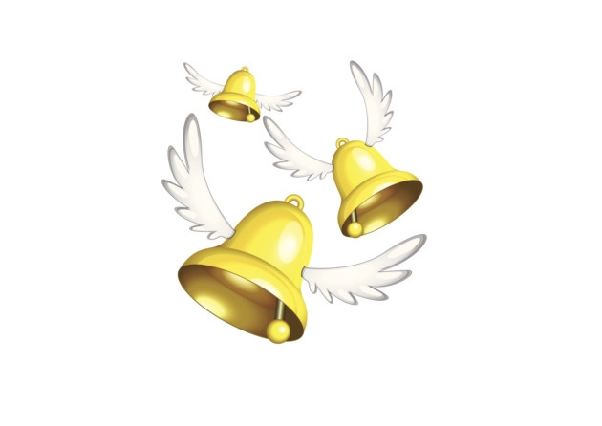
The Easter bells – les cloches de Pâques
One of the main French Easter traditions are the Easter bells or les cloches de Pâques. On Maundy Thursday, the Thursday before Easter, church bells across France are silenced to mourn the death of Christ and they remain silent until Easter Sunday. According to legend, the bells would fly to Rome to be blessed by the Pope. They would then begin their journey back to the French churches, but would pick up eggs along the way before scattering them into the gardens. The bells would then ring on Easter Sunday to announce the Resurrection of Christ and therefore 'return'. So in France it is the bells rather than the Easter bunny who delivers the Easter eggs.
https://www.gouvernement.fr/en/france-sustainable-development

Slide 3
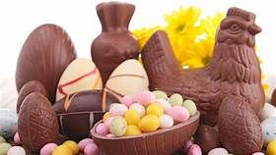
2. Easter chocolate
Chocolate is also a popular French Easter tradition. Decorated chocolate eggs, chocolate bunnies and chocolate bells are common gifts to give children (and adults) at Easter. Chocolatiers take the opportunity to let their imaginations run wild and the windows of chocolate shops and pâtisseries display intricate works of art.

Slide 4
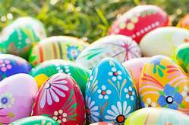
3. Easter egg hunts
Easter egg hunts are also popular in France. Some towns and villages organise Easter egg hunts in the local park and you can find details from the local mairie. Easter egg hunts in the back garden are also popular with young children. Tradition has it that the Easter eggs are dropped into the garden by the bells as they fly past on their return from Rome to their churches, not the Easter bunny. These eggs used to be decorated hard-boiled eggs but now they tend to be small chocolate eggs.

Slide 5
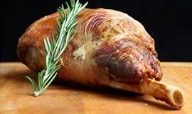
4. Easter meal
As with many national holidays it is a French tradition to have a family meal at Easter. Often this will include lamb as the main course which is a symbol of spring and new life. Usually, dessert is chocolate-based and, as with all good French meals, there is a cheeseboard. Try our recipe for French lamb stew (navarin d'agneau) and choose between these 4 decadent chocolate desserts, plus use our tips to make the perfect French cheeseboard.

Slide 6
CATHOLIC EASTER
The Holy Week in France For Catholics, Holy Week (Semaine Sainte) is the week before Easter and the last part of Lent. It is intended to commemorate the Passion of Christ. It includes the Easter Triduum (Triduum pascal) of the Passion and Resurrection of Christ which begins on the Thursday evening of this week and ends on the evening of Easter Sunday. These three days is the culmination of the liturgical year because it was through his sacrifice tat Christ destroyed death and it was through his resurrection that he restored life...
Copyright © French Moments Ltd unless otherwise stated. Read more at https://frenchmoments.eu/easter-in-france/ .

Slide 7
Palm Sunday in France Holy Week opens on Palm Sunday (Dimanche des Rameaux), considered one of the twelve great feasts of the liturgical year. It is a festive Sunday because it celebrates Christ’s entry into Jerusalem, where he is triumphantly welcomed by the people holding palms. The faithful bring palm branches on this day and the priest blesses them. However, Jesus’ coming to Jerusalem marks the beginning of the Passion of Christ, towards which he voluntarily moves into.
Copyright © French Moments Ltd unless otherwise stated. Read more at https://frenchmoments.eu/easter-in-france/ .

Slide 8
Easter in France is a holiday when you don’t work! Good Friday (Vendredi Saint) is not a public holiday in France, except in the French départements of Moselle [57] in Lorraine, and Haut-Rhin [68] and Bas-Rhin [67] in Alsace. It is therefore common to see Alsatians (and Germans) rushing into shops that are left open in Nancy and Belfort on Fridays, causing monster traffic jams on the outskirts of the “border” towns. Easter Monday (Lundi de Pâques) is a public holiday in France during which you don’t work: shops and administrations are closed (except perhaps your local and favourite boulangerie!). ...Copyright © French Moments Ltd unless otherwise stated. Read more at https://frenchmoments.eu/easter-in-france/ .

