Slide 1
SCOALA GIMNAZIALA ,,DR. AL. SAFRAN,, BACAU
ERASMUS PLUS KA229 PROJECT
LOVE MY CITY
THE SUSTAINABLE DEVELOPMENT IN EDUCATION

Slide 2
SDGs & Education Agenda 2030

Slide 3
1. CONTEXT: THE SUSTAINABLE DEVELOPMENT AGENDA AND SDG4

Slide 4
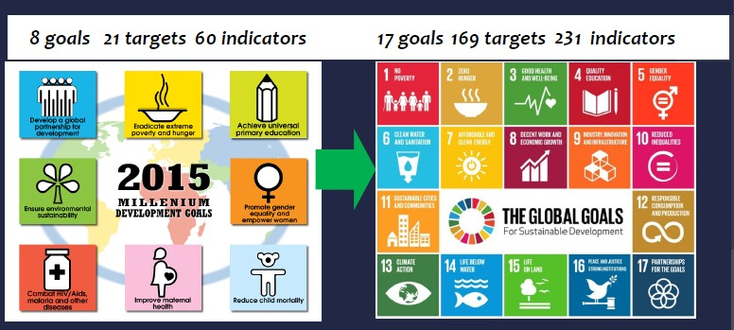
From MDG to SDG

Slide 5
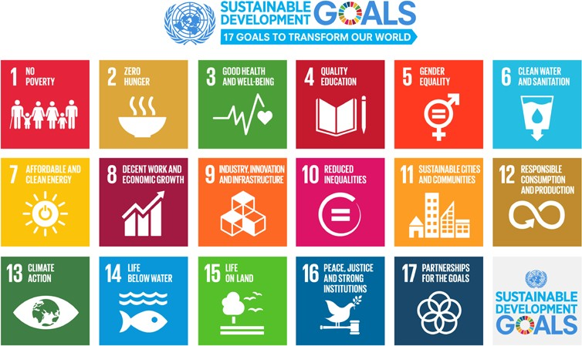
Sustainable Development Agenda and Goals
merge development (MDG 2000-2015) and environment (Rio 1992-) agendas
17 goals with 169 targets
adopted by UN Member States in 2015
to be achieved by 2030

Slide 6
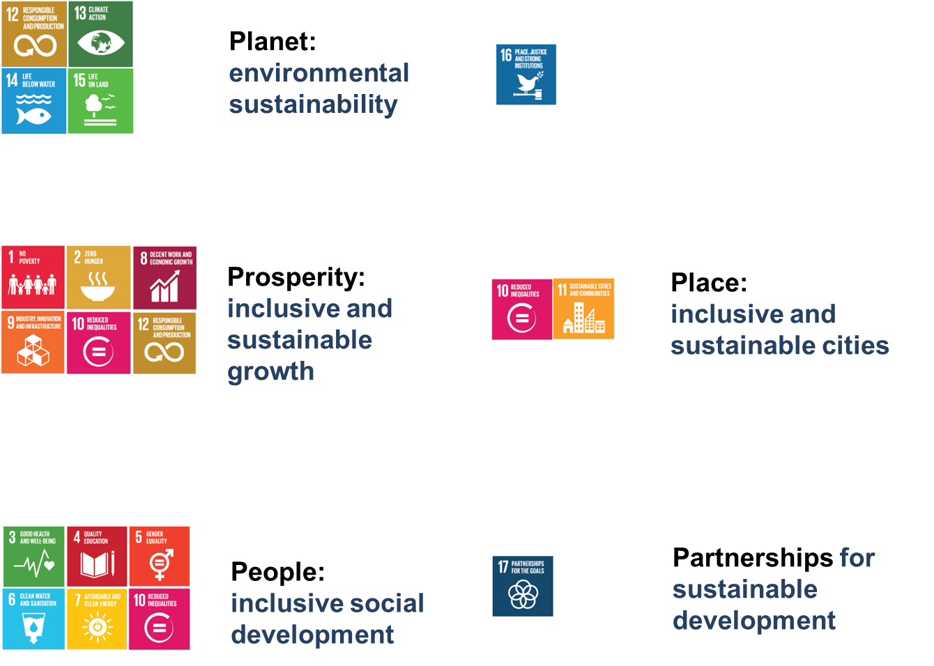
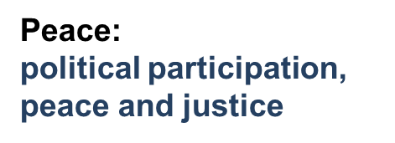
6-Ps of the 2030 Sustainable Development Agenda
Notes:
Presenter
2018-07-25 15:30:00
--------------------------------------------
[introduce yourself]
A year ago, in September 2015, the member states of the United Nations agreed on a new sustainable development agenda with 17 goals to be achieved by 2030. This includes a global goal on education. Member states also outlined a process to follow up and review progress, globally and by goal.
This is the first report in a fifteen-year series to monitor progress on education in the new sustainable development agenda.

Slide 7
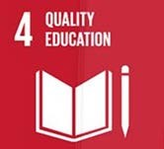
2. THE 2030 EDUCATION AGENDA : FROM MDGS, EFA TO SDG4

Slide 8
Sustainable Development Goal 4
“Ensure inclusive and equitable, quality education and promote lifelong learning opportunities for all’
Universal relevance - both global North and global South
Rights-based and a public good
Inclusion, equity and gender equality as fundamental principles
Addresses all forms of discrimination and of situations, including emergencies, which impede the fulfilment of the right to education.
“No one left behind”
Notes:
Presenter
2018-07-25 15:30:00
--------------------------------------------
The overarching 2030 Agenda for Sustainable Development education goal (SDG 4) commits to providing inclusive and equitable quality education at all levels and expresses the new key features of Education 2030.

Slide 9
SDG4: an ambition goal, with more of everything
More comprehensive: Expanded access to all levels of education
at least 12 years of free, publicly funded, quality primary and secondary education, higher education, TVET.
More outcome/skills oriented
Renewed focus on effective acquisition of foundational skills
New focus on relevance of learning for decent work
New focus on relevance of learning for social and civic life
More integrated with other goals (e.g. SDG 8.7)
Needs more resources

Slide 10
Global Education Agendas compared
 | MDG2 | EFA | SDG4
Scope | Primary Education (children) | Basic Education (children, youth & adults) | Basic education + Post-basic education with Lifelong perspective
Coverage | Low-income countries; Conflict-affected | Universal in intention; Focus on lower- income countries | Universal agenda Global North and South
Process led by | UN | UN | Member States
Policy focus | Access to and completion of primary education for all | Access to quality basic education for all | Access to quality basic learning for all + Equitable access to post-basic education + Relevance of learning for work & citizenship
No of targets | 2 | 6 goals | 10
(Source: adaptation from the PPT by S.Tawil, UNESCO)

Slide 11
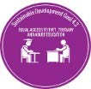
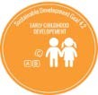
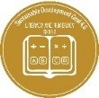
The Targets
Outcome Targets [7]
Quality primary/secondary education for all
Early childhood & pre-primary education
Equal access to TVET & higher education
Relevant skills for work
Gender equality & equal access for all
Youth and adult literacy
Global citizenship education for sustainability
Means of implementation [3]
Safe & inclusive learning environments
Scholarships for higher education
Teachers’ training and working conditions
Notes:
Presenter
2018-07-25 15:30:01
--------------------------------------------
Sustainable Development Goal 4 aims to ‘Ensure inclusive and equitable quality education and promote lifelong learning opportunities for all’. It includes seven outcome targets ranging from early childhood to higher education :
Primary & secondary education for all;
Early childhood development & pre-primary education for all; Equal access to TVET & higher education;
Relevant skills for work;
Gender equality & equal access for all; Youth and adult literacy;
Citizenship education for sustainable development
It also comprises three means of implementation that have to do with: Safe and inclusive learning environments;
Scholarships for higher education; and Teacher training and working conditions.

Slide 12
3. CREATING LINKAGES BETWEEN SECTORS FOR THE IMPLEMENTATION OF
SDG4-EDUCATION 2030

Slide 13
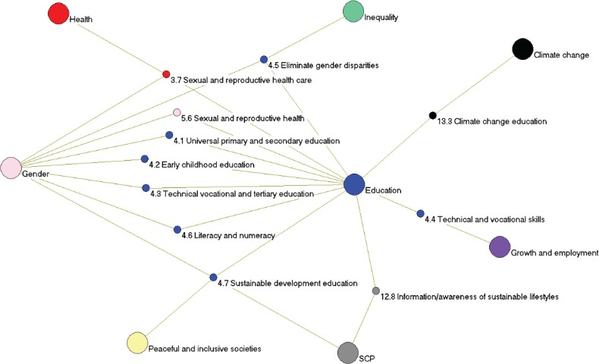
Centrality of Education: Links between other SDGs
Source: Vladimirova & Le Blanc (2015). www.un.org/esa/desa/papers/2015/wp146_2015.pdf
Graph Credit: M. Dayan
Notes:
Presenter
2018-07-25 15:30:01
--------------------------------------------
Source: Author’s elaboration, from Le Blanc (2015).
Note: The SDGs are represented as broader circles of differing colors, while targets are figured by smaller circles and have the color of the goal under which they figure. Targets are reflected as linking two or more goals if their wording explicitly refers to those goals.

Slide 14
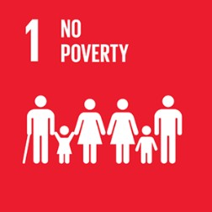
Education targets/indicators
within other SDGs
No Poverty
Global indicator: Proportion of total government spending on essential services (education, health and social protection)
Health and Well-being
Target 3.7: By 2030, ensure universal access to sexual and reproductive health-care services, including for family planning, information and education, and the integration of reproductive health into national strategies and programmes
Gender Equality
Global Indicator: Number of countries with laws and regulations that guarantee women aged 15-49 years access to sexual and reproductive health care, information and education
Decent Work and Economic Growth
Target 8.6: By 2020 substantially reduce the proportion of youth not in employment, education or training
Notes:
Presenter
2018-07-25 15:30:02
--------------------------------------------
While education in the 2030 Agenda for Sustainable Development is most explicitly formulated as a stand-alone goal (SDG4), there are also a number of education-related targets and/or indicators in other sustainable development goals. These include:
Health and well-being [Target 3.7] Gender equality [Target 5.6]
Decent work and economic growth [Target 8.6] Responsible consumption and growth [Target 12.8] Climate change mitigation [Target 13.3]
Since education is not only an integral part of, but also a key enabler for sustainable development, it should be part of the strategies to achieving all SDGs. Importantly, all SDGs are inter-dependent and can only be achieved if implemented together, reinforcing each other.

Slide 15
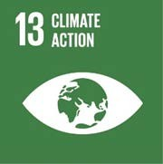
Education targets/indicators
within other SDGs
Decent Work and Economic Growth
Target 8.6: By 2020 substantially reduce the proportion of youth not in employment, education or training
Responsible Consumption & Production
Target 12.8: By 2030 ensure that people everywhere have the relevant information and awareness for sustainable development and lifestyles in harmony with nature
Climate Change Mitigation
Target 13.3: Improve education, awareness raising and human and institutional capacity on climate change mitigation, adaptation, impact reduction, and early warning
Peace, Justice and Strong Institutions
Global indicator: Primary government expenditures as a proportion of original approved budget by sector (or by budget codes or similar)
Notes:
Presenter
2018-07-25 15:30:02
--------------------------------------------
While education in the 2030 Agenda for Sustainable Development is most explicitly formulated as a stand-alone goal (SDG4), there are also a number of education-related targets and/or indicators in other sustainable development goals. These include:
Health and well-being [Target 3.7] Gender equality [Target 5.6]
Decent work and economic growth [Target 8.6] Responsible consumption and growth [Target 12.8] Climate change mitigation [Target 13.3]
Since education is not only an integral part of, but also a key enabler for sustainable development, it should be part of the strategies to achieving all SDGs. Importantly, all SDGs are inter-dependent and can only be achieved if implemented together, reinforcing each other.

Slide 16
Thank you!
https://en.unesco.org/education2030-sdg4

