Slide 1




SMART CITY AND CONNECTED LIFE
Lycée Clément Ader

Slide 2
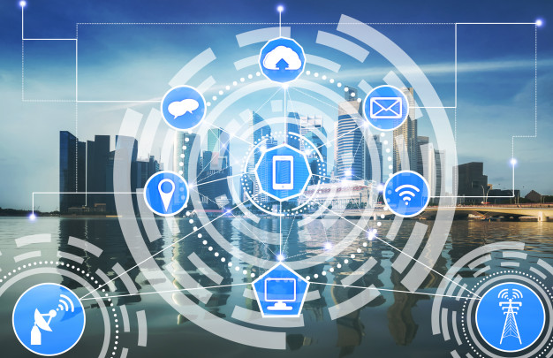

Slide 3
What is Smart City
The first question is what is meant by a ‘smart city’.
The answer is, there is no universally accepted definition of a smart city.
It means different things to different people.
The conceptualisation of Smart City, therefore, varies from city to city and country to country, depending on the level of development, willingness to change and reform, resources and aspirations of the city residents.
A smart city would have a different connotation in India than, say, Europe. Even in India, there is no one way of defining a smart city.

Slide 4
The picture of a smart city contains a wish list of infrastructure and services that describes his or her level of aspiration.
To provide for the aspirations and needs of the citizens, urban planners ideally aim at developing the entire urban eco-system, which is represented by the four pillars of comprehensive development-institutional, physical, social and economic infrastructure.

Slide 5
In the approach of the Smart Cities Mission, the objective is to promote cities that provide core infrastructure and give a decent quality of life to its citizens, a clean and sustainable environment and application of ‘Smart’ Solutions. The focus is on sustainable and inclusive development and the idea is to look at compact areas, create a replicable model which will act like a light house to other aspiring cities

Slide 6
The core infrastructure elements in a smart city would include:
adequate water supply,
assured electricity supply,
sanitation, including solid waste management, iv. efficient urban mobility and public transport,
affordable housing, especially for the poor, vi. robust IT connectivity and digitalization,
good governance, especially e-Governance and citizen participation, viii. sustainable environment,
safety and security of citizens, particularly women, children and the elderly, and
health and education.

Slide 8
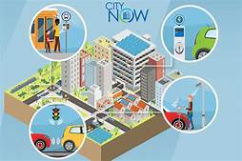

Slide 9
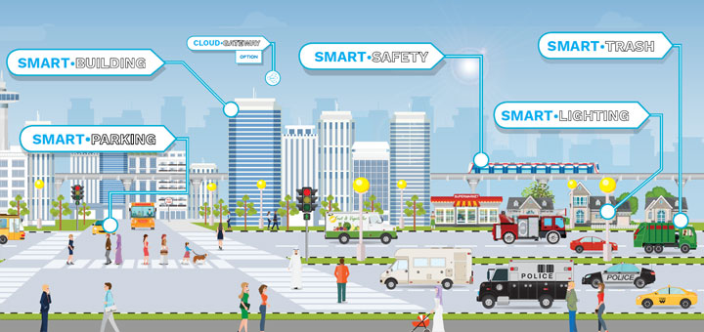

Slide 10
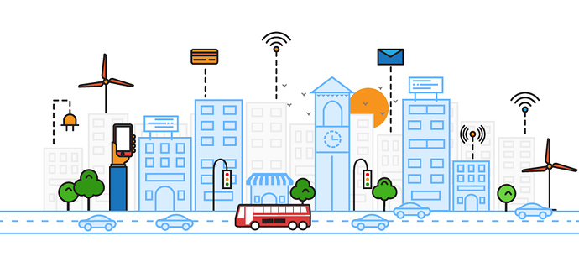

Slide 11
WHAT ABOUT THE SMART HOME
What Is a Smart Home?
A smart home refers to a convenient home setup where appliances and devices can be automatically controlled remotely from anywhere with an internet connection using a mobile or other networked device.
Devices in a smart home are interconnected through the internet, allowing the user to control functions such as security access to the home, temperature, lighting, and a home theater remotely.

Slide 12
KEY TAKEAWAYS
A smart home allows homeowners to control appliances, thermostats, lights, and other devices remotely using a smartphone or tablet through an internet connection.
Smart homes can be set up through wireless or hardwired systems.
Smart home technology provides homeowners with convenience and cost savings.
Security risks and bugs continue to plague makers and users of smart home technology.

Slide 13
How Smart Homes Work
A smart home’s devices are connected with each other and can be accessed through one central point—a smartphone, tablet, laptop, or game console. Door locks, televisions, thermostats, home monitors, cameras, lights, and even appliances such as the refrigerator can be controlled through one home automation system. The system is installed on a mobile or other networked device, and the user can create time schedules for certain changes to take effect.

Slide 14
Smart home appliances come with self-learning skills so they can learn the homeowner’s schedules and make adjustments as needed. Smart homes enabled with lighting control allow homeowners to reduce electricity use and benefit from energy-related cost savings. Some home automation systems alert the homeowner if any motion is detected in the home when they're away, while others can call the authorities—police or the fire department—in case of imminent situations. Once connected, services such as a smart doorbell, smart security system, and smart appliances are all part of the internet of things (IoT) technology, a network of physical objects that can gather and share electronic information.

Slide 15
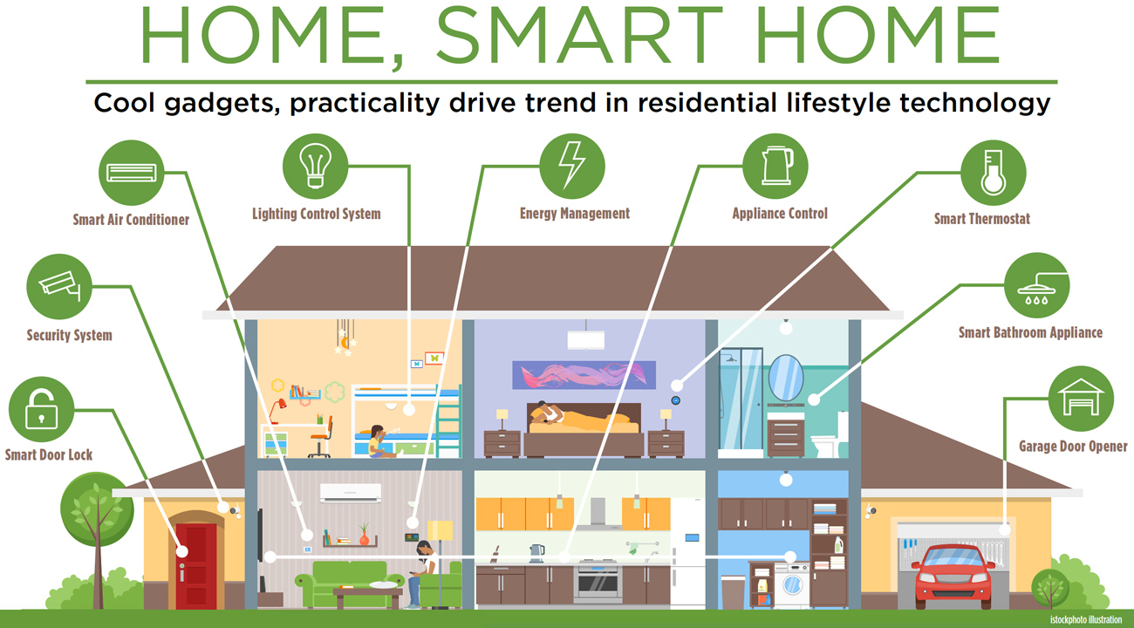

Slide 16
