Slide 1
Love My City SUSTAINABLE DEVELOPMENT Mehmet Nuri Küçükköylü Religious Vocational Secondary School

Slide 2
WHAT is Sustainable Development? Sustainable development is a organizing principle for meeting human development goals while simultaneously sustaining the ability of natural systems to provide the natural resources and ecosystem services on which the economy and society depend

Slide 3
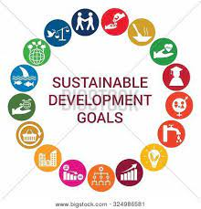
the 17 Sustainable Development Goals (SDGs) of the 2030 Agenda for Sustainable Development — adopted by world leaders in September 2015 UN Summit.

Slide 4
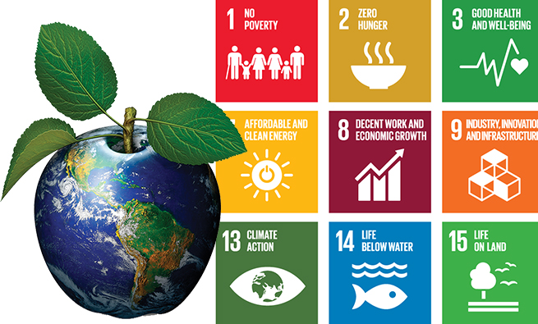

Slide 5
The 17 Sustainable Development Goals
No Poverty
Zero Hunger
Good health and well being
Quality Education
Gender equality
Clean water and sanitation
Affordable and Clean Energy
Decent work and economic growth
Reduced Inequalities
Sustainable cities and communities
Responsible consumption and production
Climate action
Life below water
Life on Land
Peace ,Justice and Strong Instutions
Partnerships for the goals

Slide 6
TURKEY HAS EMPHASIZED ITS COMMITMENT IN EVERY OCCASION TO CONTRIBUTE TO A SUSTAINABLE WORLD SINCE THE ADOPTION OF AGENDA 2030. DEMONSTRATING A STRONG OWNERSHIP, TURKEY WAS AMONG THE FIRST 22 VNR PRESENTING COUNTRIES IN 2016 For more information https://sustainabledevelopment.un.org/memberstates/turkey

Slide 7
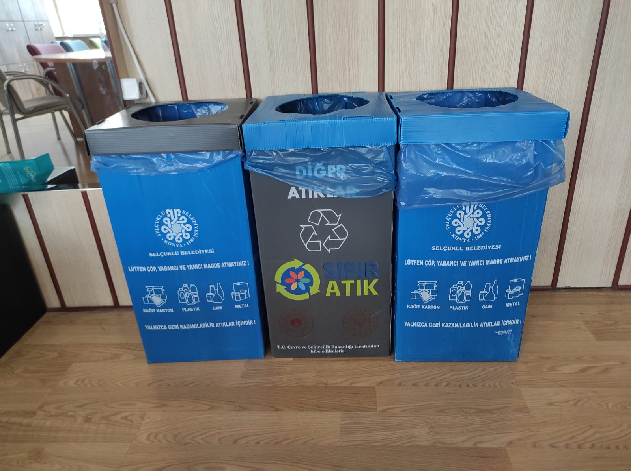
In order to be a more sustainable school, WE… Put recyling bins on every floor..

Slide 8
Collect wasted batteries..

Slide 9
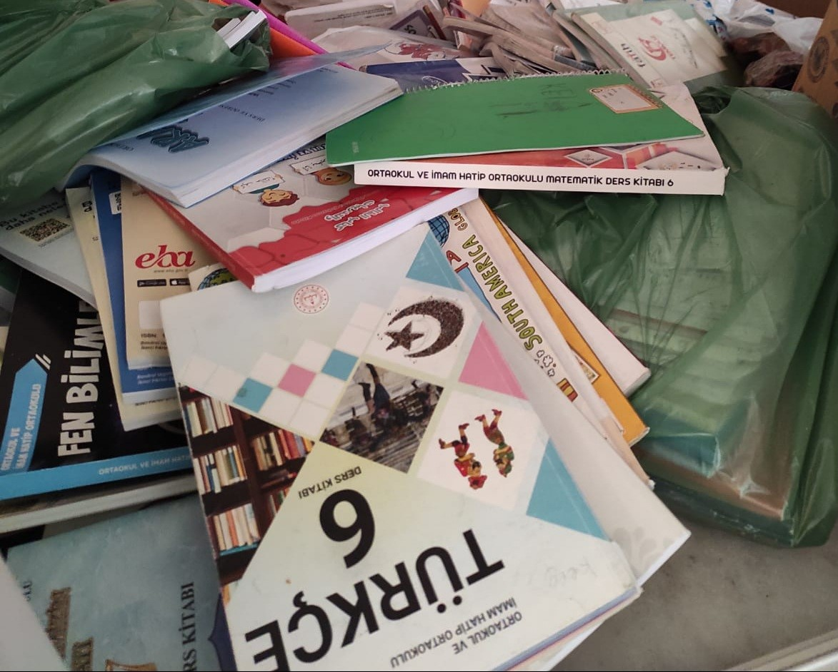
We collect used paper materials and send them to recycling factories.

Slide 10
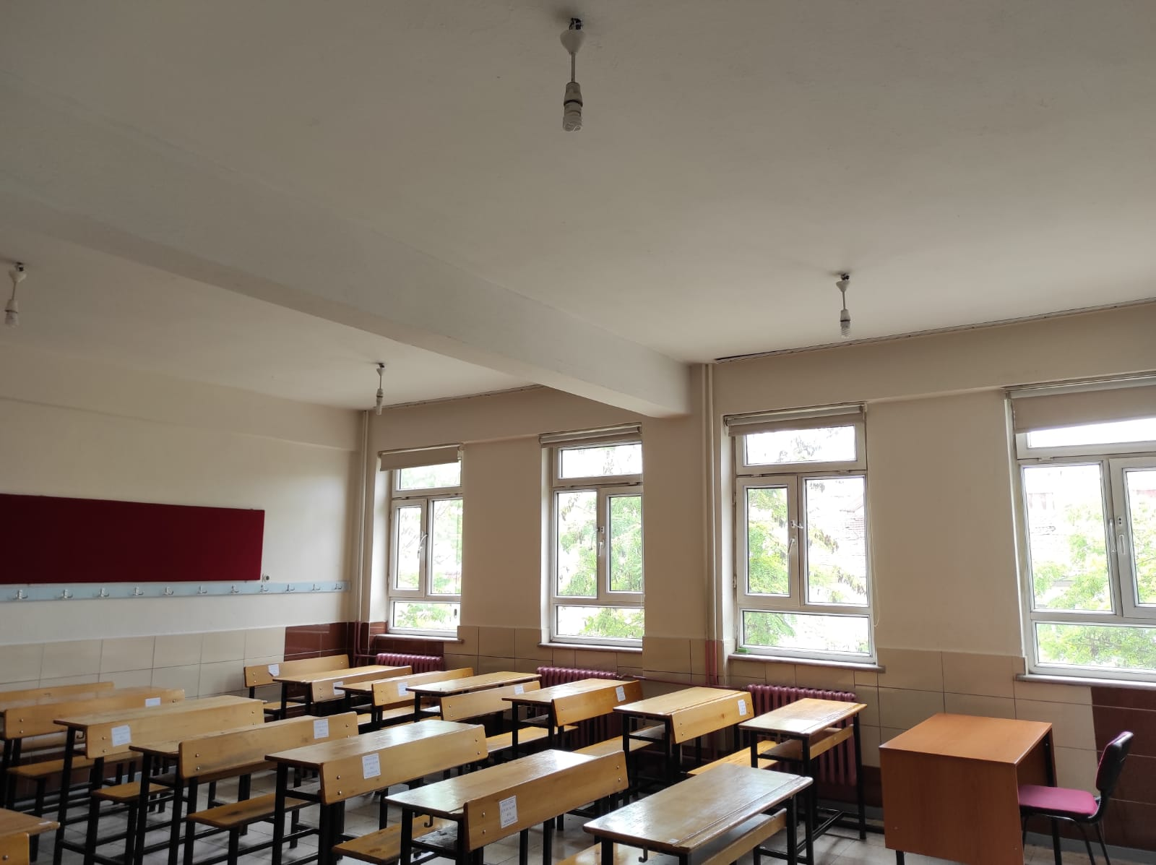
We use energy saving light bulps

Slide 11
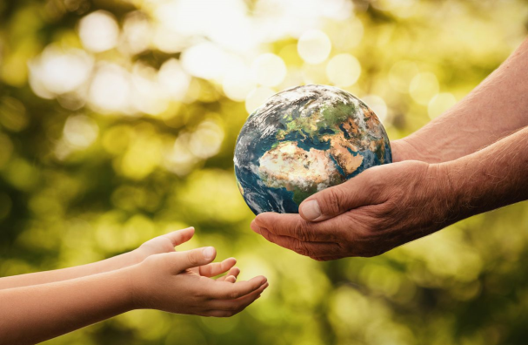
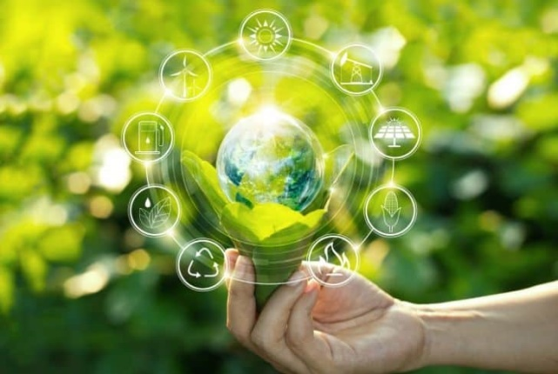
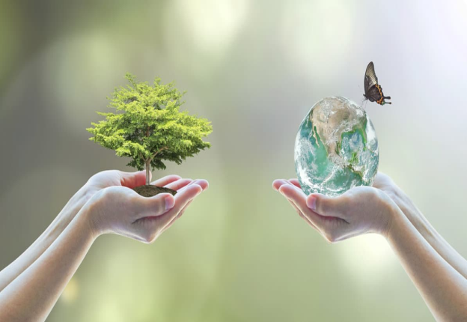
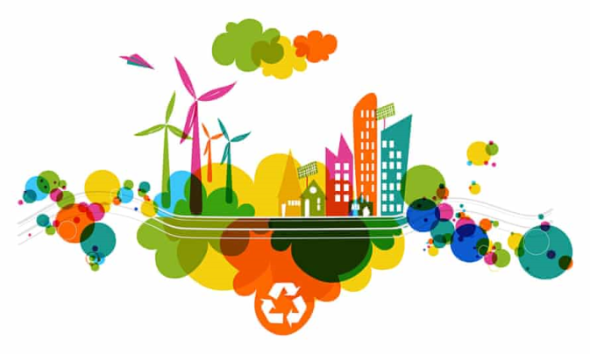
Thank you for listening! Prepared by Muhammed Çağlayan

