Slide 1
RAMADAN FEAST in TURKEY

Slide 2
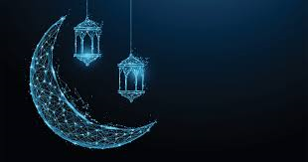
ALL ABOUT RAMADAN

Slide 3
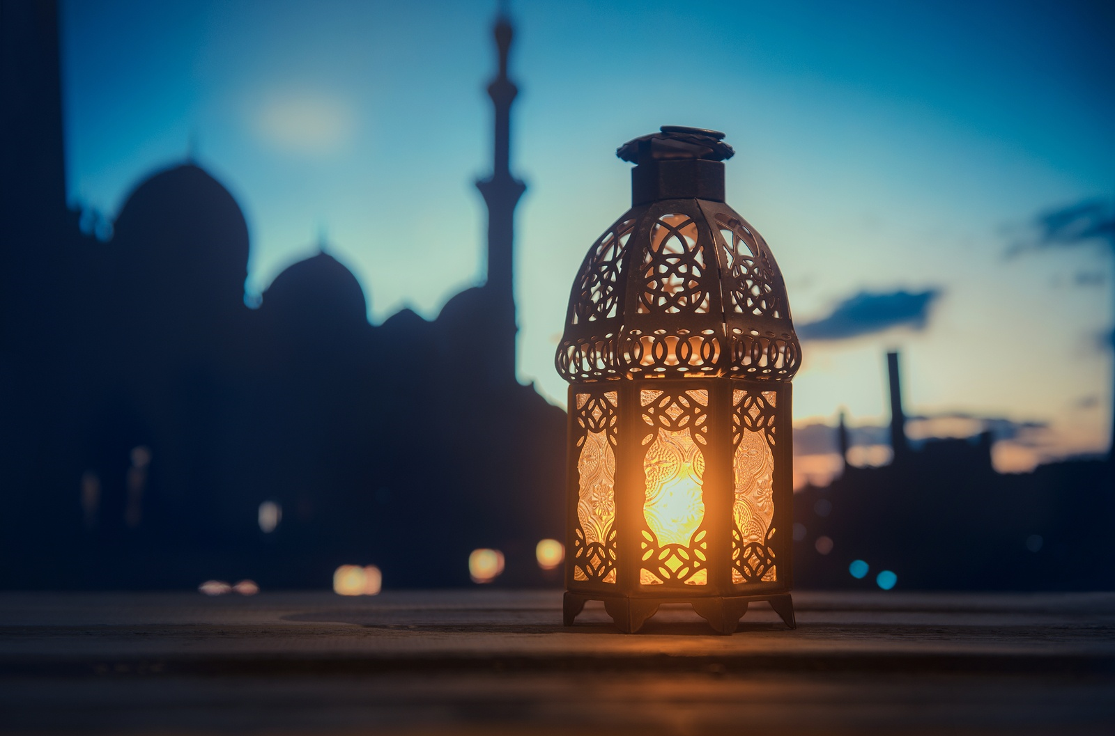
Ramadan is the fasting month and an important event for Muslim people. It takes place in the ninth month of the Islamic calendar.

Slide 4
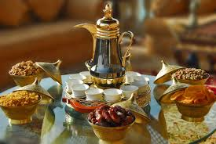
During the month of Ramadan, Muslim people fast. This means that they cannot eat or drink anything between sunrise and sunset.

Slide 5
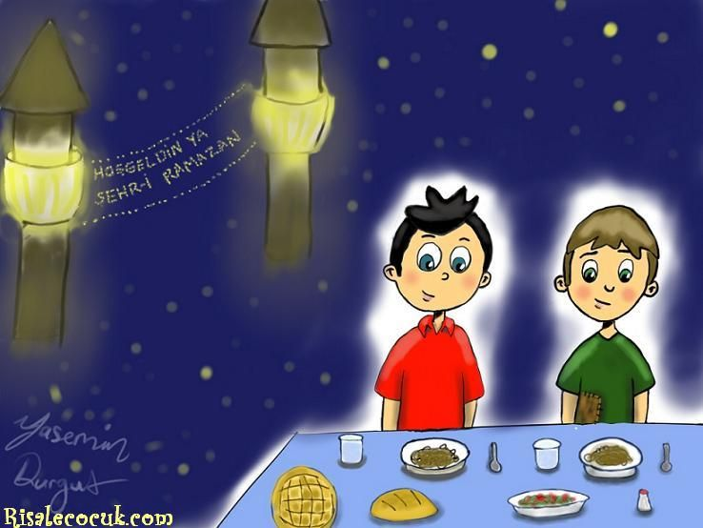
Muslims believe that fasting reminds them of people who have less than they do Not every Muslim person is expected to fast. Young children and older and ill people are not expected to fast, although sometimes, they do

Slide 6
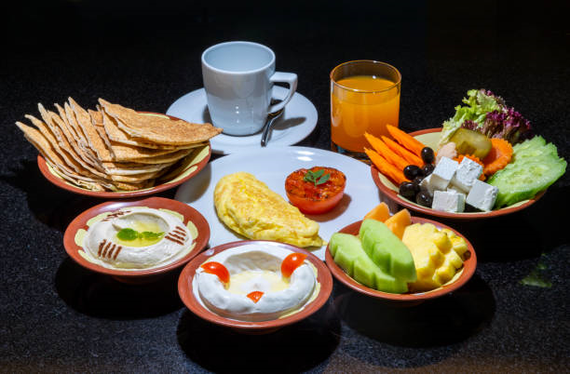
Suhoor
Suhoor is the meal Muslim people eat before their day of fasting starts. This meal is very important. The people who are fasting have to make sure they eat the right kinds of foods to give them energy for the rest of the day.
Muslims get up very early in the morning, before the sun comes up (around 4 a.m.) and eat their suhoor.It is not compulsory to eat suhoor but it is advised to do.

Slide 7
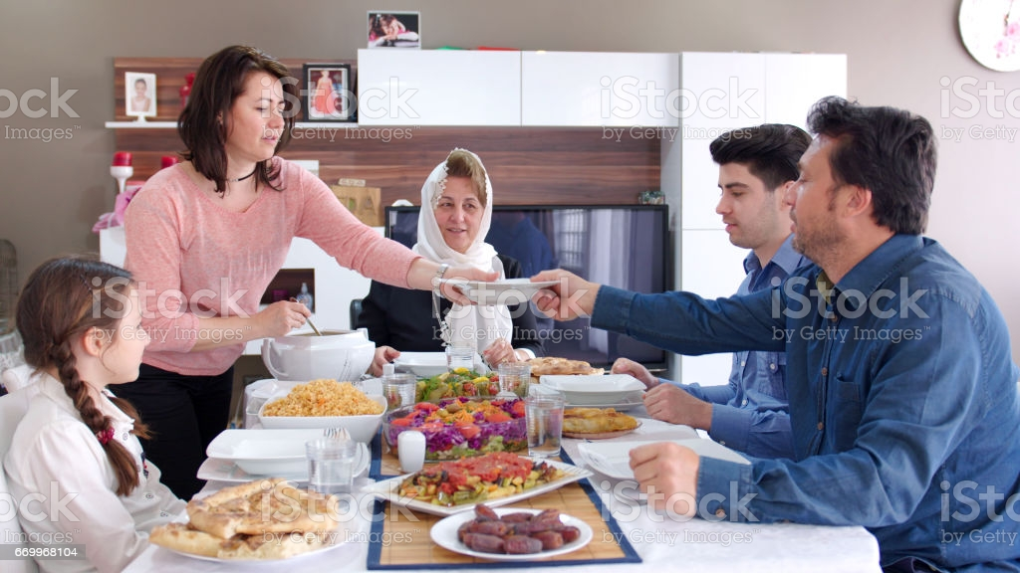
İftar
Iftar is a very important meal during Ramadan. This is the time when Muslims break their fast and are able to eat again.
People usually come together with their families,relatives or friends and eat iftar together

Slide 8
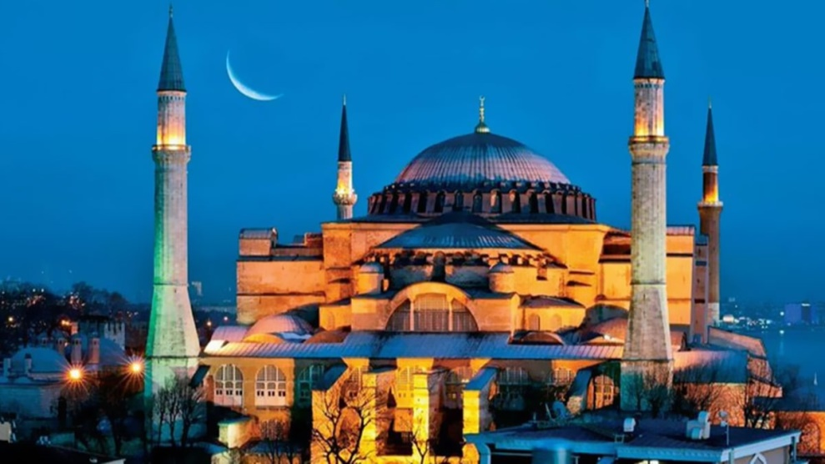
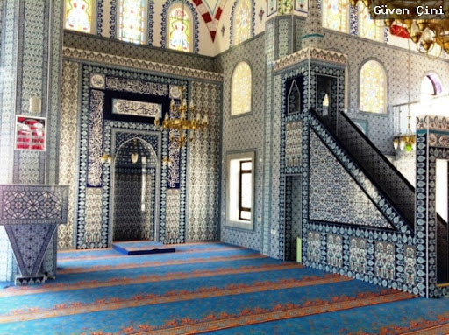
Going to Mosque
Going to mosque is an important part of both Ramadan and Eid.
The special prayer during Ramadan is called the ‘Taraweeh’

Slide 9
Helping Others
Helping others and doing good deeds is an important part of Ramadan. Sometimes, this means giving money to charities or people that need help. It can also mean being kind, giving your time and sharing what you have.

Slide 10
Ramadan feast (Eid al-Fitr)
Eid al-Fitr is the festival that marks the end of Ramadan and the fast. It lasts for three days.
For Ramadan feast,muslims often buy new clothes
They visit their families,relatives,friends and have
a large feast for lunch or dinner.
Elder people give some small amount of money or some small gifts to children.
All people offer sweets or baklava(a traditional Turkish desert)
to visitors.

Slide 11
Thank you ! Prepared by Hasan Enes Karaca

