Slide 1


Smart City
MEHMET NURİ KÜÇÜKKÖYLÜ RELIGIOUS VOCATIONAL SECONDARY SCHOOL

Slide 2
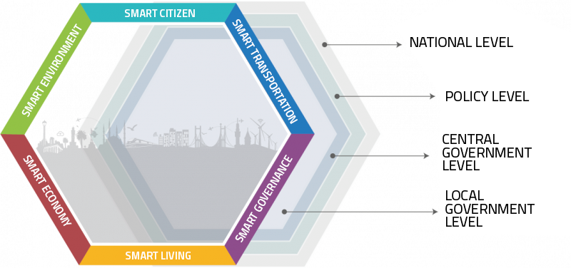
What is a SMART City?
A smart city is a city that uses technology to provide services and solve city problems. A smart city does things like improve transportation and accessibility, improve social services, promote sustainability, and give its citizens a voice

Slide 3
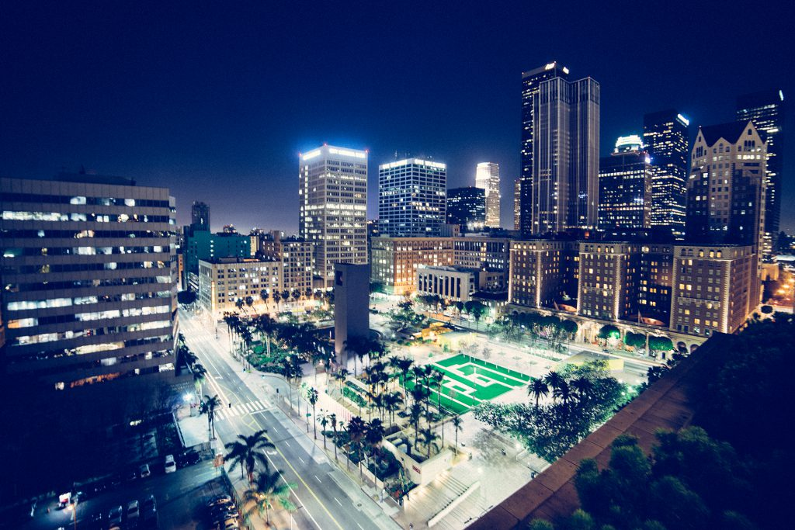
The main goals of a smart city are to improve policy efficiency, reduce waste and inconvenience, improve social and economic quality, and maximize social inclusion.

Slide 4
A city isn’t smart because it uses technology,
a city is smart because it uses technology
to make its citizens’ lives better.

Slide 5

Why we focus today on smart cities?
Today 3.6 billion people live in cities
By 2050, 75% of the world’s population will live in cities
Up to 80 billion connected objects by 2025

Slide 6
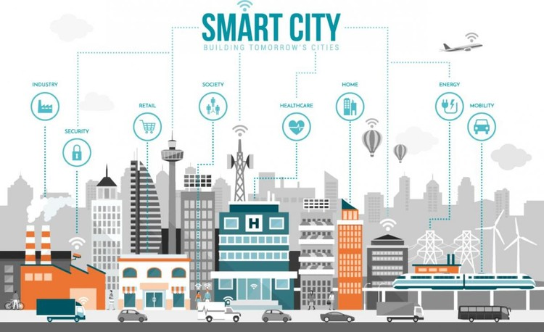
Components that define smart city smart mobility smart economy smart people smart government smart environment smart living

Slide 7
The 7 Top Smart Cities Around the World
New York
Singapore
London
Barcelona
Oslo
Toronto
Tokyo

Slide 8
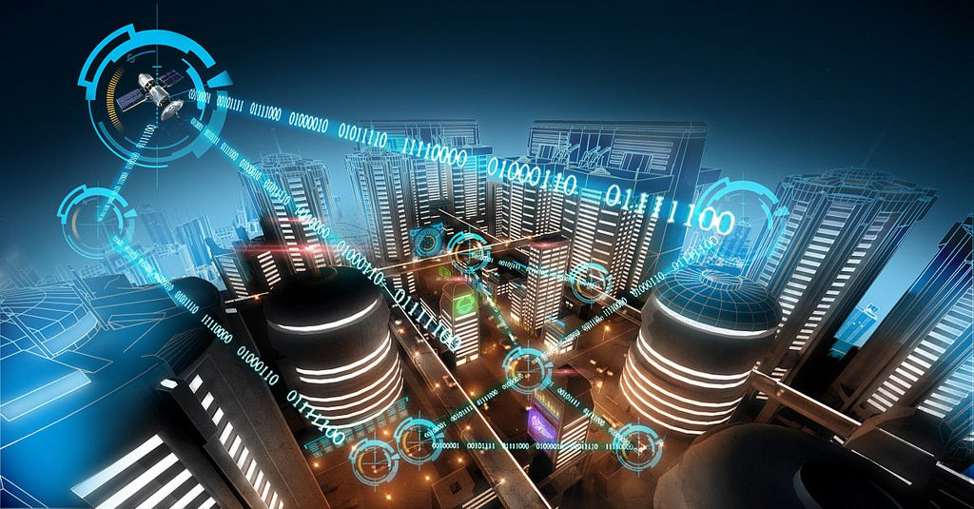
Thank You!
Prepared by Mustafa Çelebi

