Slide 1
My town Zambrów

Slide 2
Zambrów in Poland

Slide 3
Coat of arms of Zambrów

Slide 4
The emblem legend Zambrów
It refers to the past of Zambrów, as in the Middle Ages bisons used to live in the surrounding woods. Also, the city's name is derived from the Old Polish noun which means „the place of residence of bisons”.
The pattern of the coat of arms was adopted by City Council Resolution No. 26 / V / 03 of 25 February 2003.

Slide 5
Population of Zambrów
Description | Altogether | Women | Men
Unit | people | % | people | % | people | %
Population | 22 451 | 100 | 11 641 | 51,85 | 10 810 | 48,15

Slide 6
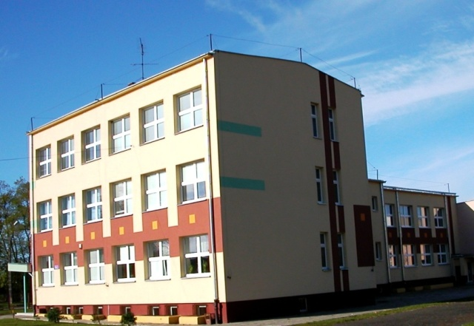
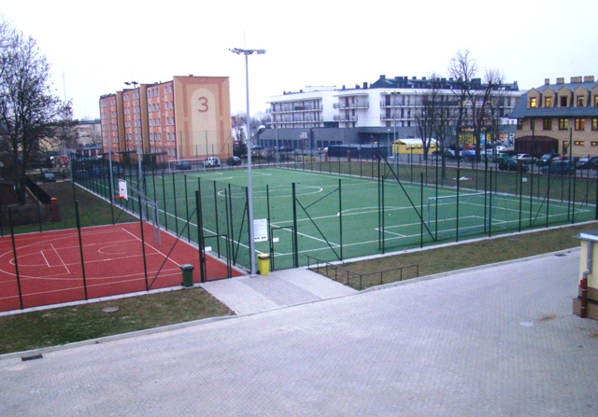
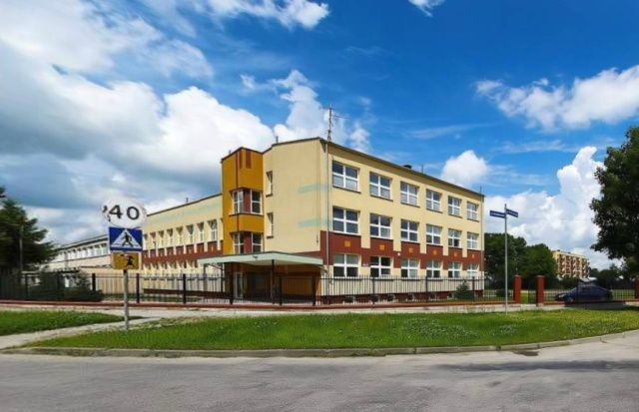
This is my school

Slide 7
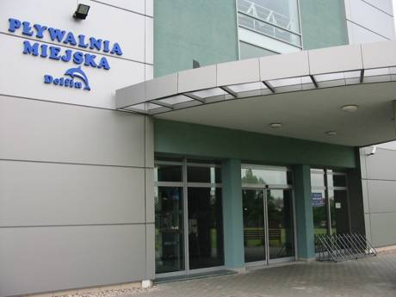
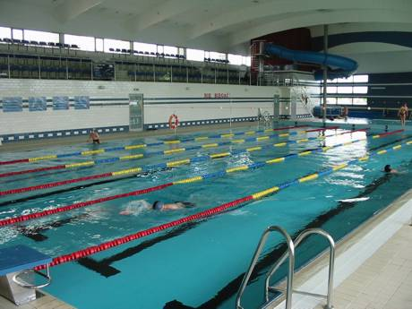
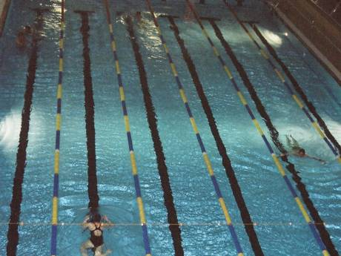
Pool in Zambrów

Slide 8
The End

Slide 9
Made by Patryk Thanks

