Slide 1
OUR GROUP
Gimnazjum nr 14, Ruda Śląska (Poland)
Prepared for the project
WE ARE DIFFERENT BUT THE SAME
2014/2015

Slide 2
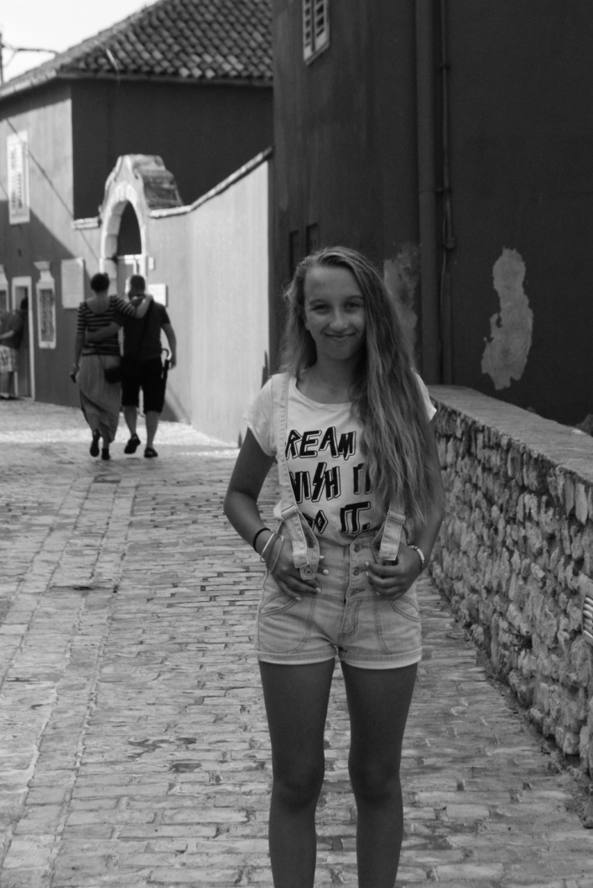
I’m Magda! I’m 14 years old.
I like listening to One Direction, they’re great.
I like cycling, swimming,
ice skateing and skiing.
I’m keen on reading books.
I’m different from a typical teenage girl because I enjoy playing League of Legends!

Slide 3
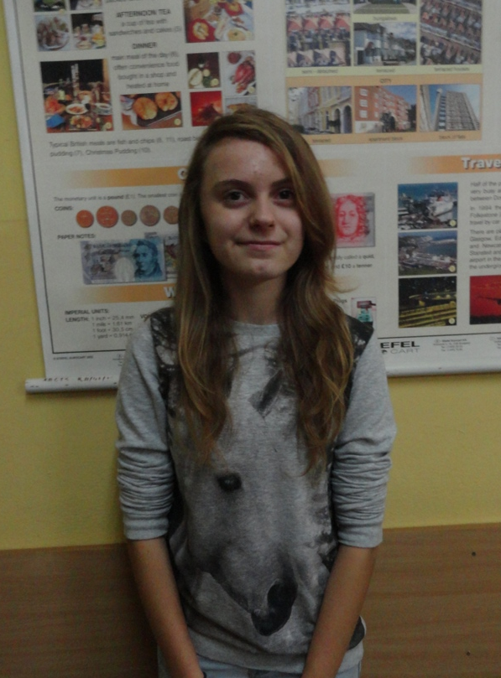
I’m Paulina. I’m 14 years old. I love horse riding! My hobby is reading books. One of my favourite books are ‘Hunger Games’ and ‘The Lord of the Rings’. I enjoy writing poems.
I don’t like school;-( But eTwinning is OK☺

Slide 4
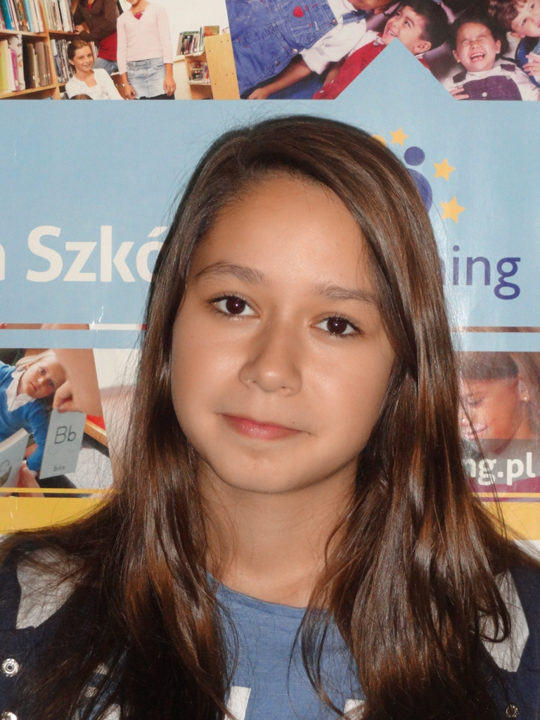
I’m Danka ☺ I’m 14 years old.
I love listening to rock music.
My hobby is swimming, painting and ice skating.
I’ve got a sister, her name is Paulina.
I’ve got a dog. Its name is Axel. I’ve got fish, too.

Slide 5
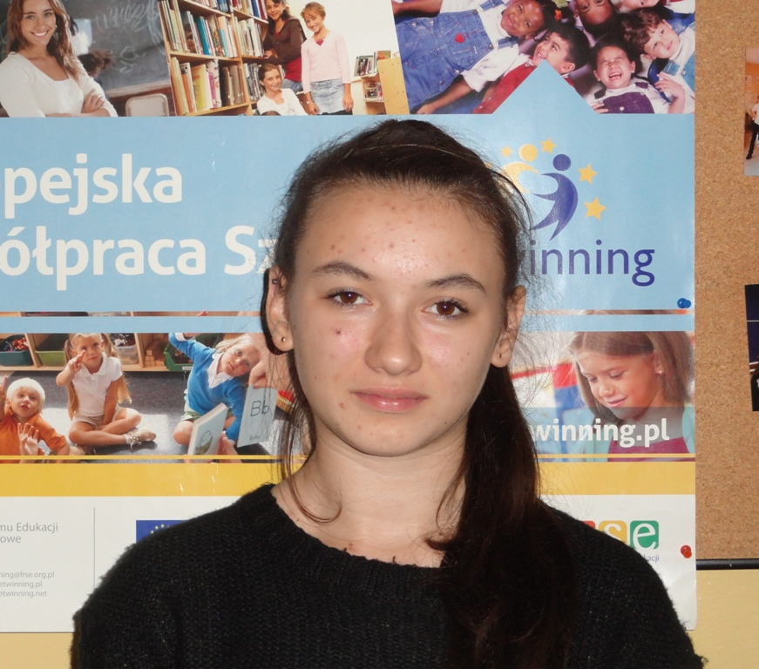
I’m Ola ☺. I’m 14 years old.
I’ve got long brown hair and brown eyes.
I like listening to rap music.
I don’t have a brother or a sister.
I’ve got a dog called Lady.

Slide 6
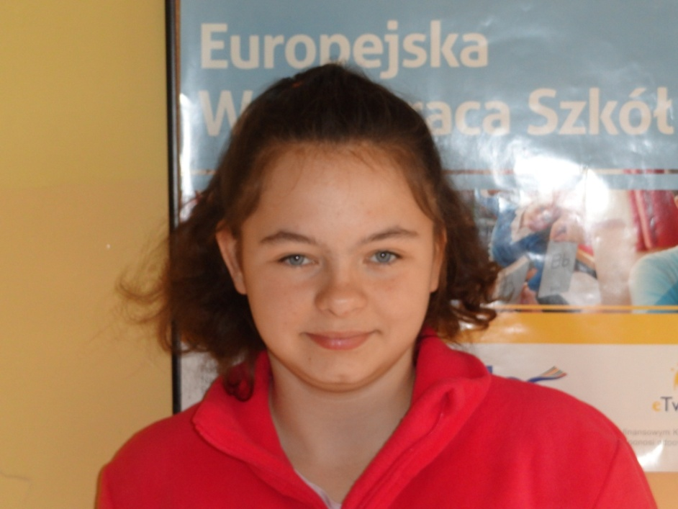
I’m Nikola. I’m 14 years old. I like Japanese music, especially J-rock and VOCALOIDs.
I’m keen on reading books. I think that reading a good book is better than playing computer games. My favourite games are SIMS 3 and 4 and Fable 3.
I’m interested in history – it’s my favourite subject. I like learning about new things!

Slide 7
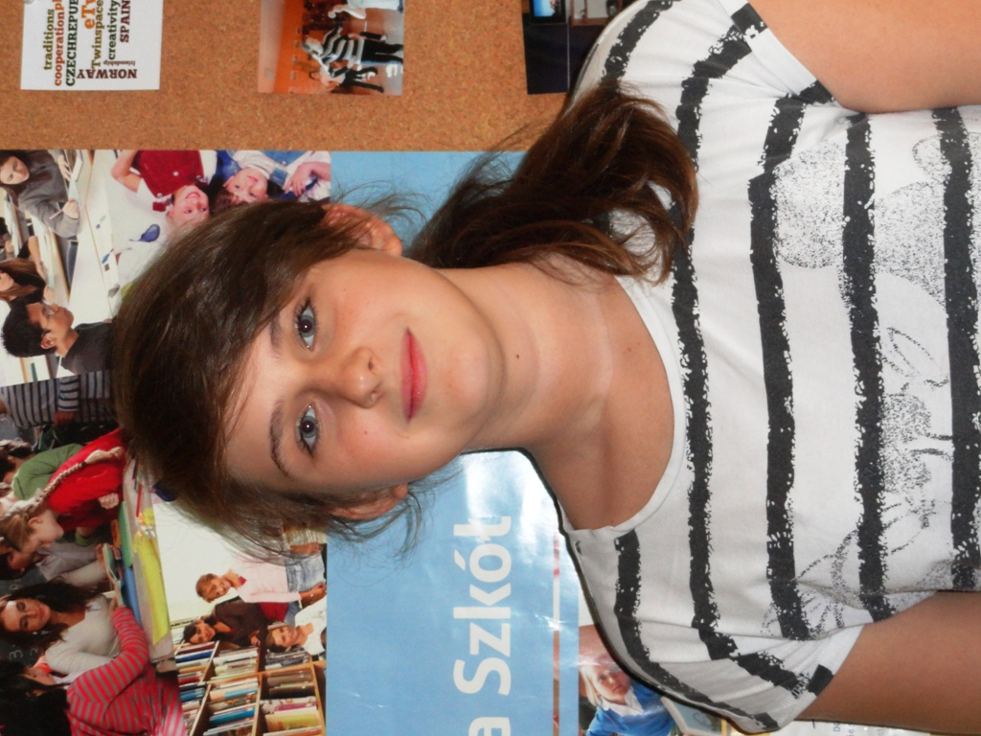
Hi! My name is Angela. I' m 13 years old. I'm from Ruda Śląska in Poland. I like football. My hobby in handball, too.
I go to Gimnazjum nr 14 in Ruda Śląska.
I have a dog and fish.
My favourite school subject is eTwinning club☺

Slide 8
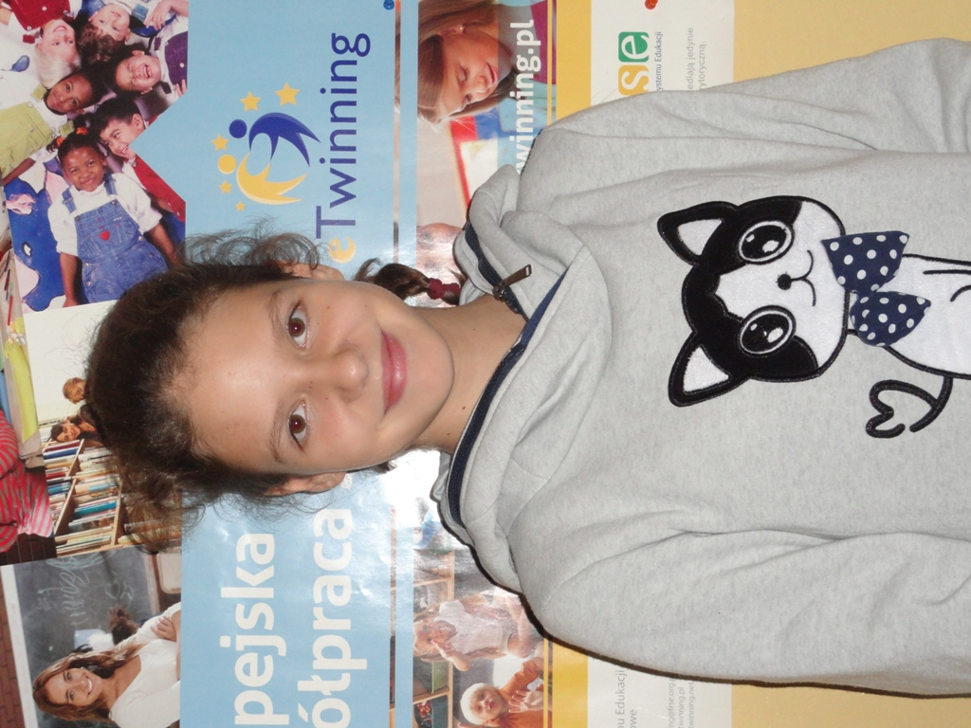
Hello! I’m Ania. I’m 13 years old. I have got a brother. His name is Jacob.
I love swimming! I like singing, too. I sing in a church choir. My favourite school subjects are Art and Design and PE☺
In my free time I like meeting my friends!

Slide 9
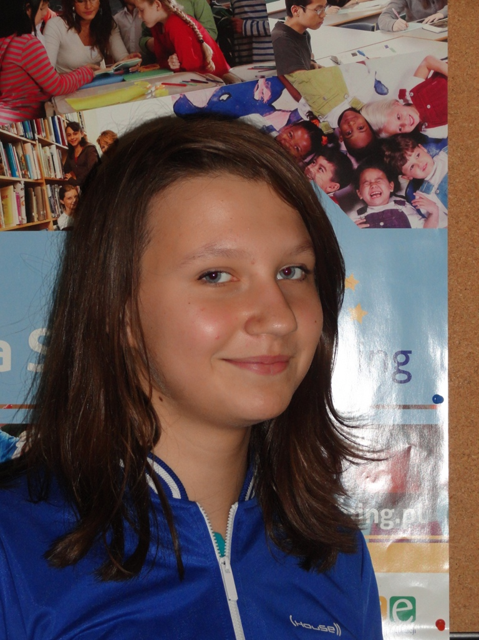
I’m Agata. I’m 14 years old. My birthday is on 4 May. My favourite sport is handball. I have got a dog called Nasta.
I love spending time on FB☺
My favourite school subject is PE!

Slide 10
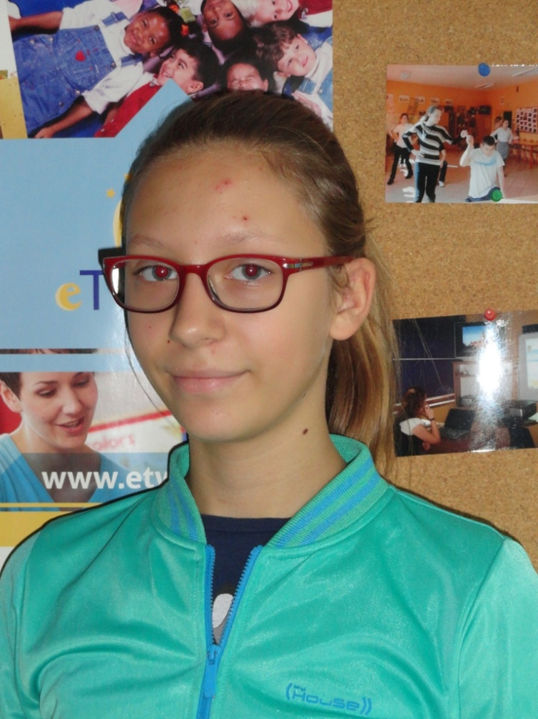
I’m Agnieszka. I’m 13 years old. My birthday is on 11th July.
I love sport, I’ve been training handball for 6 years. My favourite subject is PE. I like swimming, too.
My favourite colour is purple.

Slide 11
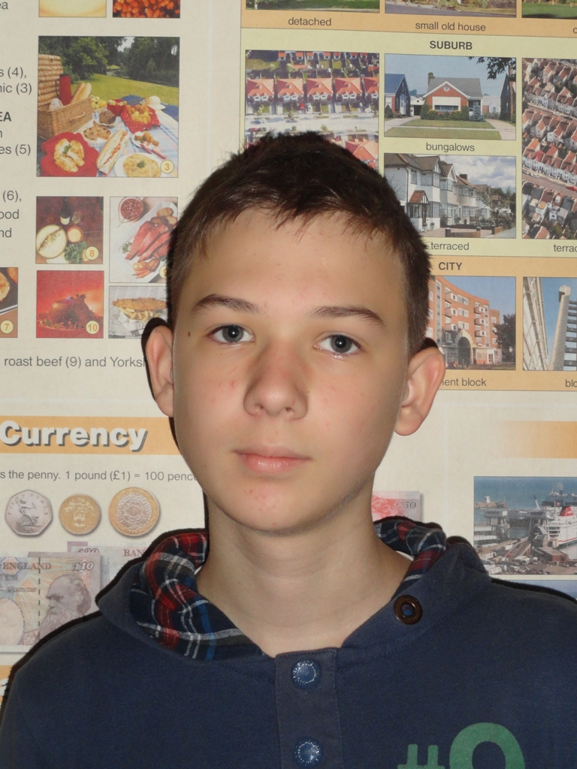
My name’s Damian. I’m 13 years old. I have a sister. Her name’s Ewa. I’ve also got a dog called Tosiek.
My favourite school subjects are English and Biology.
I like watching films.
I also like playing computer games. My favourite game is SIMS.
I’m good at swimming. It’s my favourite sport!

