Slide 1
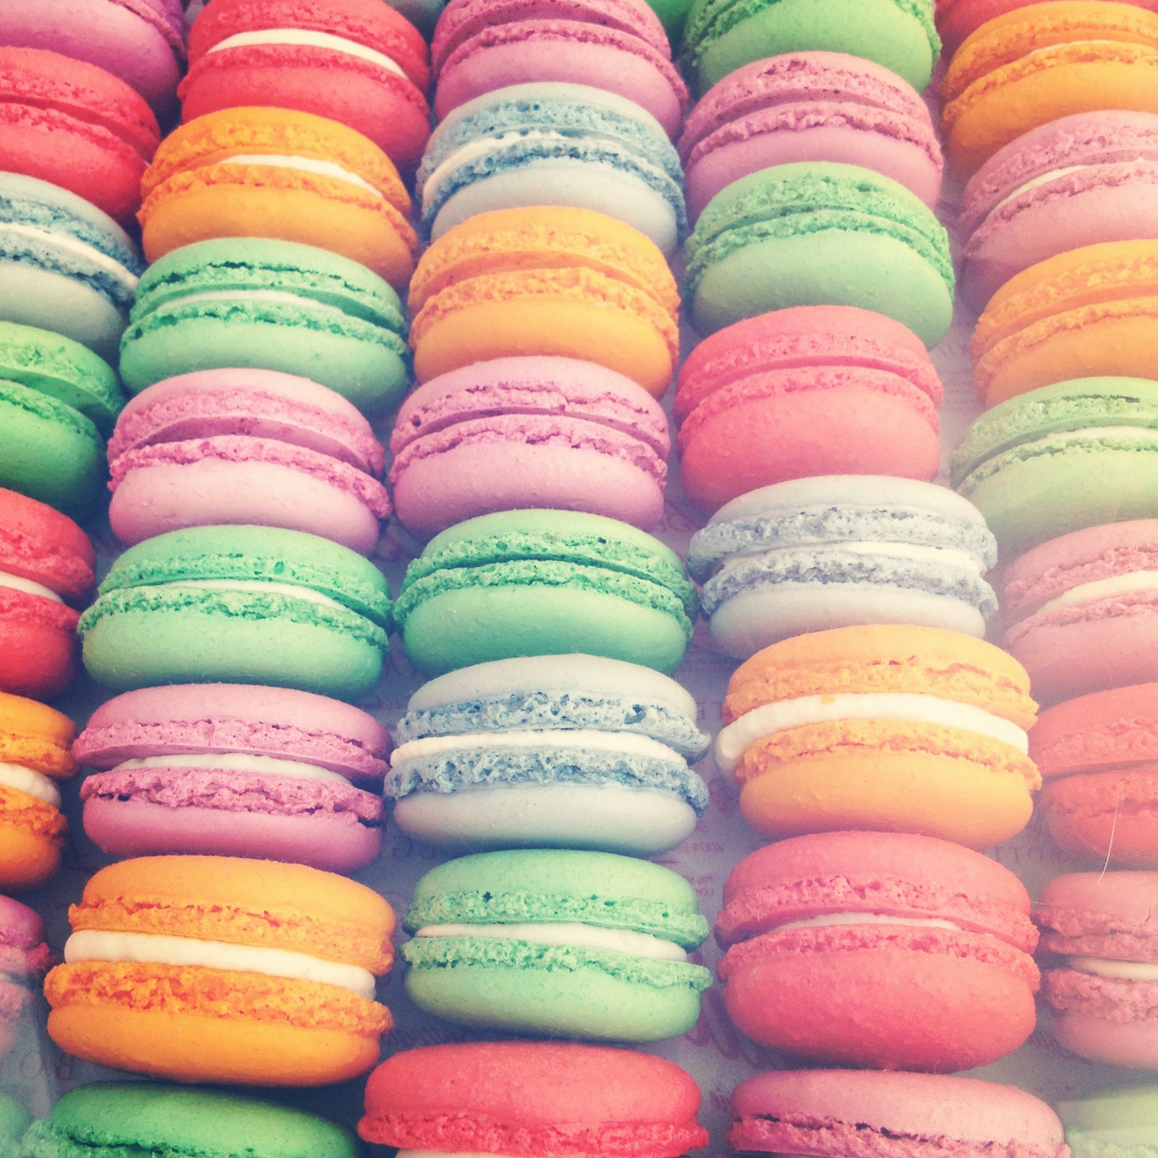
Macaroons

Slide 2
Ingredients
Macaroons
138 g almond flour
125 g powdered sugar
105 g egg whites
105 g caster sugar
Chocolate cream
200 g of dark or white chocolate
125 ml cream de luxe / or above 30%

Slide 3
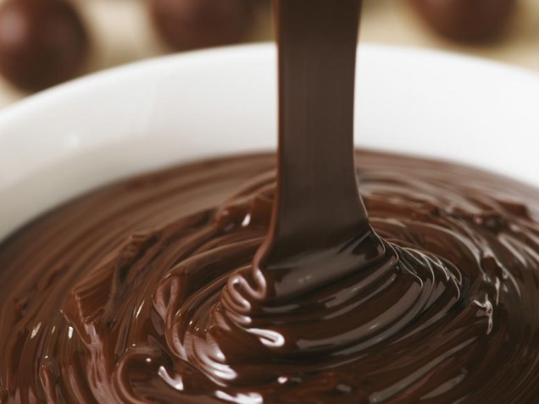
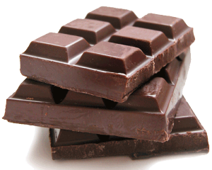
Chocolate cream
Break chocolate pieces in a bowl and pour the hot cream that you have previously warmed up
Stir until chocolate is melted and then let cool
For a complete solidification put in the fridge
The cream can cook for a few hours in advance, calmly in the evening before preparing macaroon
Cream of white chocolate can be colored food coloring.

Slide 4
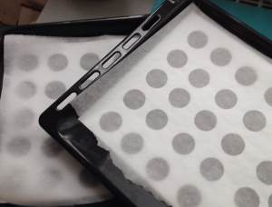
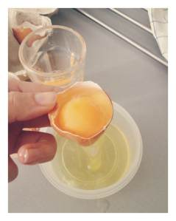
Macaroons
Before preparing is important to separate the egg whites from the egg yolks at least 24 hours in advance
At the beginning of the preparation to measure out all the ingredients
On the baking sheet put the template (on paper, make a circles with a diameter of 3.5 cm) and lay them on the baking paper.

Slide 5
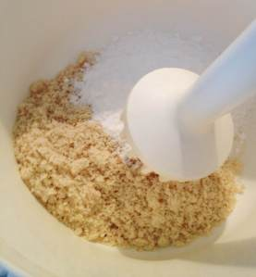
Although almond flour finely ground for smooth shells still have grind it with powdered sugar
After grinding the mixture sifted through a sieve

Slide 6
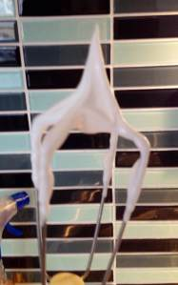
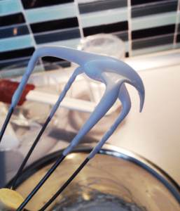
In a chilled stainless steel bowl, mix the sugar with caster sugar and whisk on low speed until the sugar dissolves
Then increase to medium speed (whisk in one direction)
When it starts to solidify, increase the top speed and wait until it is completely solid
All this takes about 10 minutes
Wrong Right

Slide 7
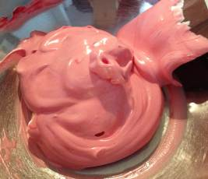
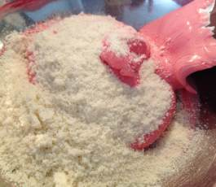
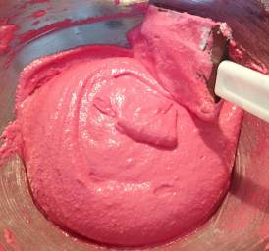
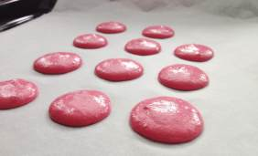
Now add the food coloring
Stir mixture of almond flour and sugar
Pastry bag fill about half of the dough
Start on a baking sheet sprayed circles
Work quickly so the dough will not warm

Slide 8
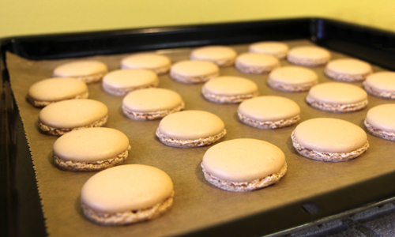
Macaroons must dry - It takes about 20-30 minutes
To get rid of the air, slams baking sheet on the table
Before placing in the oven, remove the template
At a time when you give macaroons to dry you preheat the oven
The temperature should be between 120 °C - 150 °C and baking times of up to 20 minutes.
After baking, immediately remove the macaroons with baking paper from baking sheet
After cooling unite macaroons with chocolate cream

Slide 9
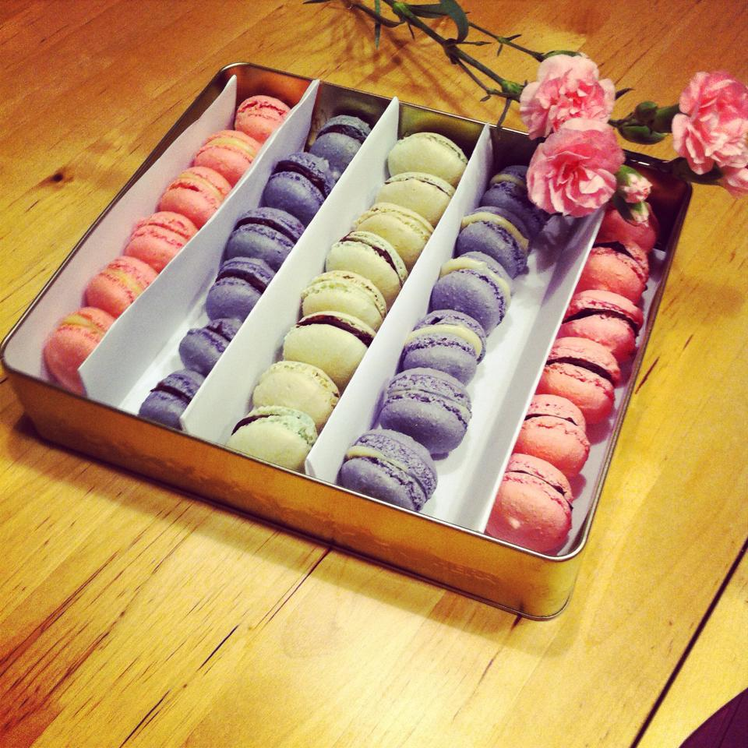
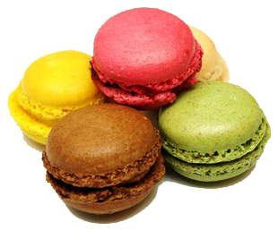
Bon appetit!

