Slide 1
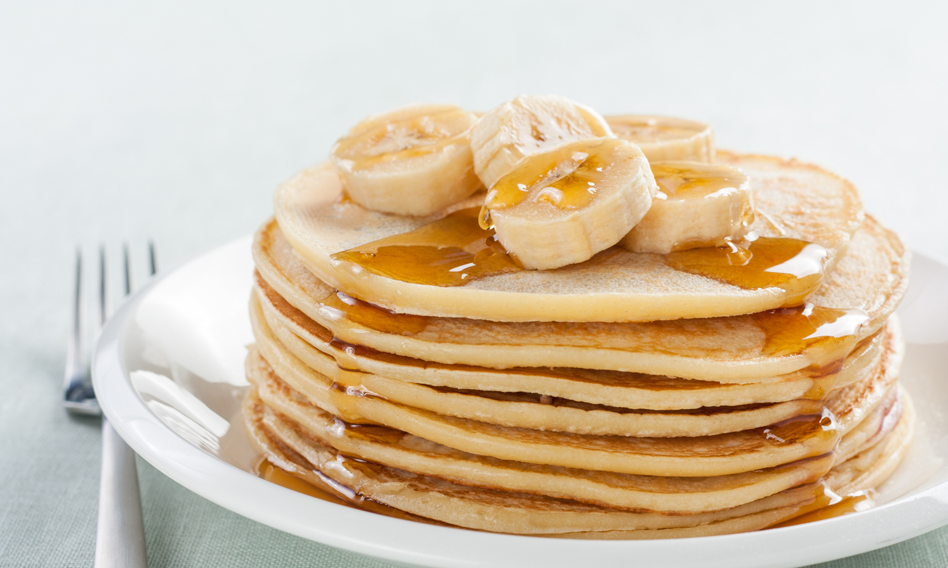
Banana Pancakes

Slide 2
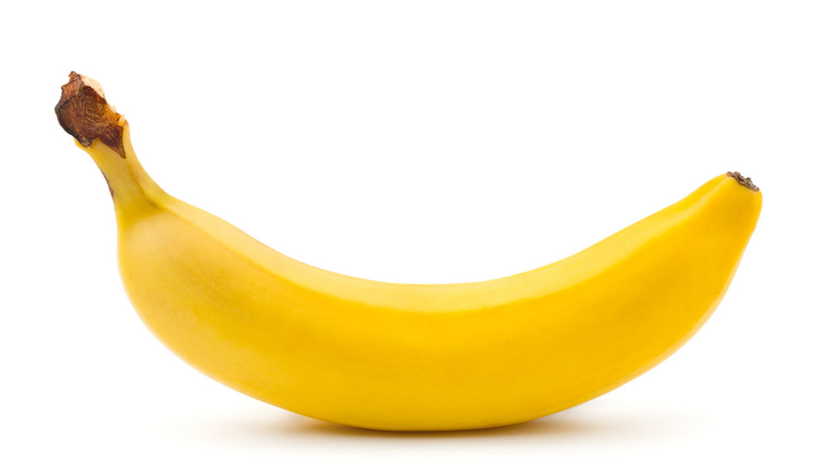
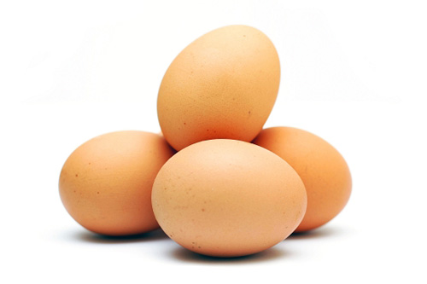
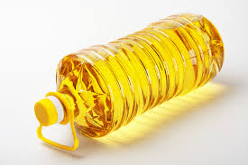
Ingrediens
Ingrediens: 1 banana – 150g
2 eggs – 120g (chicken eggs)
2 teaspoons of sunflower oil – 14ml

Slide 3
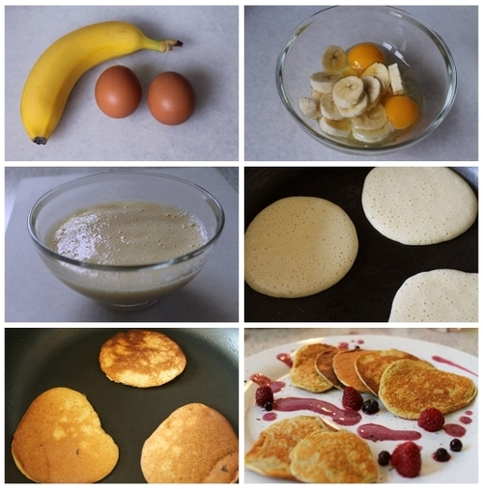
Instructions
1. Peel a banana
2. Mash the banana with a fork
3.Put mashed banana into a bowl and add 2 eggs
4. Mix everything with a rod mixer
5. Pour into the pan 2 tea spoons of sunflower oil
6. Fry the pancakes on a painon both sides until golden brown
7. Decorate with pancakes to taste

