Slide 1
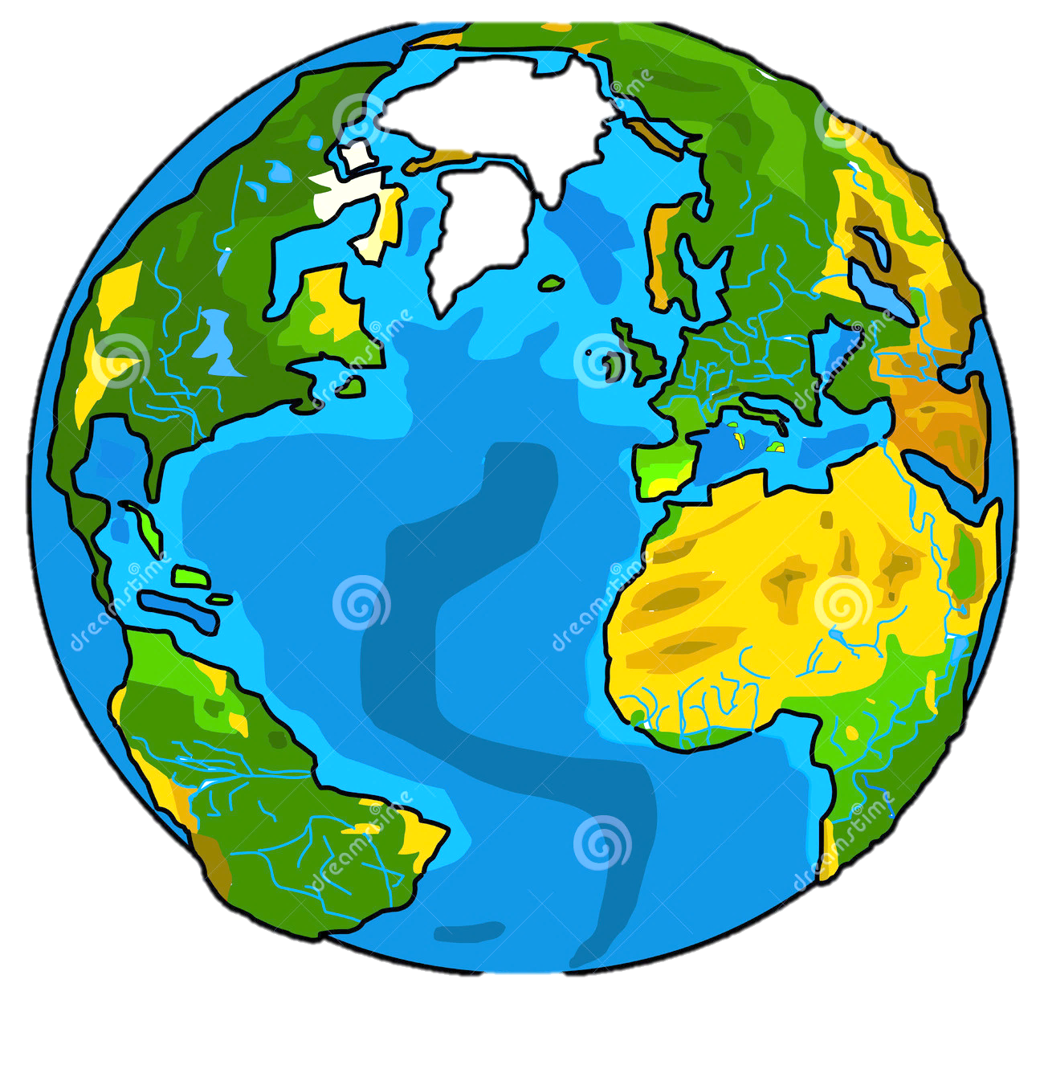
How to save our future

Slide 2
What does our way of life has in common with the climate ?
Our lifestyle uses too much power and produces too much carbon dioxid. Think about:
your consumption
your nutrition
Your living
Your mobility
Your freetime actvities

Slide 3
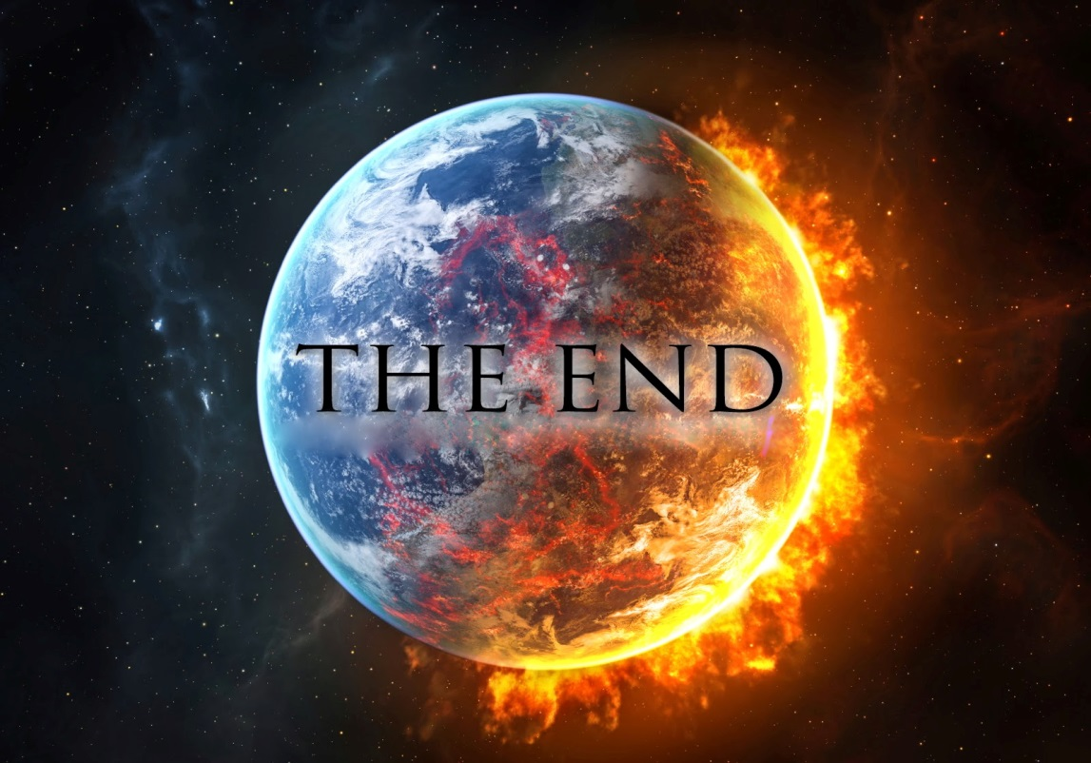
The effects
Greenhouse effect
Climate change
Ozon holes

Slide 4
The worst energy users:
Flights
Plastic wrappings
Non-durable goods
High consumption of
electric power
High consumption of
meet
Fast food

Slide 5
And what can you do?
Buy only regional and seasonal products
Buy more organic-products
Go to school by bike
Use public transport
Eat less meet
Reduce your
Shopping habits
Share things with
Others (clothes,
gadgets, books etc.)

Slide 6
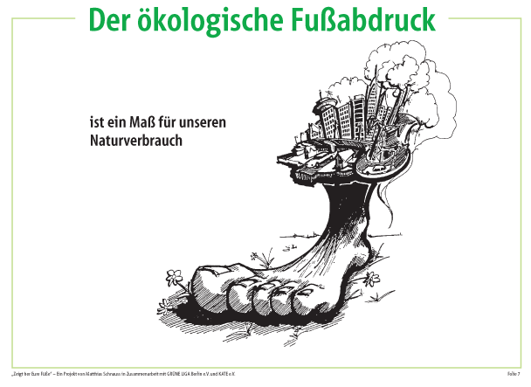
What is the carbon footprint?
Founder: Mathis Wackernagel, William Rees
The carbon footprint shows us, how much space and water (resources) we use every day for our lifestyle
Unit of measure: „global hectar“ (10 000 qm)

Slide 7
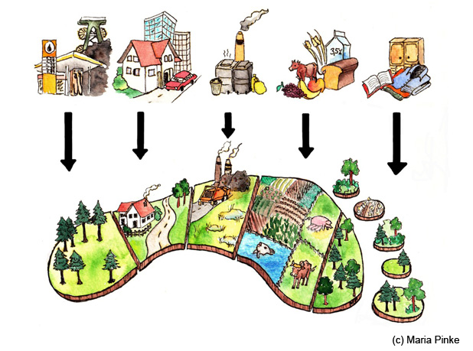
Questions in order to calculate your carbon footprint
How do you live ?
How many things do
you own/consume?
What do you eat?
What about your
mobility?
calculator: www.fussabdruck.de

Slide 8
Result
Every person needs about 1.8 global hectar (gbh) for living
The calculator shows us how much space (how many Earths) we use
Calculate your own carbon
footprint and change your
way of life!

Slide 9
It‘s worth doing what you can! Thank you!

