Slide 1
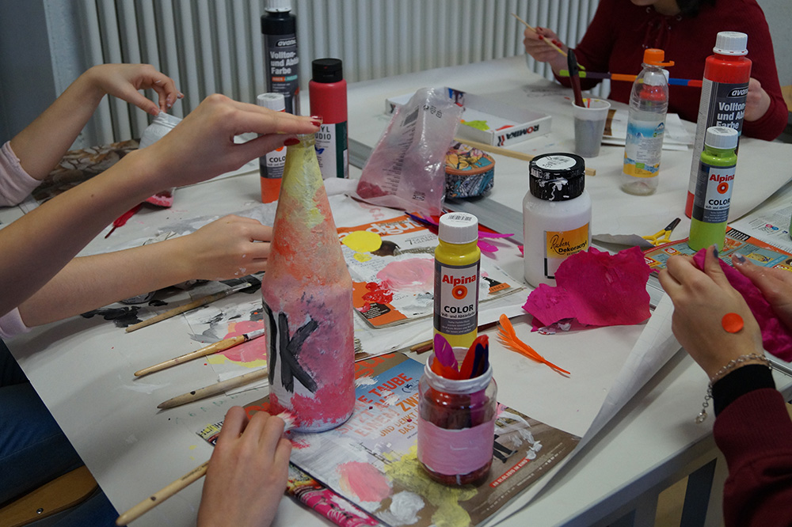
Our climate week
By Moritz, Benjamin, Paula, Jelena
Grade 8, JMS Ingolstadt

Slide 2
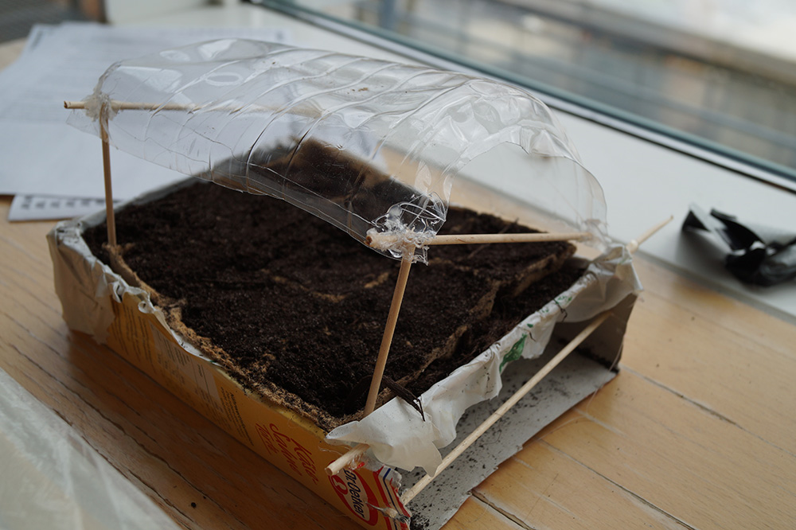
What did we learn?
climate & climate change
What to do to reduce our carbon footprint
We worked at different stations
Upcycling → How to make new things from waste

Slide 3
What did we learn?
Information about climate change
Power measure → consume comparison
(hairdryer ca. 1500-2000 Watt)
Origin of clothes

Slide 4
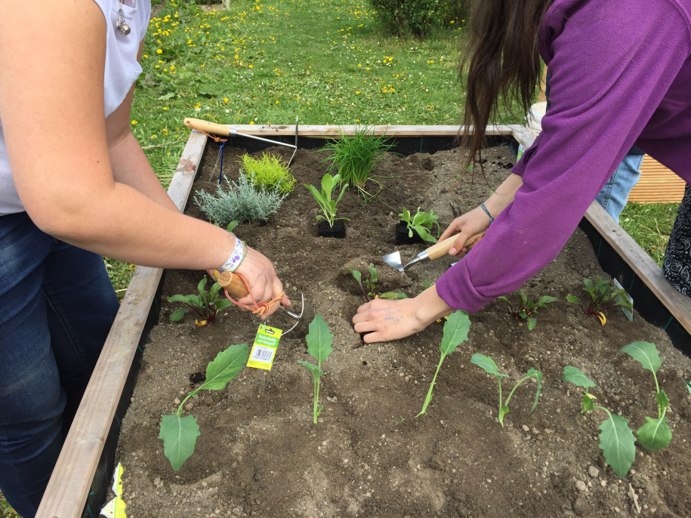
Lets plant
Family and consumer science
Bought things for garden
planting the schoolgarden
Our plants

Slide 5
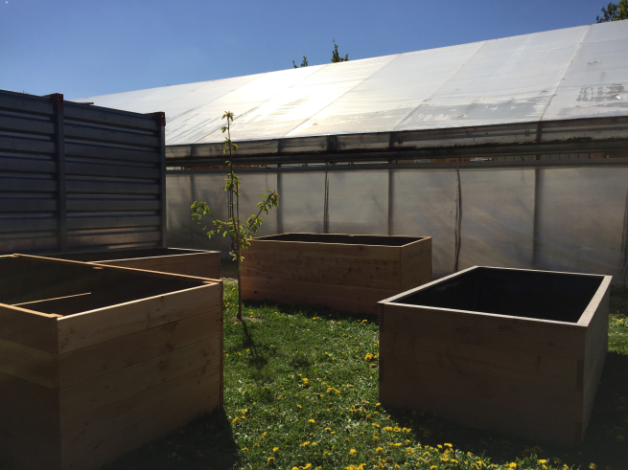
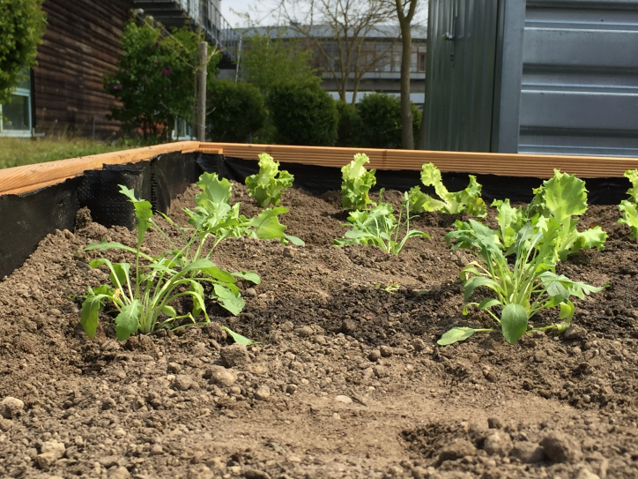
Let‘s plant
We are looking forward to the first selfmade salad in our school garden!
And we hope you enjoyed our presentation

