Slide 1
RIGHTFUL PERCEPTION OF REALITY
RESEARCH PROJECTS
IES JUAN SEBASTIÁN ELCANO
SPAIN

Slide 2
INDEX
THE PHENOMENON OF INDEPENDENTISM IN EUROPE
HEALTH, HOUSING AND EDUCATION RIGHTS
CENSORSHIP AND FREEDOM OF EXPRESSION
INTERVIEWS WITH LOCAL POLITICAL LEADERS
POLITICAL CORRUPTION SURVEY AND SOME OPINIONS
RESEARCH ABOUT JUSTICE QUALITY IN EUROPE
CIVIL RIGHTS SURVEY
Notes:
Gonzalo

Slide 3
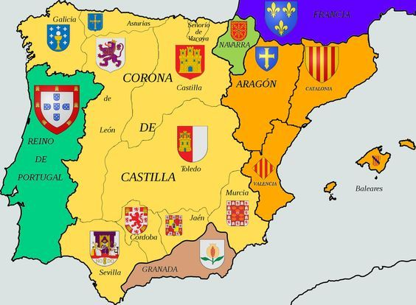
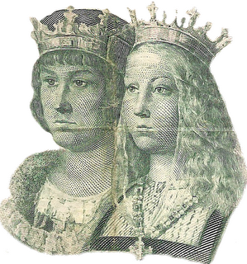
1.- THE PHENOMENON OF INDEPENDENTISM IN EUROPE
With the research, we would like to inform us about the nationalism in Europe and Spain.
Catalan nationalism is the best known, but not the only one in Spain. There is also a Basque nationalism and Galician nationalism.
All the movements are based on historical reasons. Some people want to go back on time and to interpret in a nationalist key episodes that took place in the last centuries and that actually responded to other motivations.
Notes:
Gonzalo

Slide 4
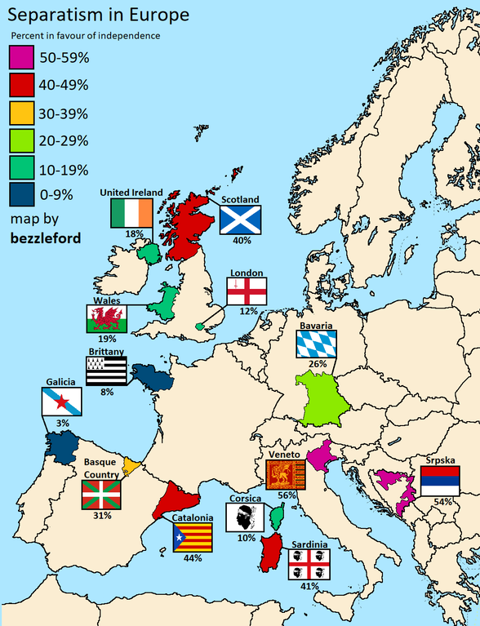
This phenomenon is not exclusive to our country. The nationalist phenomenon seems to extend to the rest of the continent, as we see in the map published in a newspaper.
Examples of this are the Corsican nationalism in France, the northern league in Italy, the recent referendum in Scotland or the tensions with the Flemish population in Belgium.
Notes:
Moises

Slide 5
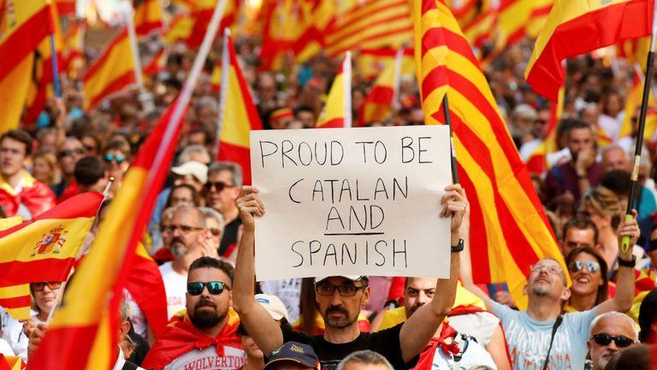
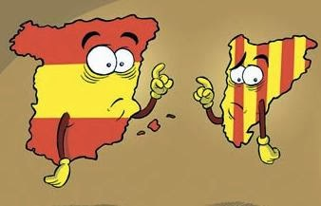
Lots of options have been evaluated and the majority of the experts conclude that an unilateral declaration of independence does not seem to be the best option. In any case, it must be an agreed solution that includes all sensitivities, be it a legal referendum or federalism.
In these times of integration and European globalization, nationalist claims do not make much sense.
Notes:
Laura

Slide 6
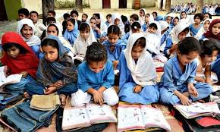
2. HEALTH, HOUSING AND EDUCATION RIGHTS
The objective of this research is to explain why all Spaniards born or not in Spain have the right to sanitation, public education and decent housing. And to what extent do the Spaniards have these rights.
Notes:
Ana

Slide 7
HEALTH RIGHTS
We believe in a public health system accessible to all Spanish people, in which everybody can have health rights. As regards foreigners, immigrants and visitants, we can affirm that, currently, they have granted access to all this as well.
We, as teenagers, claim that they should always have medical assistance according to the conventions included in our constitution and the international civil rights laws.
Notes:
Alba

Slide 8
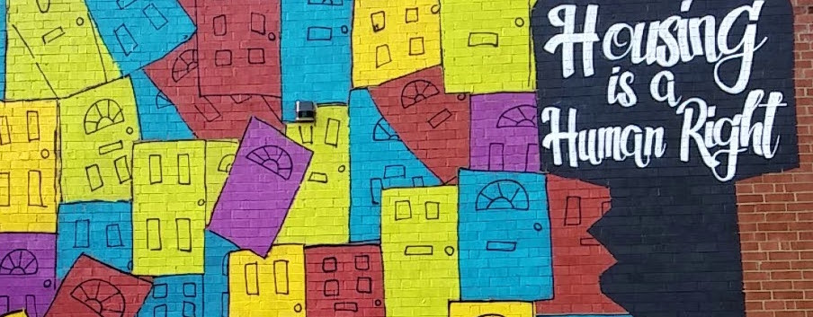
HOUSING RIGHTS
The right to housing has suffered a decline during the economic crisis (especially in 2008) when many people lost their homes because they could not pay the debt they had acquired with the banks.
Solving the problem of the homeless remains a great challenge to achieve. Another big concern is the housing speculation, although banks and people are more aware of risks after the crisis.
Notes:
Celeste

Slide 9
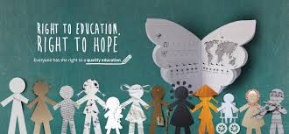
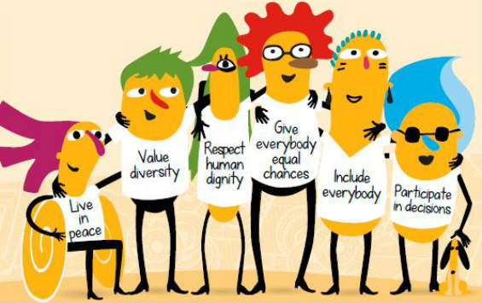
EDUCATION RIGHTS
In Spain, all children under 16 must attend school, both private and public. Access to a free public education allows us to use great advances to guarantee great opportunities for our future, both in academic and personal terms. Although university studies are not free, there is a system of government grants and scholarships which provides that students fulfill the requirements.
Notes:
Alba

Slide 10
As a conclusion, we can say that healthy and education are two of the most respected and guaranteed rights in Spanish society. There are aspects to improve but our country is among the best ones in Europe.
However, housing right is a right which must be improved in Spain, a right where politicians must act without being influenced by the large construction companies nor the banks.
Notes:
Celeste

Slide 11
3.-CENSORSHIP AND FREEDOM OF EXPRESSION
The objective of this presentation is to illustrate censorship in music, politics and social networks in our country.
We looked on internet different websites and we asked our English teacher.
Notes:
Moises

Slide 12
Definition
Censorship is the power exercised by a state, a person or an influential group to prohibit a series of threatening ideas against the stability of a person or a group of people.
As examples of censorship, we'll mention several cases of it in 3 fields :
Notes:
Gonzalo

Slide 13
IN MUSIC : Becky G was censored in a TV program in Spain (Operación Triunfo). The singer had to change the controversial lyrics of “Mayores”to make it more 'white'. Check : https://twitter.com/i/status/925135253177593856
IN POLITICS : We can find many types of statements like this one: “I have sometimes been the victim of censorship for my political opinions, for criticizing Cuban socialism (said a Cuban exiliated); or radical feminism, for being against Islamic terrorism and denouncing its atrocities”.
IN SOCIAL NETWORKS : The TV presenter and radio announcer, Nuria Roca, was the victim of social media censorship. Instagram deleted one of her images in which she showed the shadow of her naked chest.
Notes:
Moises

Slide 14
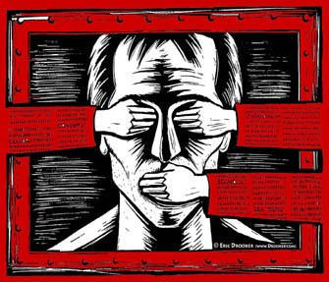
CENSORSHIP IN SPAIN
In Spain, every day more cases are added to the list of violations of the right to freedom of expression . All types of collectives have been victims: rappers, journalists, artists, actors. For instance, Cassandra Vera was denounced in 2016 because of some tweets joking about the death of Carrero Blanco. The complaint was filed by the Civil Guard.
Notes:
Laura

Slide 15
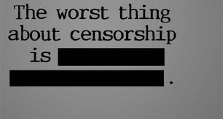
As a conclusion, we have observed that there is more censorship than we see on daily bases and that we could think since we are in a democratic country.
Notes:
Ana

Slide 16
4. INTERVIEWS WITH LOCAL POLITICAL LEADERS
We wanted to know the opinion of local political leaders and tried to interview the most of them.
We had some problems with the neoliberal-right party “Ciudadanos” and the center-left party PSOE to get the interview. But we did it with the left party “Podemos and IU” and the right party “PP”. The extreme-right party VOX doesn’t have any seat in our city so we couldn’t obtain an interview.
Notes:
Ana

Slide 17
Interview
What is the most important thing that Spain has achieved in these 40 years of representative democracy?
Podemos; Fundamental rights have been achieved, women's rights, labor rights ... That are currently in danger
PP; Personal freedoms, although there is still a lot to achieve as we are a young democracy.
Notes:
Celeste

Slide 18
Does our democratic system have flaws? If yes, what would you change?
PP;Yes because there are so many cases of corruption showing that something is failing in our democratic system. Maybe we should control the number of years a politician is in public life.
Podemos; Our democracy is good and it is the best thing to ask to happen in Spain at the time but it is like a wound without suturing. Although the figure of the dictator fell in, we still have a king that nobody has voted for.
Notes:
Alba

Slide 19
What do you think of electronic democracy?
Podemos; I think that currently it should be implemented because it would facilitate voting and being able to vote for referendums. But above all, it would cause people to get involved.
PP;Well, I don't agree entirely with it because we will be in the hands of hackers and I think it is very easy to manipulate the votes.
Notes:
Celeste

Slide 20
As a conclusion, there is a common thought about our democracy: the majority of the population and almost all the political parties think our Constitution and other key laws need changes but, in 40 years, any change has not been made.
This is because of, according to our constitution, two thirds of the congress are necessary for the changes. And, when they have the ability to do it, they don't because the current situation benefits the biggest political parties.
Notes:
Alba

Slide 21
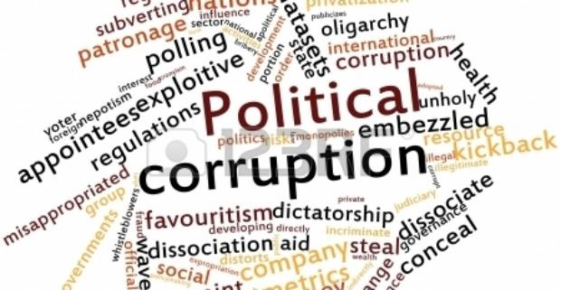
5. POLITICAL CORRUPTION SURVEY
We have done a work on corruption in our country (Spain) and for this we have decided to make a survey with several questions about corruption.
For this we have sent the survey to 60 people, whose answers are summarized in the following slides.
Notes:
Alba

Slide 22
Q1: More than 90% of interviewed people think corruption is a problem.
Notes:
Alba

Slide 23
Q2: Almost ¾ of the people conclude that corruption affects economically and socially.
Notes:
Alba

Slide 24
Q3: 80% of the people are of the opinion that the media inform us about scandals they want to be known
Notes:
Alba

Slide 25
Q4: Generally speaking, population hold that all the political parties are corrupted.
Notes:
Gonzalo

Slide 26
Q5: 40% of the interviewed people maintain that corruption is intrinsic of politics; 37% think the opposite.
Notes:
Gonzalo

Slide 27
Q6: The majority of our interviewed people believe that politicians enjoy some impunity.
Notes:
Gonzalo

Slide 28
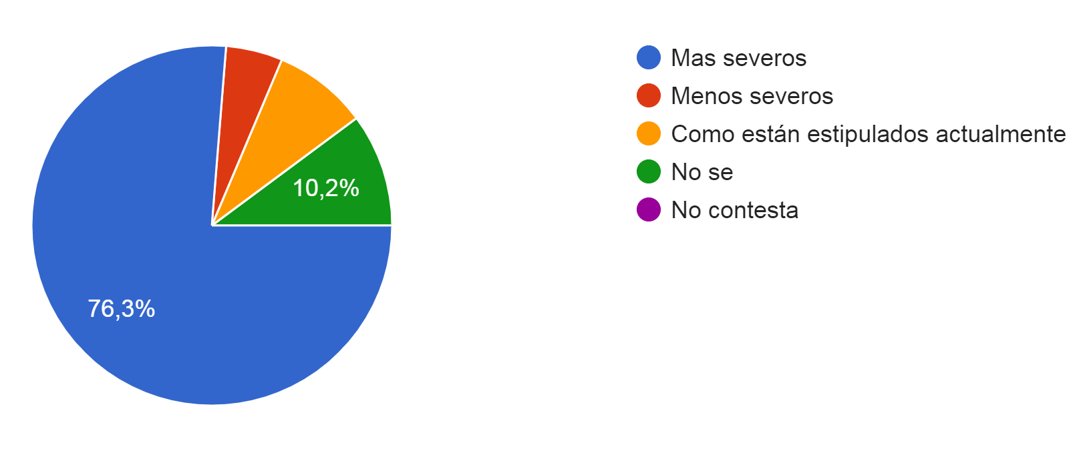
Q7: 76% of the people assume that politicians should be punished more severely.
Notes:
Moises

Slide 29
Q8: Almost everyone thinks that politicians should resign.
Notes:
Moises

Slide 30
Q9: 86% of the people believe that the image of politics is damaged by the corruption.
Notes:
Moises

Slide 31
Q10: 60% think that it is possible to eradicate corruption, although another 15% don’t know
Notes:
Laura

Slide 32
All the political parties consulted agree that corruption is a problem that must be solved so that people continue to believe in politics.
We must avoid generalizing because corruption is due to specific people who misuse politics. That is why it exists in all political parties.
The solution is that the different parties have internal rules that prevent corruption and pursue it with the measures offered by constitutional laws.
If a political party is not able to offer an honest image it will lose the support of its voters.
Notes:
Laura

Slide 33
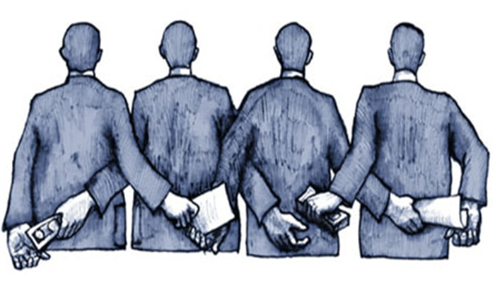
As a conclusion we can say that Corruption in politics is the problem that most worries the Spaniards.
It affects all political parties equally.
The solution is not clear but we must not accept this fact as something usual and daily; instead, we should demand the punishments to be harder and the politicians to be a model of honesty.
Notes:
Celeste

Slide 34
6.- RESEARCH ABOUT JUSTICE QUALITY IN EUROPE
We want to know what is the quality of justice in Spain and other countries around us.
For this, we rely on the Law Index® of the World Justice Project that measures the general state of the law in 126 countries and jurisdictions around the world based on more than 120,000 household surveys and 3,800 experts. With primary data, the WJP State of Law Index measures the performance of the rule of law of the countries through eight factors:
Restrictions in the public powers, Absence of corruption, Open Government, Fundamental Rights, Order and security, Compliance with The regulations, civil justice and criminal justice.
Visits: https://worldjusticeproject.org/our-work/wjp-rule-law-index
Notes:
Ana

Slide 35
The index places the top ten countries where the justice system is the best one. These countries are Denmark, Norway, Finland, Sweden, the Netherlands, Germany, Austria, New Zealand, Singapore and the United Kingdom. All these countries receive more than 80 points on a scale of 0 to 100.
Portugal receives less than 71 points and, even less our country , which receives only 70 points (23th position in the list). Italy receives 64 points, Greece is in the 41th place with 60 points and Turkey occupies the 99th place with 43 points.
COUNTRY | SCORE | GLOBAL RANKING
Portugal | 0.71 | 23
Spain | 0.70 | 24
Italy | 0.64 | 35
Greece | 0.60 | 41
Turkey | 0.43 | 99
Notes:
Celeste

Slide 36
In general, reading the Index, we might say that there is a direct relationship between justice and the economic status of the countries.
But nevertheless some countries with money do not have as good justice as others with less money. For example, the Czech Republic is in a higher rank despite being a developing country.
In general, good justice is expensive and is something that poor countries face.
Notes:
Gonzalo

Slide 37
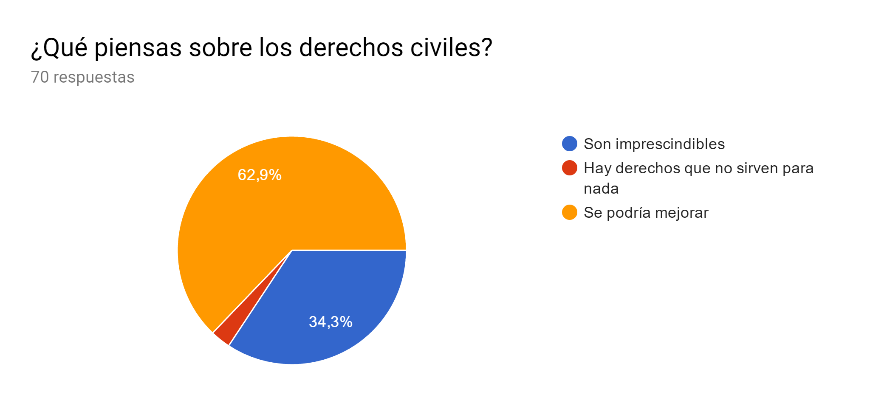
7. CIVIL RIGHTS SURVEY
In our work we interviewed seventy people and these are their answers:
1.What do you think on Civil Rights?
62,9% think that the civil rights could be better, 34,3% think that they are essential and very little people think that some of them are useless.
They are essential
Some of them are useless
They could be better
Notes:
Moises

Slide 38
2. Do you think that the right to equality is honoured in Spain?
60% of people think that the right to equality in our country isn’t totally honoured and there are many limitations.
A remarkable thing is that a great percentage (34.3%) believe that this right isn’t honoured.
No
Yes
Not fully because there are still some limitations.
Notes:
Moises

Slide 39
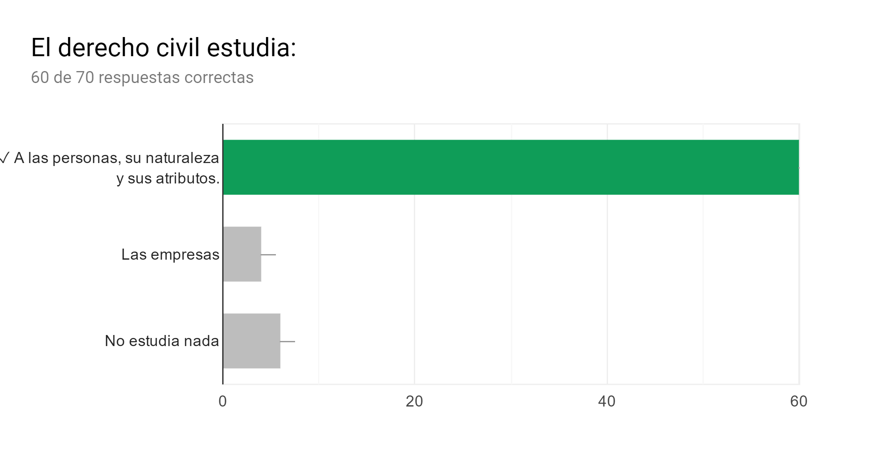
3. Civil Rights defend fields such as:
80% of people think that the civil rights defend mostly the people, its nature and features. Very little people think that they protect businesses and but more people believe that they don't protect anything at all.
People, its nature and features
Businesses
Nothing
Notes:
Laura

Slide 40
4. Which is the most violated civil right?
25,7% of people think that the most violated civil right is the right to privacy, followed by the right to freedom of speech (22,9%).
Right to intimacy/privacy
free circulation
right of asylum
right to nationality
right to free marriage
freedom of speech
freedom of assembly
right to work
Notes:
Laura

Slide 41
To sum up, we could affirm that civil rights are one of the aspects that guarantee a democratic system but the proper development of these rights depends on the economic development of the country. Countries need large investments of money to guarantee them. This is the case of the right of asylum due to the massive influx of immigrants.
Notes:
Ana

Slide 42
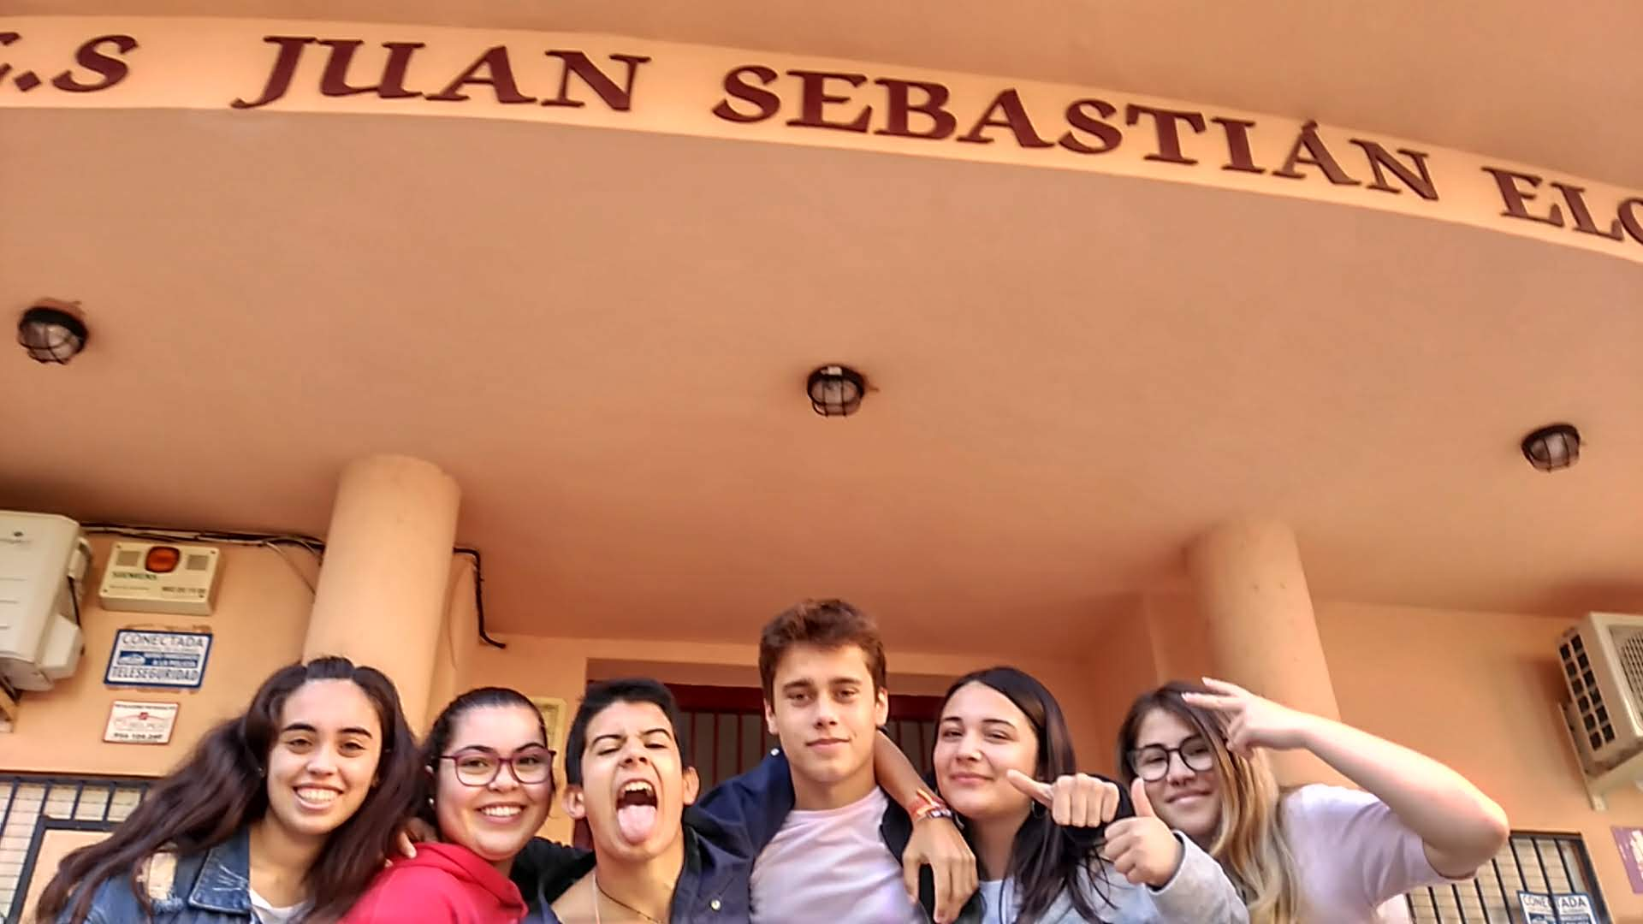
Credits
More than thirty students developed this research work.
Also eleven teachers act as guides of the investigation.
Thanks for your attention

