Slide 1
Associations
Project ERASMUS+

Slide 2
Index
Associationism
La Borraja
House Medina Sidonia Foundation
Ecologistas en acción
Association of friends of the Saharaui people “La Jaima”

Slide 3
Associationism

Slide 4
What is the associationism?
An association is a group of people constituted to carry out a collective and non-profit activity. Formally, they are independent of the State, political parties, companies...

Slide 5
How do we create an association?
We need at least 3 components (A president, a treasurer and a secretary) and they must follow these steps:
Elaborate the statutes of the association.
Obtain the foundational certificate of the legal association.
Register the association on the National Register of Associations.
Request the provisional VAT.
Open a provisional bank account.

Slide 6
How do they get their money?
The associations can be financed through two ways: publicly and privately.
The last one can be also:
Physical private funds
Legal private funds

Slide 7
LA BORRAJA

Slide 8
WHAT IS IT?
It’s an association of producers and consumers
of ecological products: fruits and vegetables grown in areas of Sanlúcar de Barrameda. They are integrated in the FACPE (Andalousian Ecological of Consumers and Producers Federation).

Slide 9
ORGANIZATION CHART
There is a president for legal purposes but decisions are taken in an assembly between all members of La Borraja. A meeting is called every two months.

Slide 10
OBJECTIVES
-Promoting the ecological products and food sovereignty.
-Promoting the local commerce. Transportation is expensive and pollutes. Consume local and seasonal.
-Promoting the consumption of products without pesticides, emulsifiers, additives …
-Fighting against excessive consumerism and multinationals monopoly.

Slide 11
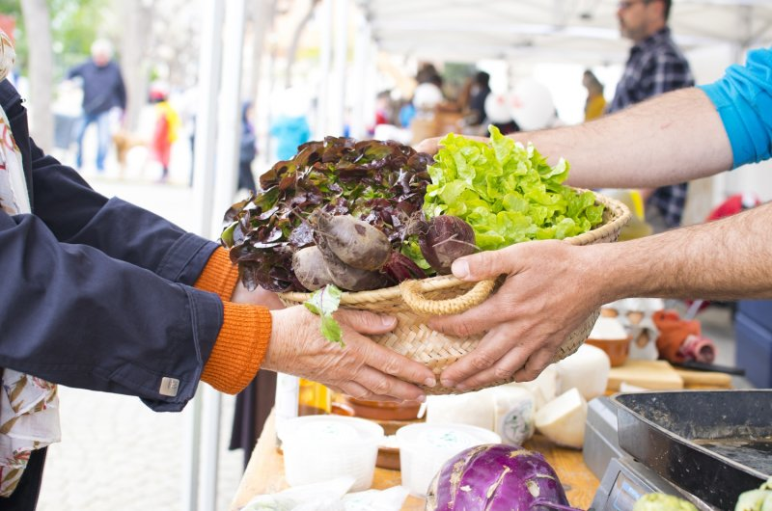
How is it financed?
La Borraja has a very simple financing: with the sale of the products.
Although La Borraja wants to minimize mediators, they keep a small percentage of the products sold to pay shopkeepers.
The premises are subsidized by the City Council.

Slide 12
MEDINA SIDONIA

Slide 13
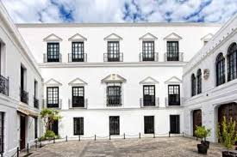
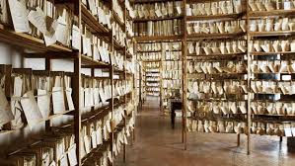
WHAT IS IT?
A non-profit organization created in 1990 by Mrs. Luisa Isabel Álvarez de Toledo, Duchess of Medina Sidonia, to preserve the Guzmanes Palace as well as its garden and all the documents of the House of Medina Sidonia (compilation which goes over 6000 files).
When the duchess' father died without any will, the foundation was created to protect the files and the three houses he owned.

Slide 14
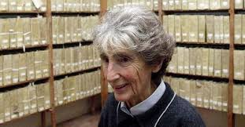
ORGANIZATION CHART
Founding president: Doña Luisa Isabel Álvarez de Toledo (deceased)
Current life president: Doña Liliane Marie Dahlmann. Leadership: Leoncio Alonso González de Gregorio Álvarez de Toledo(son of the duchess who, along with his brothers, claims a part of the duchess's inheritance; these situation was longtime controversial because the duchess ' will left everything to his partner)
Vocals: Don Laureano Rodríguez Liañez; Don Manuel Jesús Barba Calvo; Doña Marta Solórzano

Slide 15
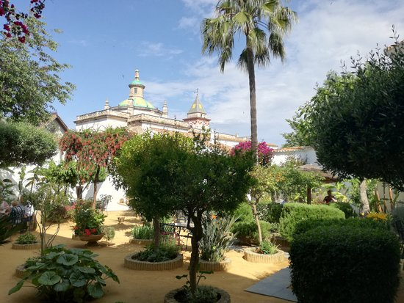
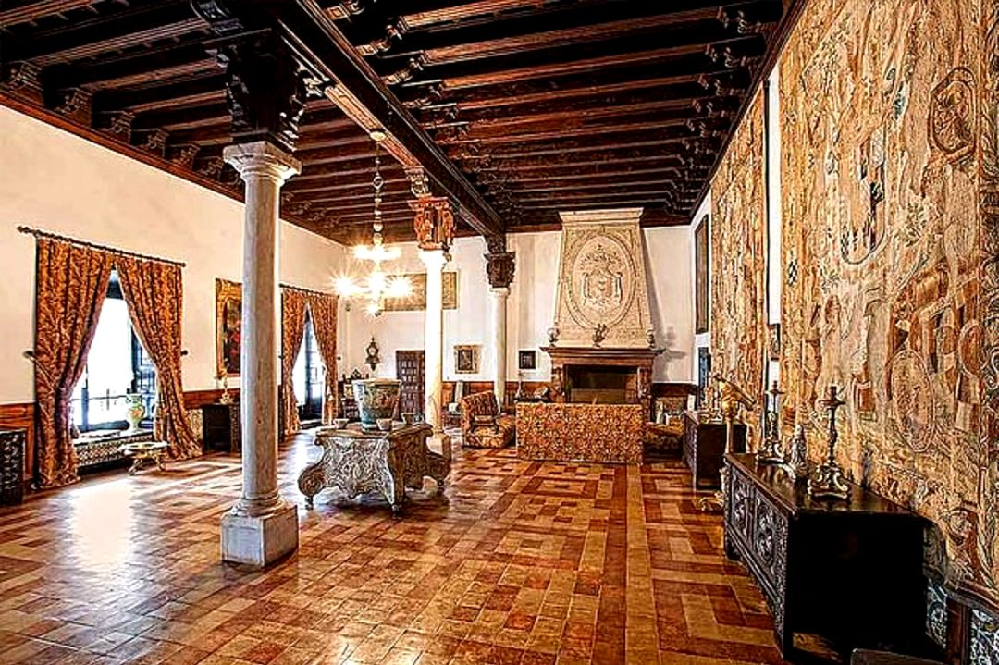
OBJECTIVES
Keep and spread the importance of the properties:
The Palace of the Guzmanes, declared in 1978 Monument of Cultural Interest;
His pictorial heritage and the furniture in the palace;
The garden, laid out in 1541;

Slide 16
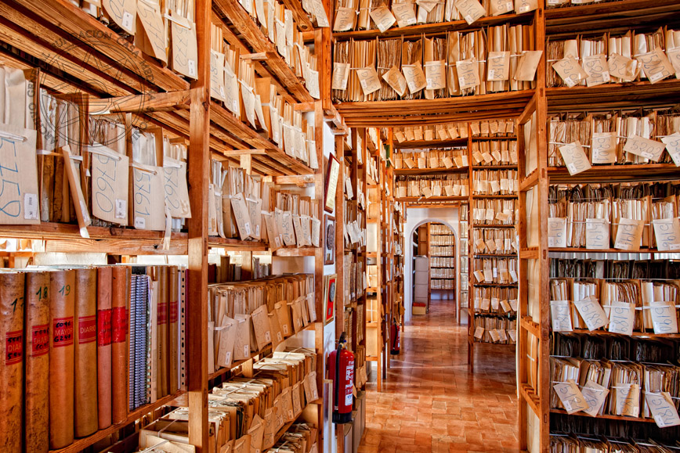
But the most important is the historical archive composed of more than six million documents mainly generated by the House of Medina Sidonia and its integrated noble houses.
The documents are dated from the twelfth and the thirteenth centuries. But most of them are related to America´s discovery and the history of Spain from that historical moment.

Slide 17
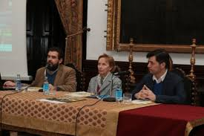
How is it financed?
The foundation is maintained thanks to the capital of the duchess, received from her father and some contributions from the Spanish government. In order to get more funds, the foundation organises also conferences, seminars, poetry days, exhibitions , guided visits to the palace, concerts ..; and it receives some donations.

Slide 18
ECOLOGISTAS EN ACCIÓN

Slide 19
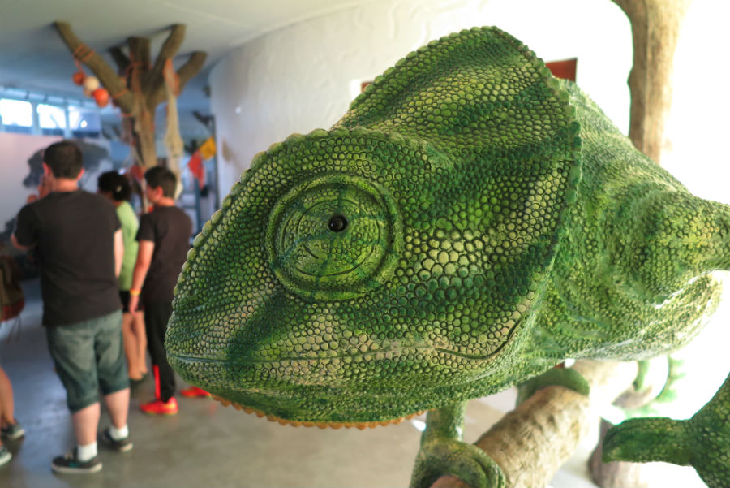
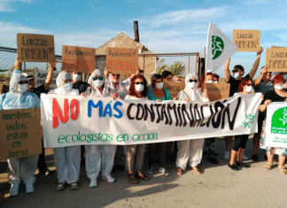
WHAT IS IT?é es?
Ecologistas en Acción of Sanlúcar has its origin in the environmental association Al-Jaramil, which was born in 1989 with the union of three Sanlúcar environmental groups with the aim of uniting efforts in the conservation of nature (chameleon, Iberian lynx…), defending the quality of the environment and promoting peace.
Along these lines, its transformation into Ecologistas en Acción is due to the process of unifying environmental movement throughout the State.
People know their activities because they inform and explain about them using their own resources and sometimes mass media.

Slide 20
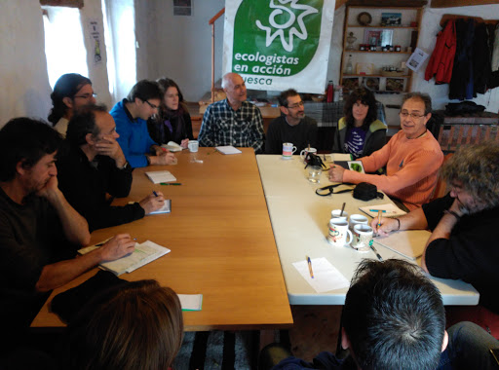
ORGANIZATION CHART
The organization is territorially structured through federations and groups, which are the organisational and decision-making basis of the association.
This decentralized organization chart is based on the principles of an assembly as the highest decision-making body. All the groups that make up the confederation share the same ideological principles and they meet in the annual confederal assembly to decide the strategic lines of the organization.

Slide 21
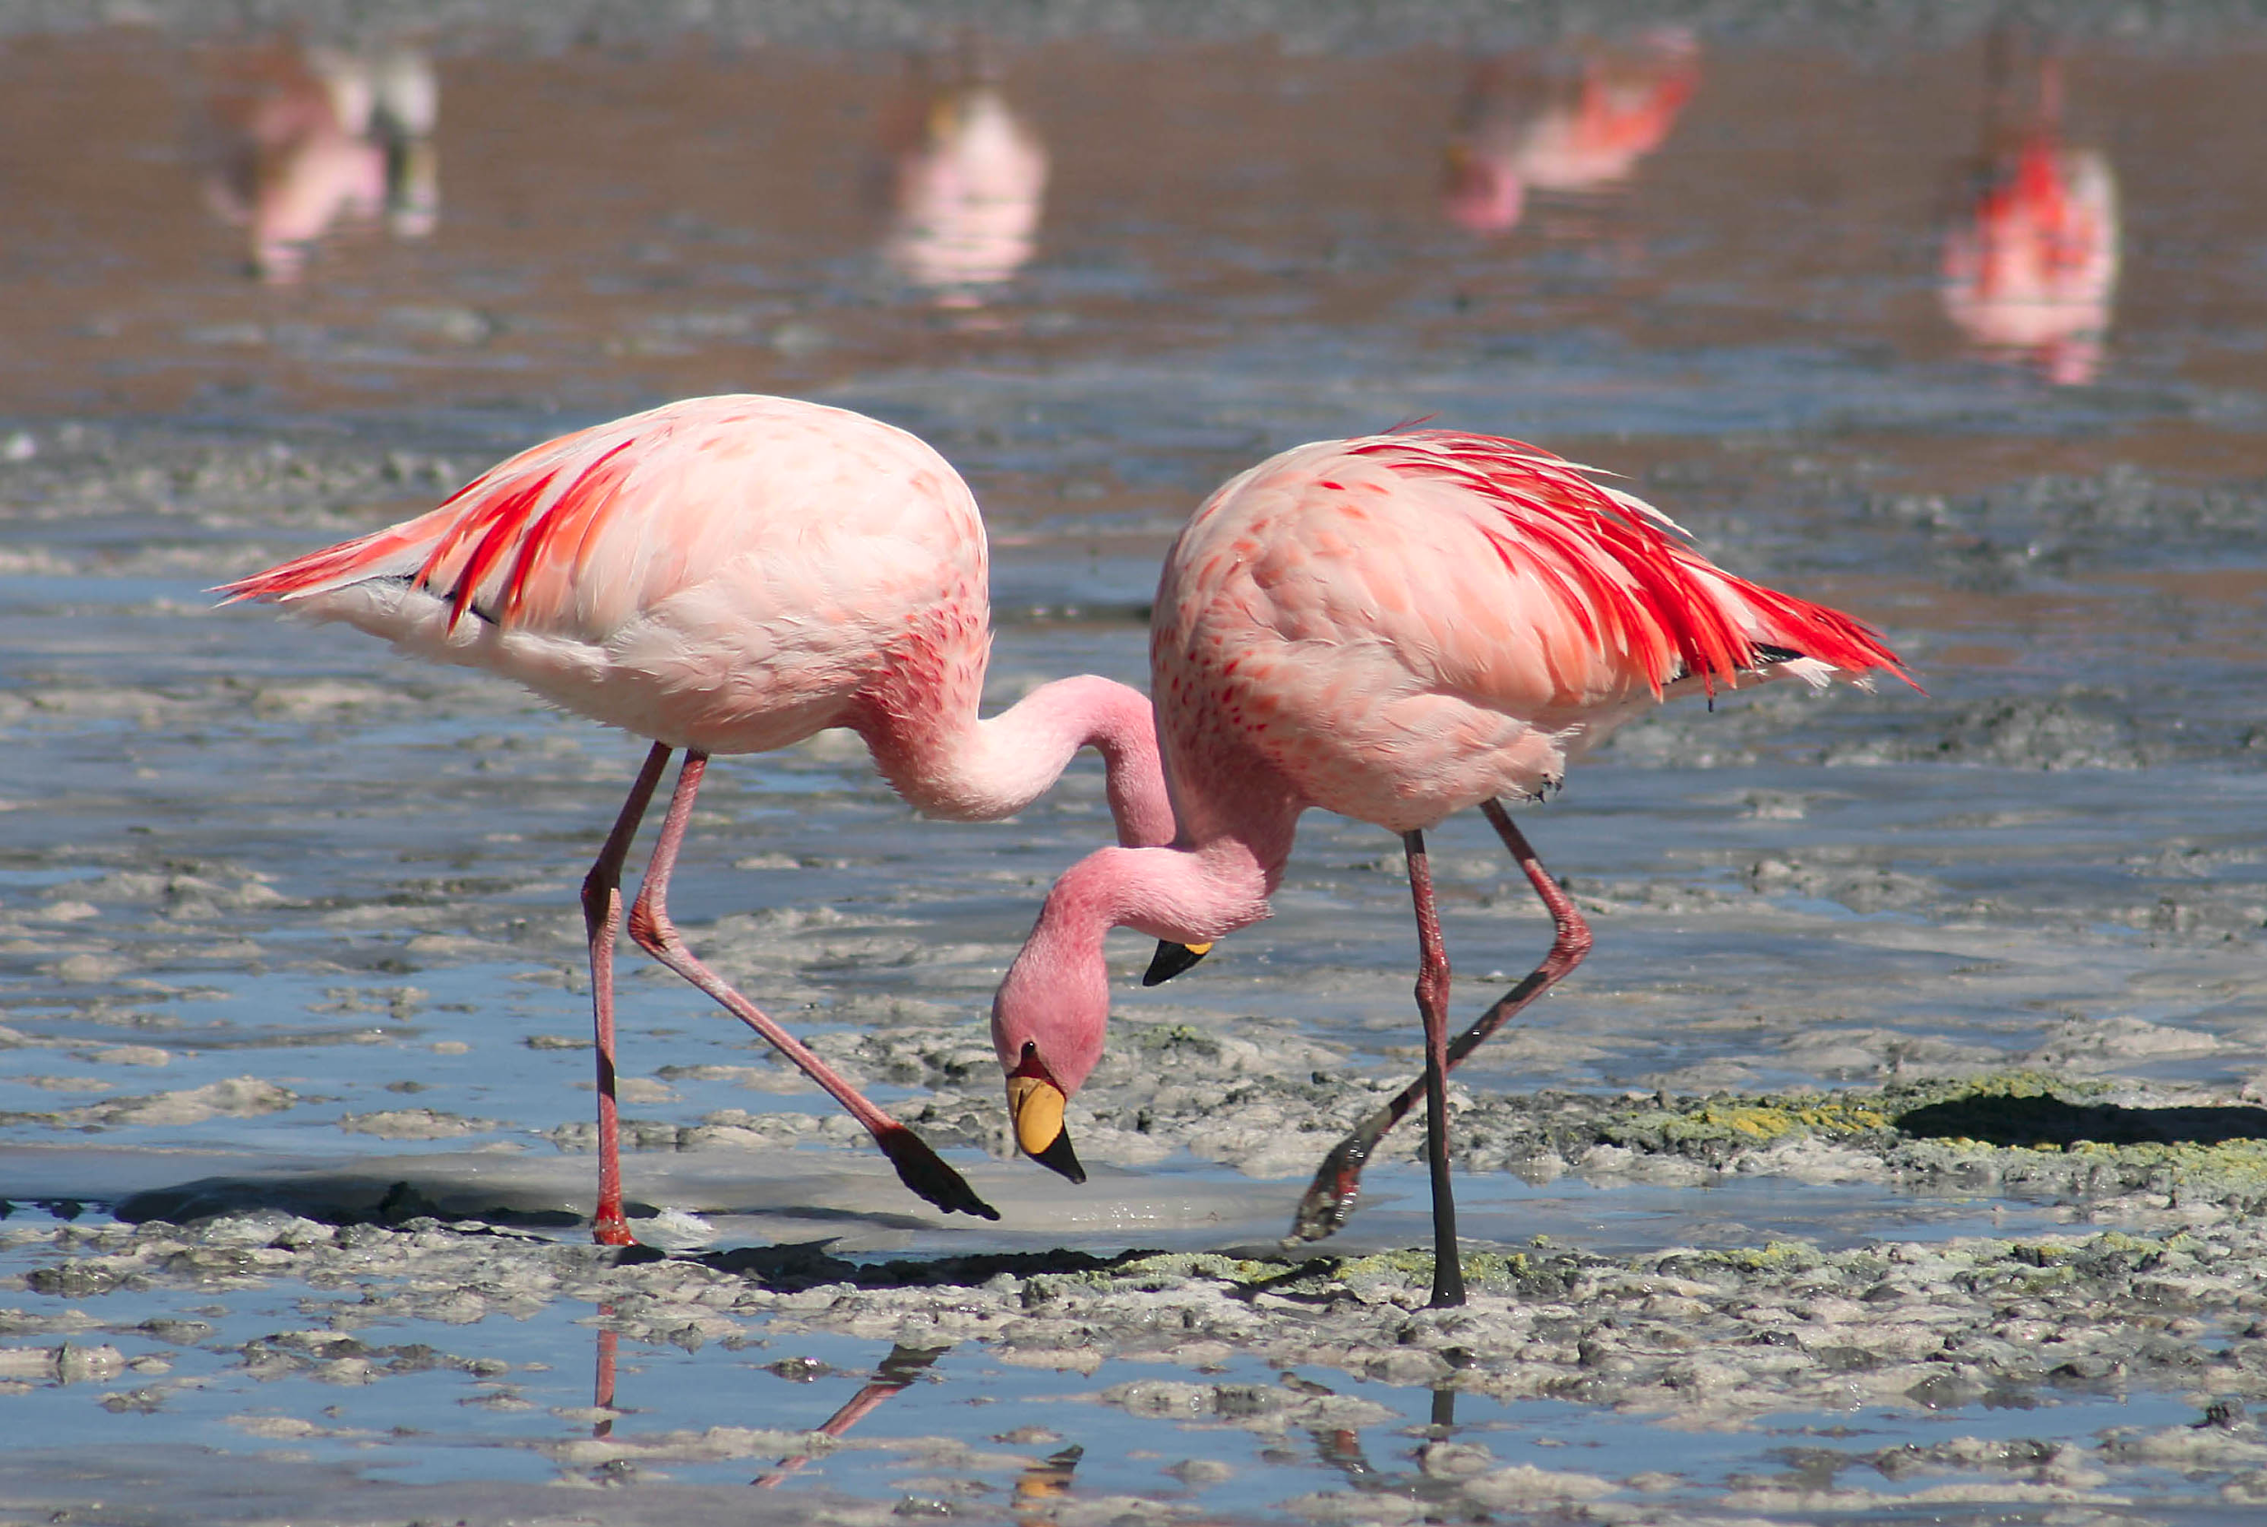
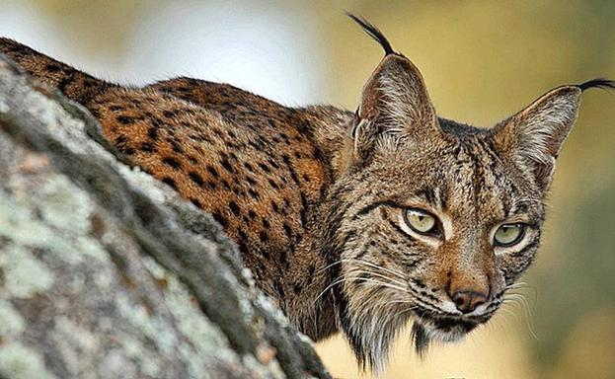
OBJECTIVES
Among the many activities they have been developing we can underline:
Developing a network of protected areas.
Protecting wetlands (marshes and salt marshes) in order to preserve, among other values, very important populations of waterfowl.
Defending our forests and reforest land destroyed by fires.
Promoting less aggressive agriculture with the environment.
Protection of endangered animal and plant species.

Slide 22
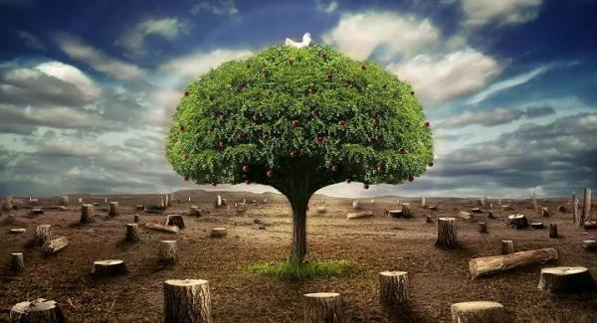
Campaigns for education for peace in Spain and abroad.
Fighting pollution of our waters and our atmosphere.
Defending a more human model with more leisure spaces and public facilities.
Increasing ecological self and public awareness through programs and campaigns of environmental education.

Slide 23
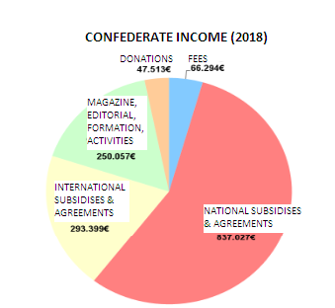
How is it financed?

Slide 24
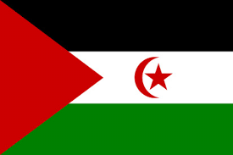
ASOCIACIÓN DE AMIGOS DEL PUEBLO SAHARAUI
“LA JAIMA”

Slide 25
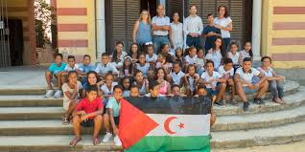
WHAT IS IT?
The association was born to respond to the needs of planning humanitarian assistance directed at Sahrawi refugees. A specific reason is that some of the volunteers or workers are in the association because they feel responsible and / or guilty because in 1975 the Sahara was a Spanish territory, and we let the Moroccans throw the Saharawi people away from being an autonomous people.

Slide 26
ORGANIZATION CHART
President: Francisco Gutiérrez Vicepresident: Purificación Cámara
Secretary: Javier Rascón Caballero Treasurer: Encarna Gil Marín
Vocal and responsible of the program “Holidays in peace”: Carmen Martínez
Vocals: Lázaro Coronado, Sixta Ruztarazo, Mª Angeles Cobo Serrano, Francisco Hurtado, Lola Carmona Talavera, Lucía Coronado Ruztarazo, Yolanda Merino Torres, y Juan Cobo Quesada.

Slide 27
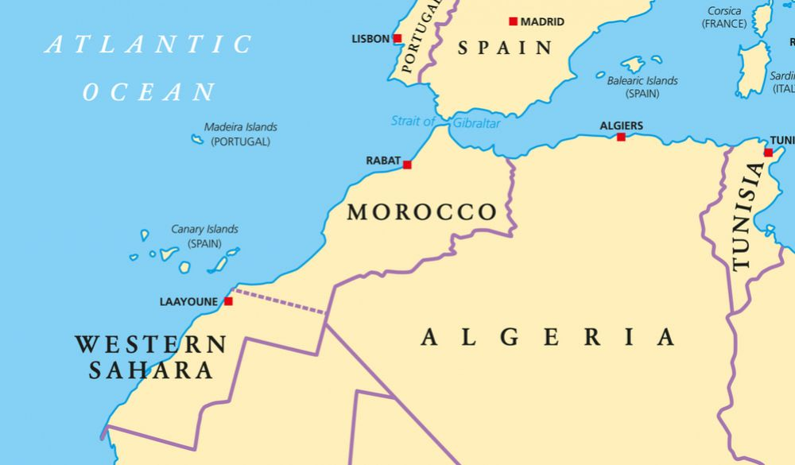
OBJECTIVES
Helping Saharawi people, for example, with a campaign gathering food to send to them.
Improving the living conditions of both Sahrawi refugees and the population living in the Western Sahara occupied by Morocco.
Hosting children in summer for two months so that they are not living in such rude conditions, in addition to receiving medical attention, etc.

Slide 28
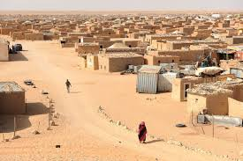
How is it financed?
The Government Council provides financial help aimed at strengthening infrastructure for the provision of food in the refugee camps of Tindouf. They get money as well by organizing different events like football matches.

Slide 29
History of associations

Slide 30
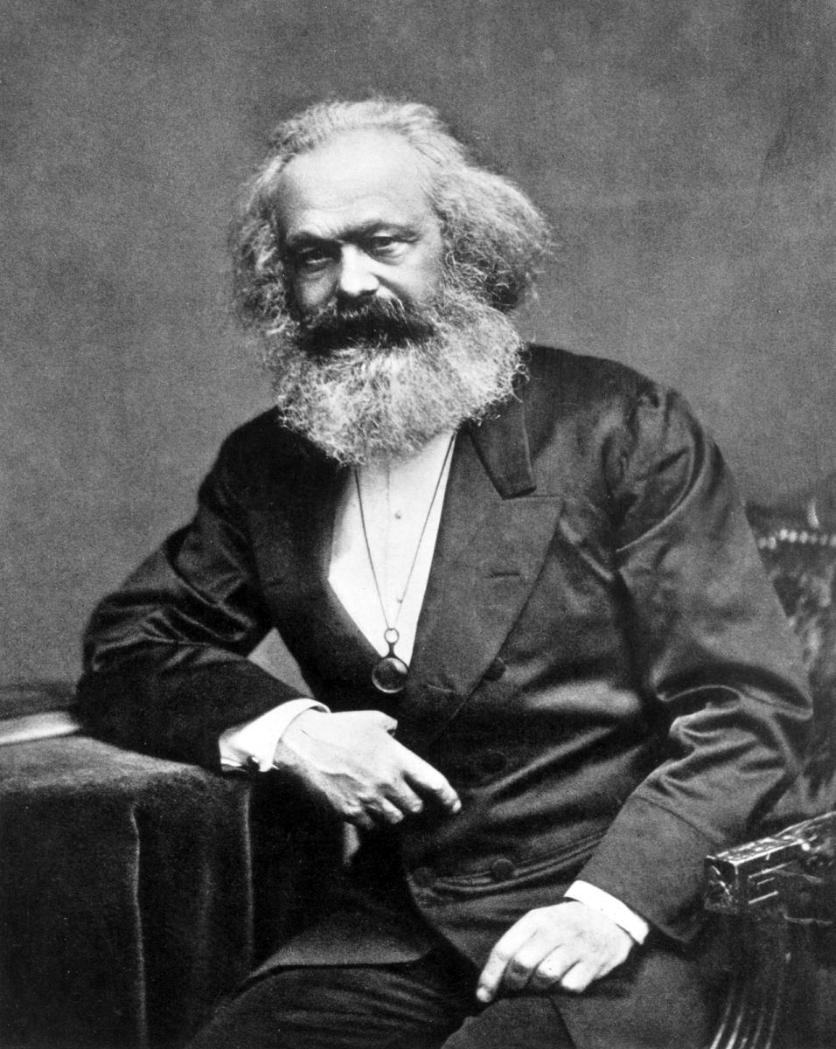
First Association
International Workers' Association (IWA)
It was created in the 19th century in an international meeting which took place in London where thinkers all over the continent met with the purpose of creating a united left. Since the first meeting, it started being celebrated annually. At first, Marx’s ideas leaded the speech, but little by little Federalism gained power overtaking Marxism. In spite of this, Karl Marx didn’t lose power, he came up with some strategies to stay ahead.

Slide 31
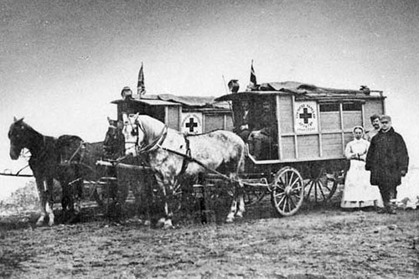
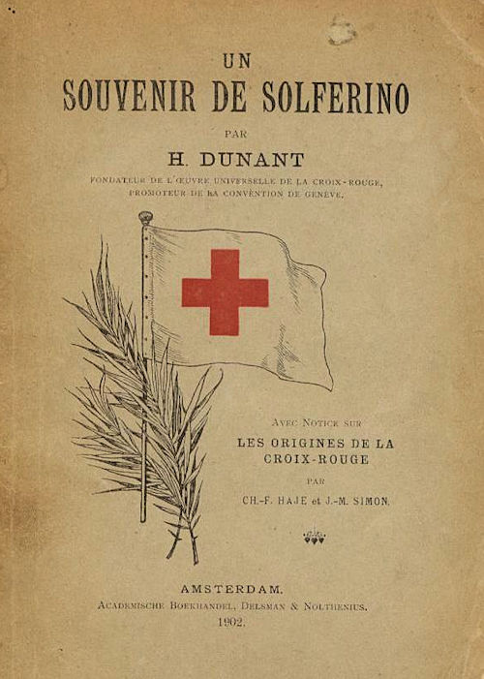
Red Cross
Red Cross is one of the most important associations in the world and it was created the same year as the International Association of Workers. In 1859, Henry Dunant,a businessman, was travelling through Solferino, a city where a battle had recently occurred. There were thousands of injured people and Henry noticed that most of them were dying because they weren’t receiving any help. So, with the help of some women from near towns, he helped these people.
Three years later, he wrote the book "Souvenir de Solferino" where he explained the idea that some volunteers helped the injured people, no matter the side they were on. Just a year later, the International Committee of the Red Cross was created; but still, there was a long administrative way to carry it out.

Slide 32
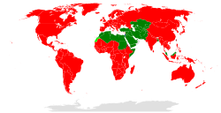
Red Cross
The first time the Red Cross went into action was in World War I, during this war it became an international association and its members multiplied by twenty. During World War II it had greater participation and it became completely independent. At the end of this war, it joined the UN and currently almost all countries are within this organization, divided in two branches: Red Cross and Red Crescent (in muslim countries).

