Slide 1
Research Projects
RIGHTFUL PERCEPTION OF REALITY
Spain
Surveys | Testimonies | Main routes | Statistics
NGO’s | Politicians | Manipulation of public opinion
Notes:
Mario

Slide 2
Survey
Explanation
We want to know what people think about immigration, social problems and politics. So that, we require to make a survey to people.
We are going to make it through the internet and we are also going to make it on the street.
We are going to spread this poll through social media and we would hope obtain a great participation.
Notes:
Maria Marquez

Slide 3
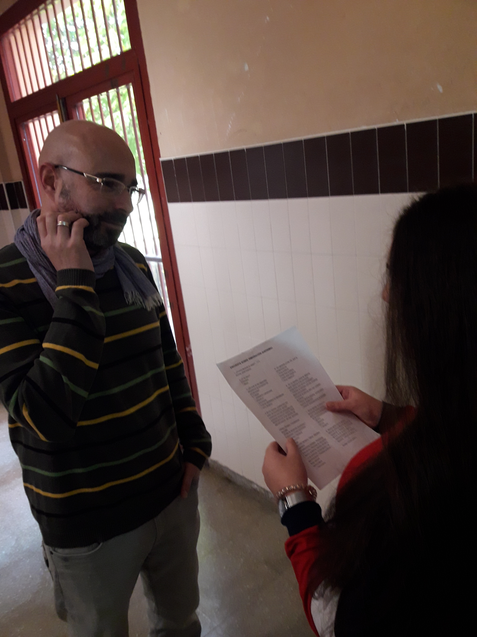
Survey
Results.
We have collected more than four hundred answers, more than we expected. The results are very interesting and now we are going to talk about them.
Notes:
Jairo

Slide 4
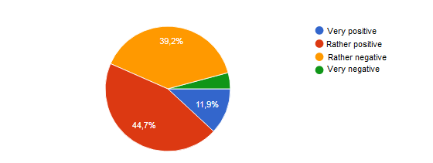
Survey
Results.
We have asked people about their opinion of immigration and they most believe that it is positive, as we can see in this graph:
Notes:
Pablo

Slide 5
Survey
Results.
We have also demand people their opinion about what should we do with foreign people and the results are here:
Notes:
MAria Roman

Slide 6
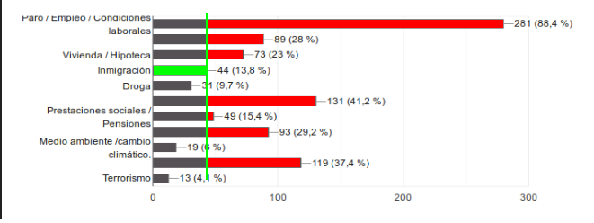
Survey
Results.
The press usually tell us that immigration is a great problem and society is very worried about this. In spite of this, when we asked people about the three biggest issues, immigration isn’t one of them. In fact, it is the seventh trouble in importance.
Notes:
Alejandra

Slide 7
Survey
Conclusions
Thanks to this survey we have been able to understand better the believings of people and also it has been very striking the division of society, since many people think immigration is good for us while another great pourcentage believe the opposite.
We have also discovered that the biggest concern of people is the lack of work.
Notes:
Maria Ruiz

Slide 8
Testimony
Explanation
We want to know the opinion of immigrants about migration, why they decided to come to Spain, their experience, their difficulties...
We are going to make three interviews to immigrants from different countries and ages to give a chance to tell their own story and their perception of immigration.
We had some problems to find immigrants who would want to participate in this project due to the fear to being recognised.
Notes:
Mario

Slide 9
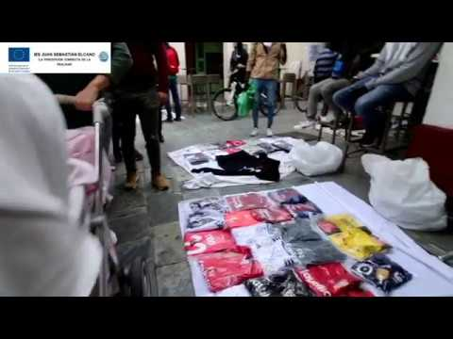
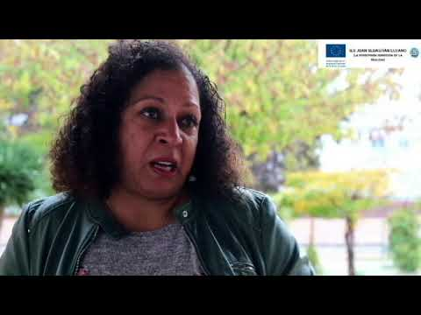
Testimony
Results.
We had made some questions to immigrants from Cuba, Venezuela and Cameroon. We have asked them about the reasons that lead them to leave their countries and these were their answers:
Notes:
Jairo

Slide 10
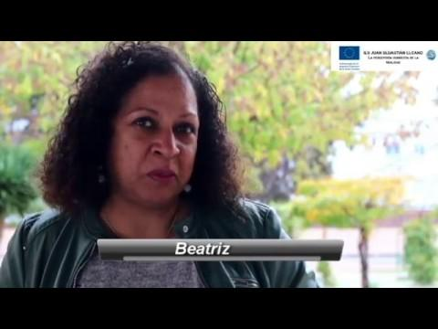
Testimony of a Cuban woman
Results
The reason was the social and economic situation of his country. They leave everything they have there and explain all the problems they have had. At the beginning it is hard to get to another country because of work and social issues.
Notes:
Jairo

Slide 11
Testimony
Conclusions
Thanks to the interviews we can make an idea about the necessity to leave from their country to begin their lives here.
They have to adapt to a new country, find a job related with their studies, go on without their family or communicated with them...
Also, the reality of the situation of their countries is not exactly how the TV try to show us sometimes.
Moreover, we had found out about the problems of children’s immigrants. Sometimes children’s immigrants suffer problems of tolerance in their schools and streets.
Notes:
Maria Marquez

Slide 12
Main routes
Explanation
We wanted to know about the main routes from other countries to Europe. Our objective is to know these routes, and their origins.
We are also want to know the true dangers they have to withstand the journey across the Mediterranean sea.
We had some problems to choose the mains routes because there were a lot.
Notes:
Pablo

Slide 13
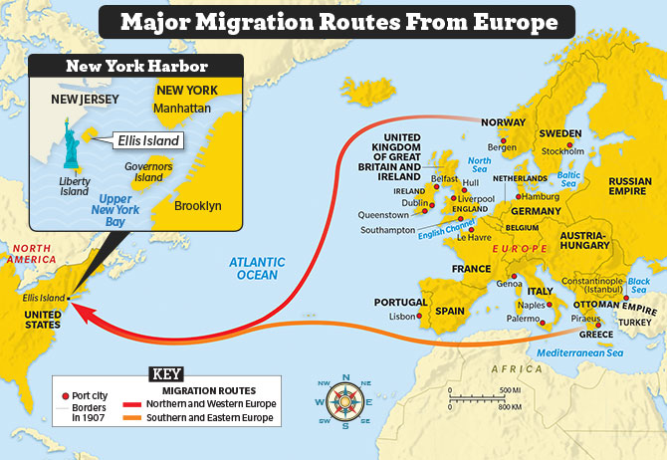
Main routes
Result
There are a lot of routes, there are less important migration routes like :
Western Balkan route
Eastern Mediterranean route
Apulia and Calabria route (italy).
West Africa route
Eastern border route
But the ways more popular are:
Western Mediterranean routes
Central Mediterranean routes
Route to Greece
Notes:
Maria Roman

Slide 14
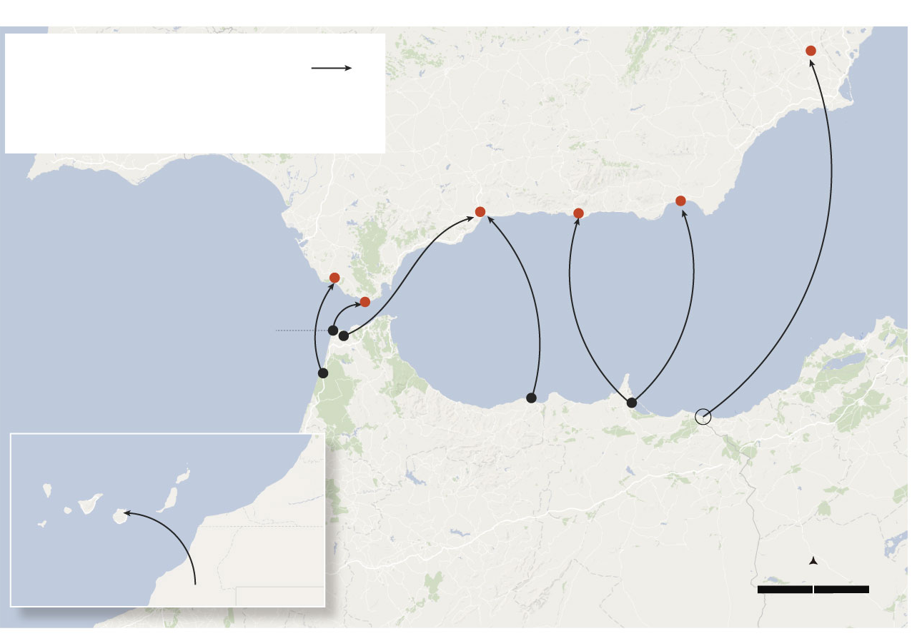
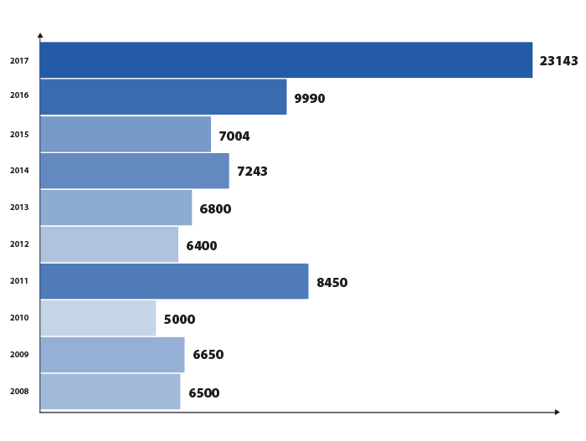
Main routes
Results
WESTERN MEDITERRANEAN ROUTE:
It includes the Morocco-Spain area and also includes both sea and land routes. People fleeing conflicts in Mali, Cameroon, Nigeria, Sudan, Chad, South Sudan or the Central African Republic
Notes:
Alejandra

Slide 15
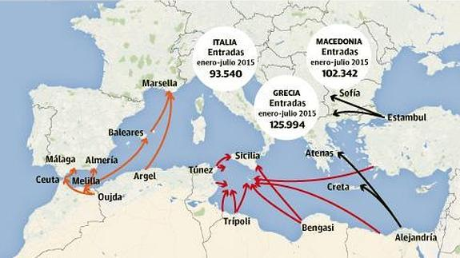
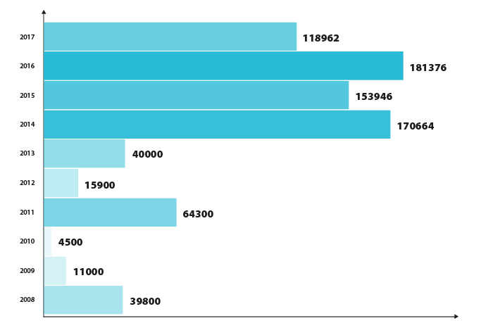
Main routes
Results
CENTRAL MEDITERRANEAN ROUTE:
As of today, the central mediterranean route goes from Libya and Egypt to the Italian coast. Countries of origin: Nigeria, Eritrea and Guinea. It is a very dangerous route where traffickers board the migrants and refugees’ rubber boats and small fishing boats, which can barely carry so many people.
Notes:
Mria ruiz

Slide 16
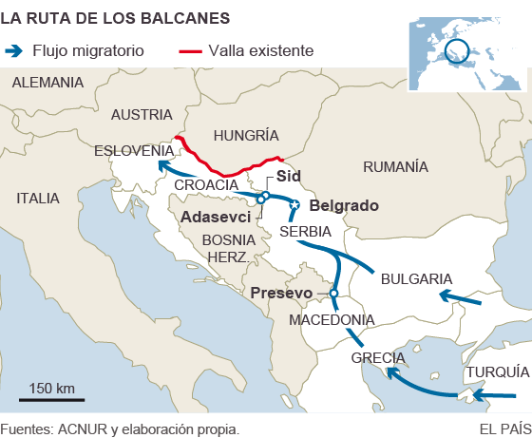
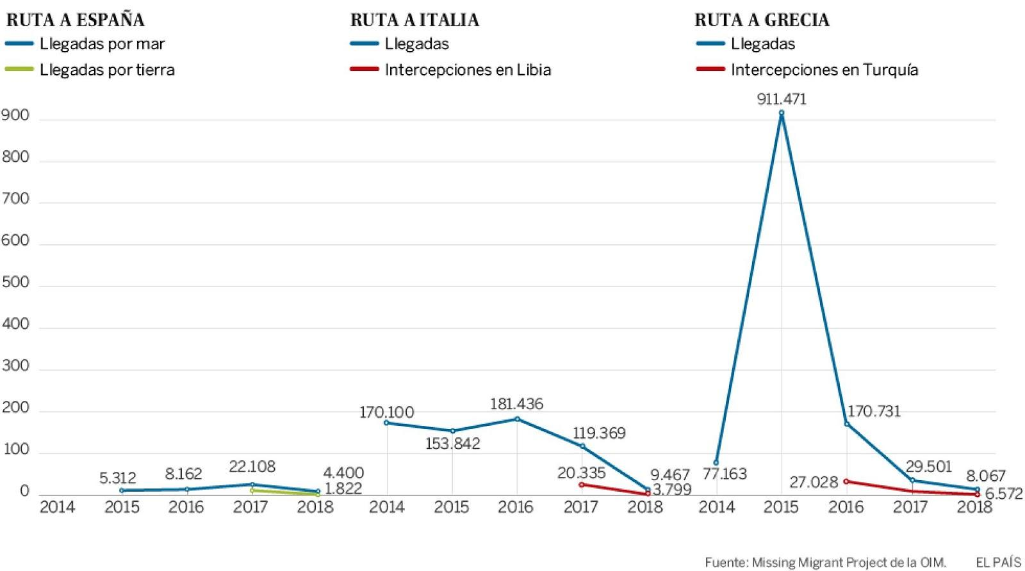
Main routes
Results
ROUTE TO GREECE
The main countries of origin are Albania, Turkey, Libya, Syria and Afghanistan. Currently this route is not widely used, but between 2008 and 2010 it represented more than one third of the total arrivals. In 2011 it suffered a great reduction of usage, but in 2015 the migrants went back to this route.
Notes:
Jairo

Slide 17
Main routes
Conclusions
There are many migrants and refugees who leave their countries in search of a better life. They leave their lives behind thinking they will find something better, but it’s not always like that. Many of them die in the attempt because they cross the straits on flimsy rubber boats which increase the risk of tipping.
One thing that caught our attention is that migrants prefer the illegal ways to the legal ways even though have more dangers and risks because in legal ways they must pay for their visas and their journeys.
Notes:
Mario

Slide 18
STATISTIC OF IMMIGRANTS
Explanation
In this project we can see the number of immigrants that arrive at Sanlúcar de barrameda, Cádiz, Andalucía.
We will teach you the percentage of immigrants and you will see that the number of immigrants that arrive is very little.
Notes:
Maria marquez

Slide 19
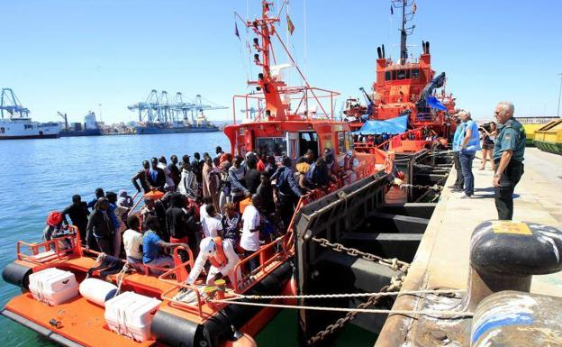
STATISTIC OF IMMIGRANTS
Results
In the province of Cadiz, only 3% of people have a different nationality. That's very few, the average in Spain is 11%.
In the province of Cadiz 13.000 immigrants have arrived in 2018, 47% more than 2017.
Notes:
Pablo

Slide 20
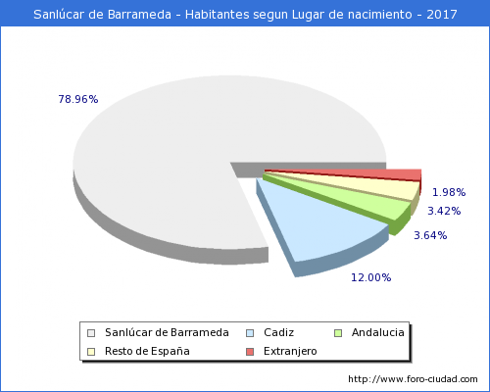
STATISTIC OF IMMIGRANTS
Results
We have done a graphic chart about immigration in our town.
We can see that the percentage of immigrants is only 1.98%. In 1996 the percentage of immigrants was 0.74%.
Notes:
Maria roman

Slide 21
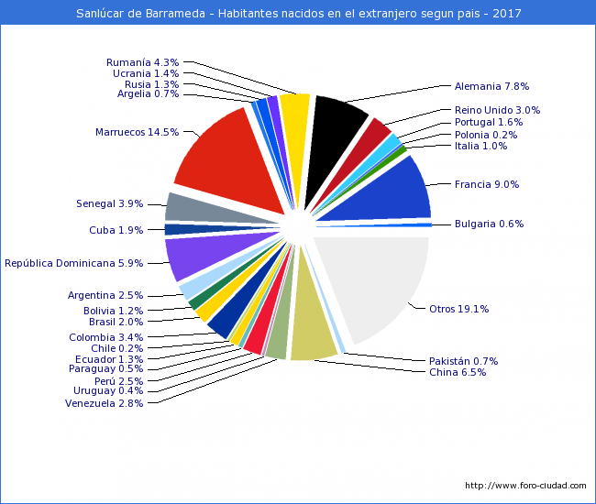
STATISTIC OF IMMIGRANTS
Results
The immigrants’ nationalization in Sánlucar is mainly Moroccan (14.5%), French (9%), German (7.8%), Chinese (6.5%) and Dominik (5.9%).
In the province of Cádiz the mainly nationalization is Bolivian, Moroccan and Senegalese.
Notes:
Alejandra

Slide 22
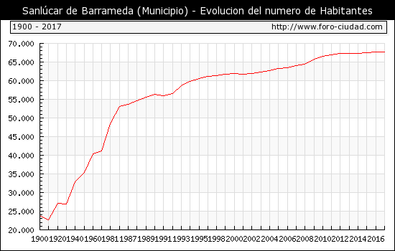
STATISTIC OF IMMIGRANTS
Results
The demography of Sanlúcar has increased. In part, this is because immigrants but there are more factors like high birth rates.
From 1900 to 1920 the population fell approximately 22,000 inhabitants, from 1920 to 1940 the population rises approximately 28,000 inhabitants, from 1940 to 1960 the population is slowly growing but in recent years approximately 68,000 inhabitants remain constant.
Notes:
Maria ruiz

Slide 23
STATISTIC OF IMMIGRANTS
Conclusions
The immigration is not a new thing, it is something that happens daily and we should get used. In this research we looked that the percentage in our town, Sanlúcar, is very low; only 1.98%. Many people thinks that the immigration is negative because they think it has increased but in fact it is not.
Notes:
Mario

Slide 24
NGO’s
Explanation
WE WANT TO KNOW THE OPINION OF THE PEOPLE AROUND US.
We are going to visit some NGOs to inform ourselves about their work and their objectives. We insist on knowing what real work these NGOs do with the money they get and how they use it for the supposed good they do.
Association of Solidary Women
Notes:
MAria marquez

Slide 25
NGO’s
Results
-They work 24 hours every day, providing social services (helping people who are suffering mistreatment by getting them to speak up, donating what is necessary, taking into account the few resources they have, providing labor advice… ). They also offer help to immigrants, mostly from Morocco and Senegal.
-They work daily, 24 hours a day. - They provide social services (help with the mistreatment getting the person to denounce, donate what is necessary, take into account the few resources they have, provide labor advice). -We also offer help to immigrants, mostly from Morocco and Senegal. - The workers of this association earn nothing, in this association are all volunteers. -To prevent people from having to do with their needs, a social worker researches the family to find out if the truth is missing, she always verifies and visits the homes of people in need, always asking for their permission.
-They work daily, 24 hours a day. - They provide social services (help with the mistreatment getting the person to denounce, donate what is necessary, take into account the few resources they have, provide labor advice). -We also offer help to immigrants, mostly from Morocco and Senegal. - The workers of this association earn nothing, in this association are all volunteers. -To prevent people from having to do with their needs, a social worker researches the family to find out if the truth is missing, she always verifies and visits the homes of people in need, always asking for their permission.
-They work daily, 24 hours a day. - They provide social services (help with the mistreatment getting the person to denounce, donate what is necessary, take into account the few resources they have, provide labor advice). -We also offer help to immigrants, mostly from Morocco and Senegal. - The workers of this association earn nothing, in this association are all volunteers. -To prevent people from having to do with their needs, a social worker researches the family to find out if the truth is missing, she always verifies and visits the homes of people in need, always asking for their permission.
Notes:
Jairo

Slide 26
NGO’s
Results
-The workers of this association earn nothing. In this association all people are volunteers, preventing other people from having to do with their needs. A social worker researches the family to find out if the truth is missing, she always verifies and visits the homes of people in need, always asking for their permission.y work daily, 24 hours - They provide social services (help with the mistreatment getting the person to denounce, donate what is necessary, take into account the few resources they have, provide labor advice). -We also offer help to immigrants, mostly from Morocco and Senegal. - The workers of this association earn nothing, in this association are all volunteers. -To prevent people from having to do with their needs, a social worker researches the family to find out if the truth is missing, she always verifies and visits the homes of people in need, always asking for their permission.
-They work daily, 24 hours a day. - They provide social services (help with the mistreatment getting the person to denounce, donate what is necessary, take into account the few resources they have, provide labor advice). -We also offer help to immigrants, mostly from Morocco and Senegal. - The workers of this association earn nothing, in this association are all volunteers. -To prevent people from having to do with their needs, a social worker researches the family to find out if the truth is missing, she always verifies and visits the homes of people in need, always asking for their
Notes:
Pablo

Slide 27
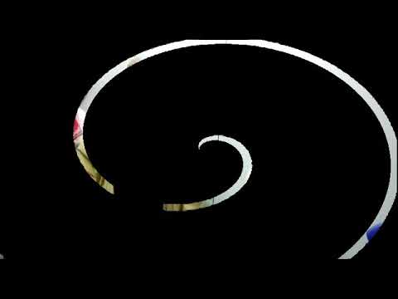
NGO’s
Interview with Solidary Women
Notes:
Pablo

Slide 28
NGO’s
Conclusions
The NGOs have let us know what their work is and everything that helps both immigrants and the national population. We also know that all the money they earn is donated and they do not keep anything, they help the needy as much as they can. And they work without expecting anything in return. Their work is very important and we should value it more and help as much as possible.
Notes:
Maria Roman

Slide 29
Politicians
Explanation
We wanted to know politician’s opinion about immigration and how they are going to solve the problem. That is why we wanted to interview all the main political parties in our country.
We had some problems with one of the main political party that refused to let us interview them(Ciudadanos).
Notes:
Mario

Slide 30
Politicians
Results
Some of the proposed solutions are:
Providing healthcare to immigrants only in actual emergencies (Cs)
Removing all illegal immigrants (Cs, PP y VOX).
Reinforcements of EU borders ( Cs, PP).
On-the-spot deportations (PP)
Open borders decreasing requirements (IU,Podemos)
Social integration policies(PSOE, IU, Podemos)
Closing centres for immigrants (Podemos, IU) and reform it (PSOE).
Assist the voluntary repatriation of immigrants(Podemos, IU).
Notes:
Maria marquez

Slide 31
Politicians
Conclusions
All of them has different opinions but they agree that the problem of immigration born in the home country; if they were there comfortable they was not want to travel such a dangerous travel. The discrepancy arises when they try to act in order to solve the problem.
Notes:
Alejandra

Slide 32
Manipulation techniques of public opinion
Explanation
We want to know if all of information which politicians and rulers, multinational companies, newspapers and news tv said is sometimes manipulated and biased. Also, people said that there are different methods that contributed to modify public opinion. We want to know what are those methods.
Notes:
Maria Ruiz

Slide 33
Manipulation techniques of public opinion
Results
There are lots of manipulation techniques:
to distract the public with other minor problems.
to make the problem something that we would have to worry about in the future.
to speak to the public as they were kids.
keep the public in ignorance.
etc.
Notes:
Alejandra

Slide 34
Manipulation techniques of public opinion
Conclusions
Immigration is being used for some countries that don’t want to welcome immigrants.
An example is that the media are influencing and convincing people to think that
immigrants come to Europe only to commit a crime,
steal the jobs
or they said “in their countries they can live perfectly…”
All this is a lie.
Notes:
Mario

Slide 35
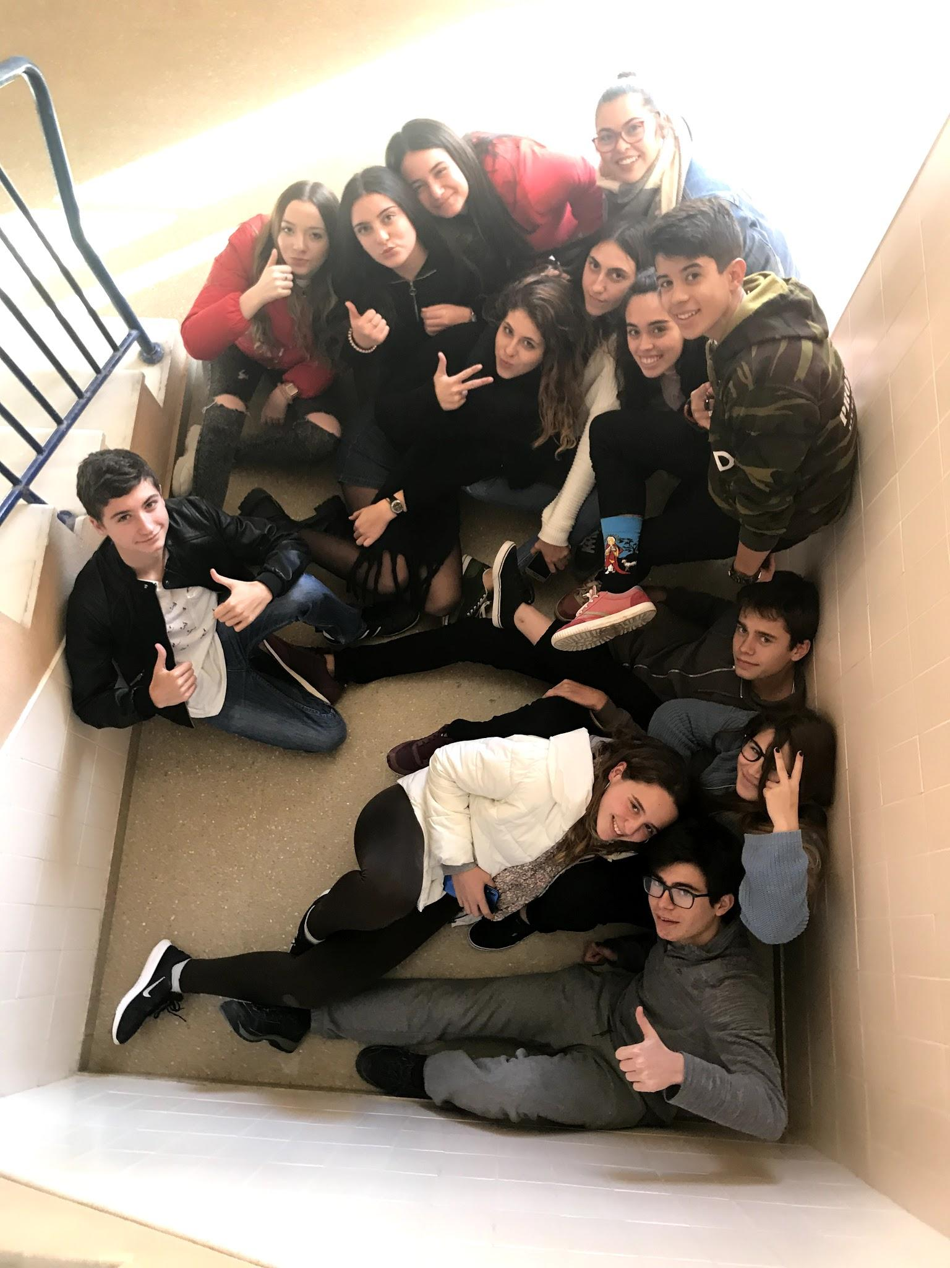
Thanks!
About 50 students and 25 teachers have participated in this work, thanks to them for their work and thanks to you for your attention!
Notes:
Maria marquez

