Slide 1
Steps to create an association

Slide 2
STEPS TO CREATE AN ASSOCIATION
Associations are formed by agreements of three or more people who are committed to sharing knowledge, means and activities to achieve objectives of general interests.
They are not for profit: the benefits obtained by the associations should be used exclusively for compliance of its purposes, without in any case its distribution between the associates.

Slide 3
CELEBRATION OF THE ASSEMBLY CONSTITUTIVE, IN WHICH A BOARD OF DIRECTORS:
President
Vice president
Secretary
Treasurer

Slide 4
2. NAME AND LOGO

Slide 5
3. Estatutes of ISDI
Rules governing the association:
It will have a educational, cultural and inclusive character.
Promote support for immigrants, refugees and displaced.
Promote equality and social inclusion of all immigrants.
Promote and increase solidarity social economy projects.
Promote the values of immigrants.
Awareness and information.

Slide 6
4. Pay the fees and roll in the Andalusian association register
5. Later we have to apply for the taxes number and legalize the minute book, partners and accounting book.

Slide 7
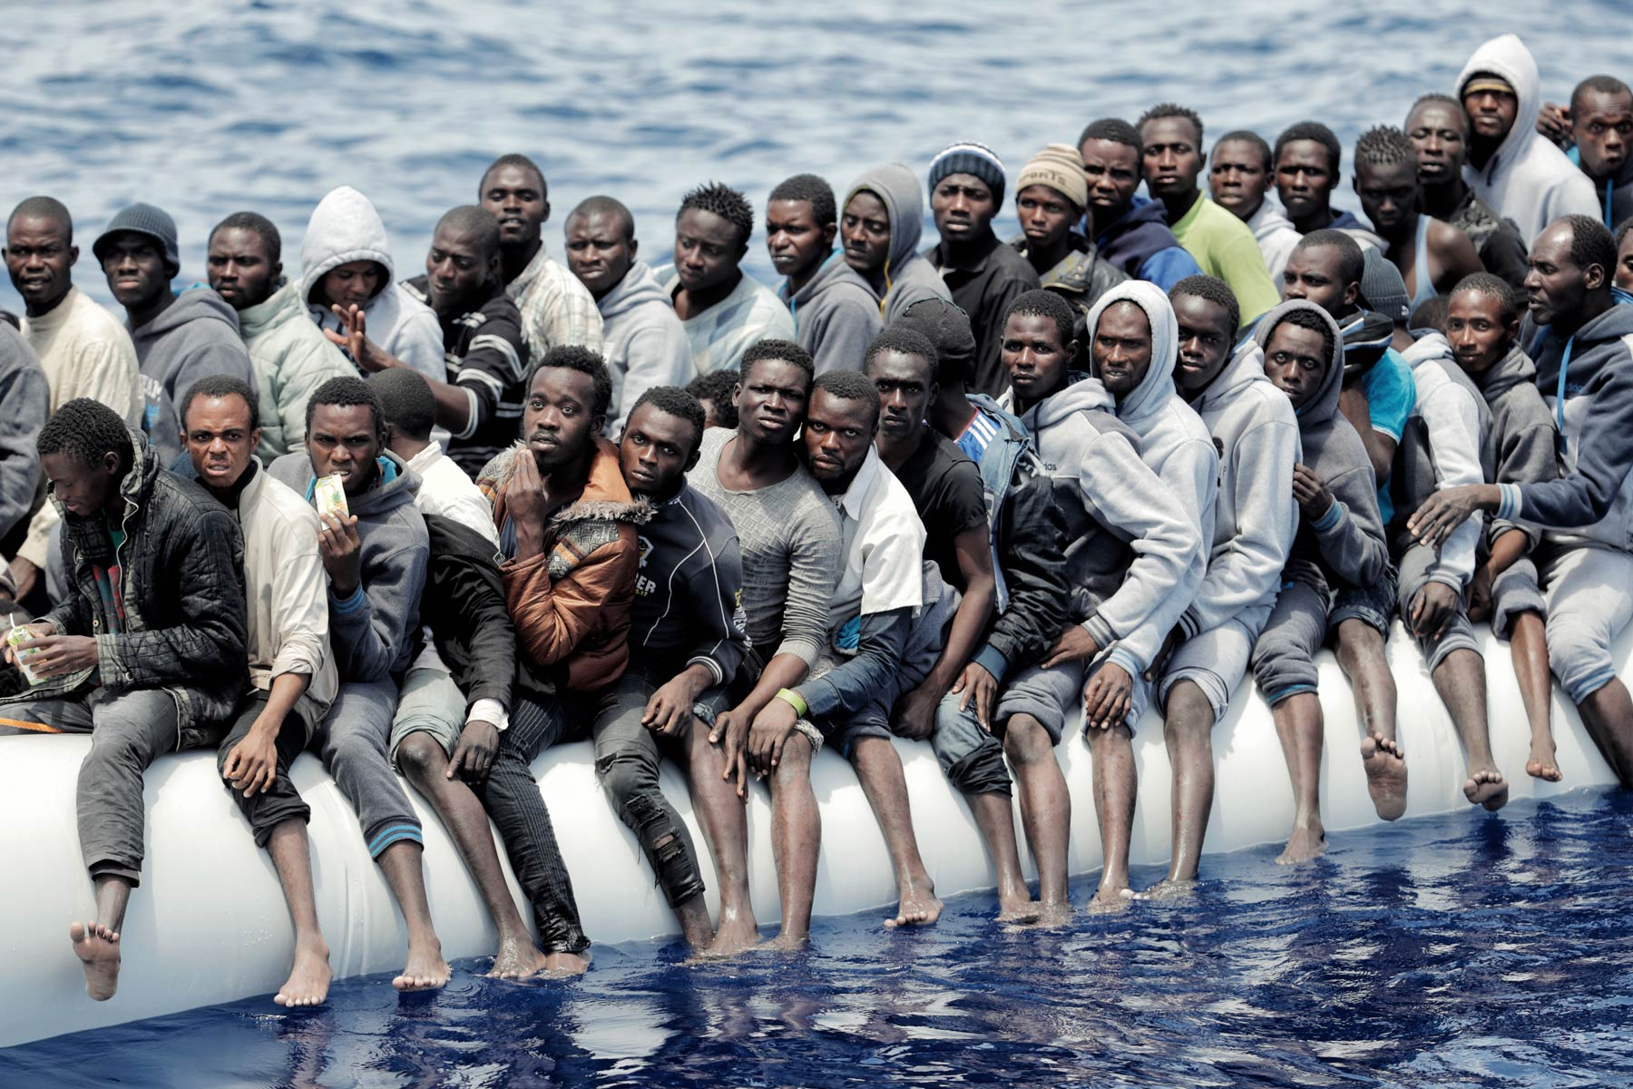
Solidarity departments
Activities to do:
•Informative talks
•Brochures
•Information stands in the high school
•Interviews in the digital newspaper
•International music on the time break

Slide 8
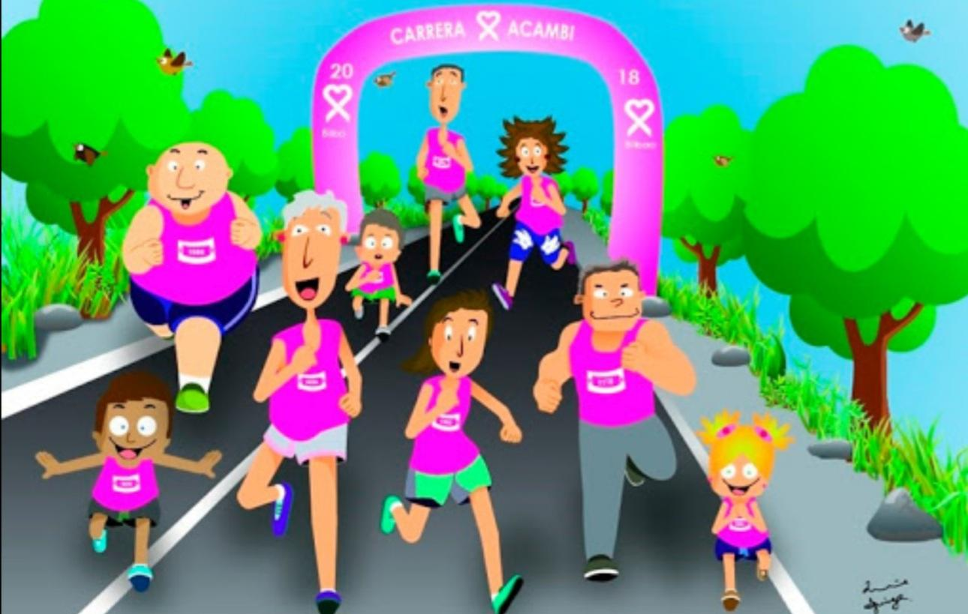
Solidarity race
It will be done a solidarity race, for collect money for the association.
Each participant will have a patron, that for each turn will give an euro. The race will be done for the promenade marítime and will have water and fruits for all of the participant.

Slide 9
Food collect
We will collect food at the door of the supermarket.
And all the food collected will be distributed for the immigrants more in need.

Slide 10
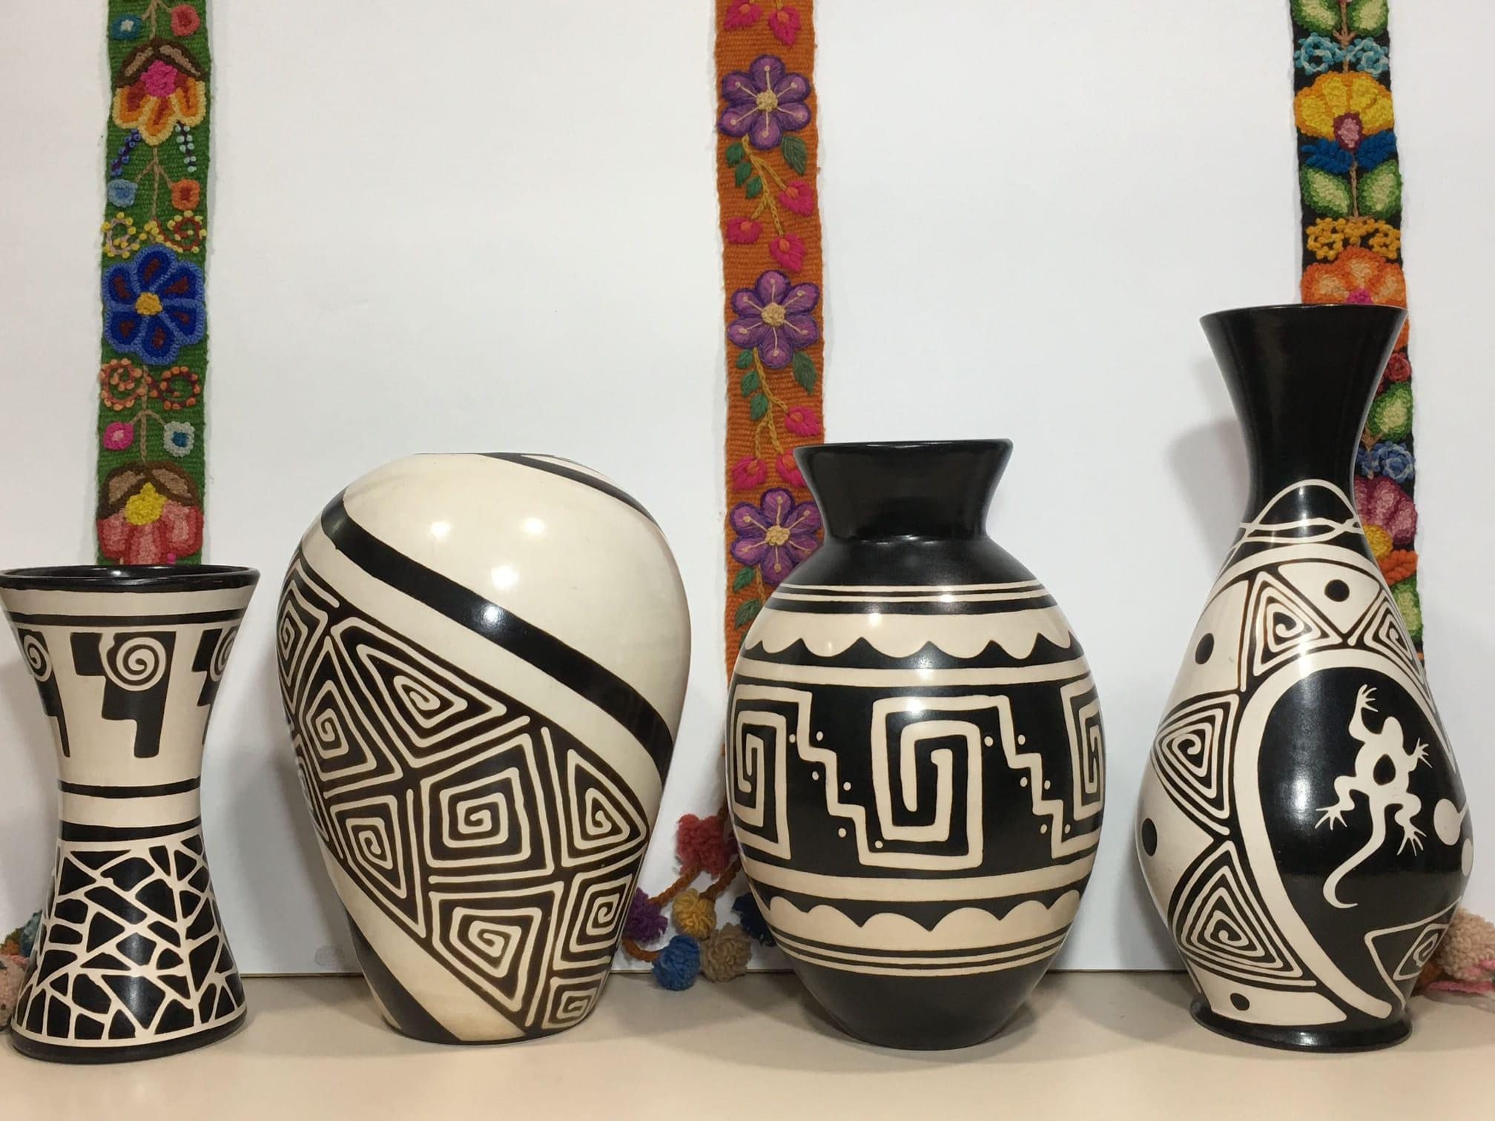
Production departament
Solidarity mini market, in the main avenue all the weekend of april.
African artesany
Vases = 15€
Vases of resin or ceramic
Kanga = 10€
Cloth used to dress or carry things

Slide 11
B) Activities
1. LOTTERY: The prize will consist on a weekend trip. In the school there will be a stand where, every Thursday, the tickets will be sold. Each number will cost one euro and there will be 100 numbers.
2. BENEFICAL FOOTBALL MATCH: Atlético Sanluqueño will play with a
representation of voluntary association members. The ticket price will cost 1 €.
3. CHARITY MARKET.

Slide 12
9.DEPARTMENT OF HUMAN RESOURCES
Its functions are:
- Each person will occupe its position, according to the characteristics of the person.
- Get associates to be integrated and motivated.
- Organise a training to adapt the worker to his job.

Slide 13
10. DEPARTMENT OF ADMINISTRATION AND FINANCE:
* It will calculate profit or loss = Total income - Total expenses
* To communicate to the rest of the associates the result obtained and the
destination of funds.
* To take care of looking for the necessary financing to carry out the draft.

Slide 14
STATEMENT OF ACCOUNTS AS OF 01 January 2021
* Initial capital (01/01/2020): 100 partners for € 3.50 =
350 €
* Income from activities carried out = € 2,100
* Donations from companies = € 300
* Costs raw materials, materials activities = € 550
Total profit = 2,100 - 550 = € 1,550

