Slide 1
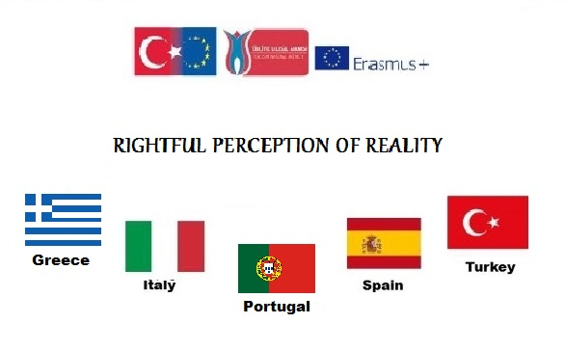

Slide 2
Migration in Turkey Turkey is a bridge between some Middle East, Asian and Euroepan Countries

Slide 3
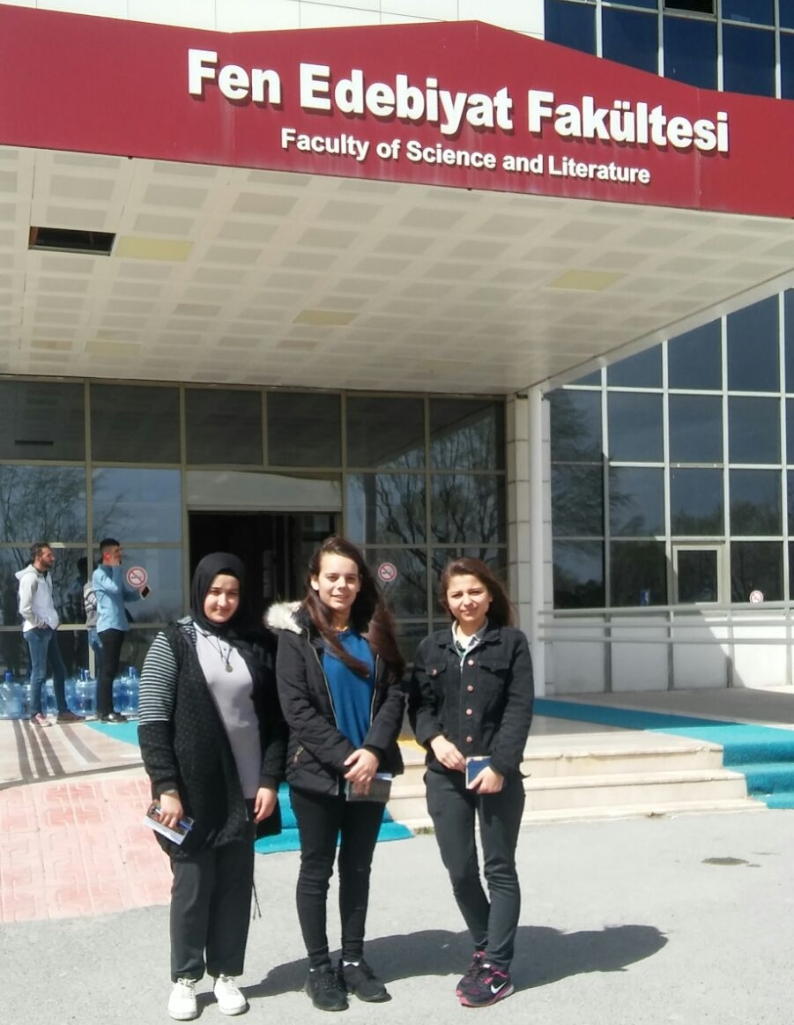
We have visited Sociology and History Departments of Kocatepe University. Prof. Dr. İlteriş YILDIRIM and Assoc. Prof Selim PULLU gave some information about immigration.

Slide 4
Migration Period begins with the invasion of Europe by the Huns in 375

Slide 5
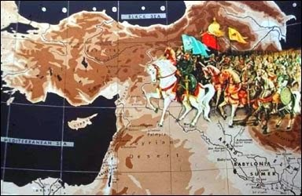
The Battle of Manzikert: How Anatolia became Turkey's home

Slide 6
Immigration movements which happened as of second half of 19th century and caused major changes in the ethnic features of Anatolia, have very important role on today’s Turkey.

Slide 7
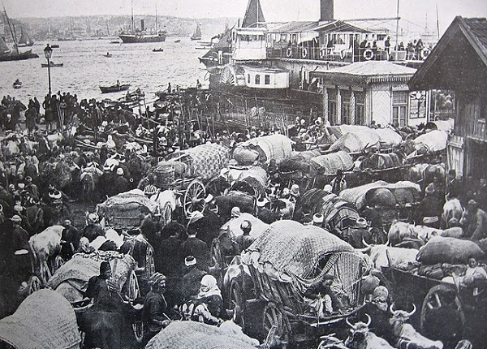
Population Exchange

Slide 8
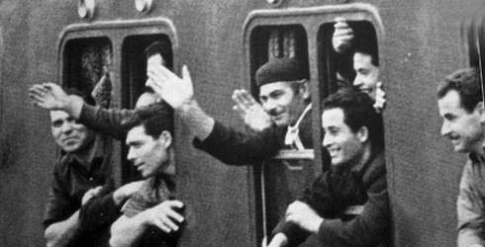
Labour Migration

Slide 9
Large-scale Turkish labor emigration to Europe started with an agreement signed by the Turkish and West German governments in 1961. The pact aimed to provide the German economy with temporary unskilled labor, "guest workers," while thinning the ranks of Turkey's unemployed.

Slide 10
Brain Drain
Significant number of highly educated individuals from Turkey choose to take advantage of overseas employment opportunities.

Slide 11
Born in Mardin,Turkish Scientist Aziz Sancar won Nobel Prize in Chemistry in 2015

Slide 12
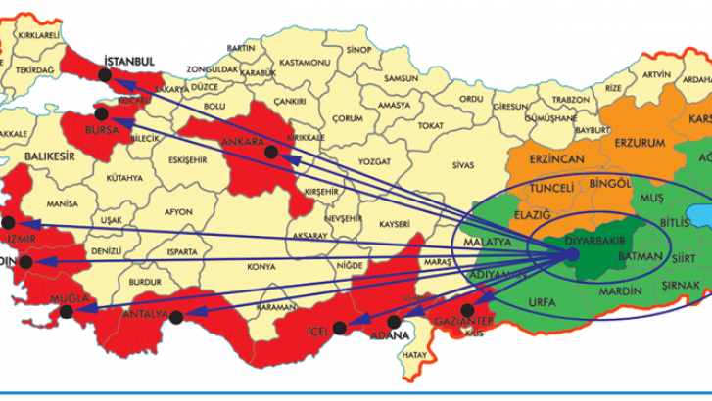
Internal migration has had a great impact on Turkey's population dynamics

Slide 13
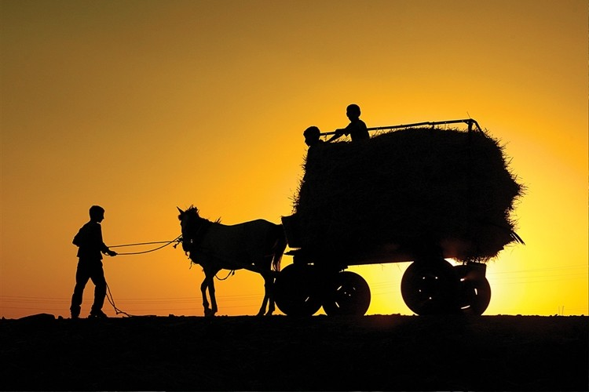
Aggriculture

Slide 14
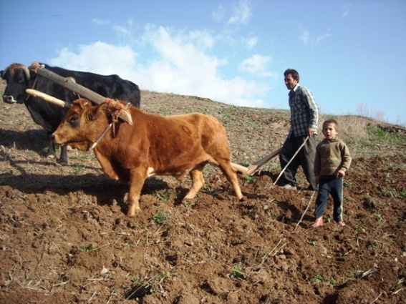

Slide 15
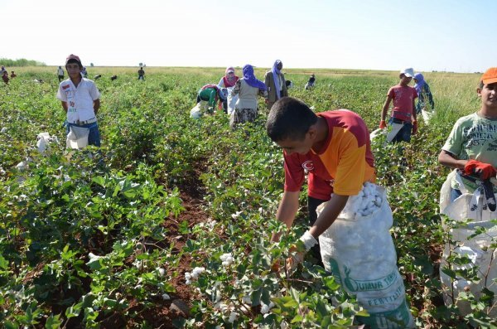

Slide 16
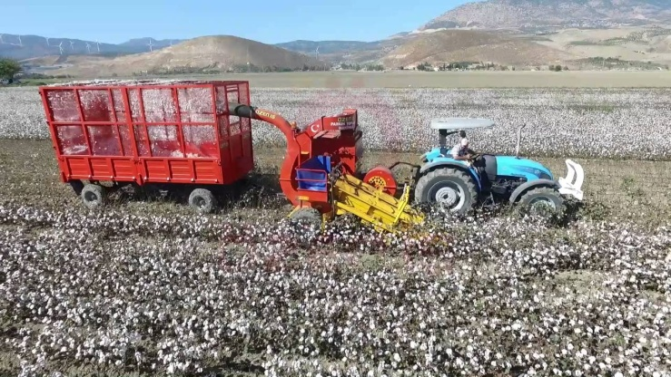

Slide 17
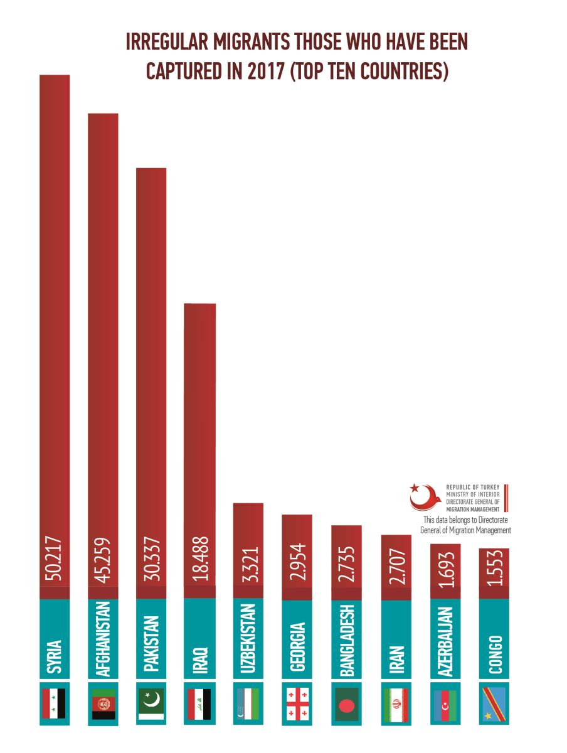
Migrant Crysis in Turkey

Slide 18
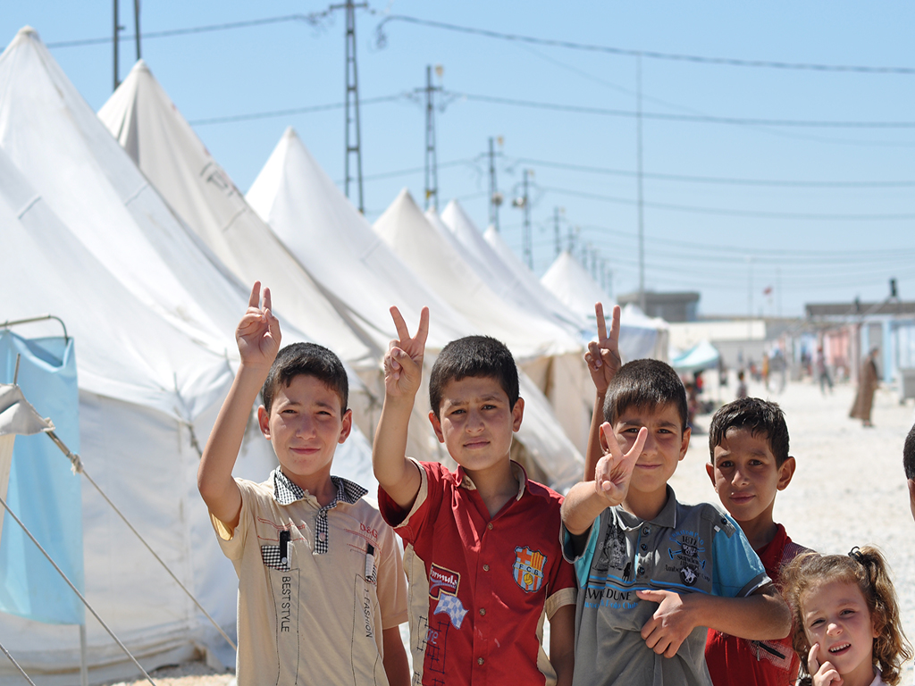
Syrian Case

Slide 19
Refugee Camp in Hatay

Slide 20
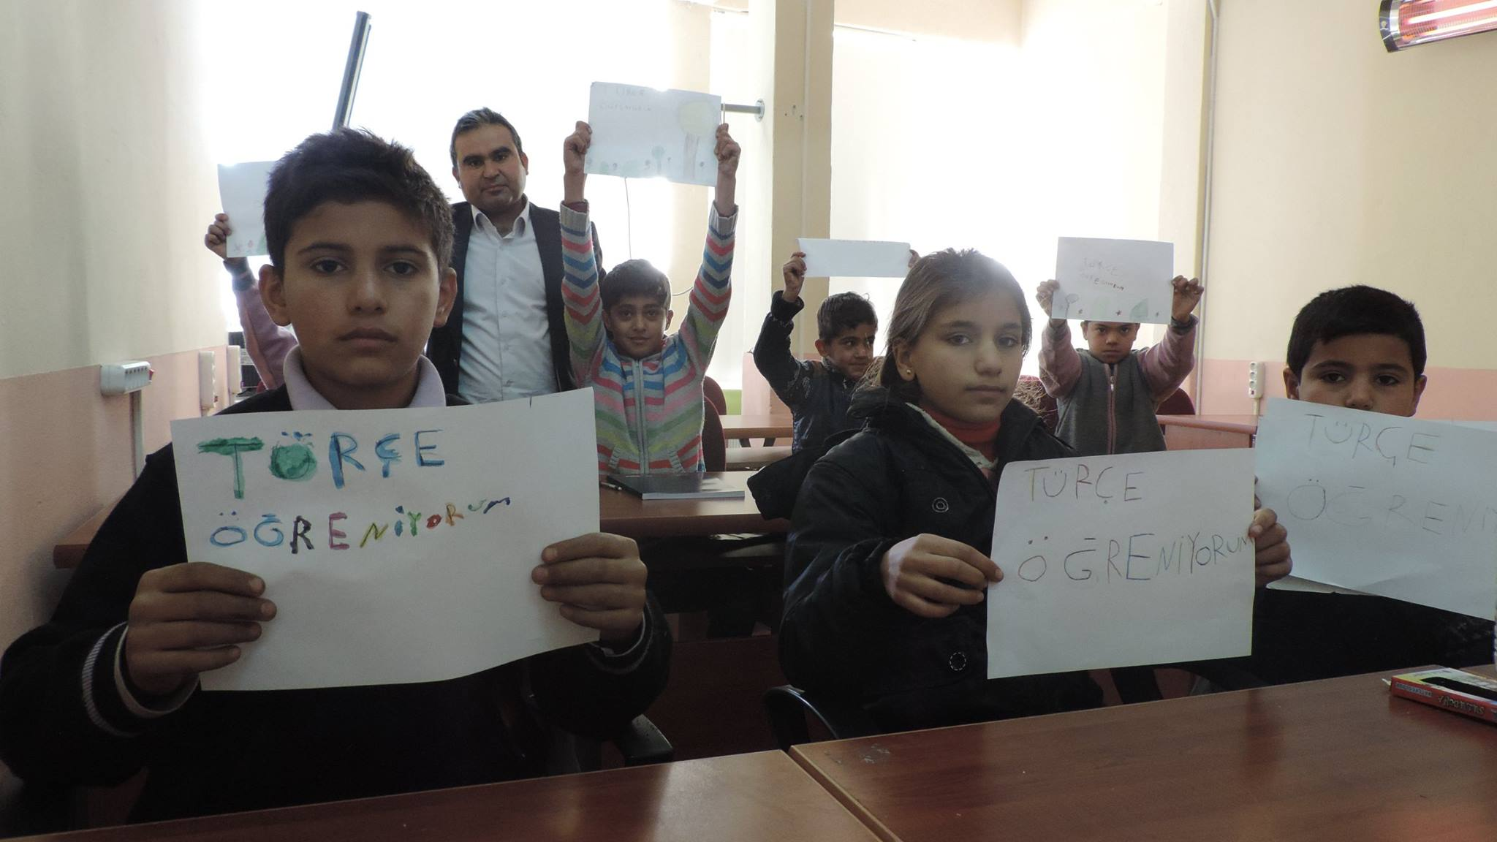
Educational Support

Slide 21
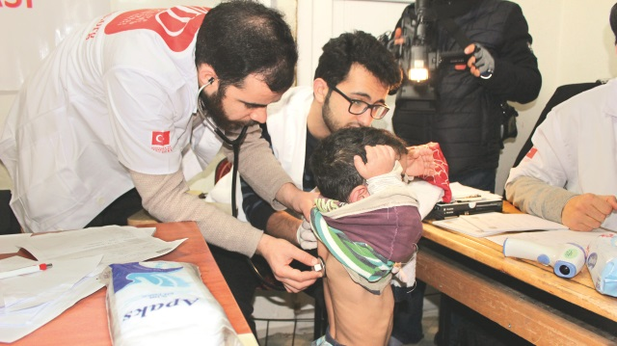
Free Medical Treatment

Slide 22
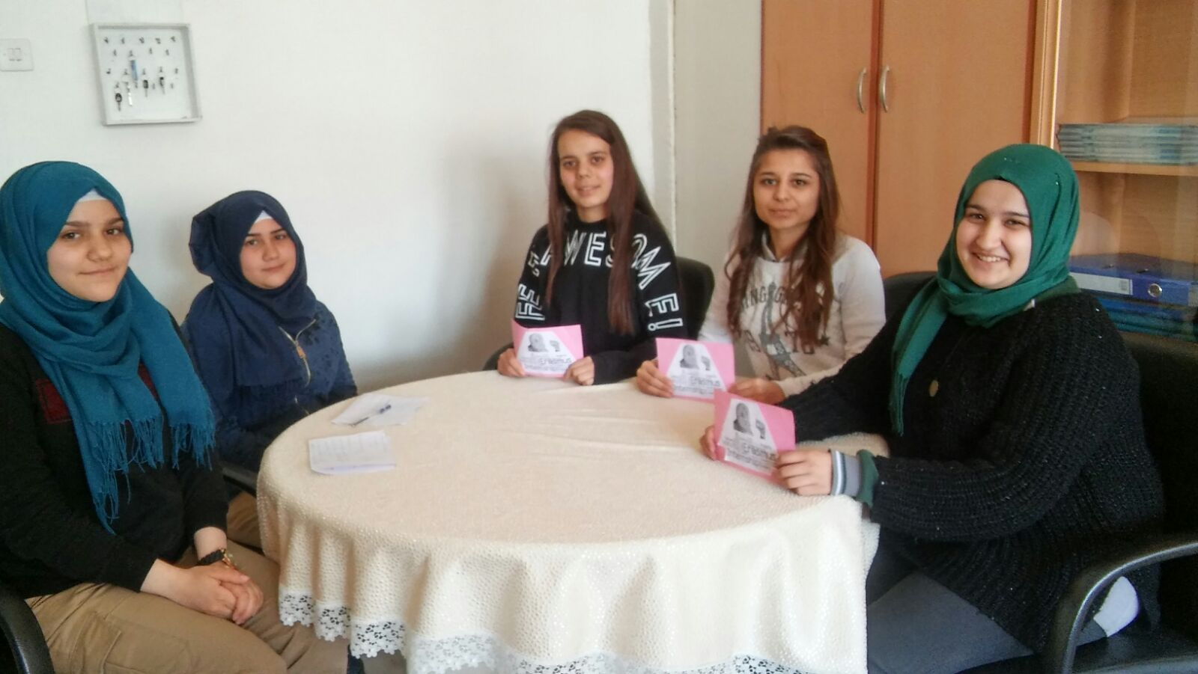
Our Interview with Syrian Students

Slide 24
The short movie called KAHWA / COFFEE tells the story of a Syrian child who is sent to buy coffee by his mother while waiting in the toilet queue. The cast of the film is formed by Turks and Syrians with the help of Sultanbeyli Municipality and Refugee Association.

Slide 26
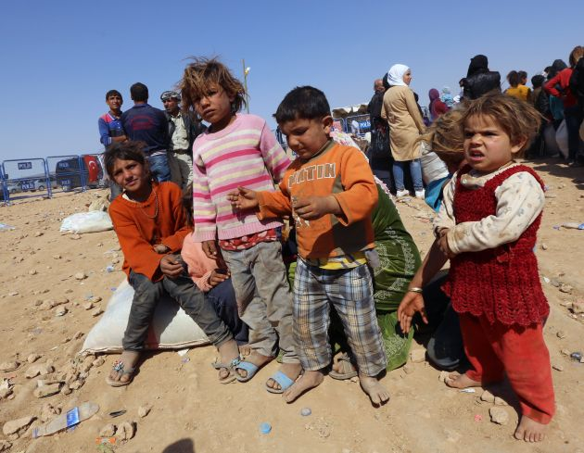
The most affected group:Kids

Slide 27
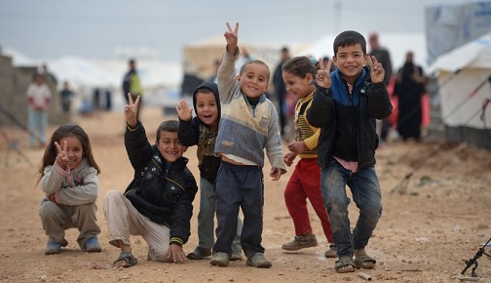
They are not aware of situation

Slide 28
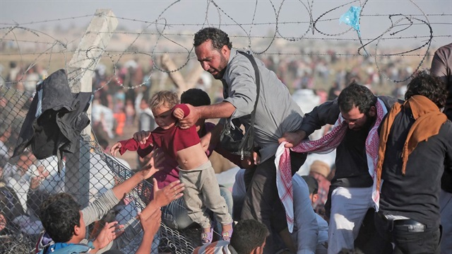
They are forced to leave their country

Slide 29
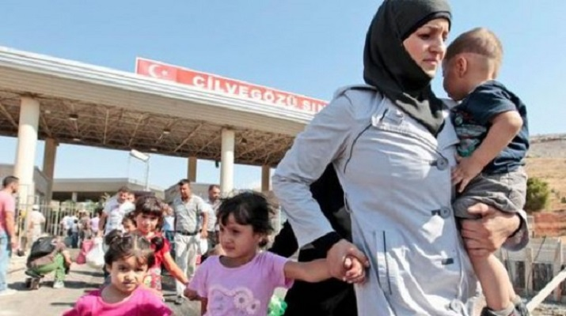
Rising problem: Population. According to the research of Turkish Statistical Institute. The number of Syrian babies born in last two years is higher than the number of Turkish babies

Slide 30
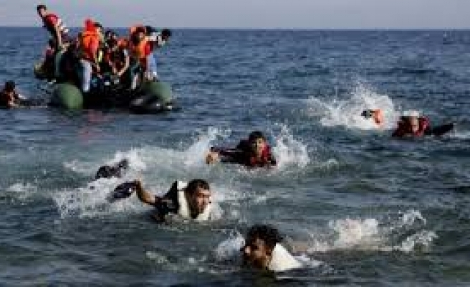
Hopes for better life often end with tragedy.

Slide 31
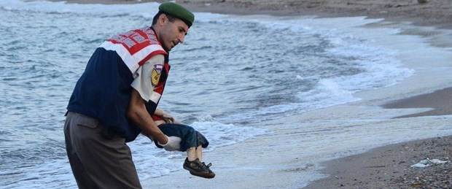
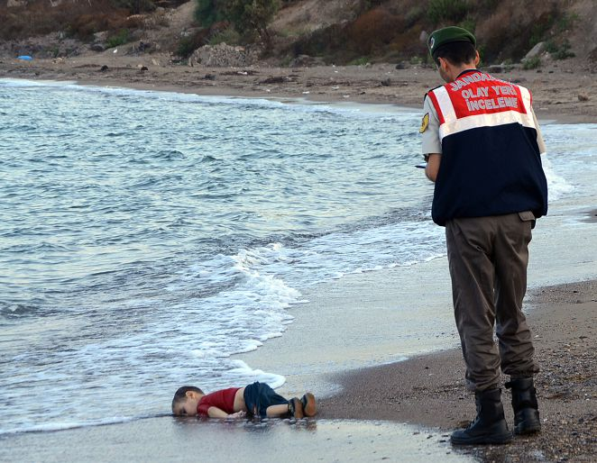
A young Syrian boy, who drowned in his family’s attempt to reach Greece from Turkey.

Slide 32
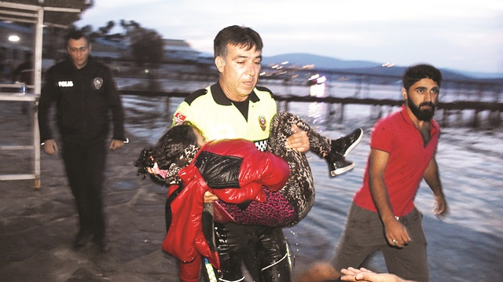
Turkish police officer carried this little girl in his hands to the hospital, but it wasn’t enough to save her life.

Slide 33
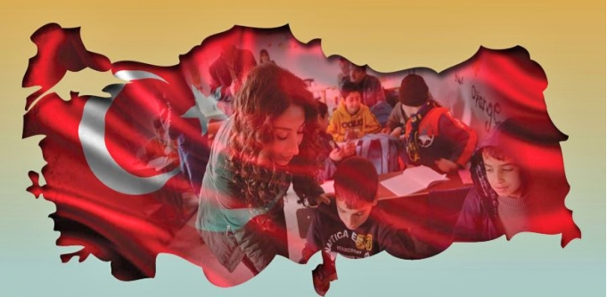
The best solution would be to end the war. That is the most important factor. Nobody would leave their countries and houses unless they have to”.
Official at the Directorate of Migration Management, Ankara

Slide 35
Resurces:
Republic of Turkey, Ministry of Interior Directorate General of Migration Manegement Website: http://www.goc.gov.tr
Içduygu, A. (2003). Irregular Migration in Turkey. IOM
Migraton Research Series No.12. Geneva. http://www.iom.
int/documents/publication/en/mrs%5F12%5F2003.pdf
Gedik, A. (1997), "Internal Migration In Turkey, 1965-1985: Test of Conicting Findings
In The Literature", Review of Urban and Regional Studies 9, 170-79
Gökhan, Ali and Alpay Filiztekin (2008), The determinants of internal migration in Turkey, http://research.sabanciuniv.edu/11336/1/749.pdf
Sizege, C. And Ballı, E. (2016) “The determınants of ınternal mıgratıon: the case of Turkey” ınternatıonal journal of economıcs and fınance studıes
Erdoğan, İ. (2003) Brain Drain in Turkey. http://www.kuyeb.com/pdf/en/7757858b8bf9bbf1f2eac1341af9d9dcganing.pdf

