Slide 1
SECOND TRAINING EVENT LATVIA, 17th-21th June 2019
Our activities during our first year with
Persona Doll Methodology
Italy

Slide 2
Our first activities with Persona Doll Methodology Latvia, 17th-21th June 2019
Initial evaluation questionaries
TEACHERS
CHILDREN
PARENTS

Slide 3
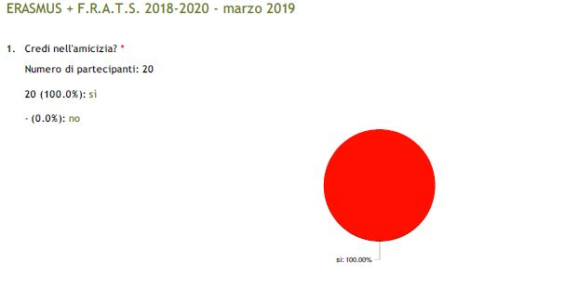
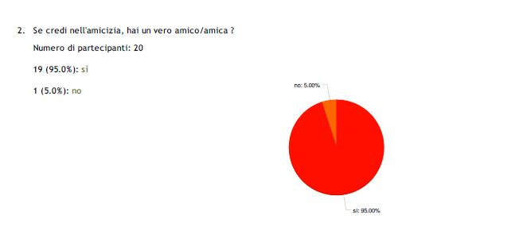
Our first activities with Persona Doll Methodology Latvia, 17th-21th June 2019
Initial evaluation questionaries
TEACHERS
26 out of 26
… a flower you have to water and take care because it does not dry

Slide 4
Our first activities with Persona Doll Methodology Latvia, 17th-21th June 2019
Initial evaluation questionaries
CHILDREN
Starting evaluation-CHILDREN
We did a starting evaluation with children, starting with general questions during circle-time.
The children who worked on this are 4/5 years old.
Some of the questions are the following:
What friendship means? What do you think friendship is?
Have you got any friends? What does it mean?
What do you do with them?
These are some of the answers:
When we are friends we must love each other
When we are friends we must not get angry
It is important to have friends because you are not alone.
We help our friends when they are in difficulty
Being friends means to hug each other when we are sad
Friendship means to love each other and when one is angry and then she/he becomes happy
A friend must not hurt you and she/he must make up with you
A real friend is good with you and does not beat you
I’m not good with my friends and I beat them… but after I make up with them and I kiss them.
Friendship means to make a child happy
I usually play with my friends, I respect the rules and I do not beat them
I watch cartoons with my friends
I meet my friends even outside the school and we can go and eat pizza
I help Simone when he draws because he is my friend
Kristal is my best friend and when I stay with her I’m happy
With my friends we do bike races
We help our friends doing some jobs
Friendship means to listen to what the others are saying, and we can fight but then we make it up and we play together
I play with my friends and I’m happy
My best friend is Duccio and I play with him
I would like that my friend could come and sleep at home with me
My best friend is Frida, my dog. She plays with me and she always licks me
My best friends are Matilde e Teresa. We keep staying together and we play. I often kiss them.

Slide 5
Our first activities with Persona Doll Methodology Latvia, 17th-21th June 2019
Initial evaluation questionaries
PARENTS
72 out of 392

Slide 6
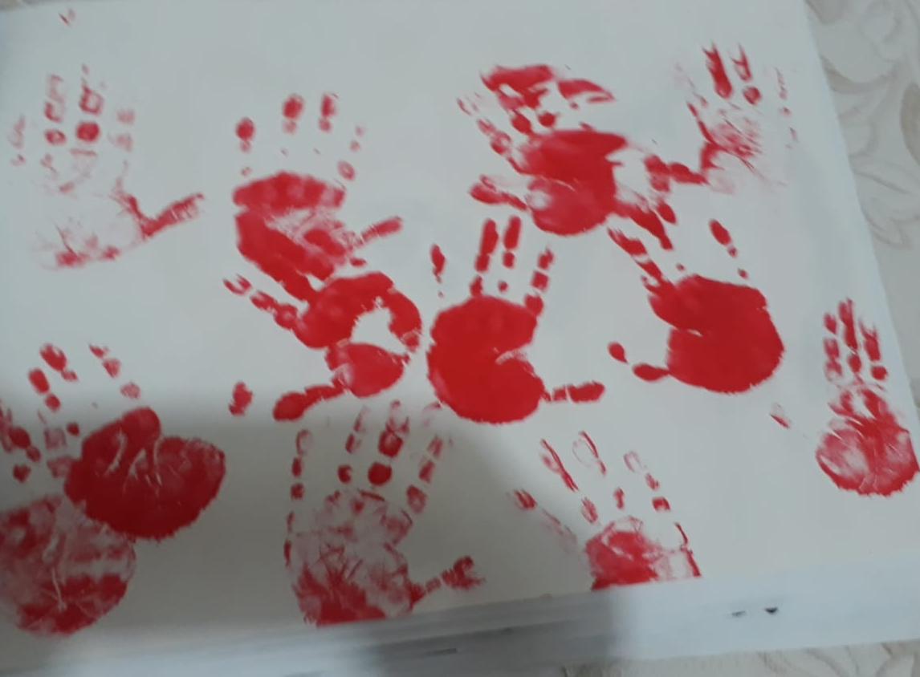
Our first activities with Persona Doll Methodology Latvia, 17th-21th June 2019

Slide 7
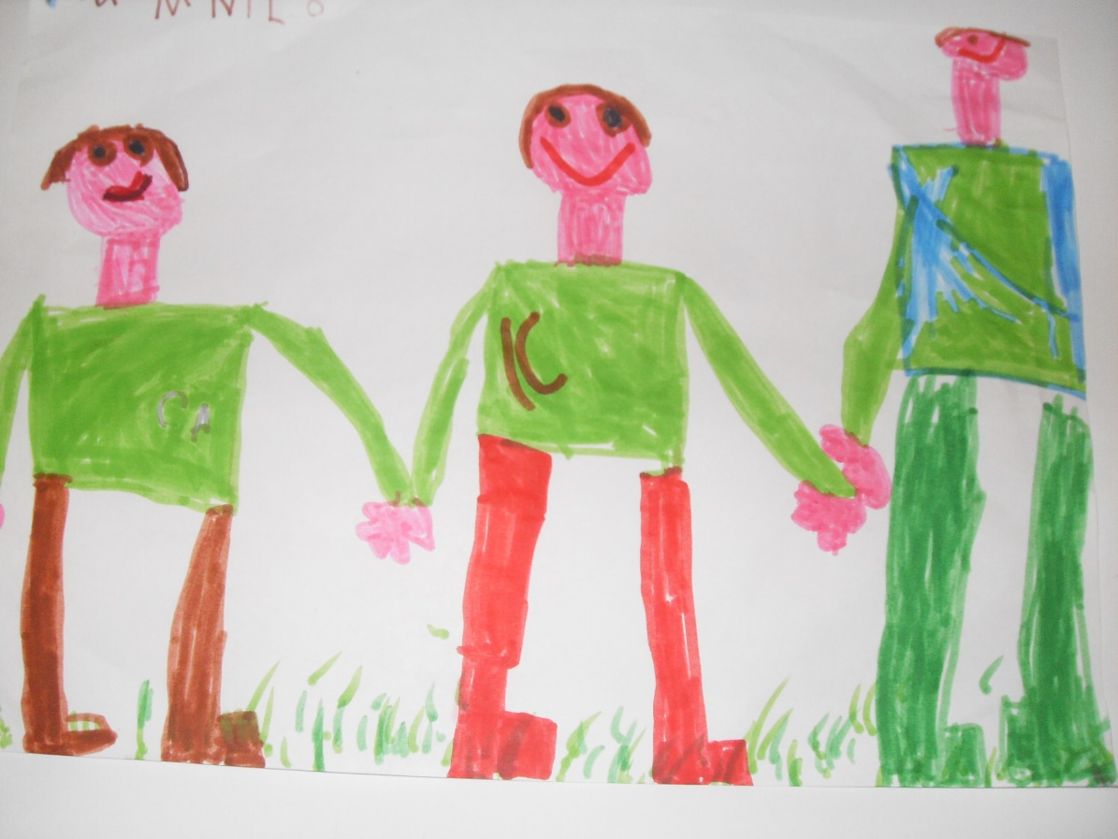
Our first activities with Persona Doll Methodology Latvia, 17th-21th June 2019

Slide 8
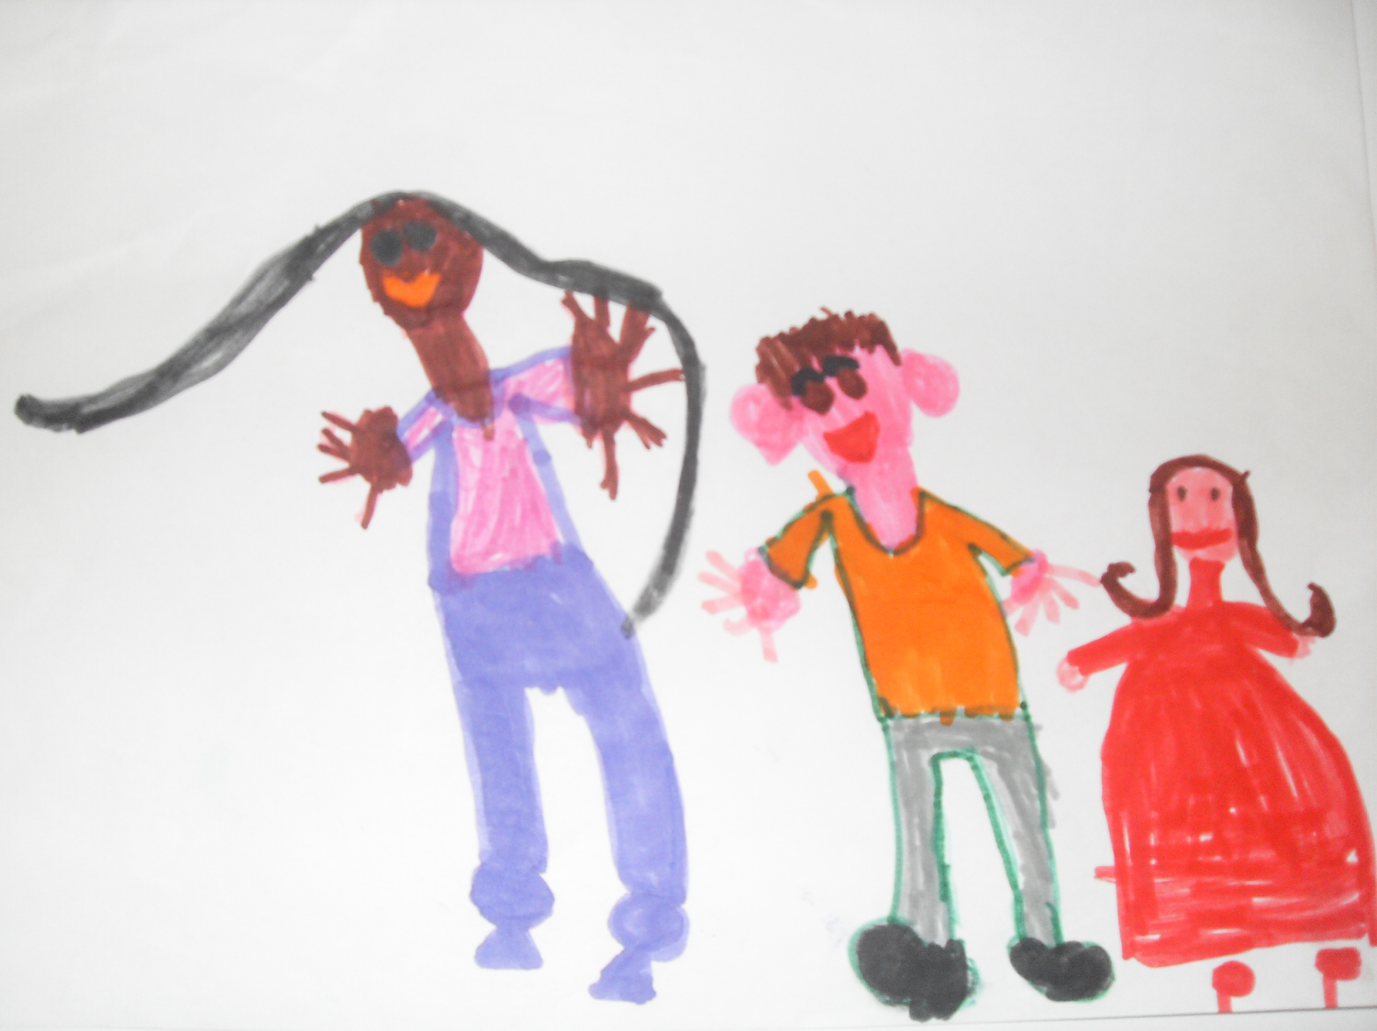
Our first activities with Persona Doll Methodology Latvia, 17th-21th June 2019

Slide 9
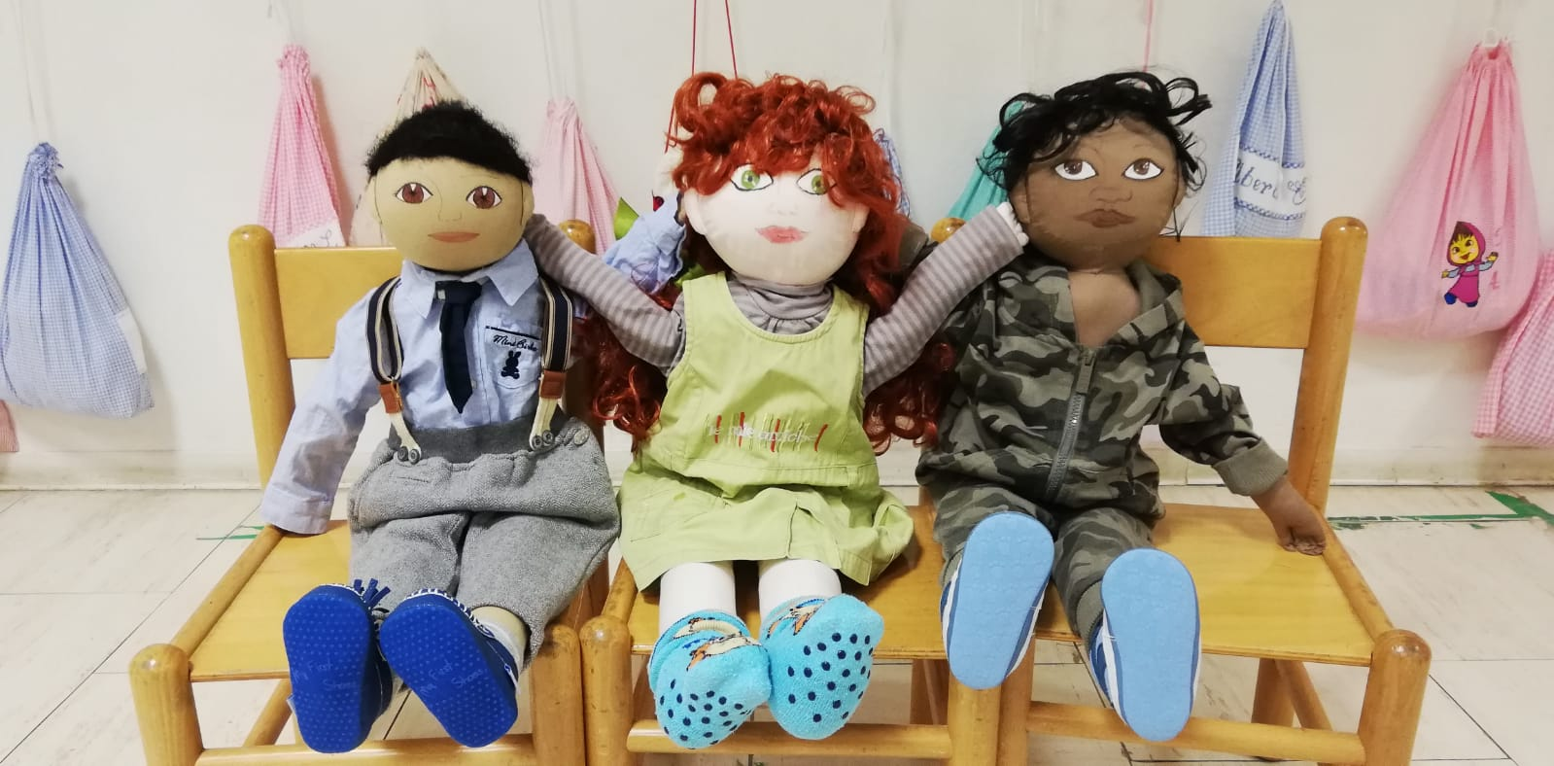
Our first activities with Persona Doll Methodology Latvia, 17th-21th June 2019
Our first doll profile and story

Slide 10
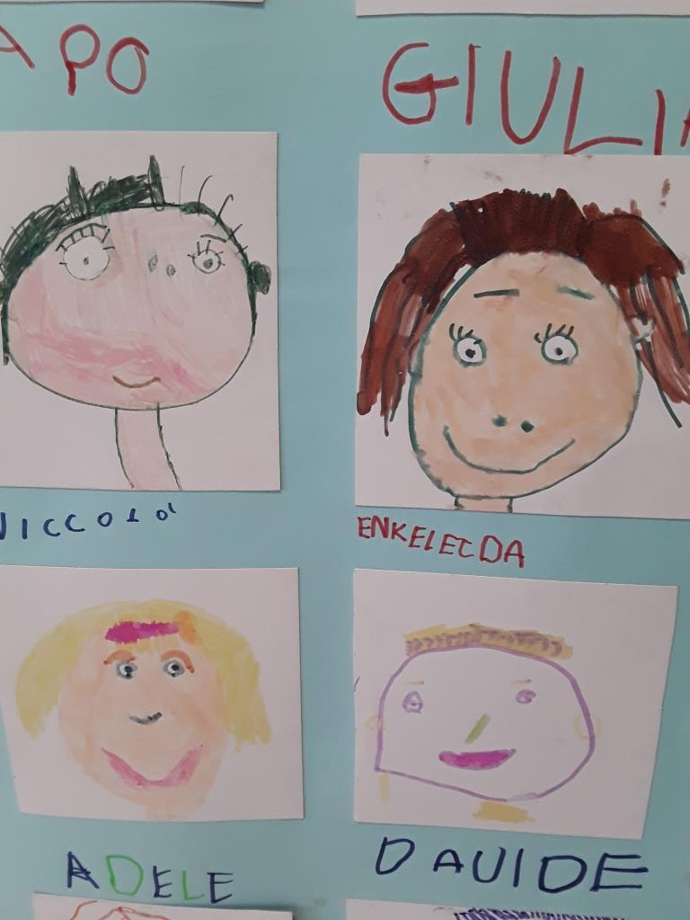
Our first activities with Persona Doll Methodology Latvia, 17th-21th June 2019
I’m special…..
Power point uploaded on etwinning
..\presentazioni\I'm special IT.pptx

Slide 11
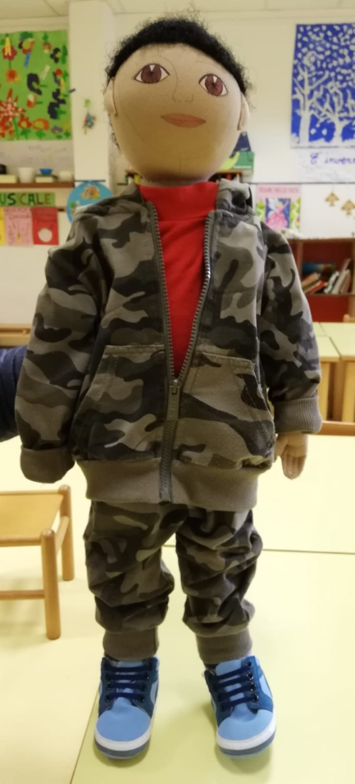
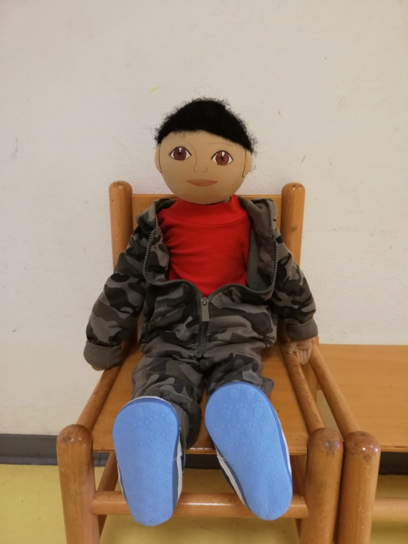
Our first activities with Persona Doll Methodology Latvia, 17th-21th June 2019
Our first doll profile and story

Slide 12
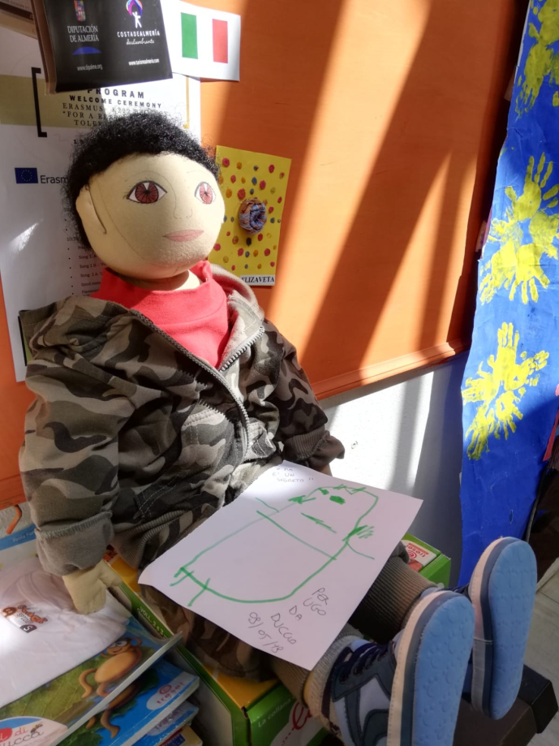
Our first activities with Persona Doll Methodology Latvia, 17th-21th June 2019
Our first doll profile and story

Slide 13
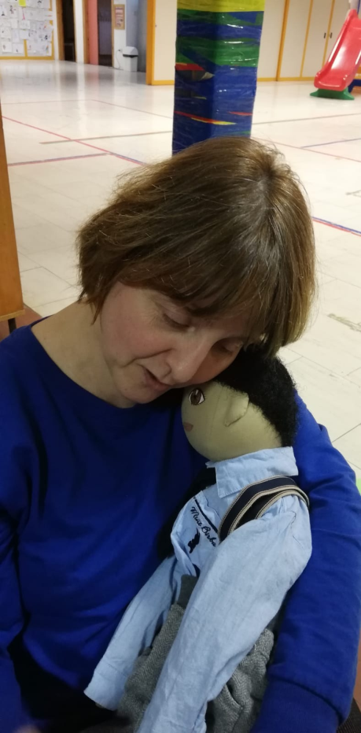
Our first activities with Persona Doll Methodology Latvia, 17th-21th June 2019
Our first doll profile and story

Slide 14
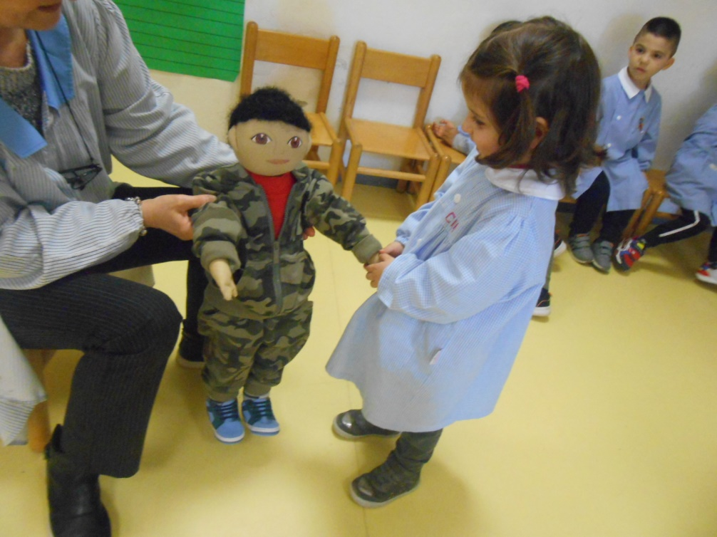
Our first activities with Persona Doll Methodology Latvia, 17th-21th June 2019
Our first doll profile and story

Slide 15
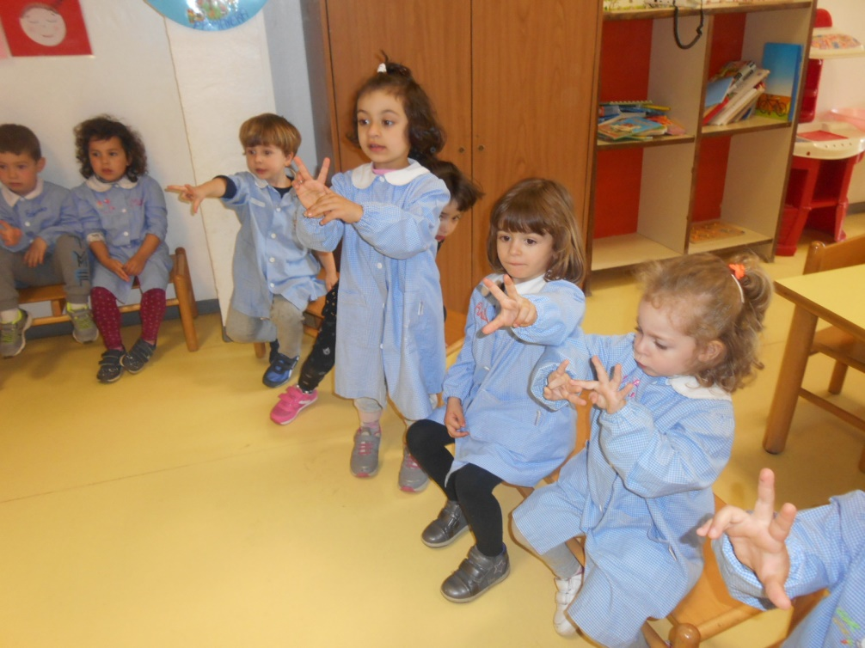
Our first activities with Persona Doll Methodology Latvia, 17th-21th June 2019
Our first doll profile and story

Slide 16
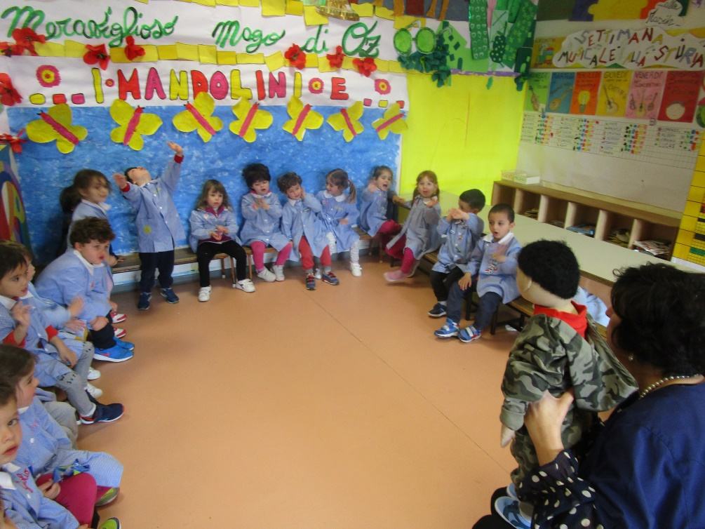
Our first activities with Persona Doll Methodology Latvia, 17th-21th June 2019
Our first doll profile and story

Slide 17
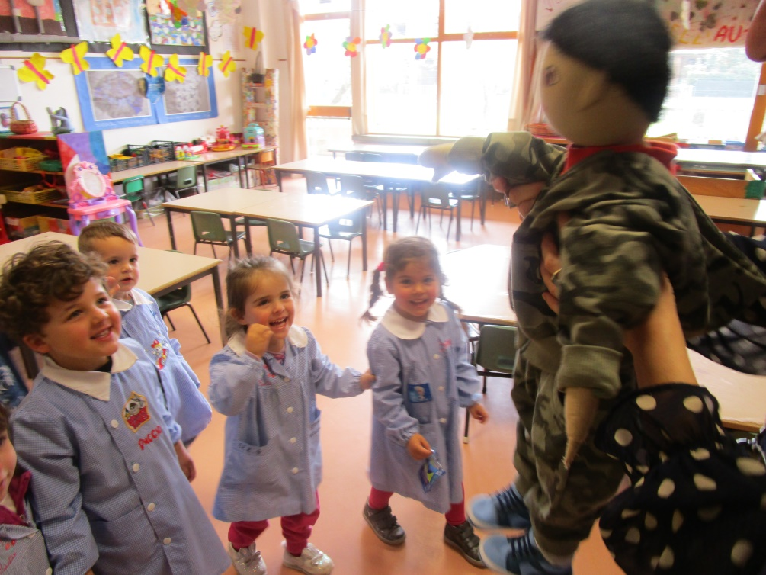
Our first activities with Persona Doll Methodology Latvia, 17th-21th June 2019
Our first doll profile and story

Slide 18
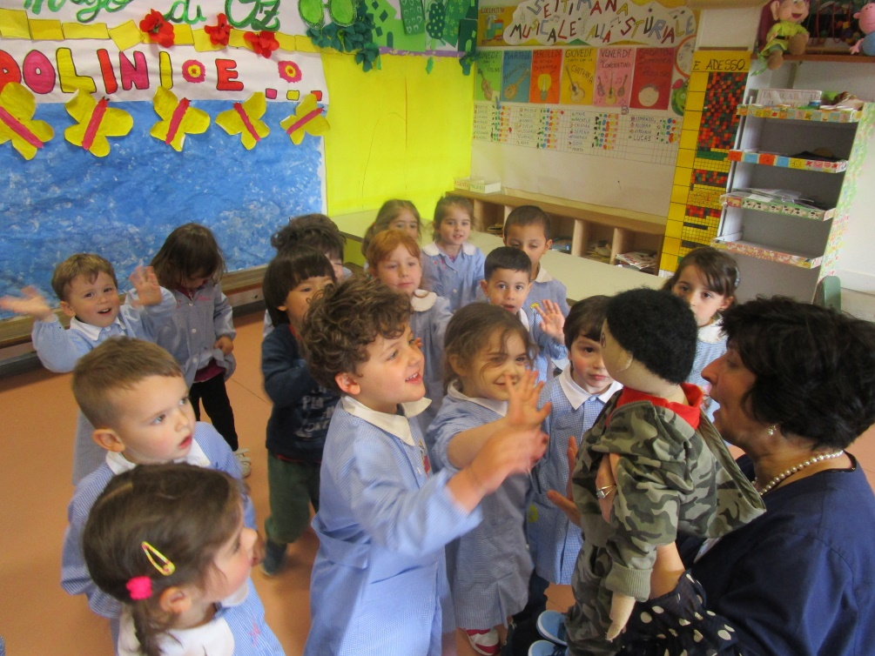
Our first activities with Persona Doll Methodology Latvia, 17th-21th June 2019
Our first doll profile and story

Slide 19
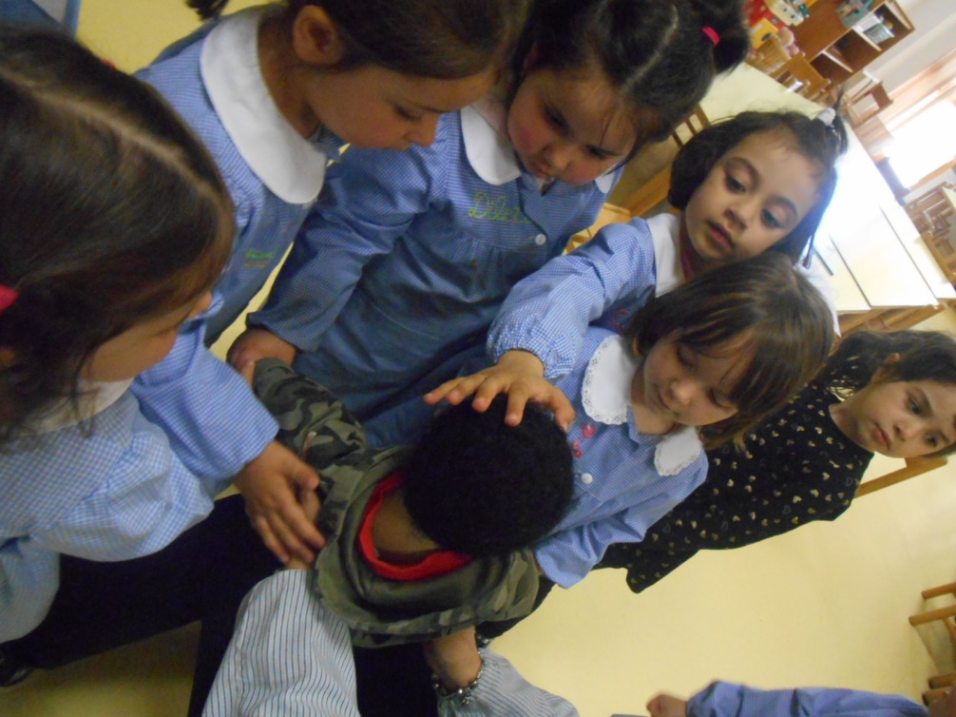
Our first activities with Persona Doll Methodology Latvia, 17th-21th June 2019
Our first doll profile and story

Slide 20
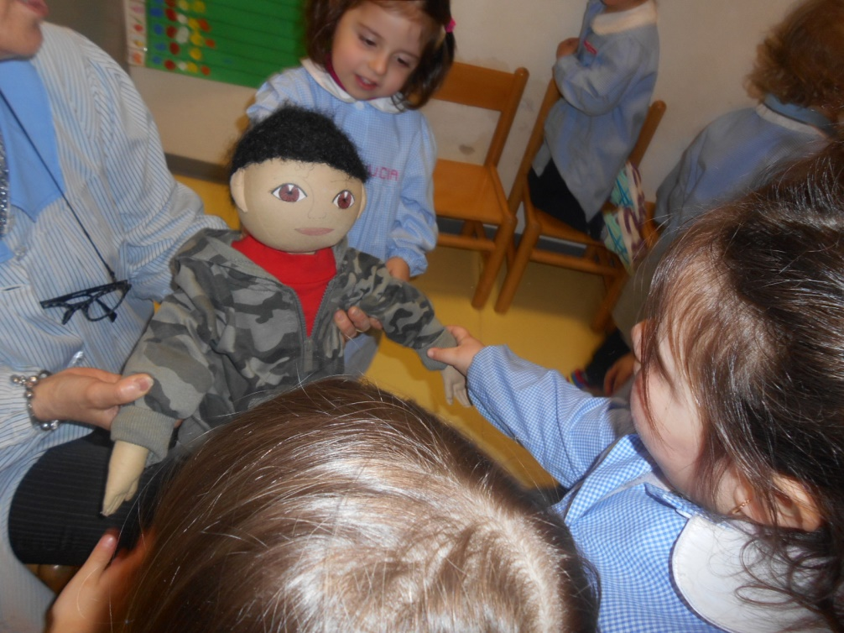
Our first activities with Persona Doll Methodology Latvia, 17th-21th June 2019
Our first doll profile and story

Slide 21
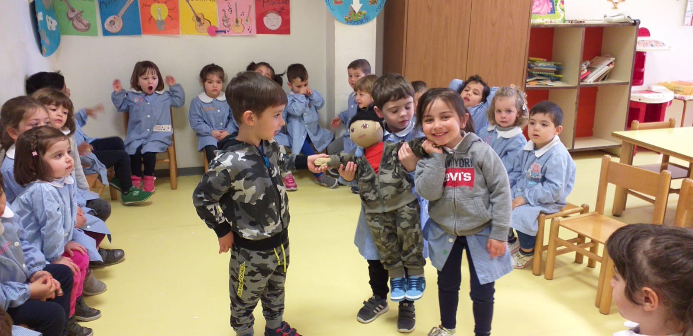
Our first activities with Persona Doll Methodology Latvia, 17th-21th June 2019
Our first doll profile and story

Slide 22
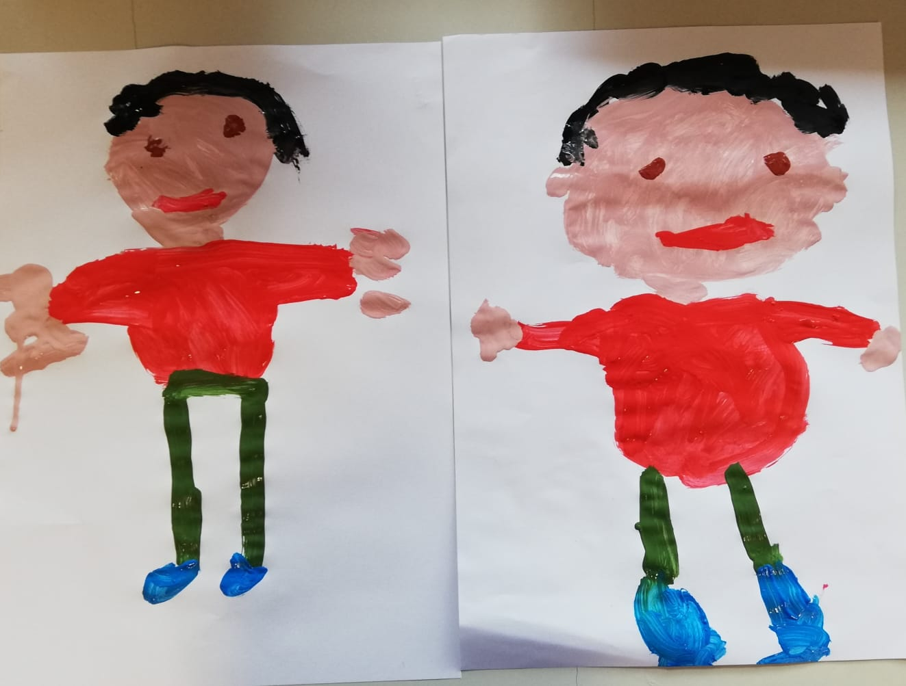
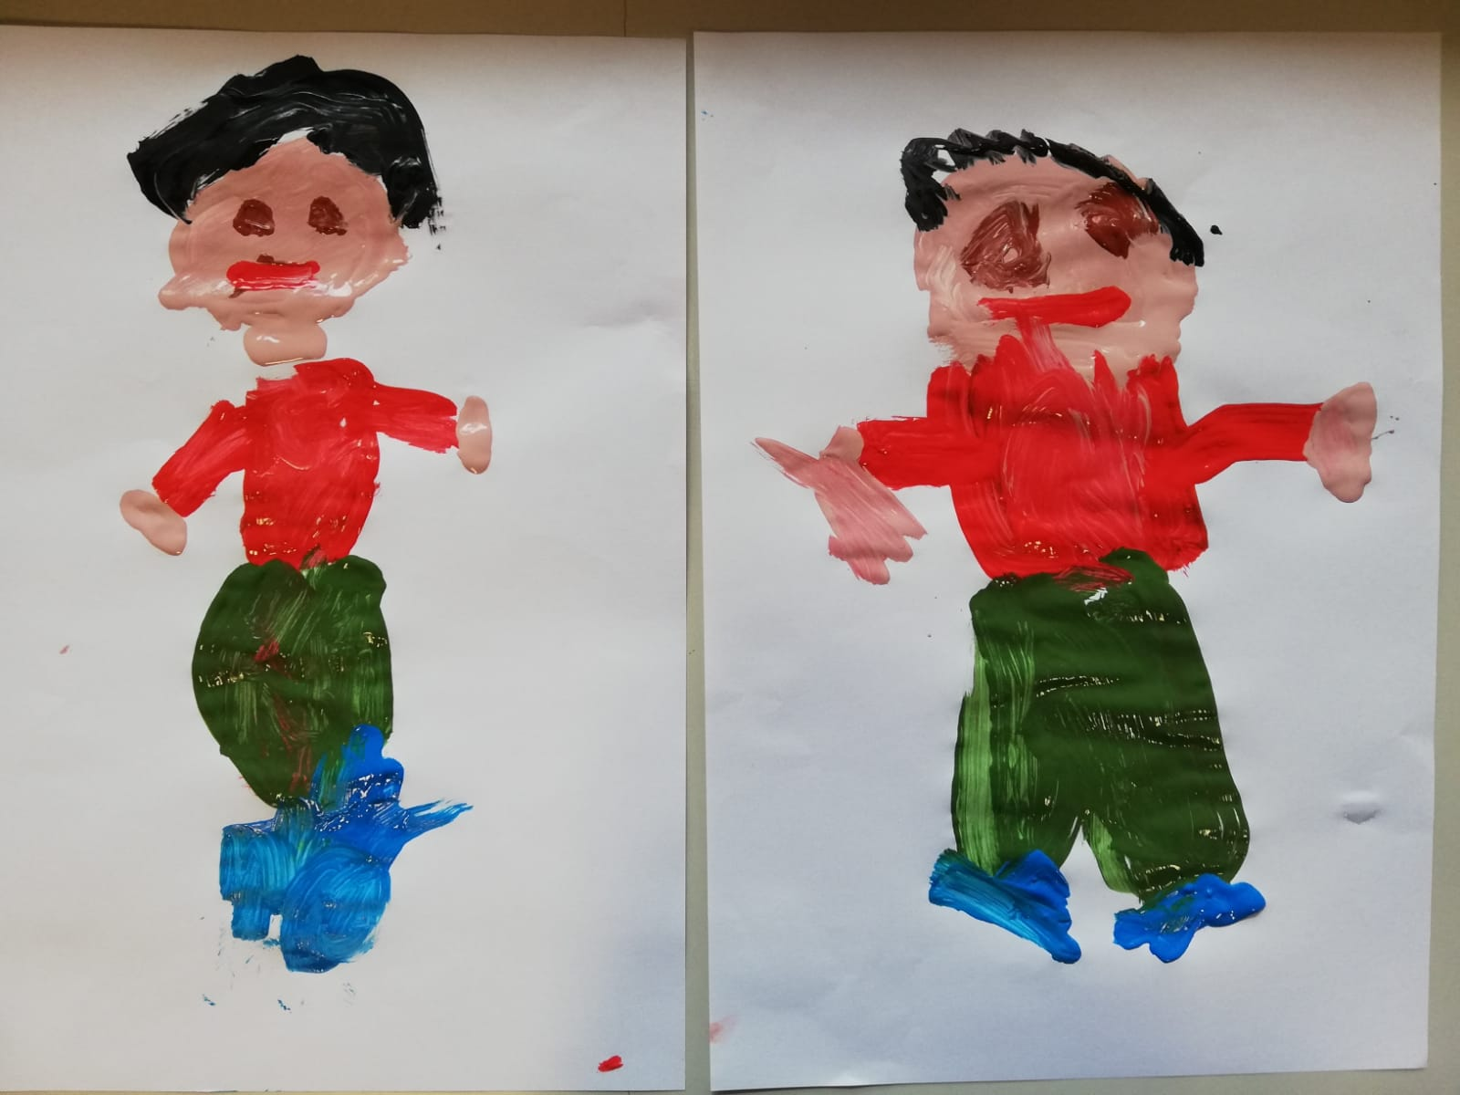
Our first activities with Persona Doll Methodology Latvia, 17th-21th June 2019
Our first doll profile and story

Slide 23
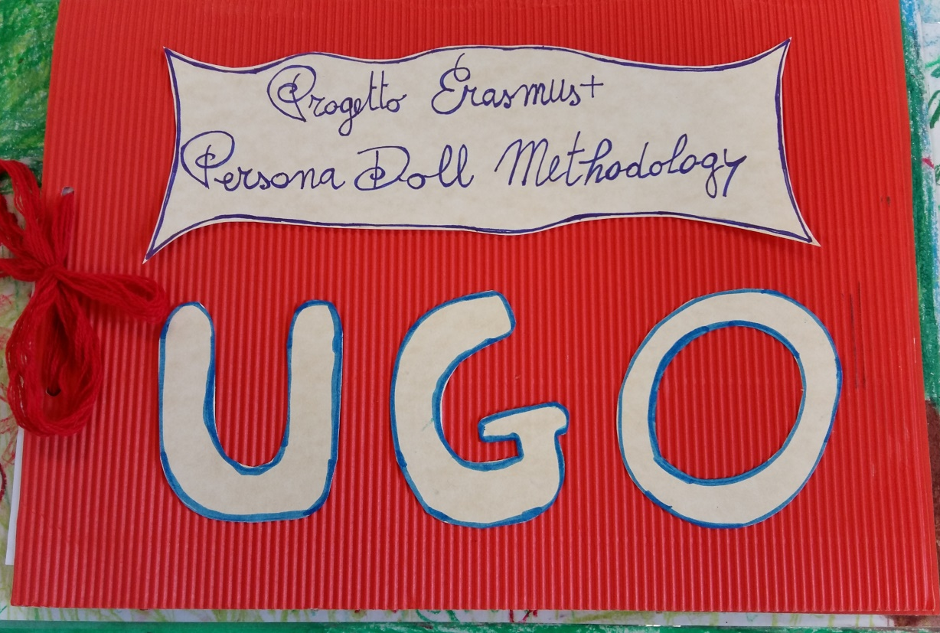
Our first activities with Persona Doll Methodology Latvia, 17th-21th June 2019
Our first doll profile and story

Slide 24
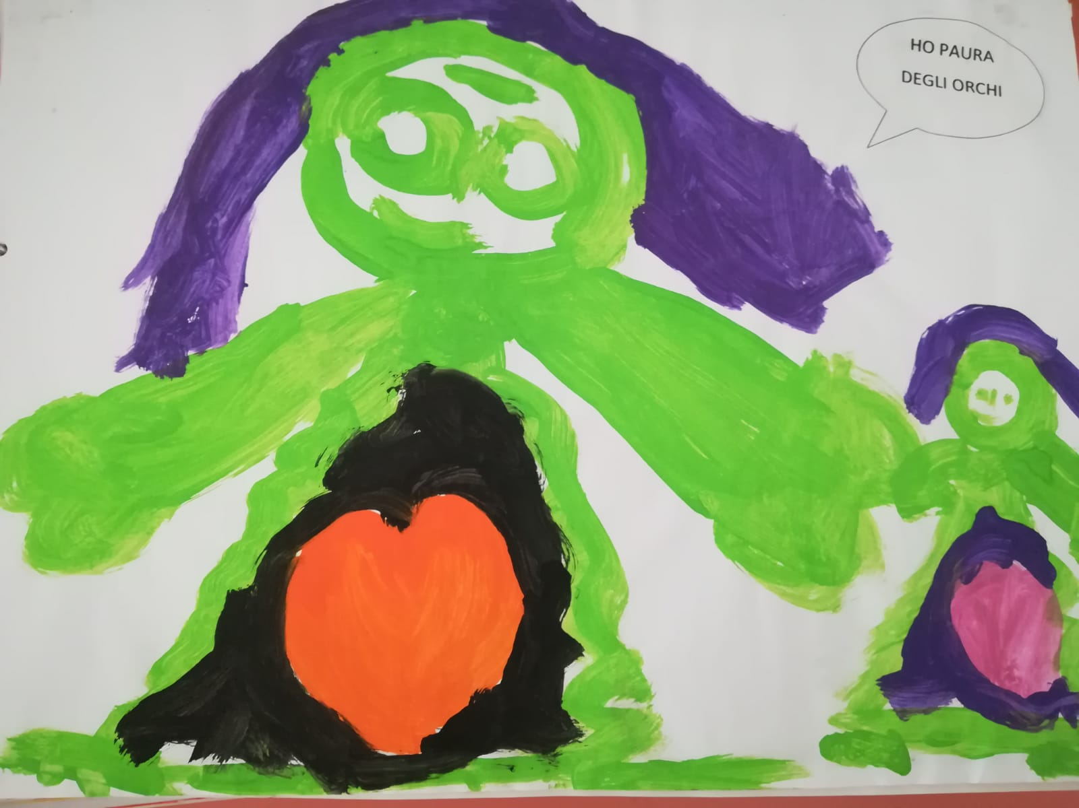
Our first activities with Persona Doll Methodology Latvia, 17th-21th June 2019
Supporting children’s individuality
Recognizing our emotions and work on this subject

Slide 25
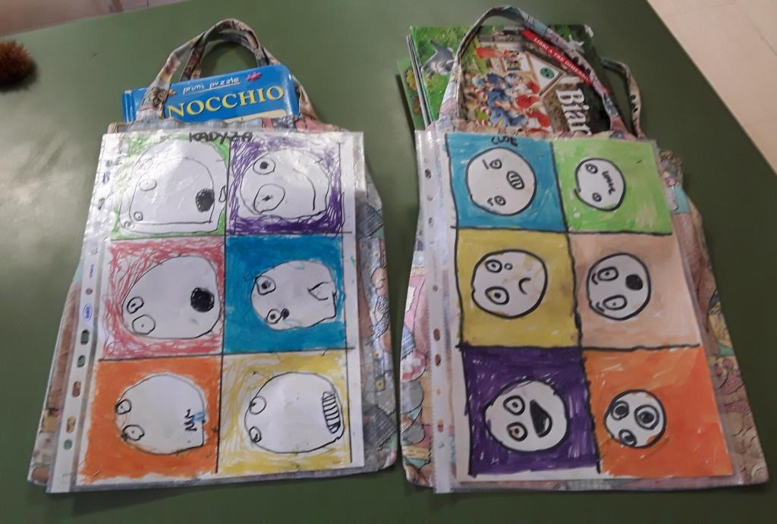
Our first activities with Persona Doll Methodology Latvia, 17th-21th June 2019
Supporting children’s individuality
Recognizing our emotions and work on this subject

Slide 26
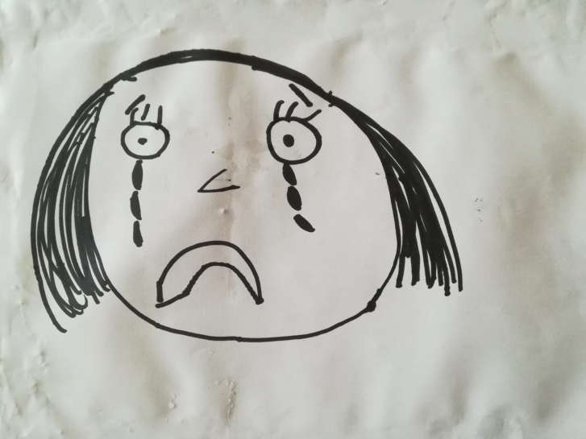
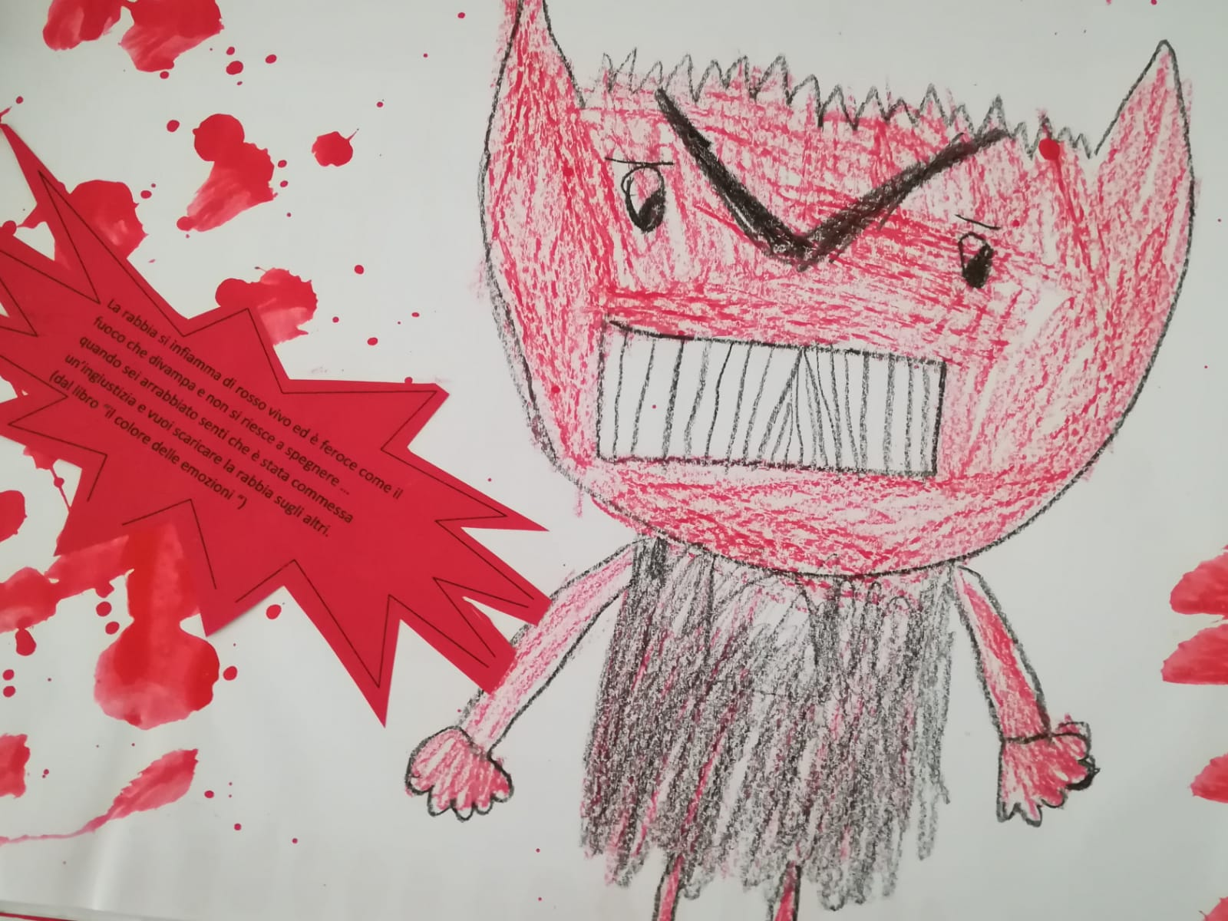
Our first activities with Persona Doll Methodology Latvia, 17th-21th June 2019
Supporting children’s individuality
Recognizing our emotions and work on this subject

Slide 27
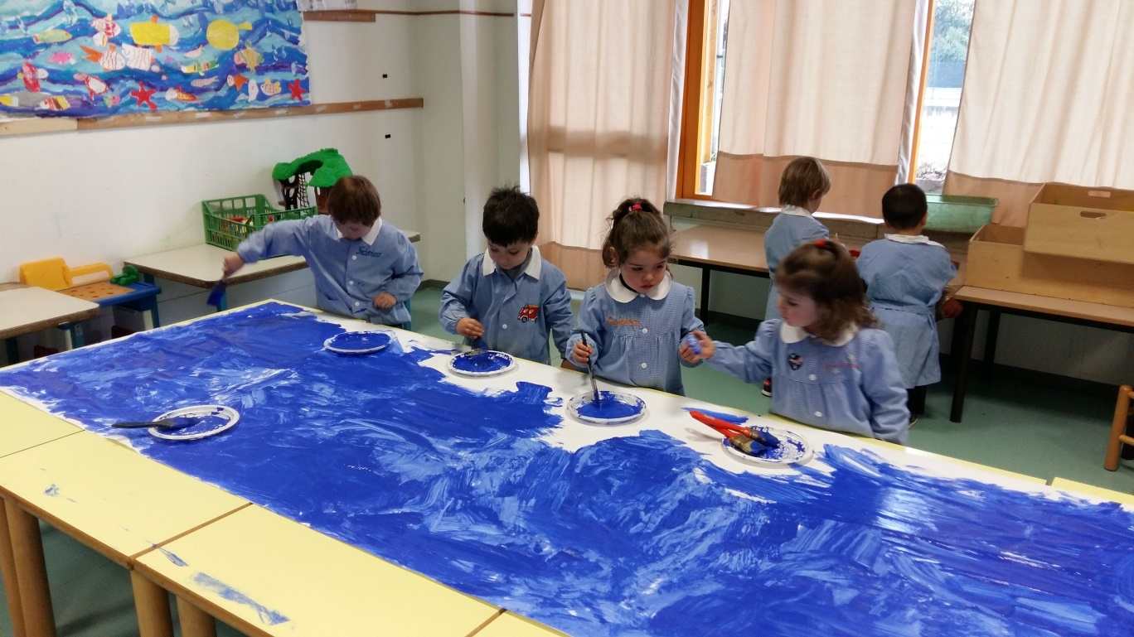
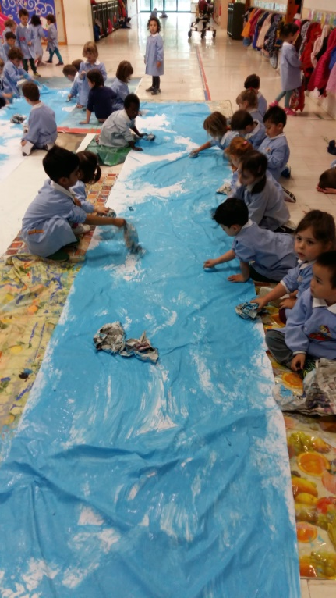
Our first activities with Persona Doll Methodology Latvia, 17th-21th June 2019
Developing children’s social skills

Slide 28
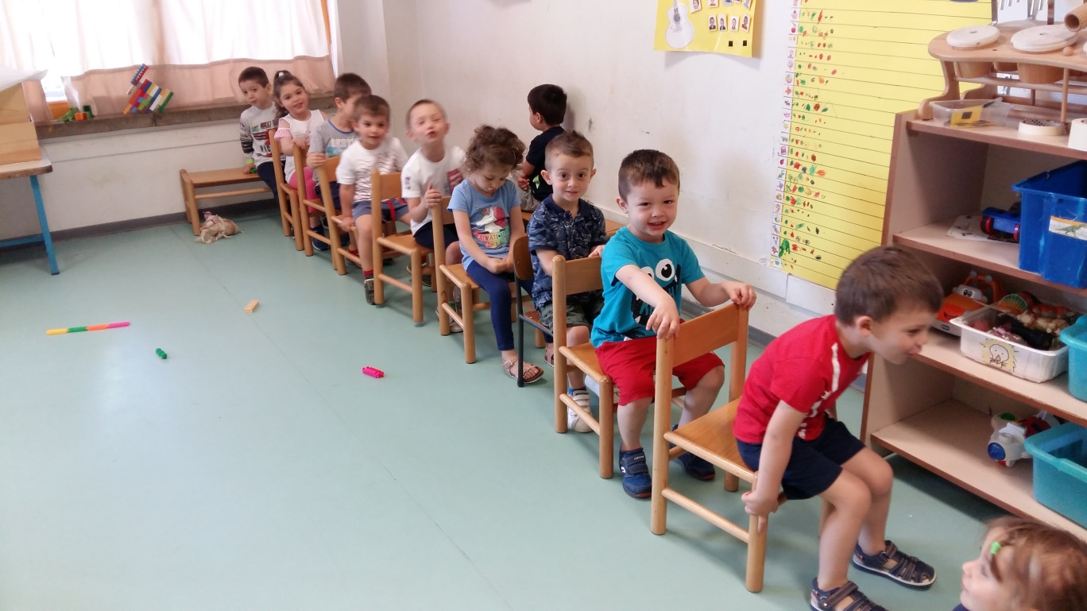
Our first activities with Persona Doll Methodology Latvia, 17th-21th June 2019
Developing children’s social skills

Slide 29
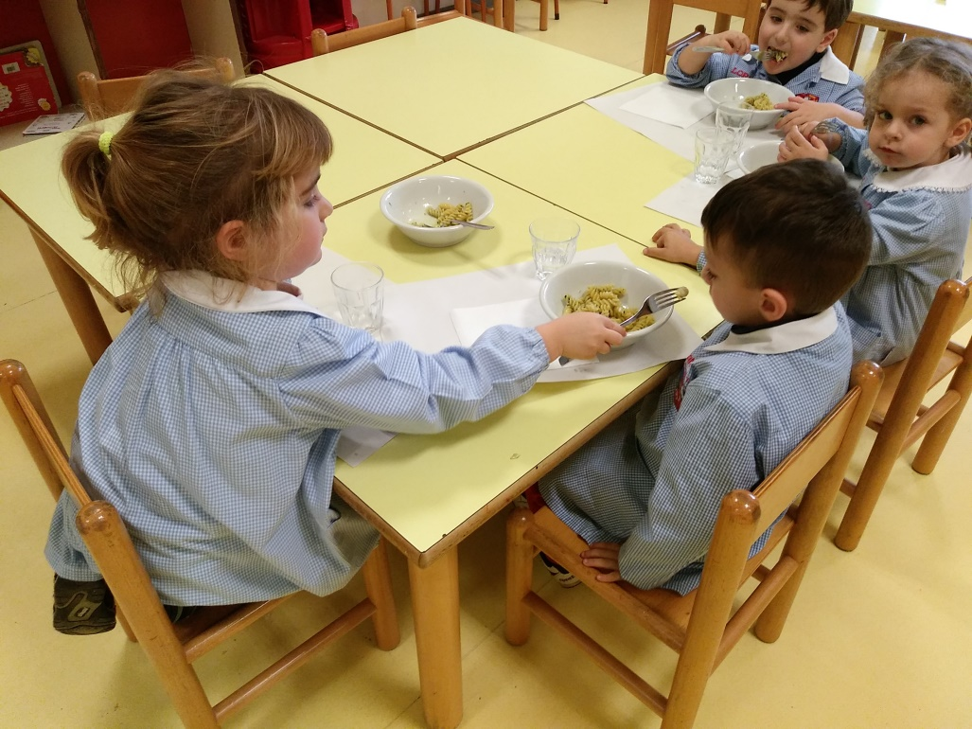
Our first activities with Persona Doll Methodology Latvia, 17th-21th June 2019
Developing children’s social skills

Slide 30
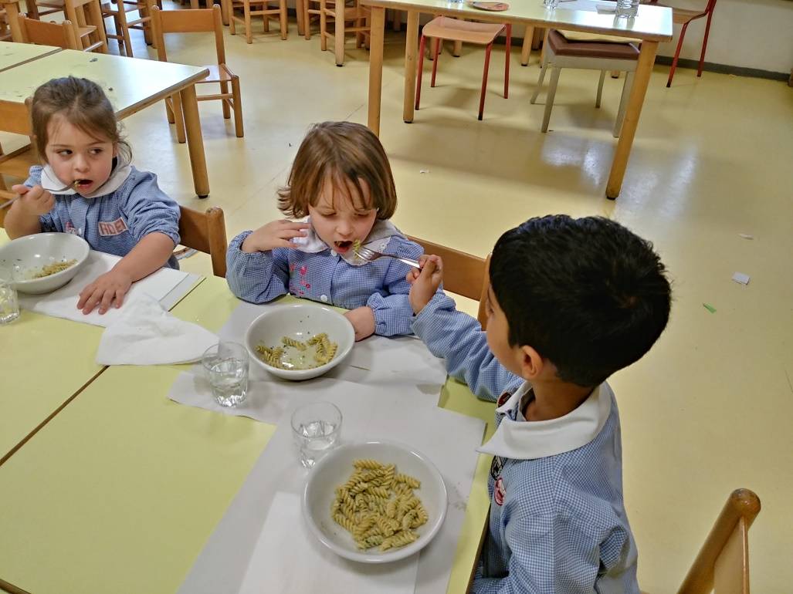
Our first activities with Persona Doll Methodology Latvia, 17th-21th June 2019
Developing children’s social skills

Slide 31
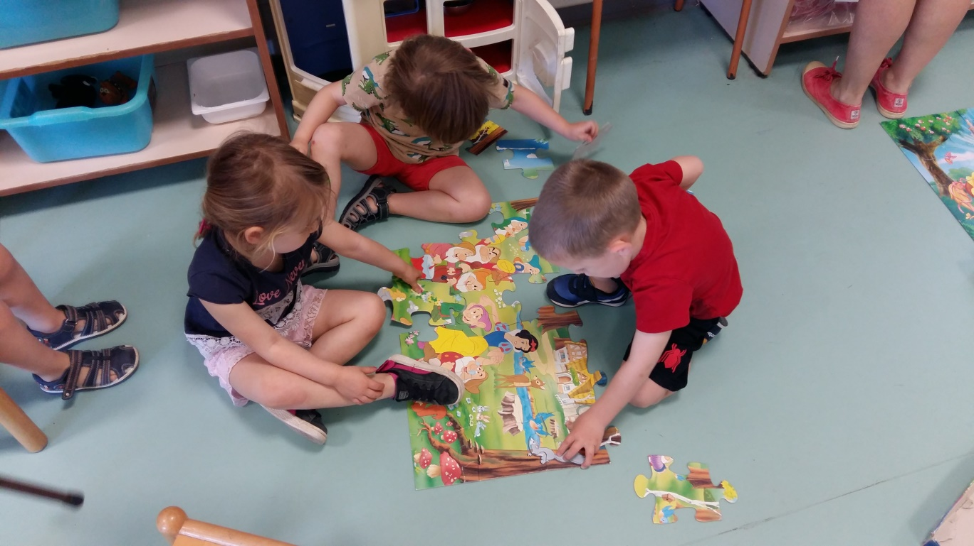
Our first activities with Persona Doll Methodology Latvia, 17th-21th June 2019
Developing children’s social skills

Slide 32
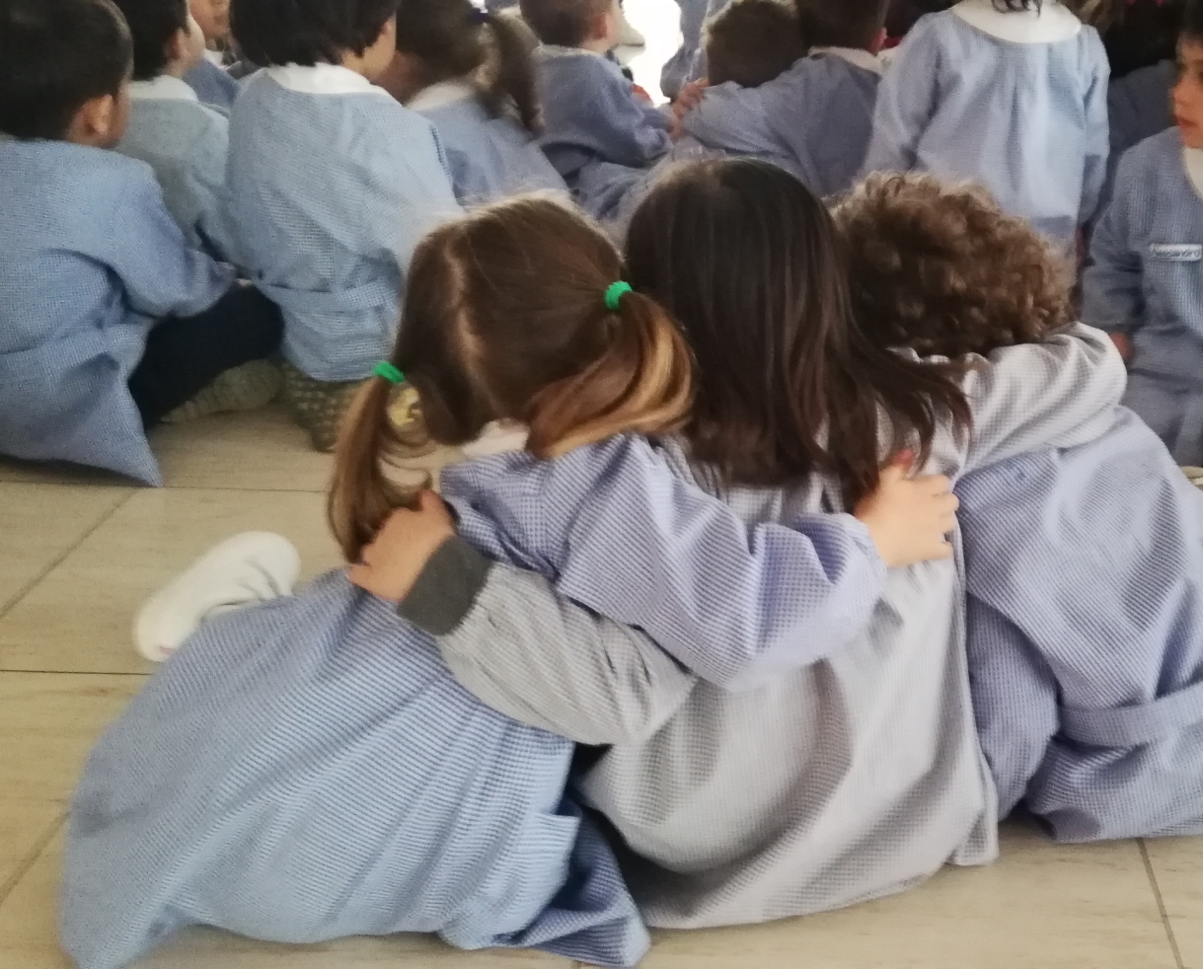
Our first activities with Persona Doll Methodology Latvia, 17th-21th June 2019
Developing children’s social skills

Slide 33
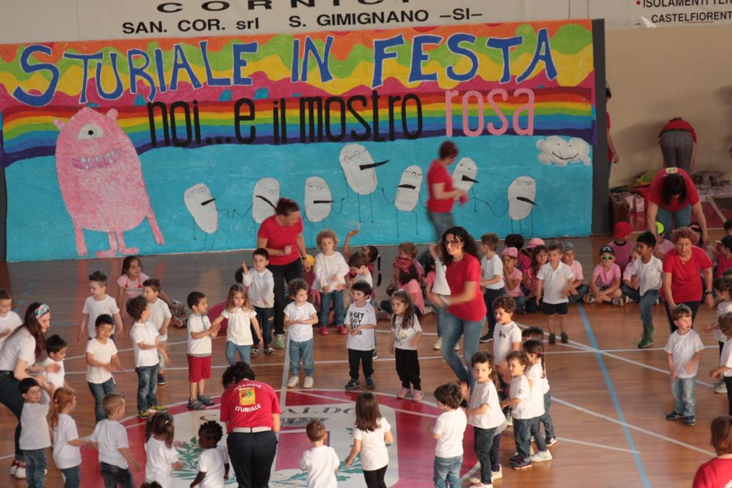
Our first activities with Persona Doll Methodology Latvia, 17th-21th June 2019
Developing children’s social skills

