Slide 1
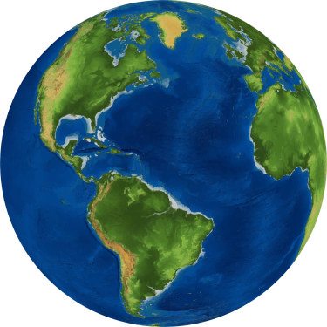
“UNDER THE SAME SUN”
International Erasmus activity 2020
Scuola dell’infanzia «Alice Sturiale» IC Certaldo, Firenze – Italy

Slide 2
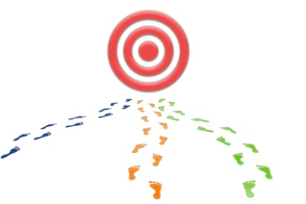
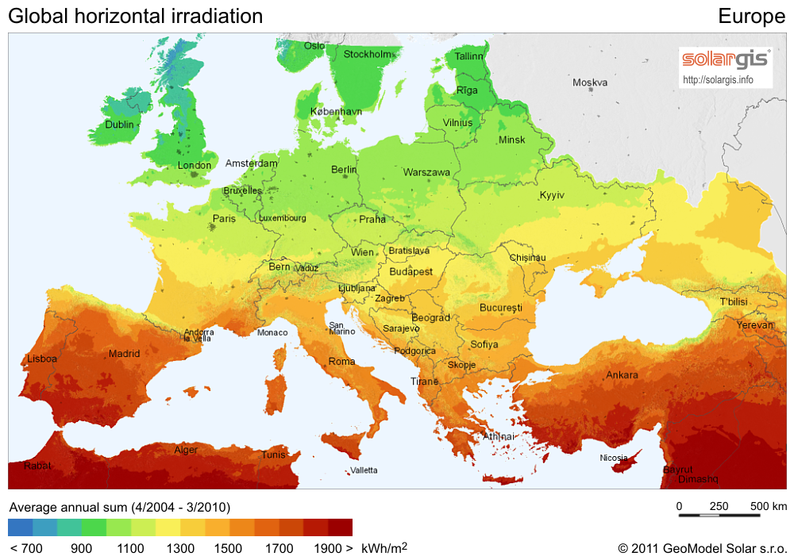
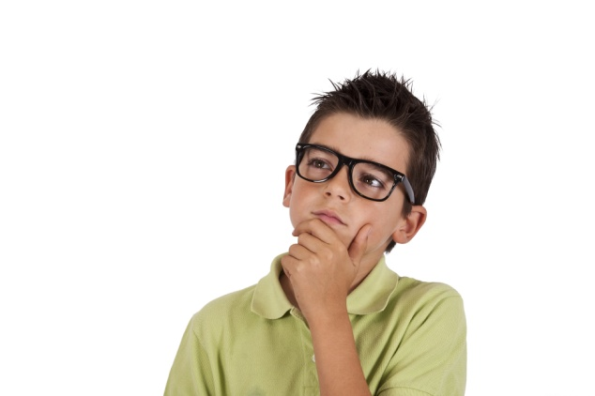
WHAT IS THE GOAL?
Do we see the same Sun at the same time from different world places?
Esta foto de Autor desconocido está bajo licencia CC BY-SA

Slide 3
WHEN TO COLLECT THE DATA?
Certaldo, Italy November 18th
Sunrise time
7:14
Sunset time
16:48
How many hours of sunlight are there in your city? 9 hours approx.

Slide 4
UNDER THE SAME SUN
We are three classes of «Alice Sturiale» kindergarten in Certaldo. Certaldo is in Tuscany in the North-Centre of Italy.
We are 5 /4 years old , we observed the sun at home and at school, we took some pictures, we made some drawings and we spoke about our activities.
Here are the result of this great activity!

Slide 5
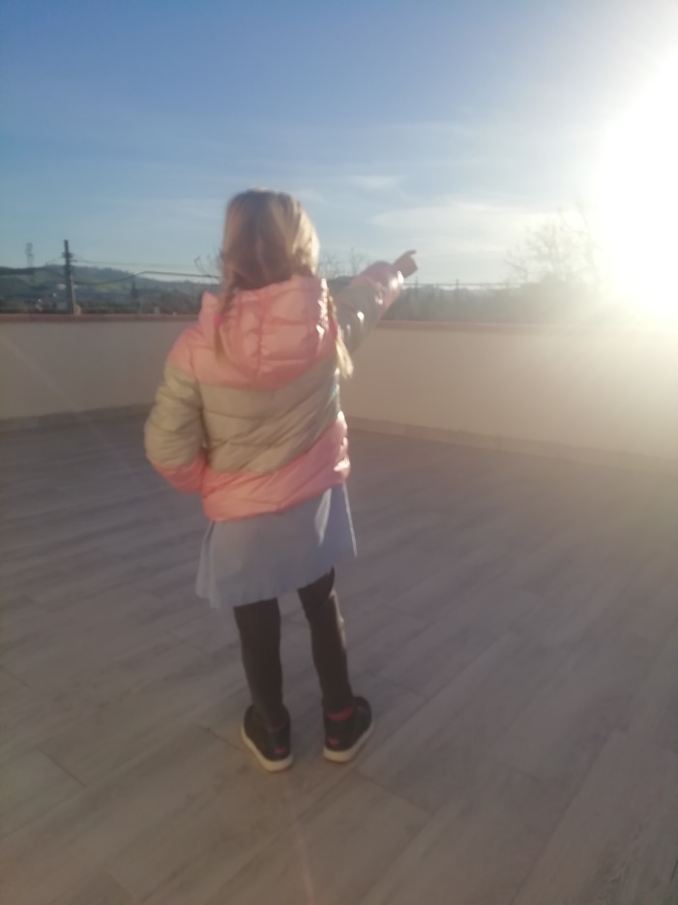
UNDER THE SAME SUN
Sunrise: it means the sun stands up, as we wake up in the morning!
Look!!!
The sun!

Slide 6
UNDER THE SAME SUN
It’s a bright day!

Slide 7
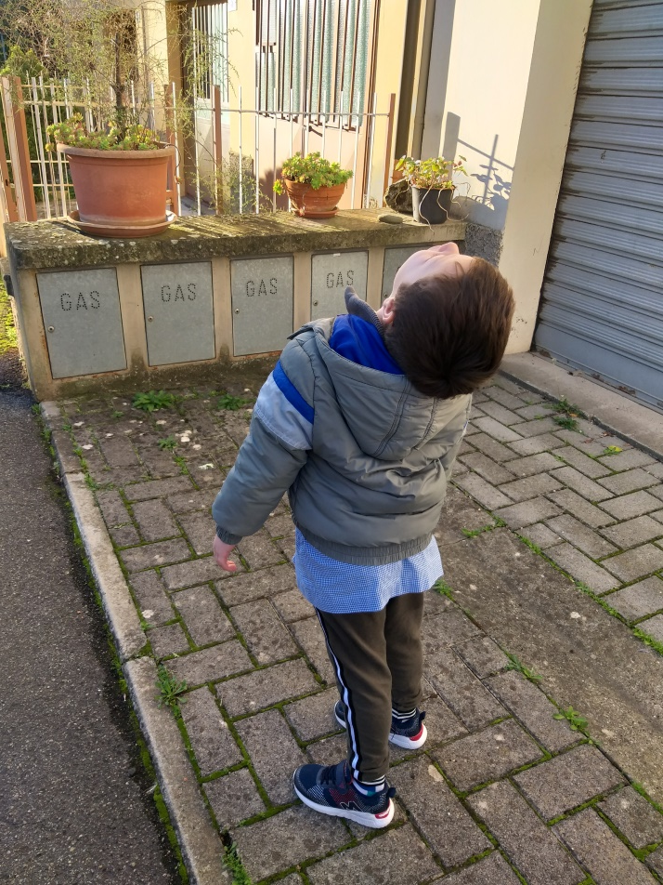
UNDER THE SAME SUN
The sun is up in the sky

Slide 8
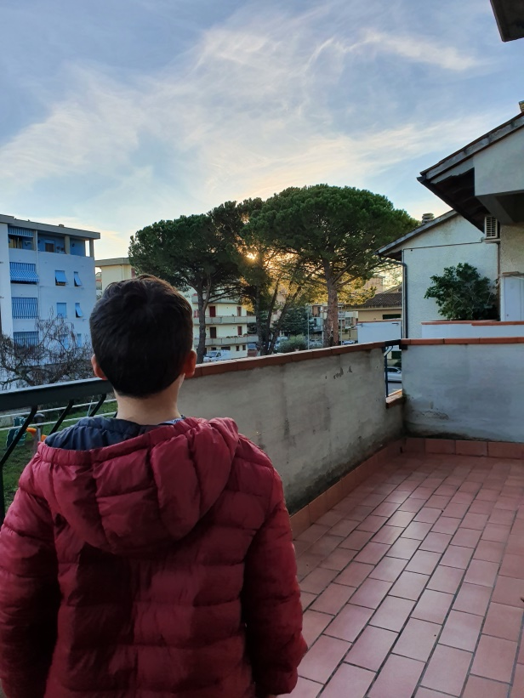
UNDER THE SAME SUN
Sometimes the sun is too strong and we need glasses
The sun is behind the trees…

Slide 9
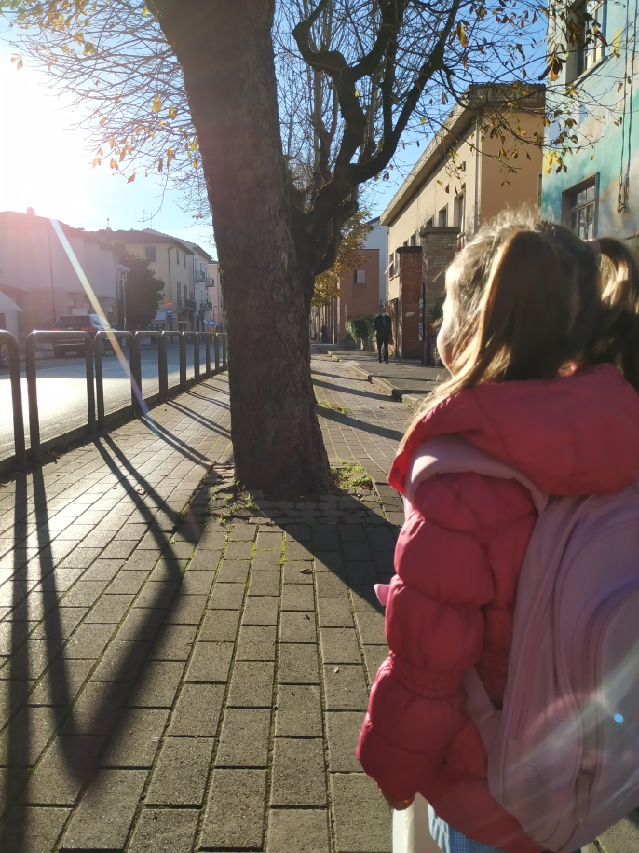
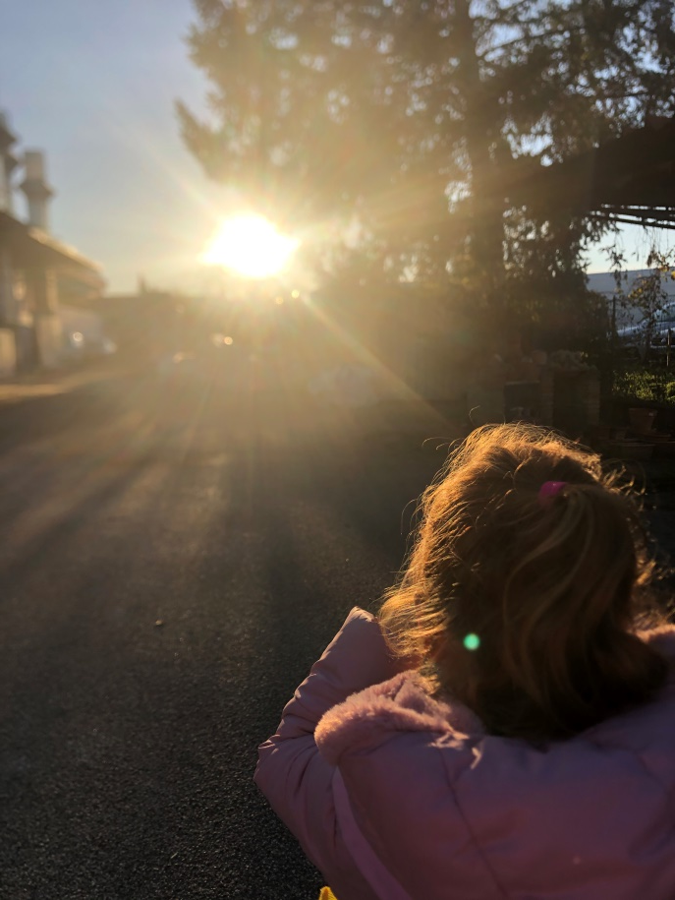
UNDER THE SAME SUN
In the morning
We have breakfast and we go to school!

Slide 10
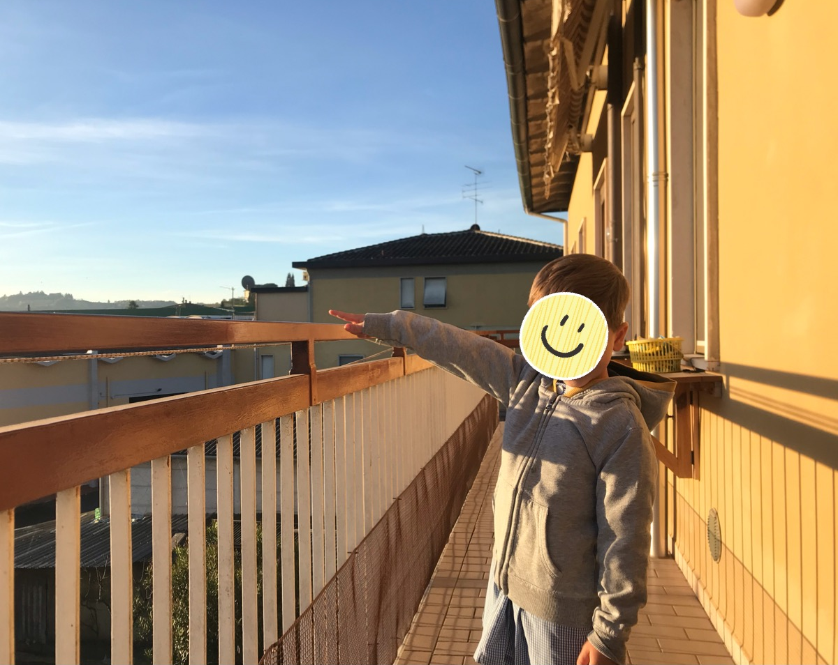
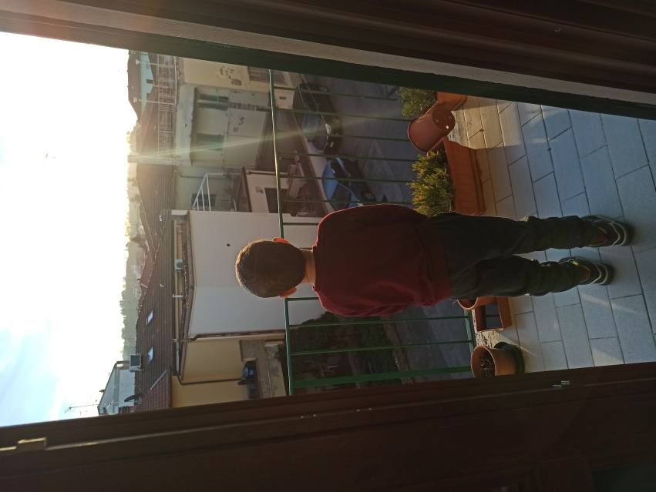
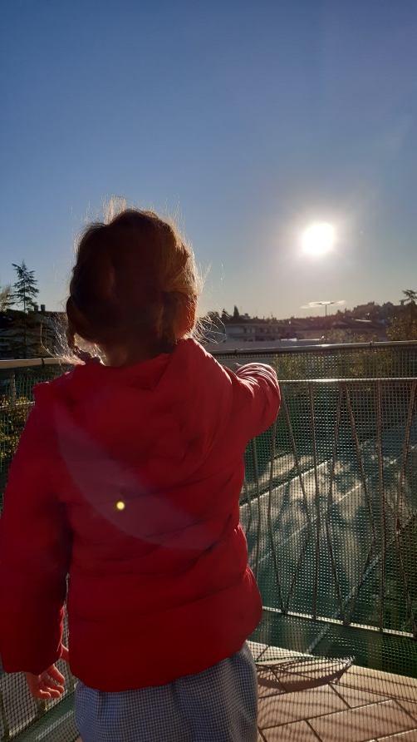
UNDER THE SAME SUN
During breakfast the sun was arising, at school it was upper

Slide 11
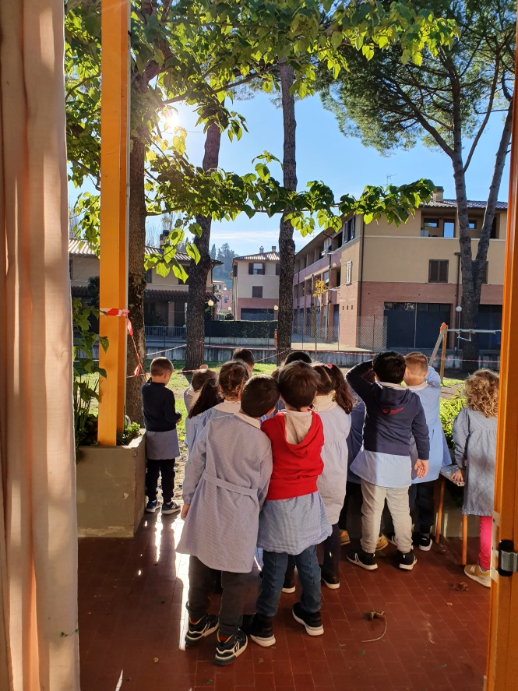
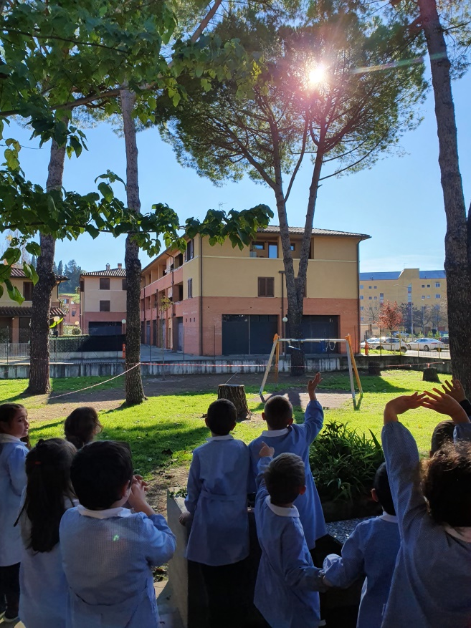
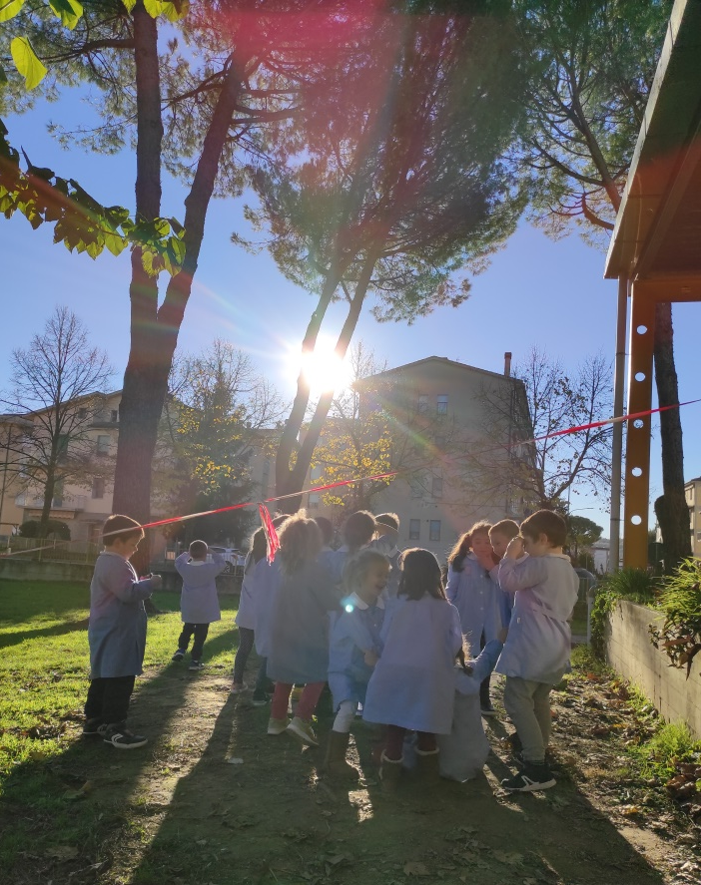
UNDER THE SAME SUN
The sun is moving!

Slide 12
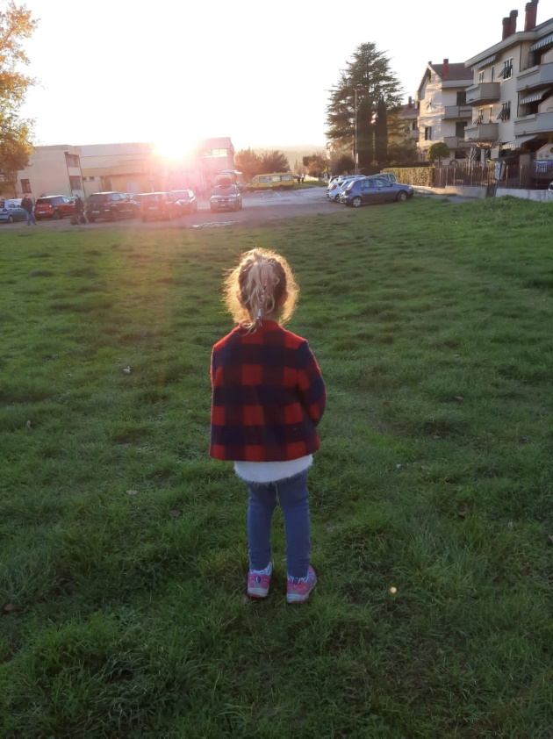
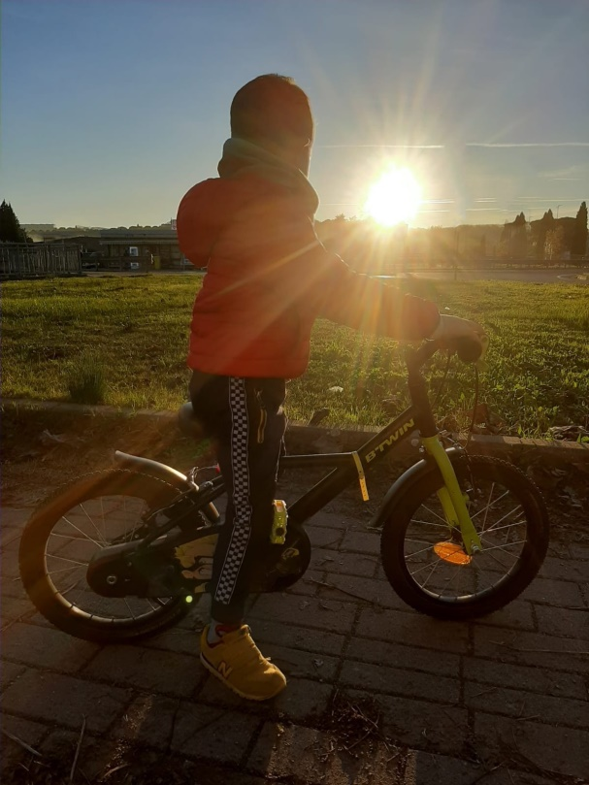
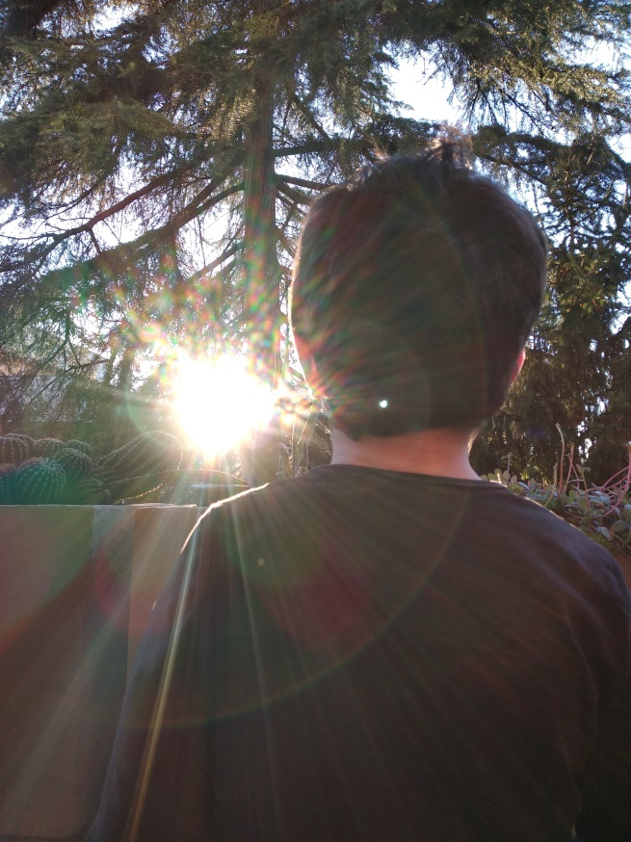
UNDER THE SAME SUN
The sunset is when the sun goes down… behind the mountains…into the sea…

Slide 13
UNDER THE SAME SUN
The sky is light yellow…

Slide 14
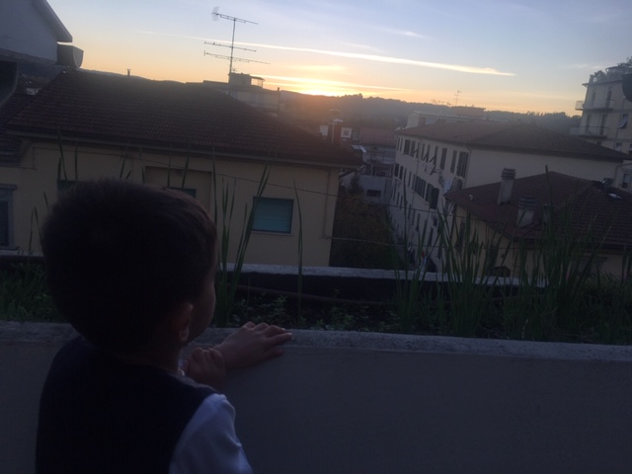
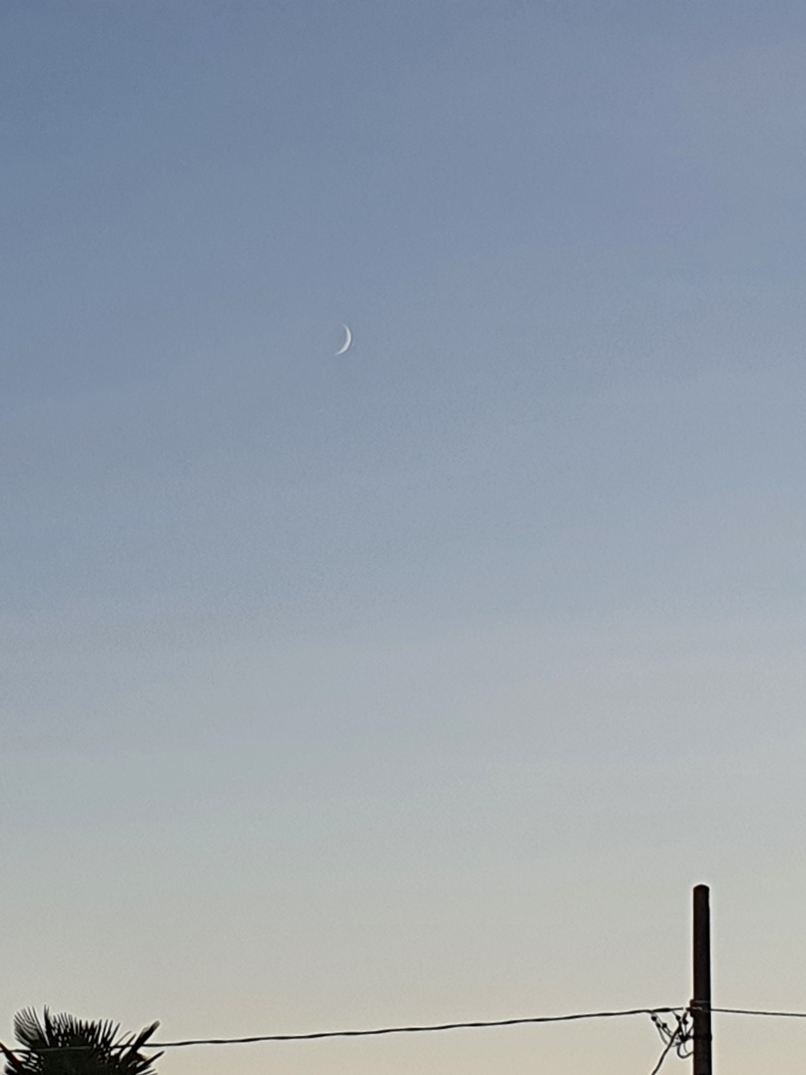
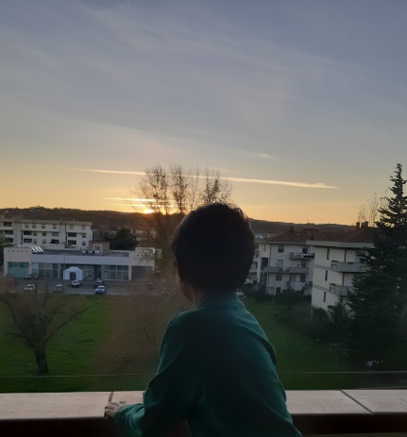
UNDER THE SAME SUN
At night there is the moon

Slide 15
UNDER THE SAME SUN
…. the stars are always there, we can’t see them because the sun is very bright…..
The sun is a star!

Slide 16
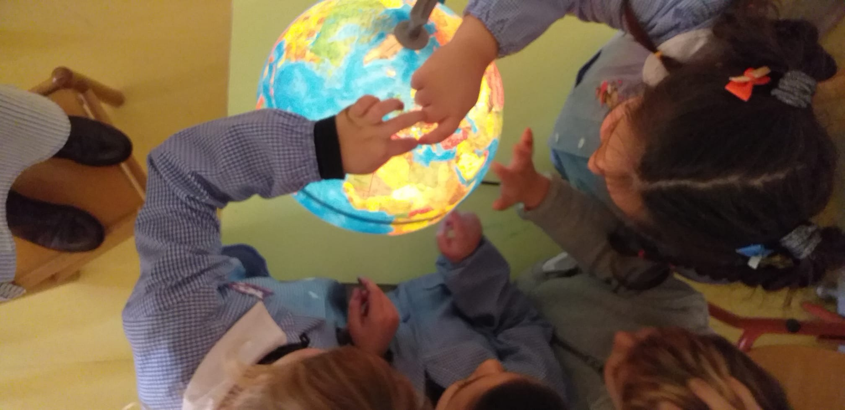
UNDER THE SAME SUN

Slide 17
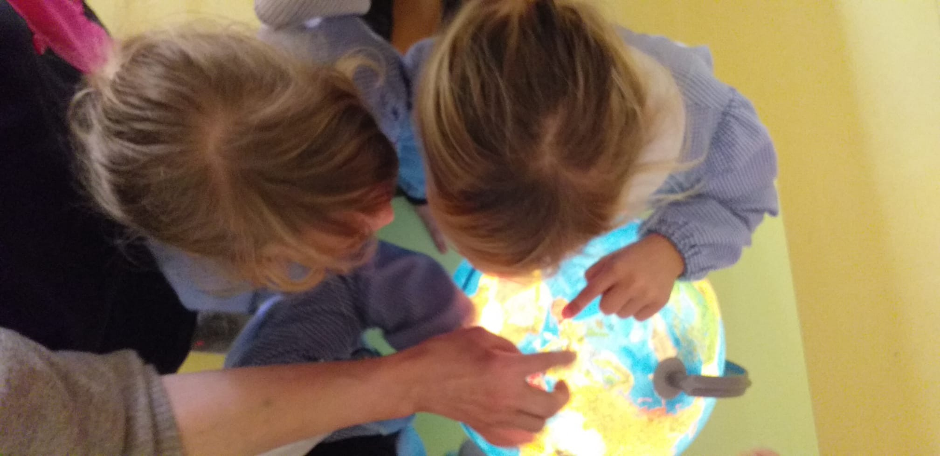
UNDER THE SAME SUN

Slide 18
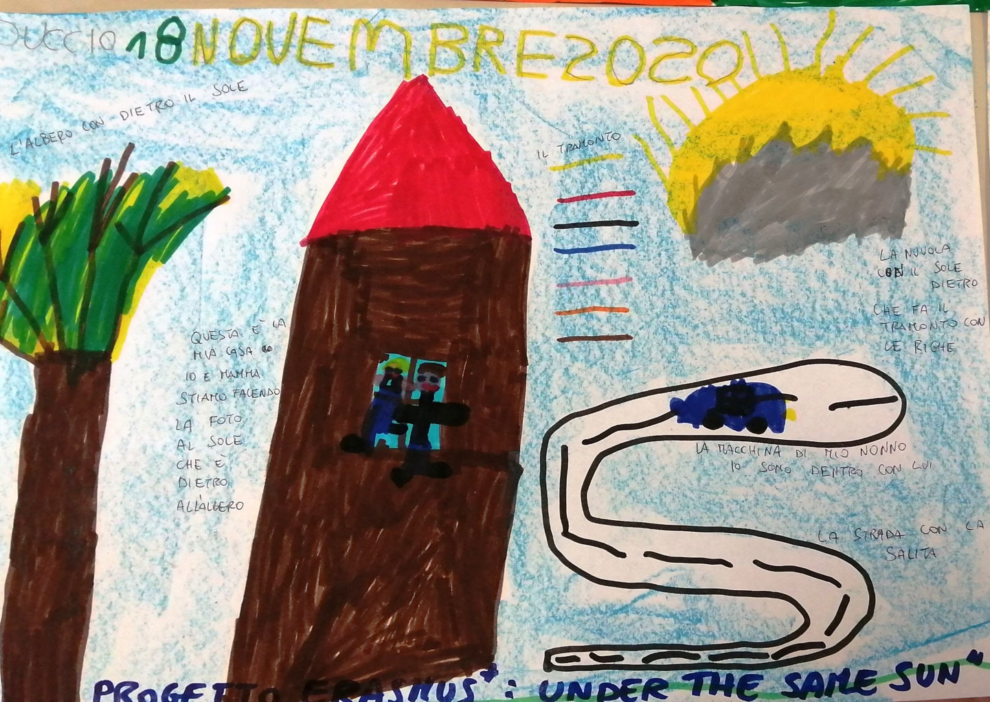
UNDER THE SAME SUN

Slide 19
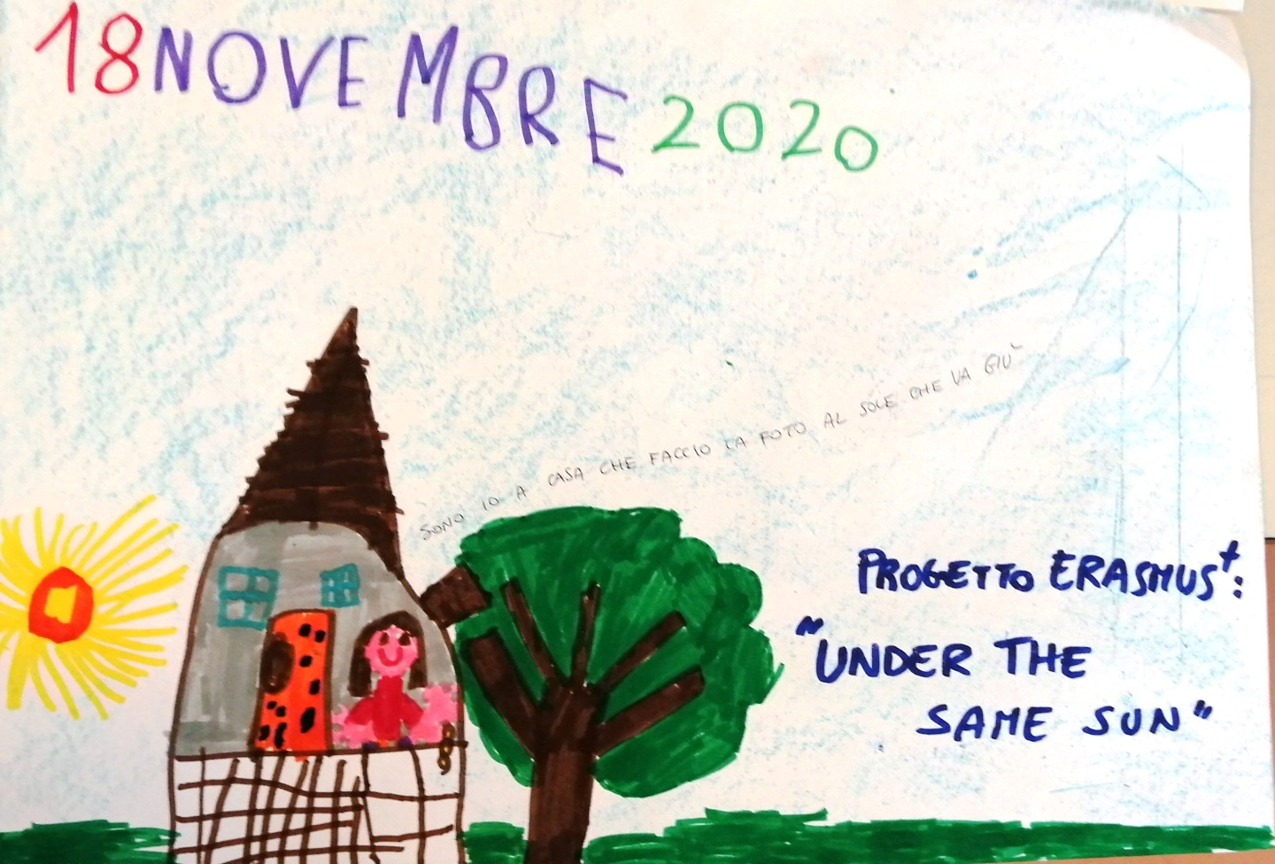
UNDER THE SAME SUN

Slide 20
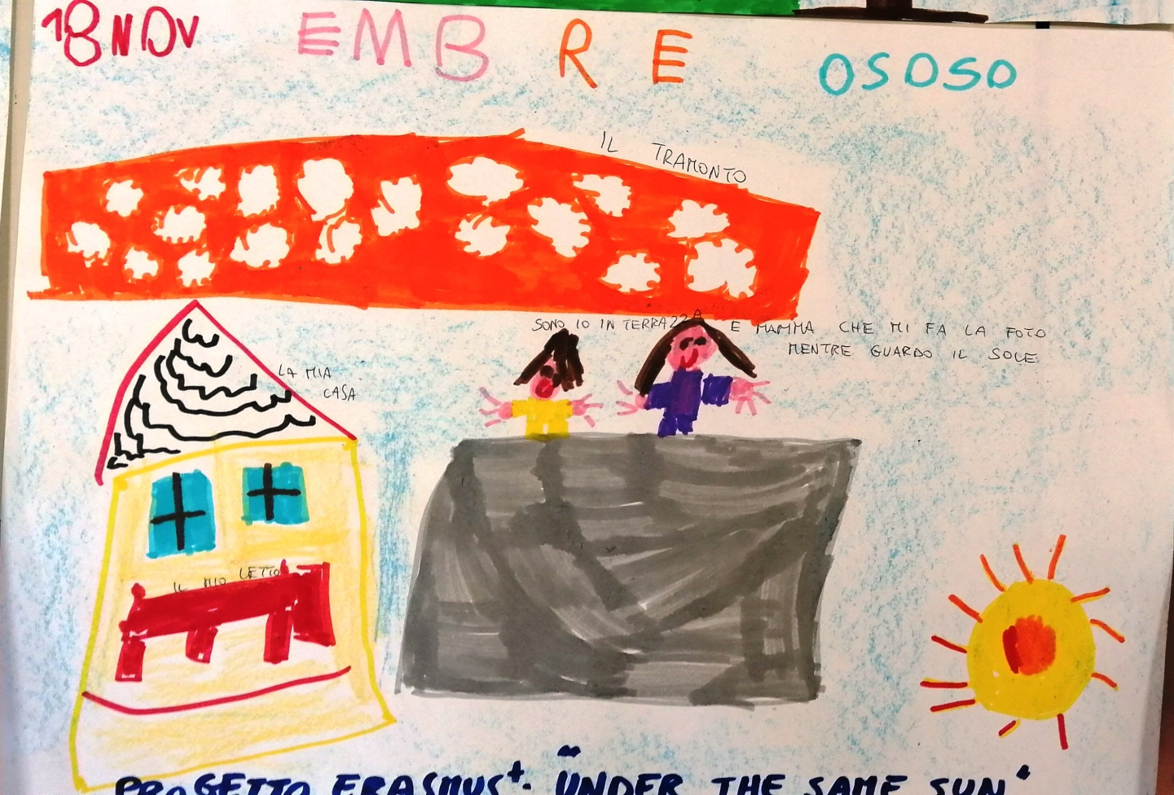
UNDER THE SAME SUN

Slide 21
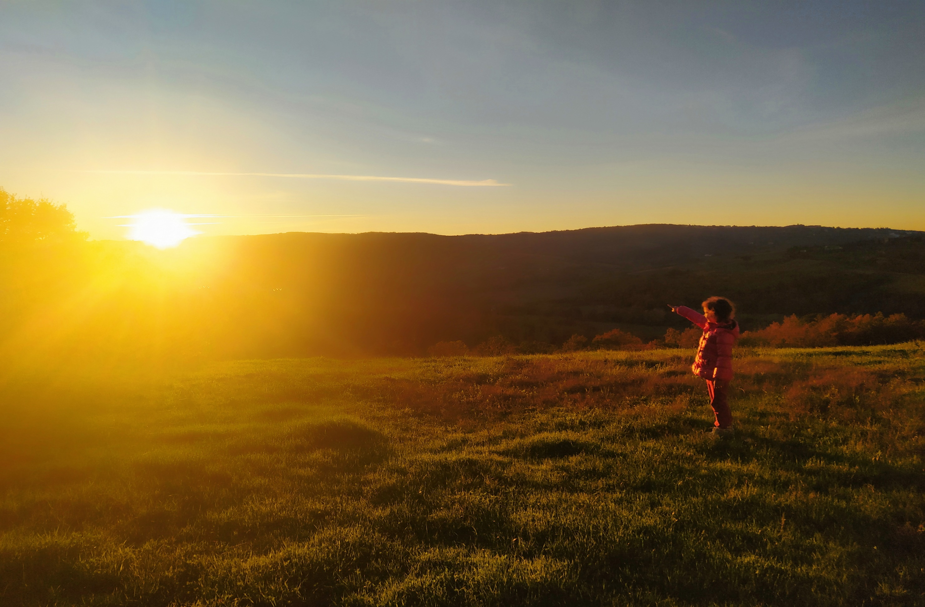
Under the same sun

