Slide 1
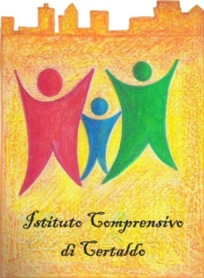
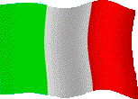
OUR ITALIAN WEEK
WHAT DO WE KNOW OF
OUR COUNTRY?

Slide 2
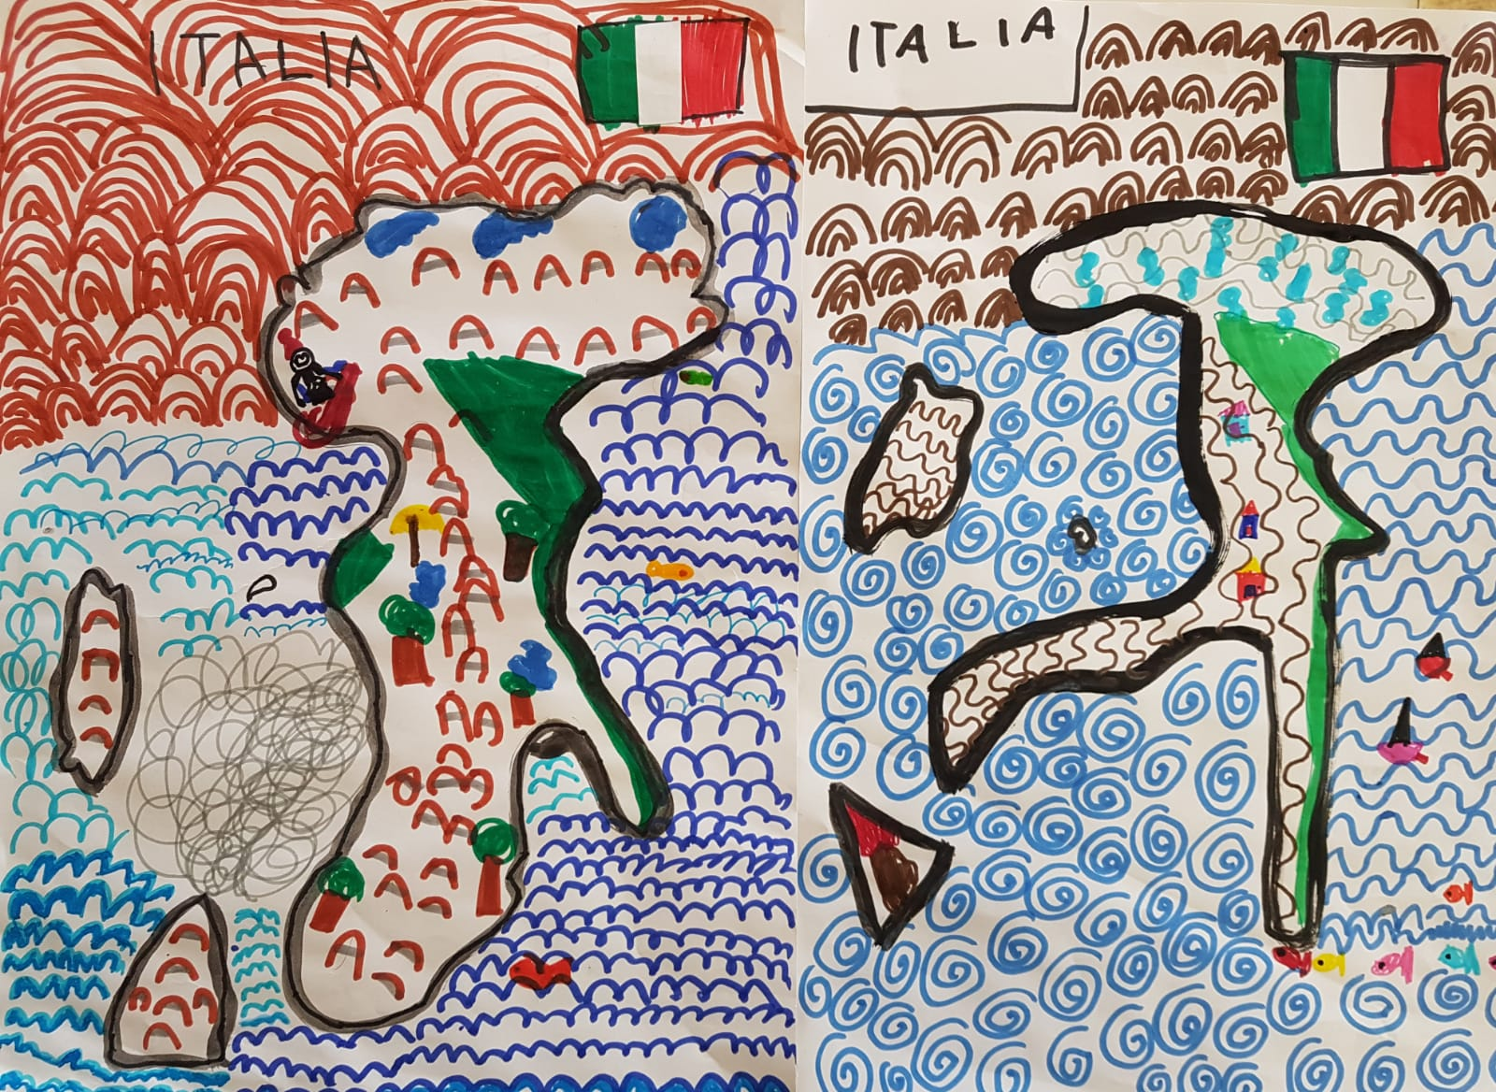
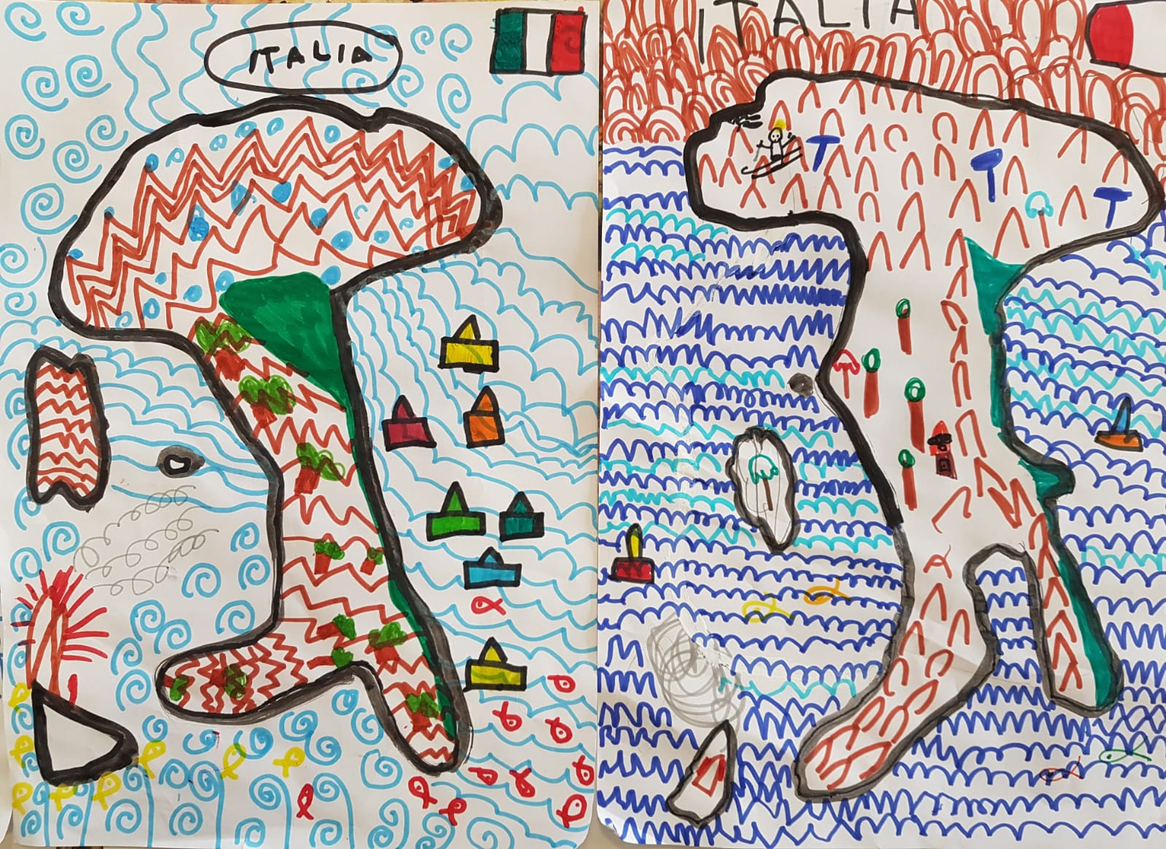
OUR ITALIAN WEEK
Creative maps

Slide 3
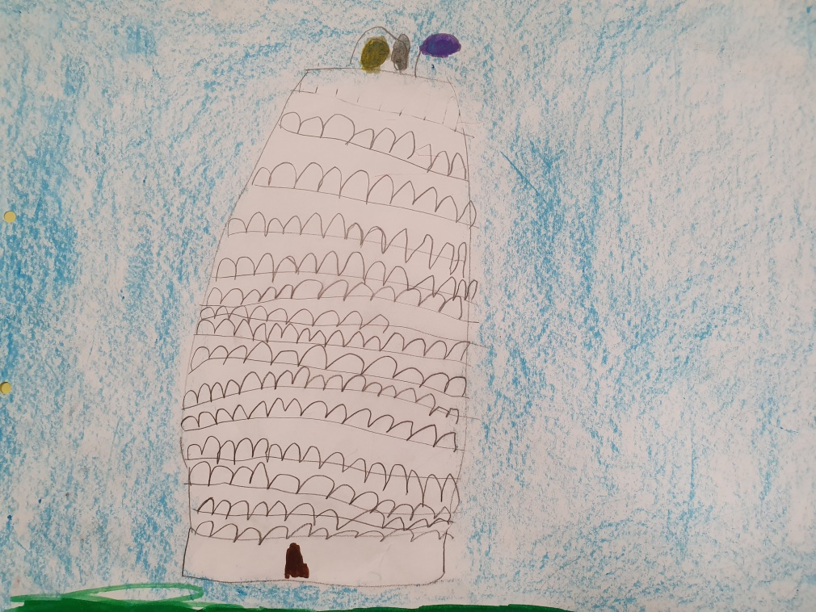
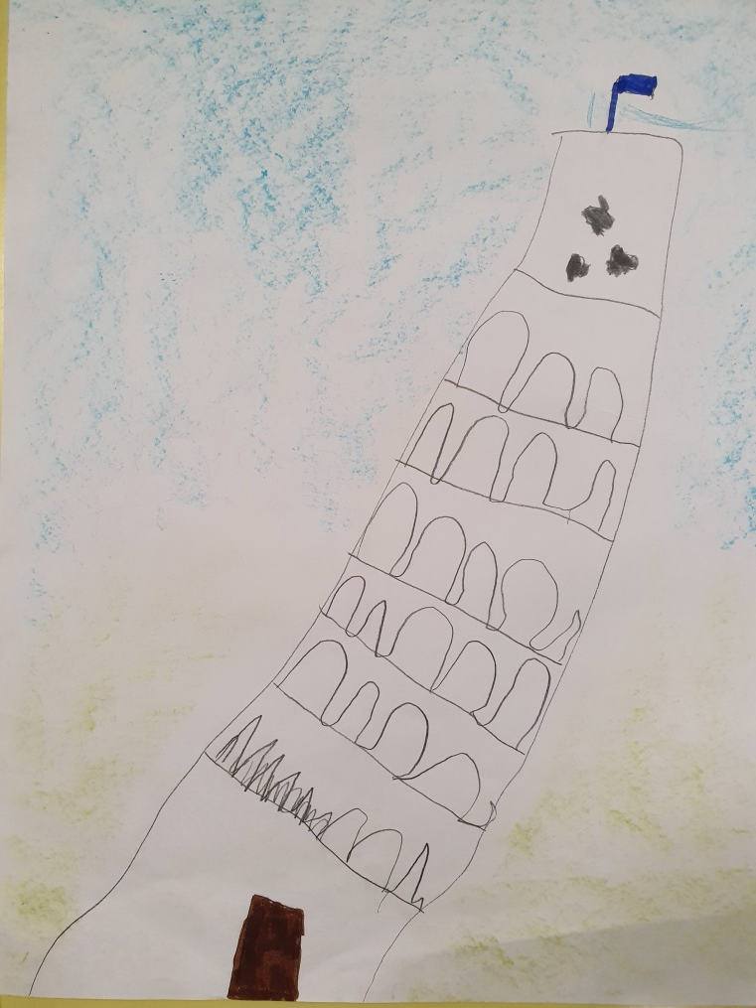
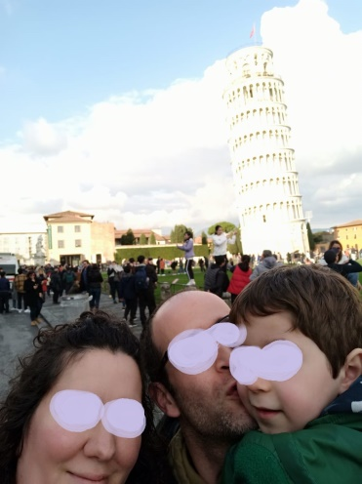
OUR ITALIAN WEEK
The leaning tower of Pisa
And a child took the right time to visit Pisa with his parents!

Slide 4
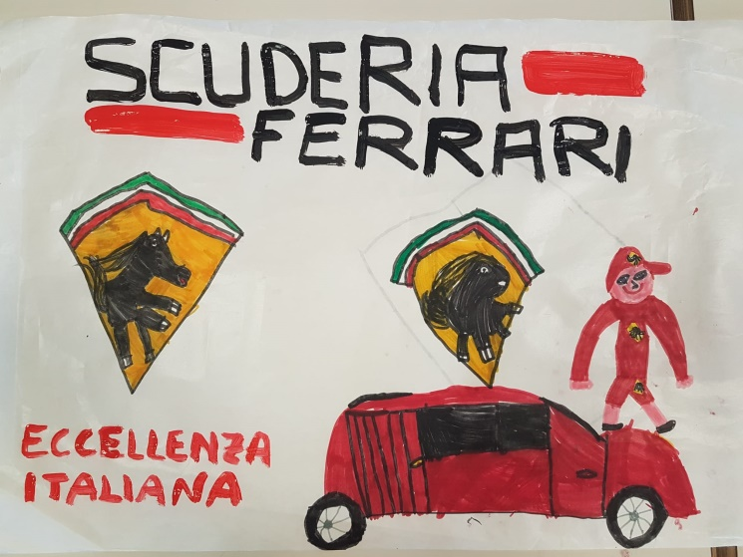
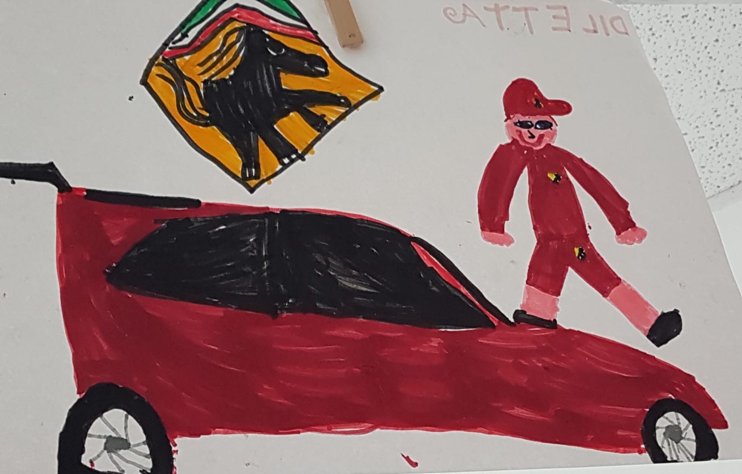
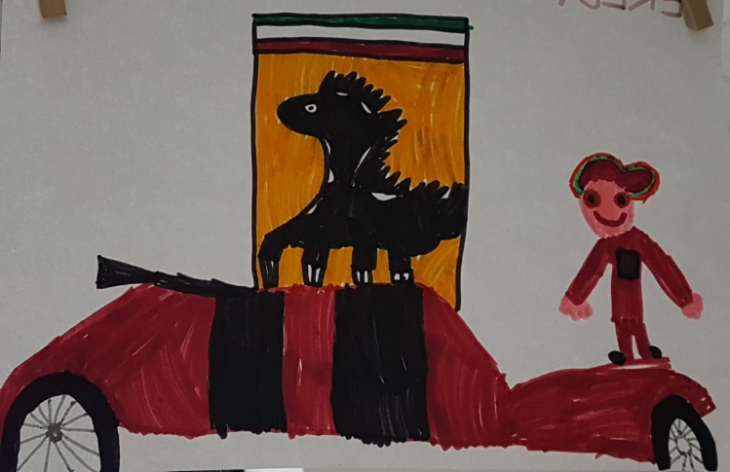
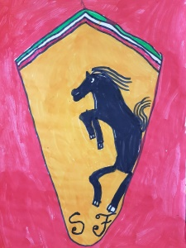
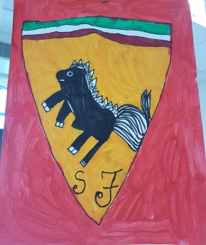
OUR ITALIAN WEEK
Ferrari

Slide 5
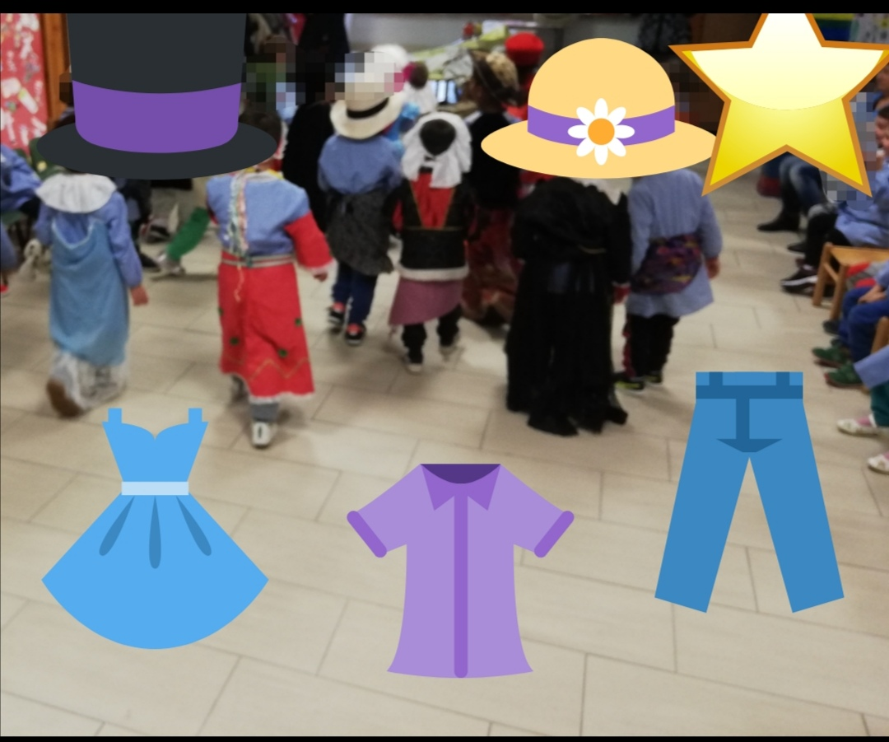
OUR ITALIAN WEEK
Fashion

Slide 6
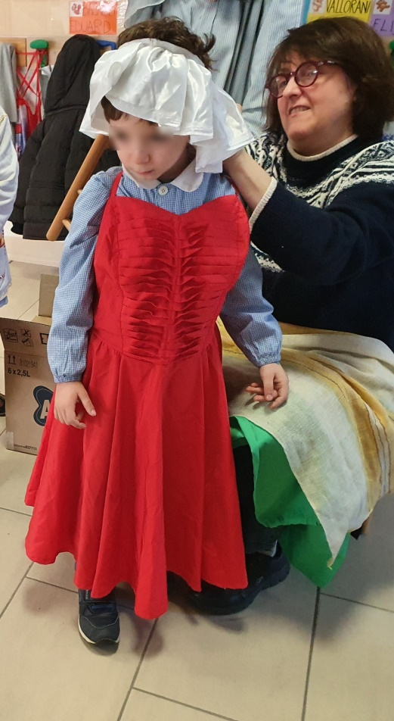
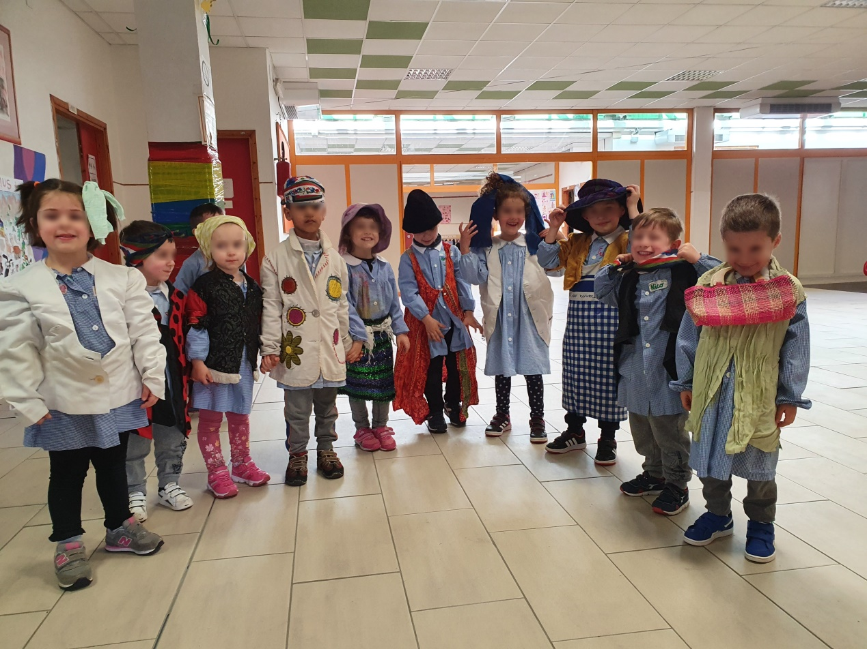
OUR ITALIAN WEEK
Fashion

Slide 7
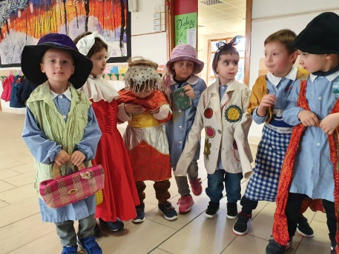
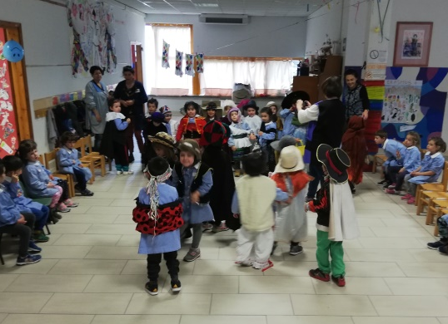
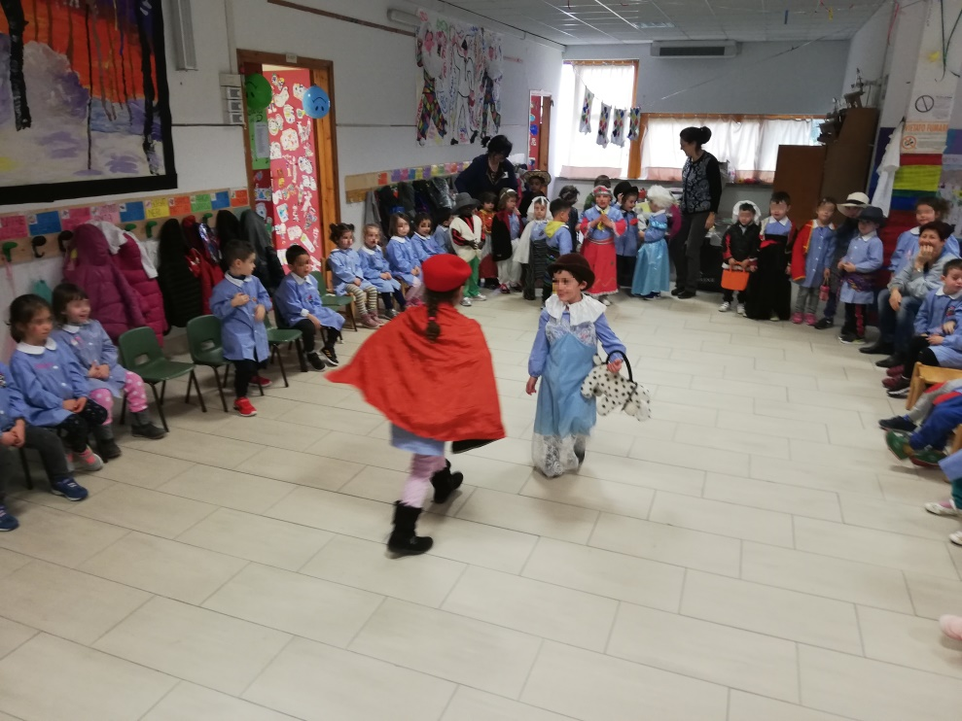
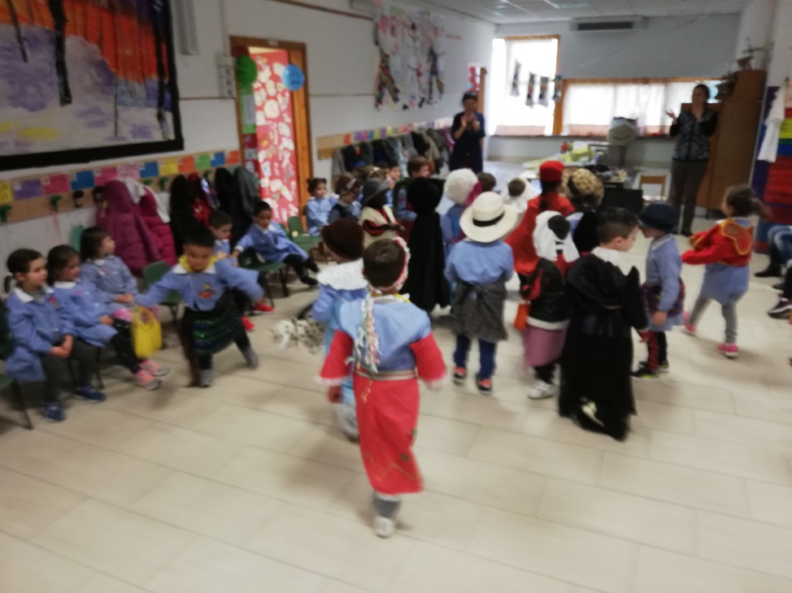
OUR ITALIAN WEEK
Fashion

Slide 8
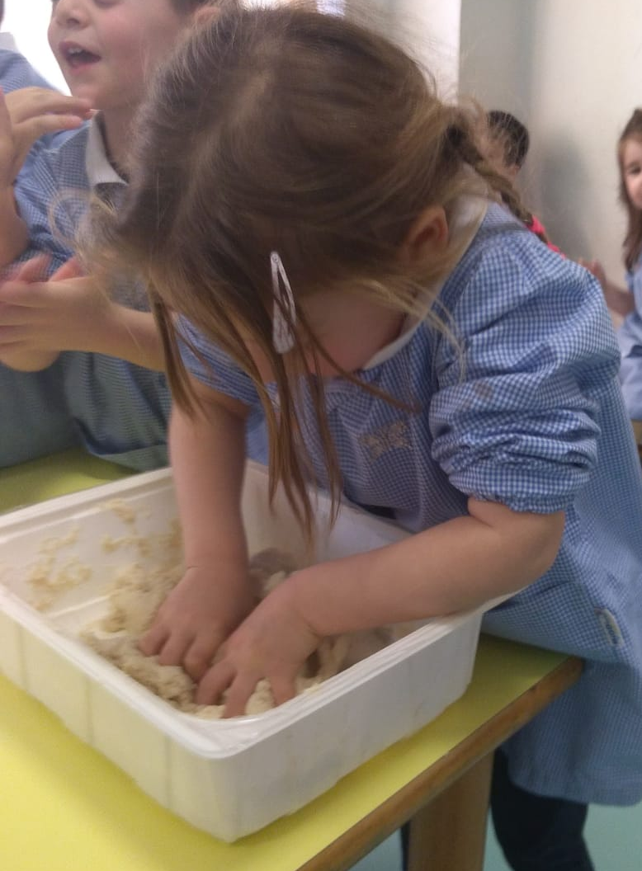
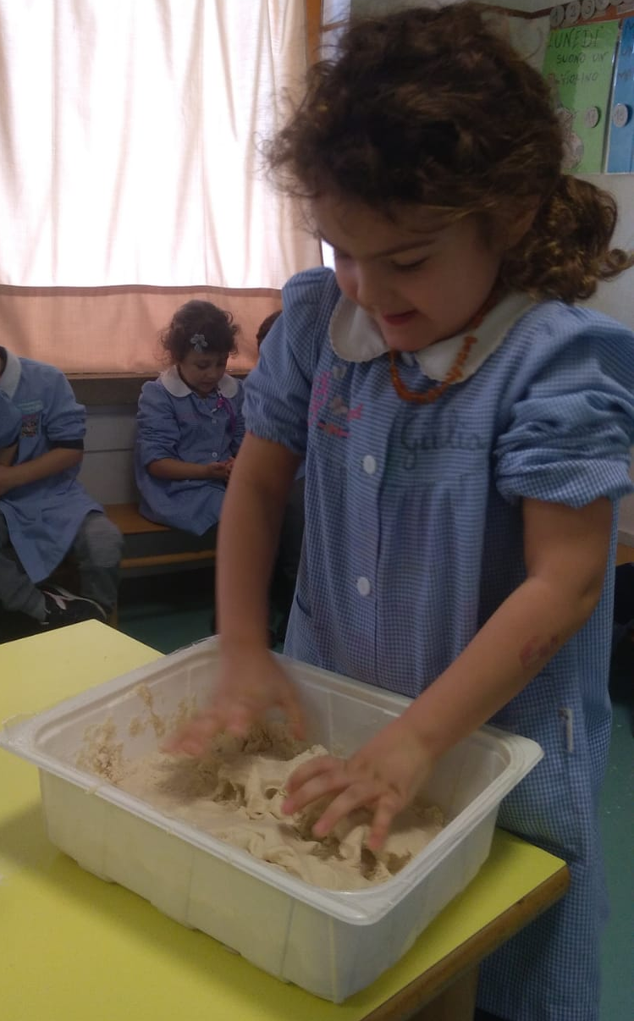
OUR ITALIAN WEEK
Food
We prepare pizza!
with salted dough, and painting

Slide 9
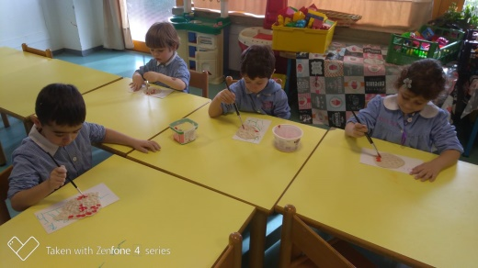
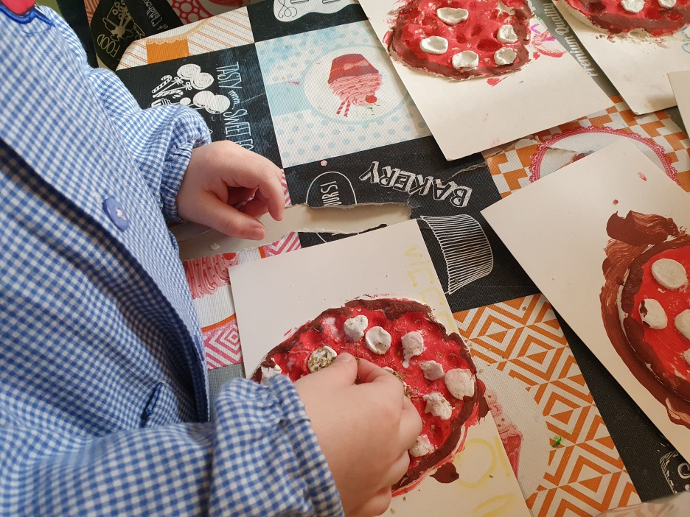
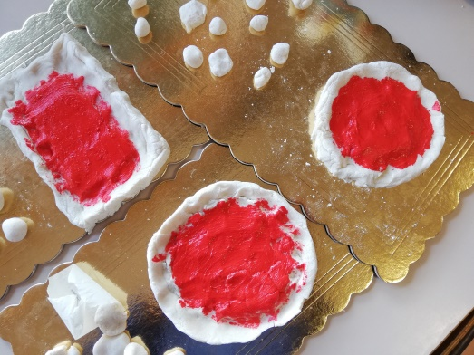
OUR ITALIAN WEEK
Food
We prepare pizza!
with salted dough, and painting

Slide 10
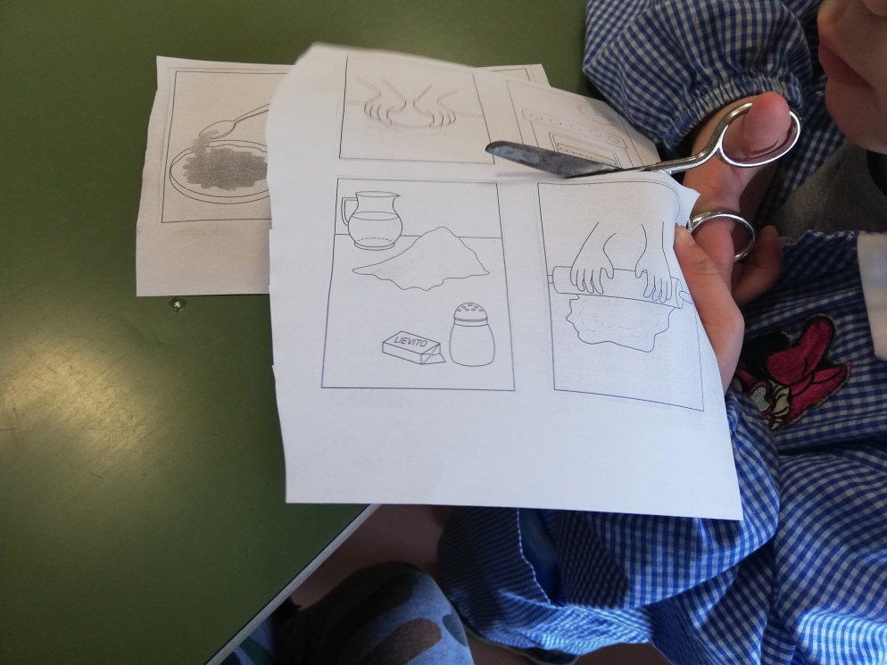
OUR ITALIAN WEEK
Food
Pizza: a coding activity!

Slide 11
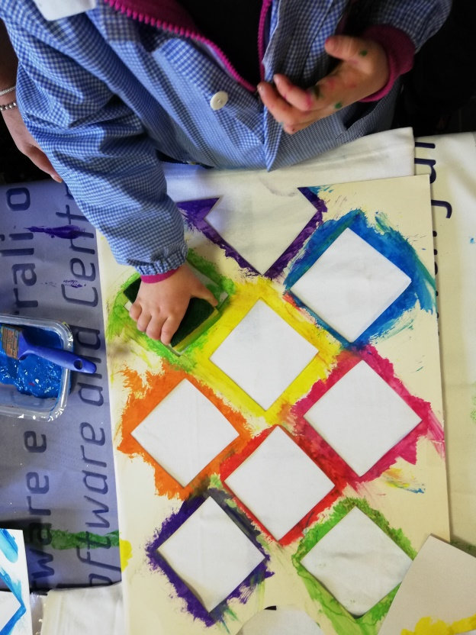
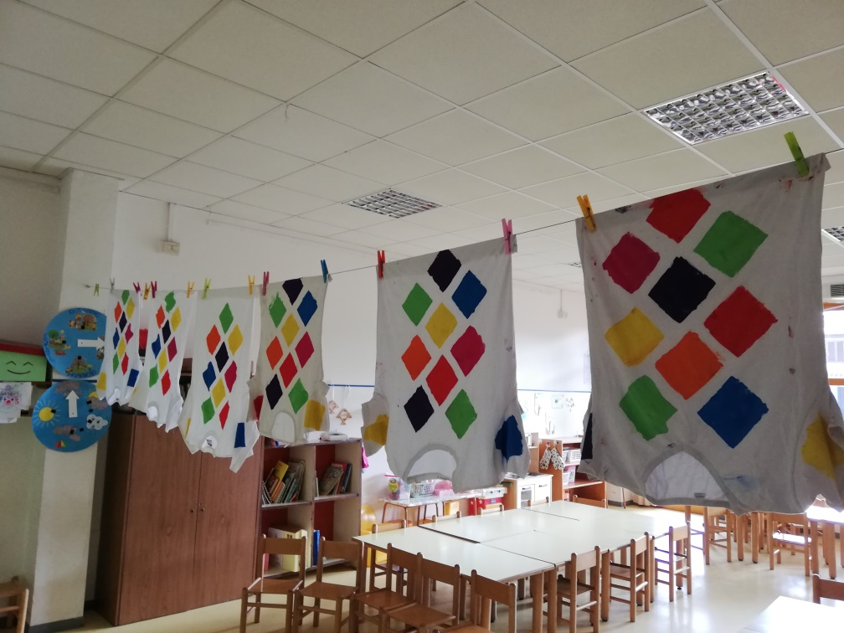
OUR ITALIAN WEEK
Italian Carnival Masks
Arlecchino

Slide 12
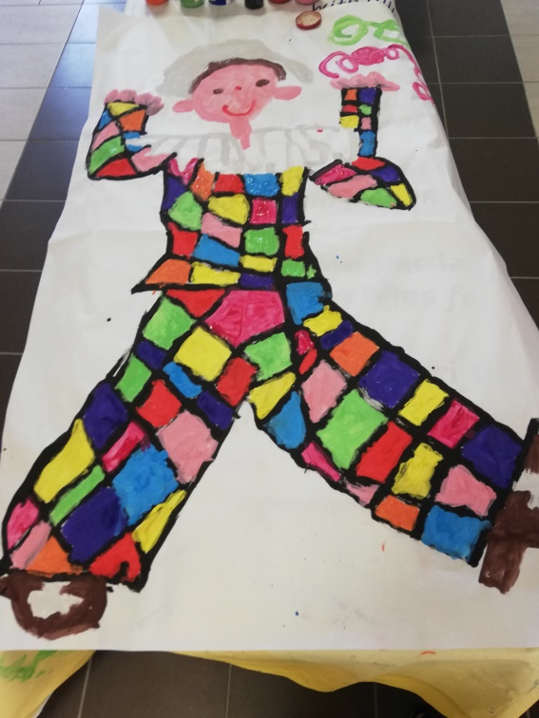
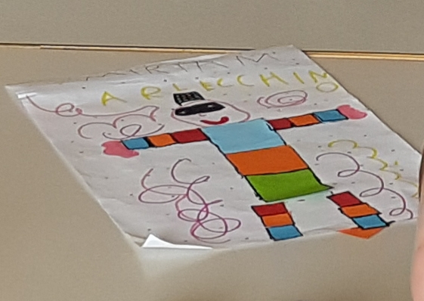
OUR ITALIAN WEEK
Italian Carnival Masks
Arlecchino

Slide 13
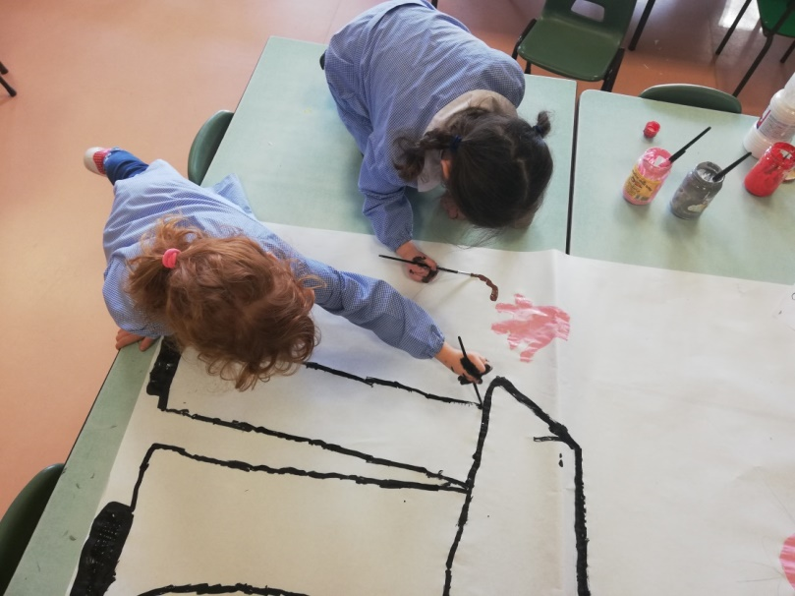
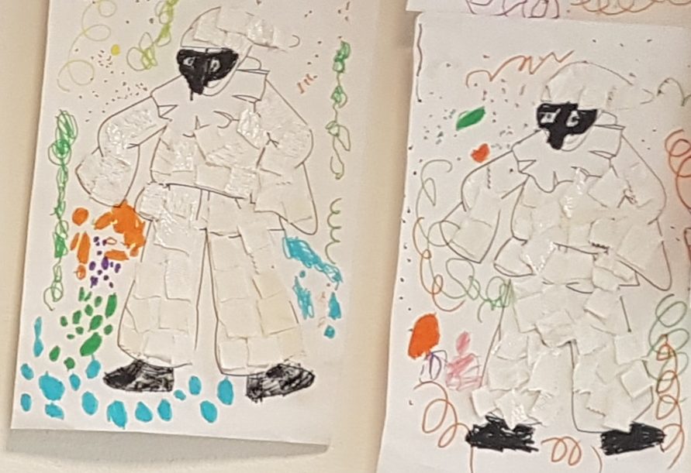
OUR ITALIAN WEEK
Italian Carnival Masks
Pulcinella

Slide 14
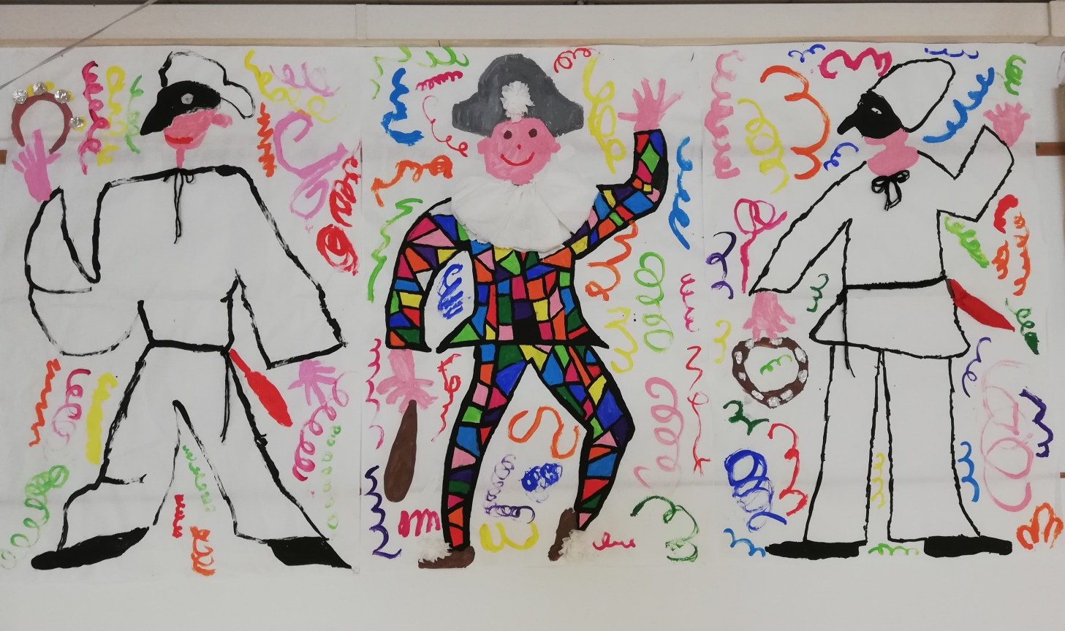
OUR ITALIAN WEEK
Italian Carnival Masks
Pulcinella and Arlecchino

Slide 15
OUR ITALIAN WEEK
Italian Carnival Masks
Pulcinella and Arlecchino

Slide 16
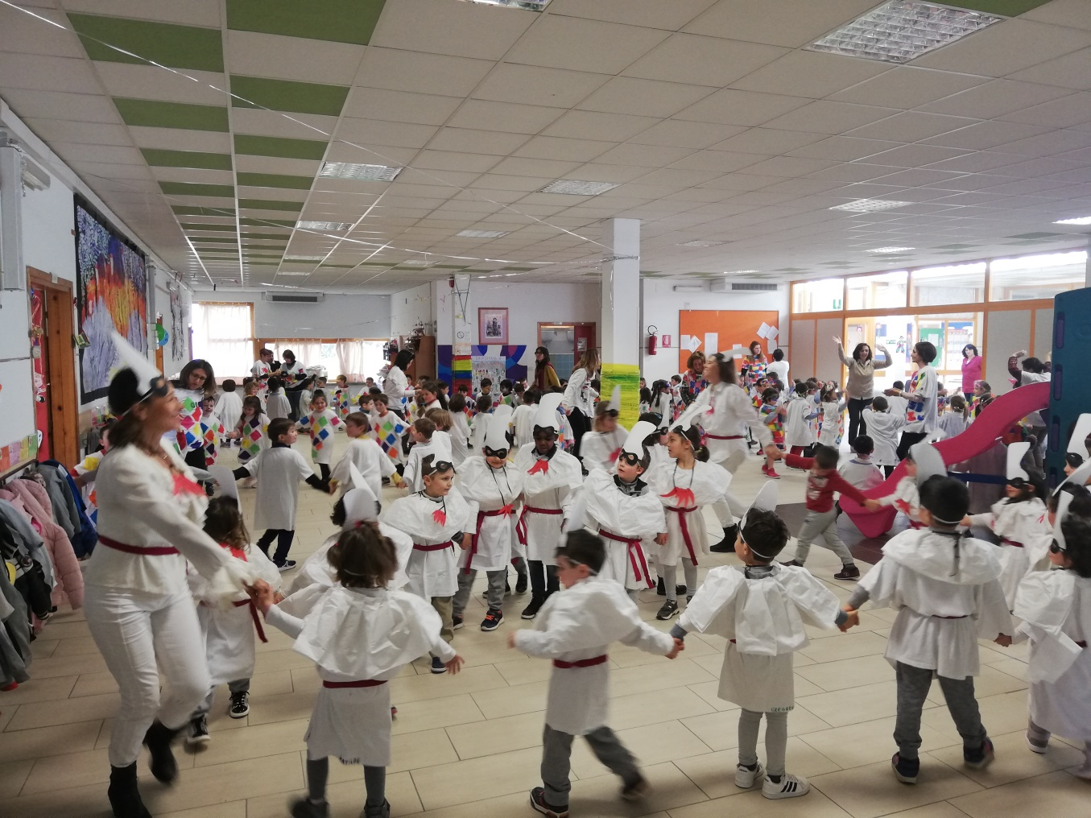
OUR ITALIAN WEEK
Carnival festival

Slide 17
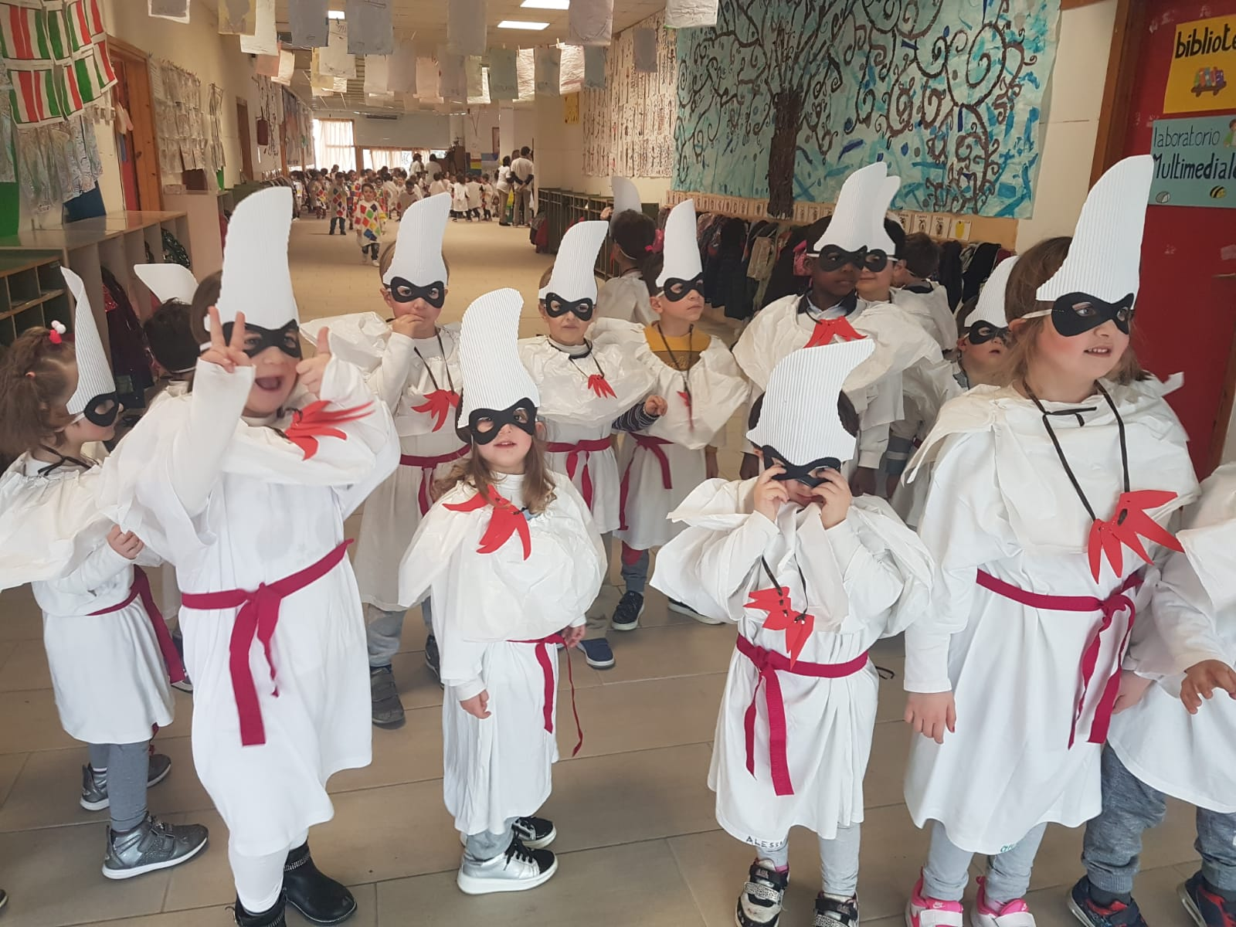
OUR ITALIAN WEEK
Carnival festival

Slide 18
OUR ITALIAN WEEK
Carnival festival

Slide 19
OUR ITALIAN WEEK
Carnival festival

Slide 20
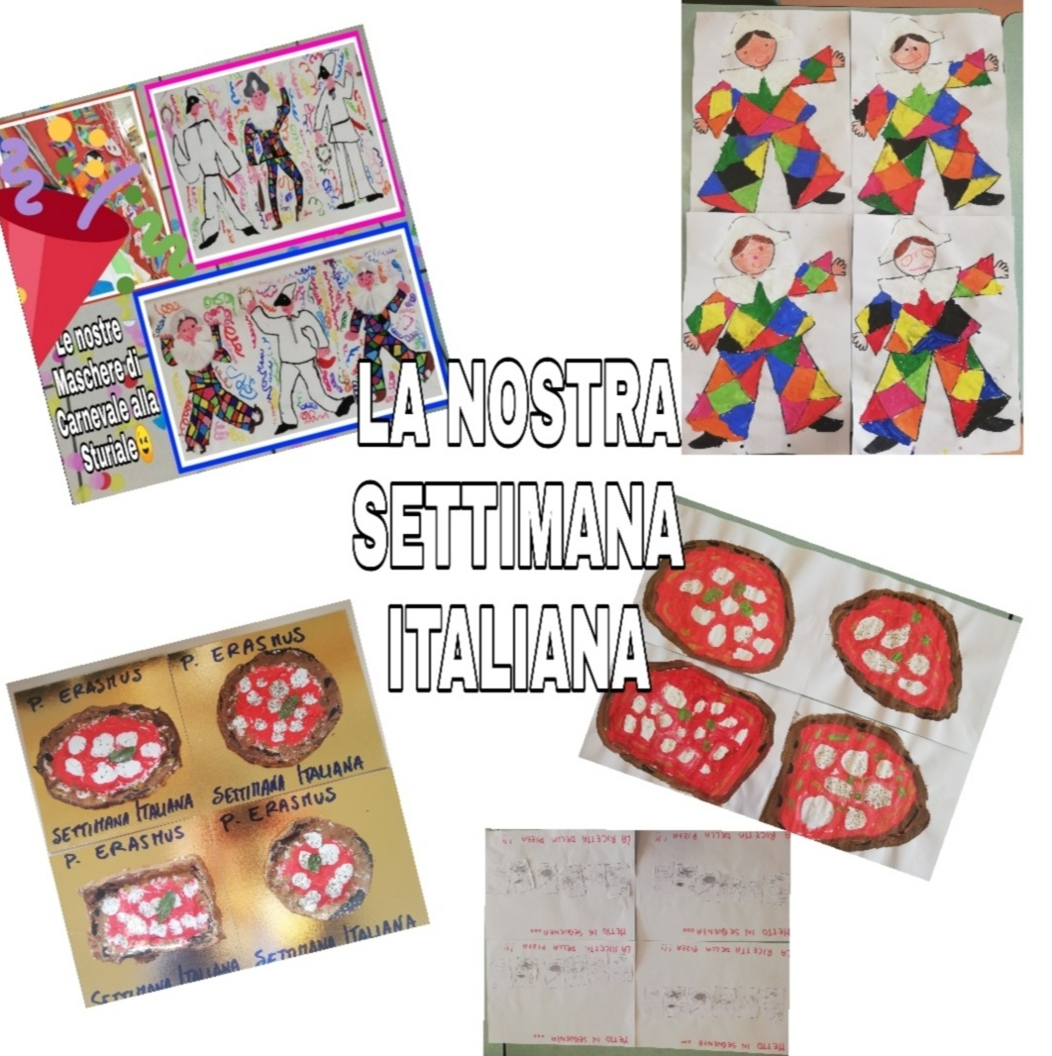
OUR ITALIAN WEEK

