Slide 1
ERASMUS + “For a respectful and tolerant school” Welcome ceremony
Third training event
14th-17th October 2019
Certaldo - Italy

Slide 2
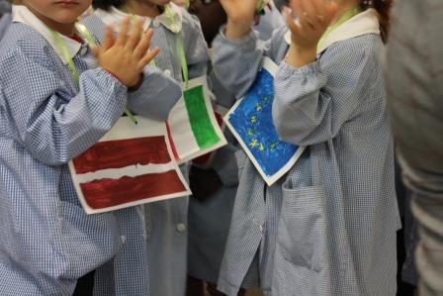
“For a respectful and tolerant school” Welcome ceremony

Slide 3
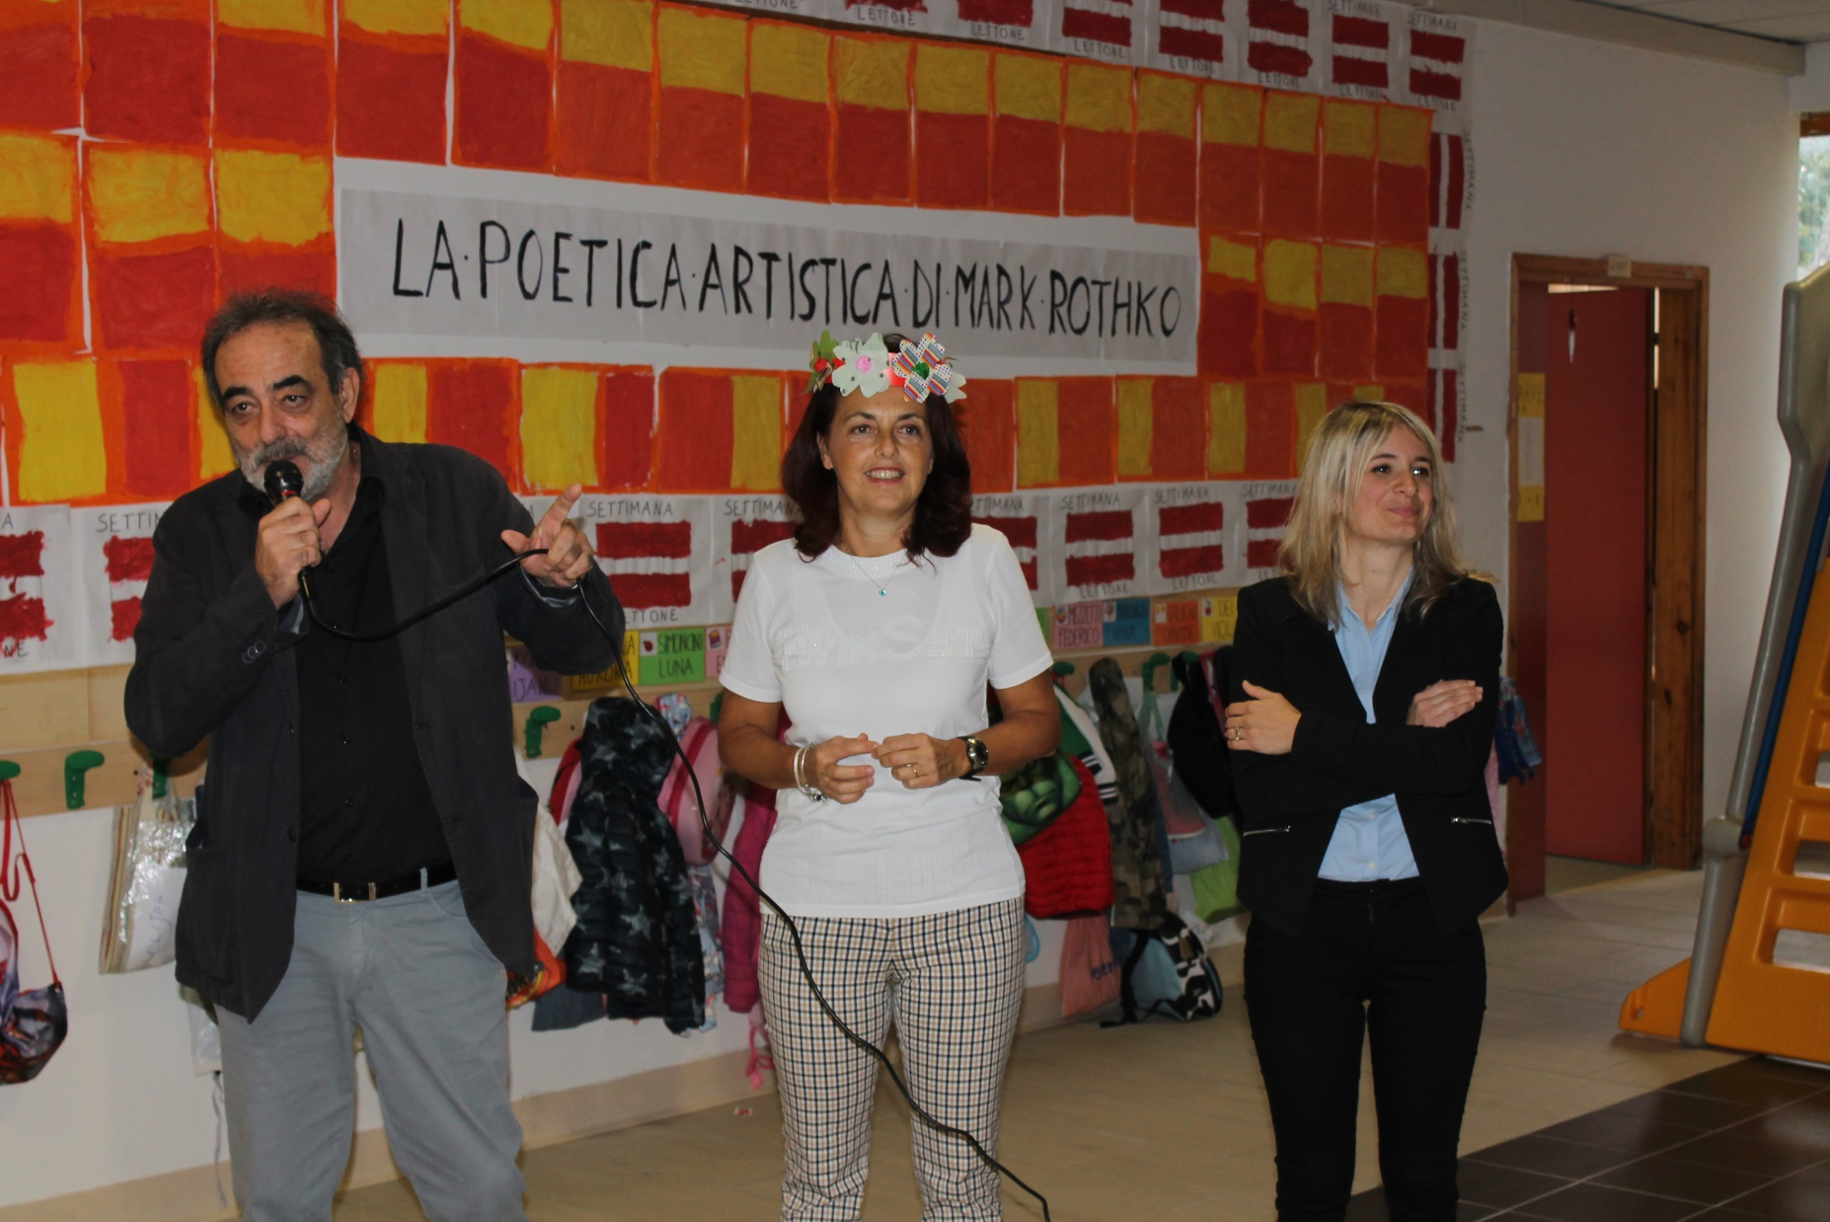
“For a respectful and tolerant school” Welcome ceremony

Slide 4
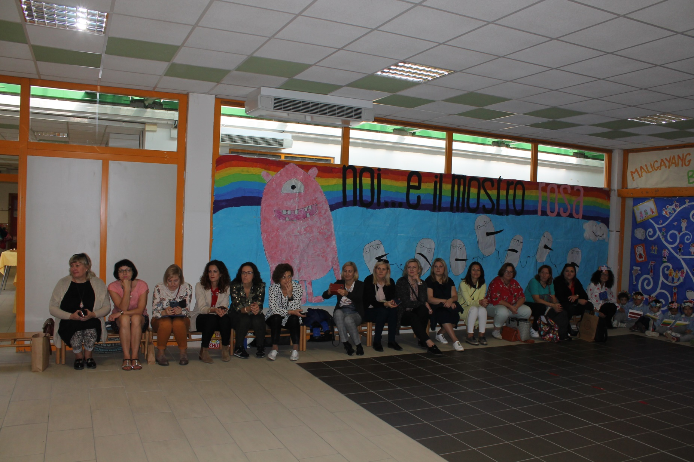
“For a respectful and tolerant school” Welcome ceremony

Slide 5
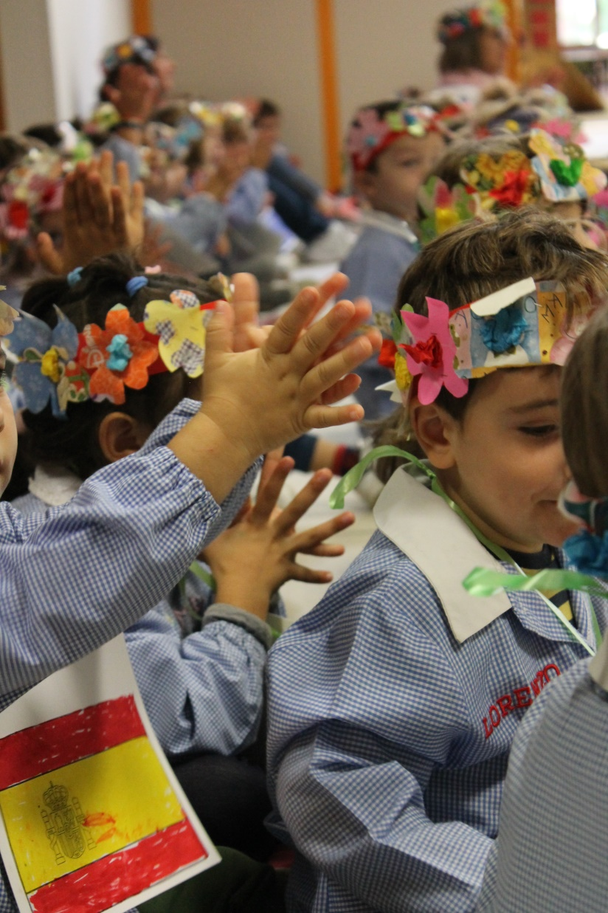
“For a respectful and tolerant school” Welcome ceremony

Slide 6
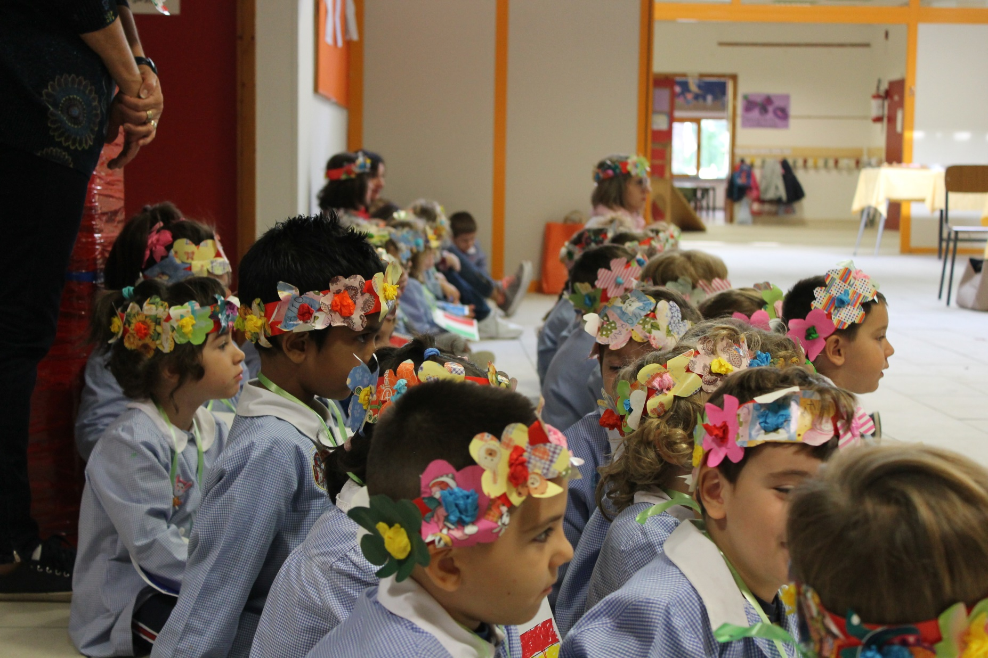
“For a respectful and tolerant school” Welcome ceremony

Slide 7
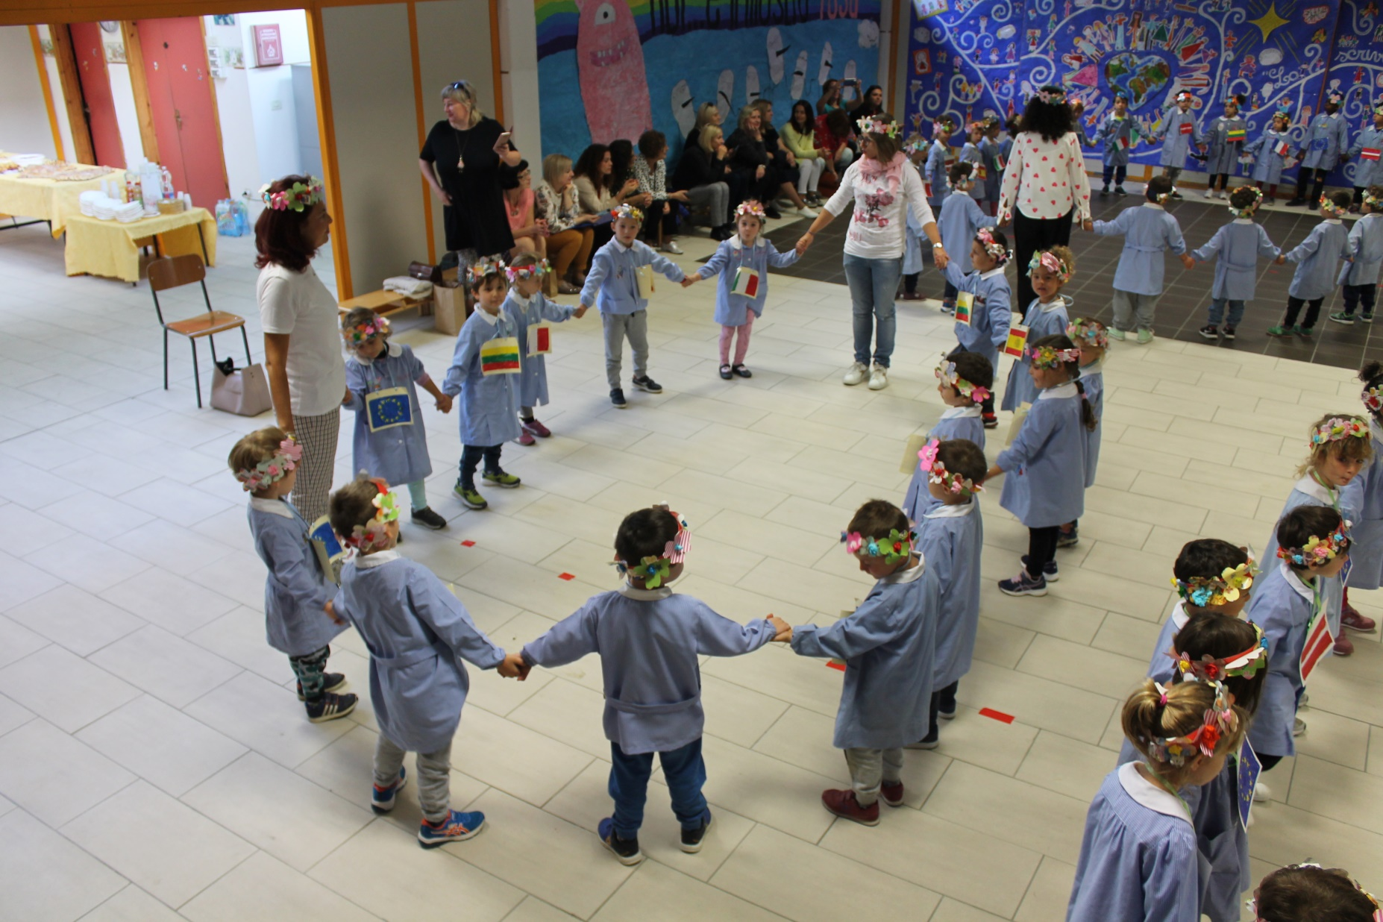
“For a respectful and tolerant school” Welcome ceremony

Slide 8
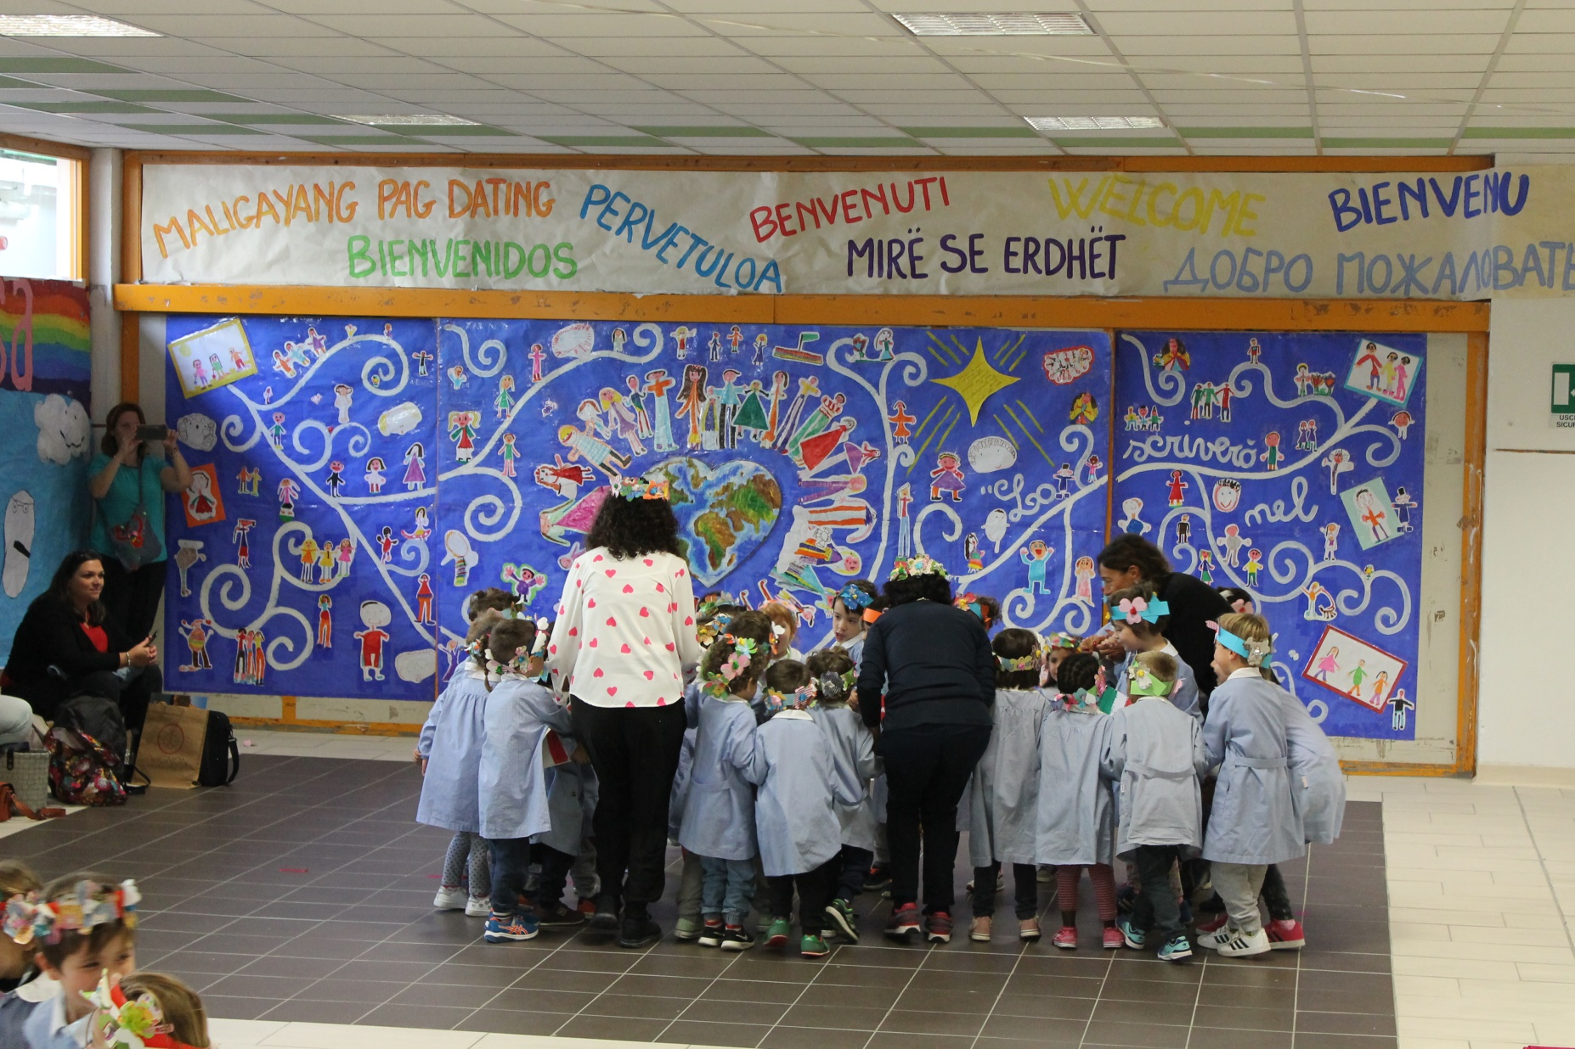
“For a respectful and tolerant school” Welcome ceremony

Slide 9
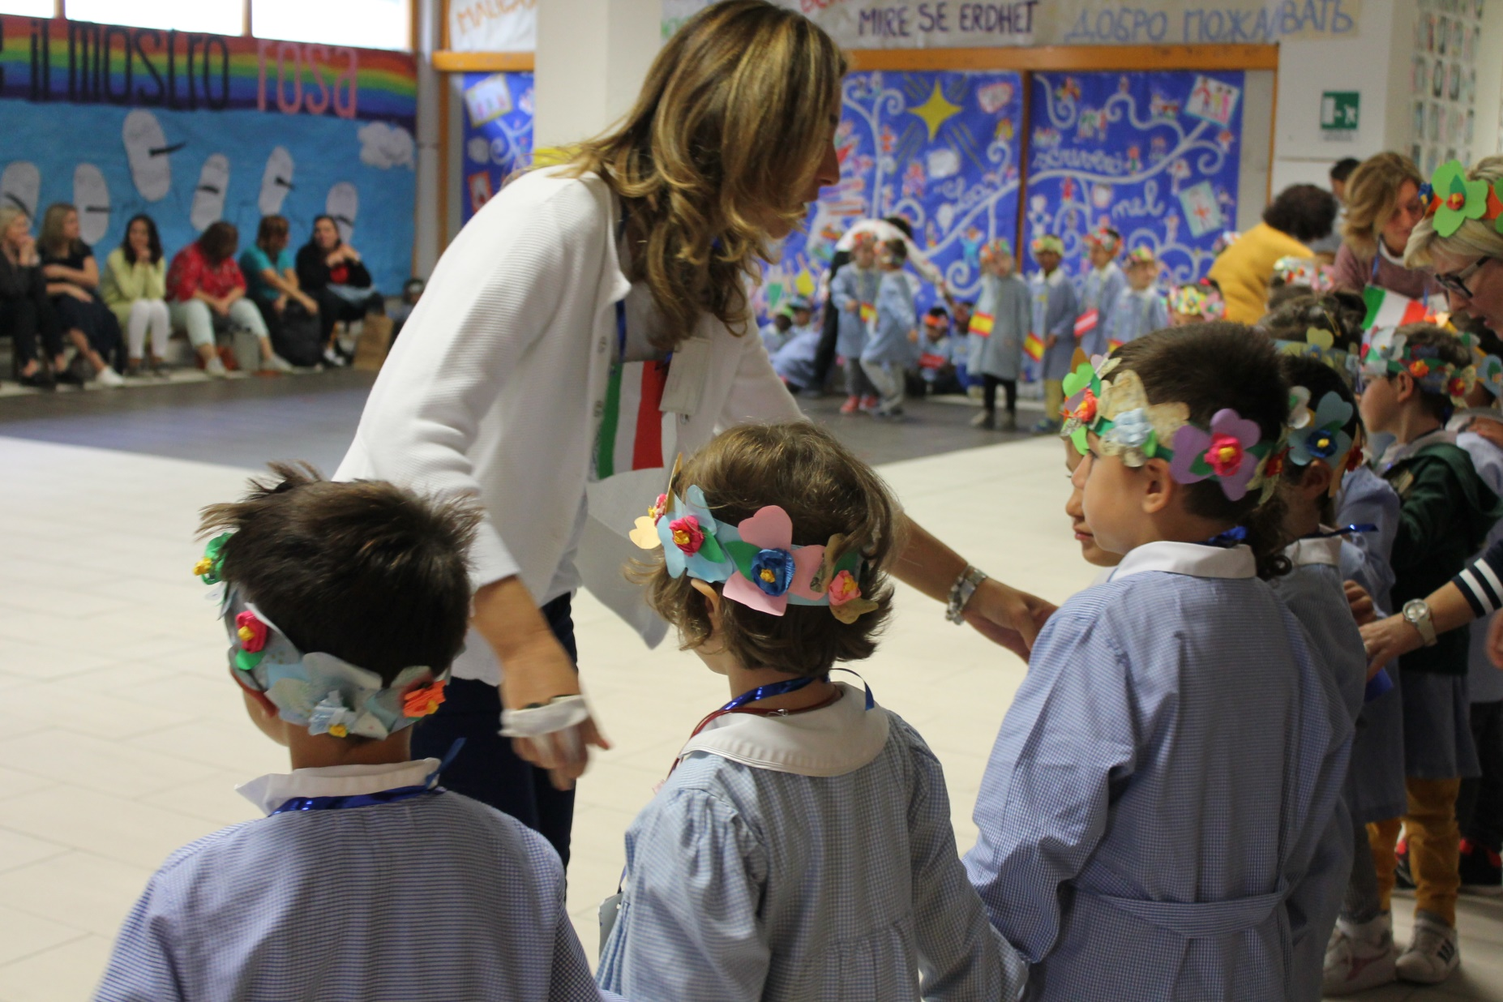
“For a respectful and tolerant school” Welcome ceremony

Slide 10
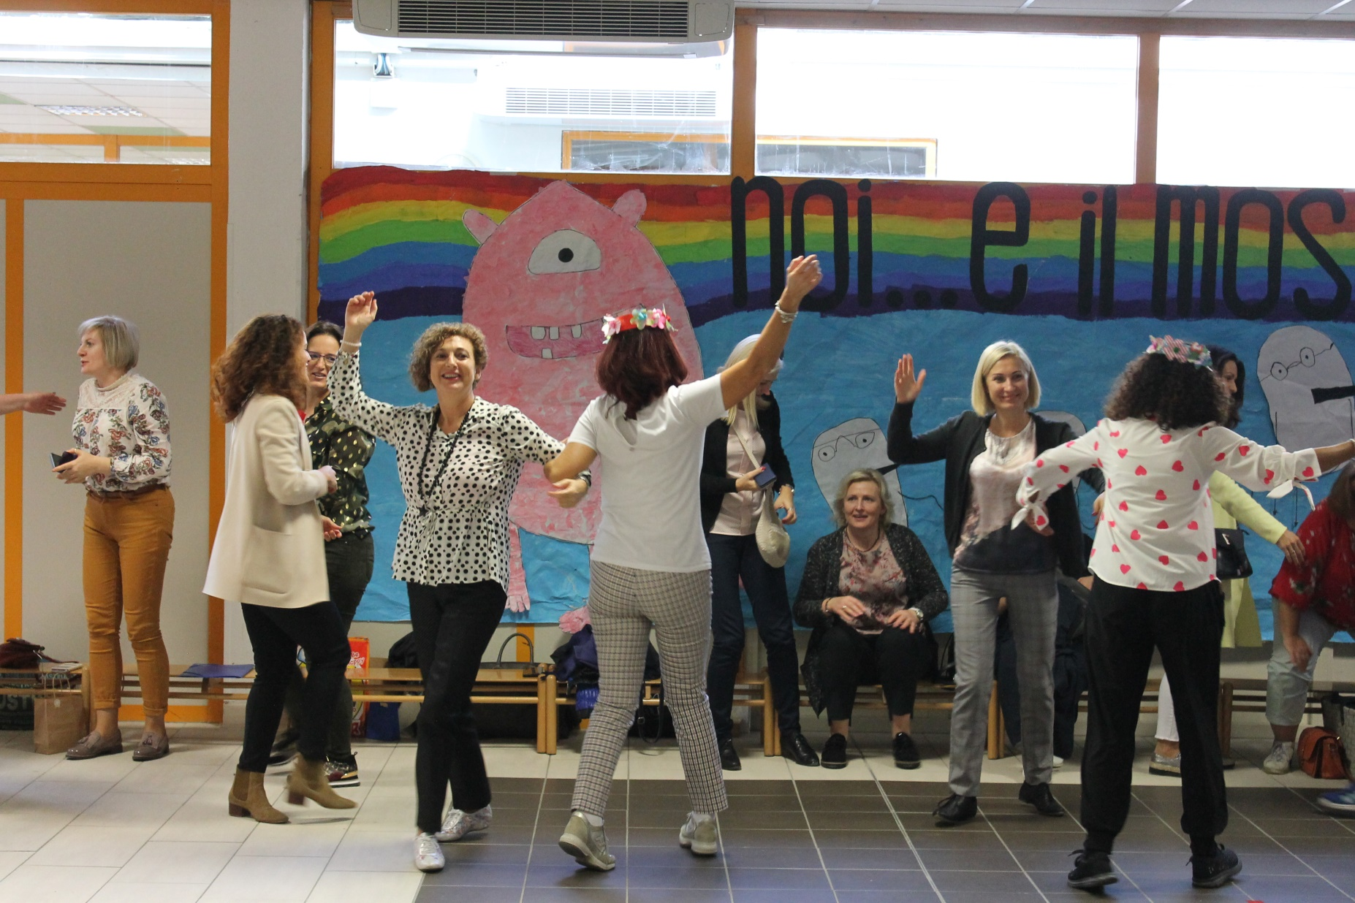
“For a respectful and tolerant school” Welcome ceremony

Slide 11
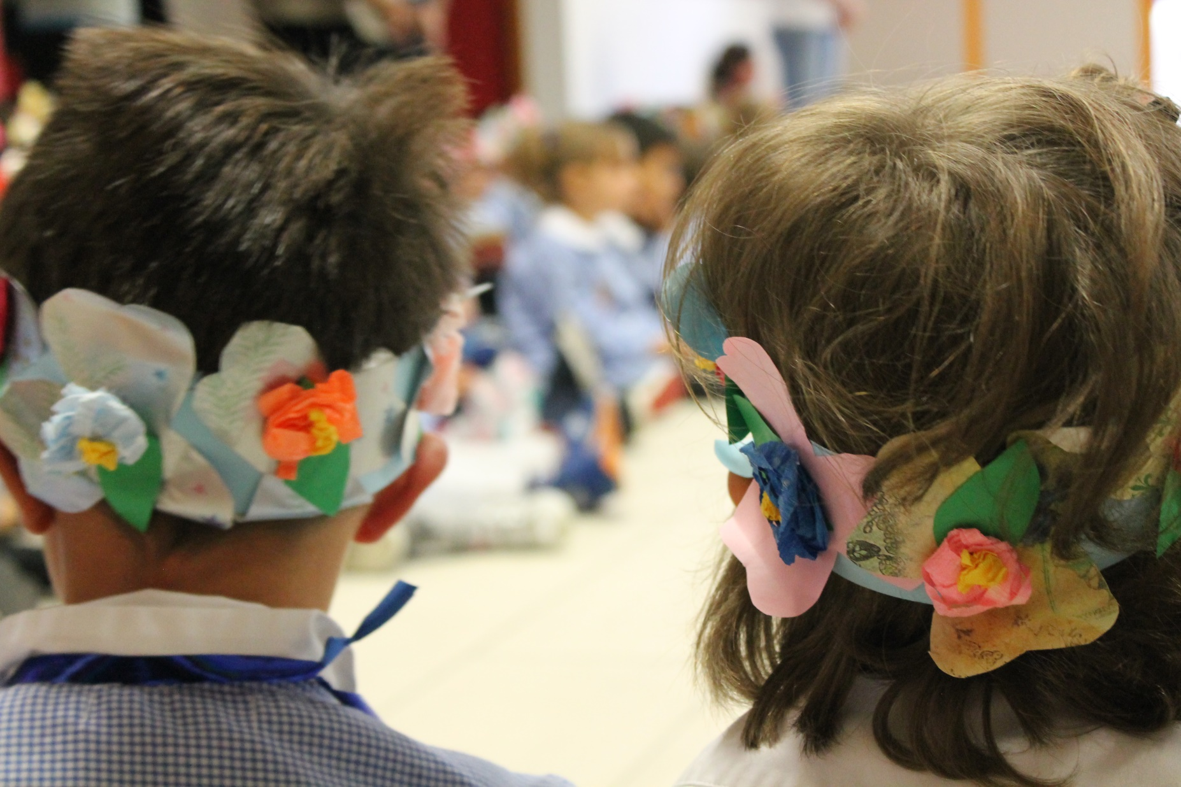
“For a respectful and tolerant school” Welcome ceremony

Slide 12
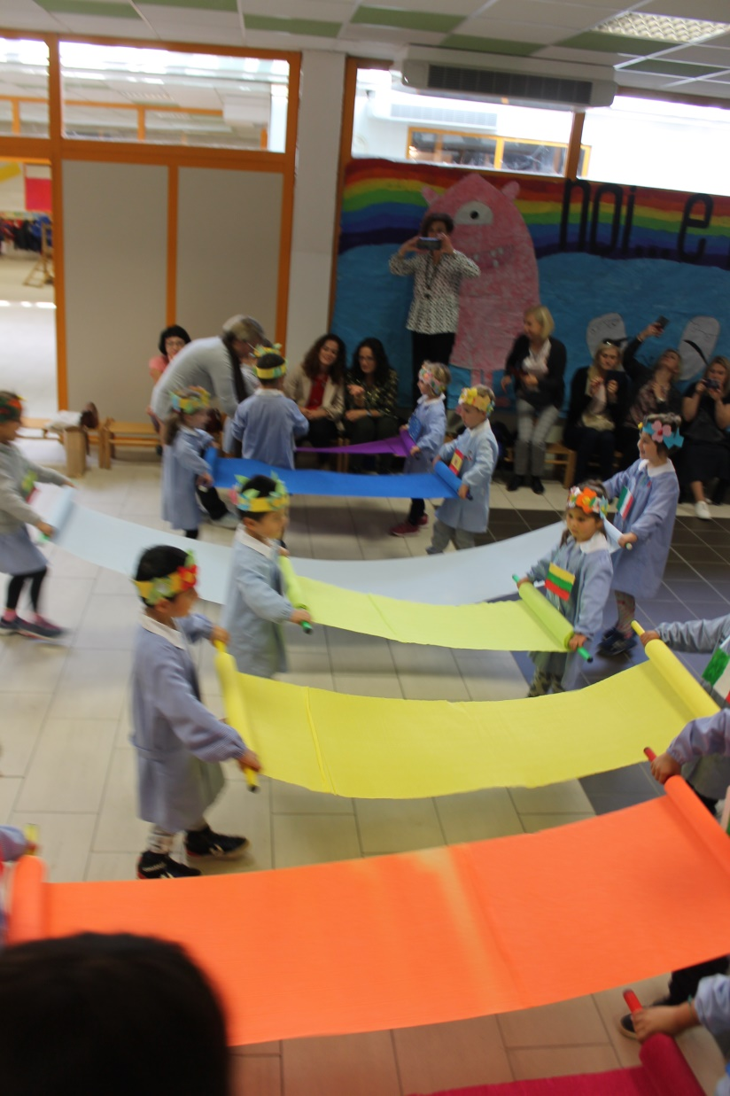
“For a respectful and tolerant school” Welcome ceremony

Slide 13
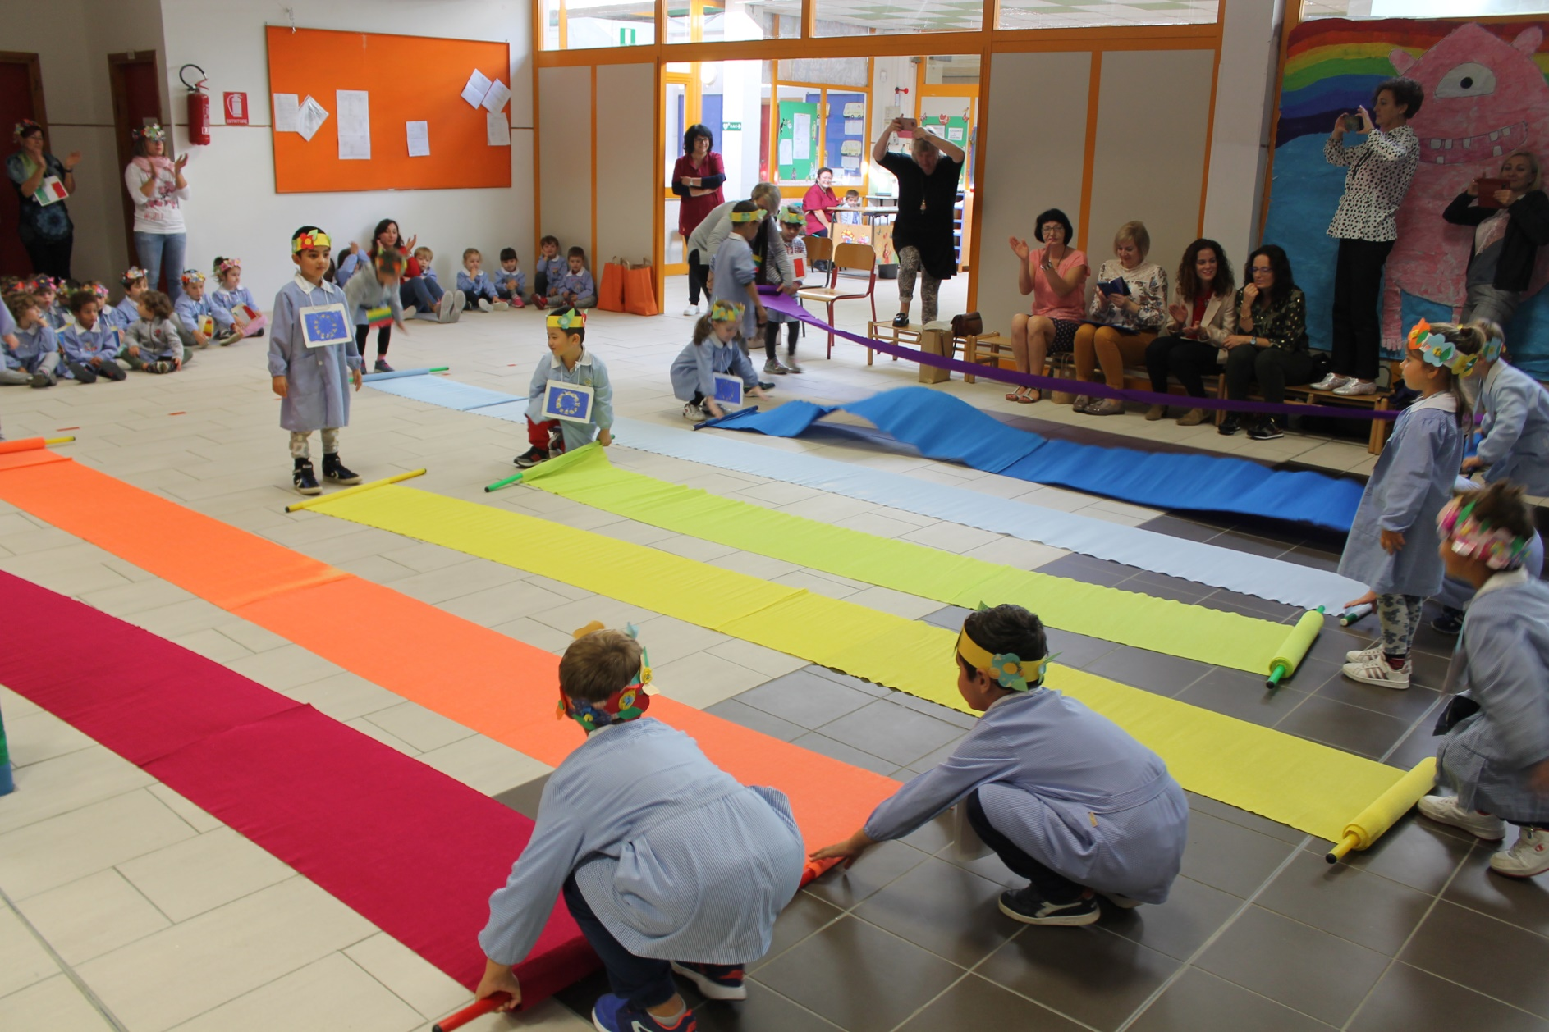
“For a respectful and tolerant school” Welcome ceremony

Slide 14
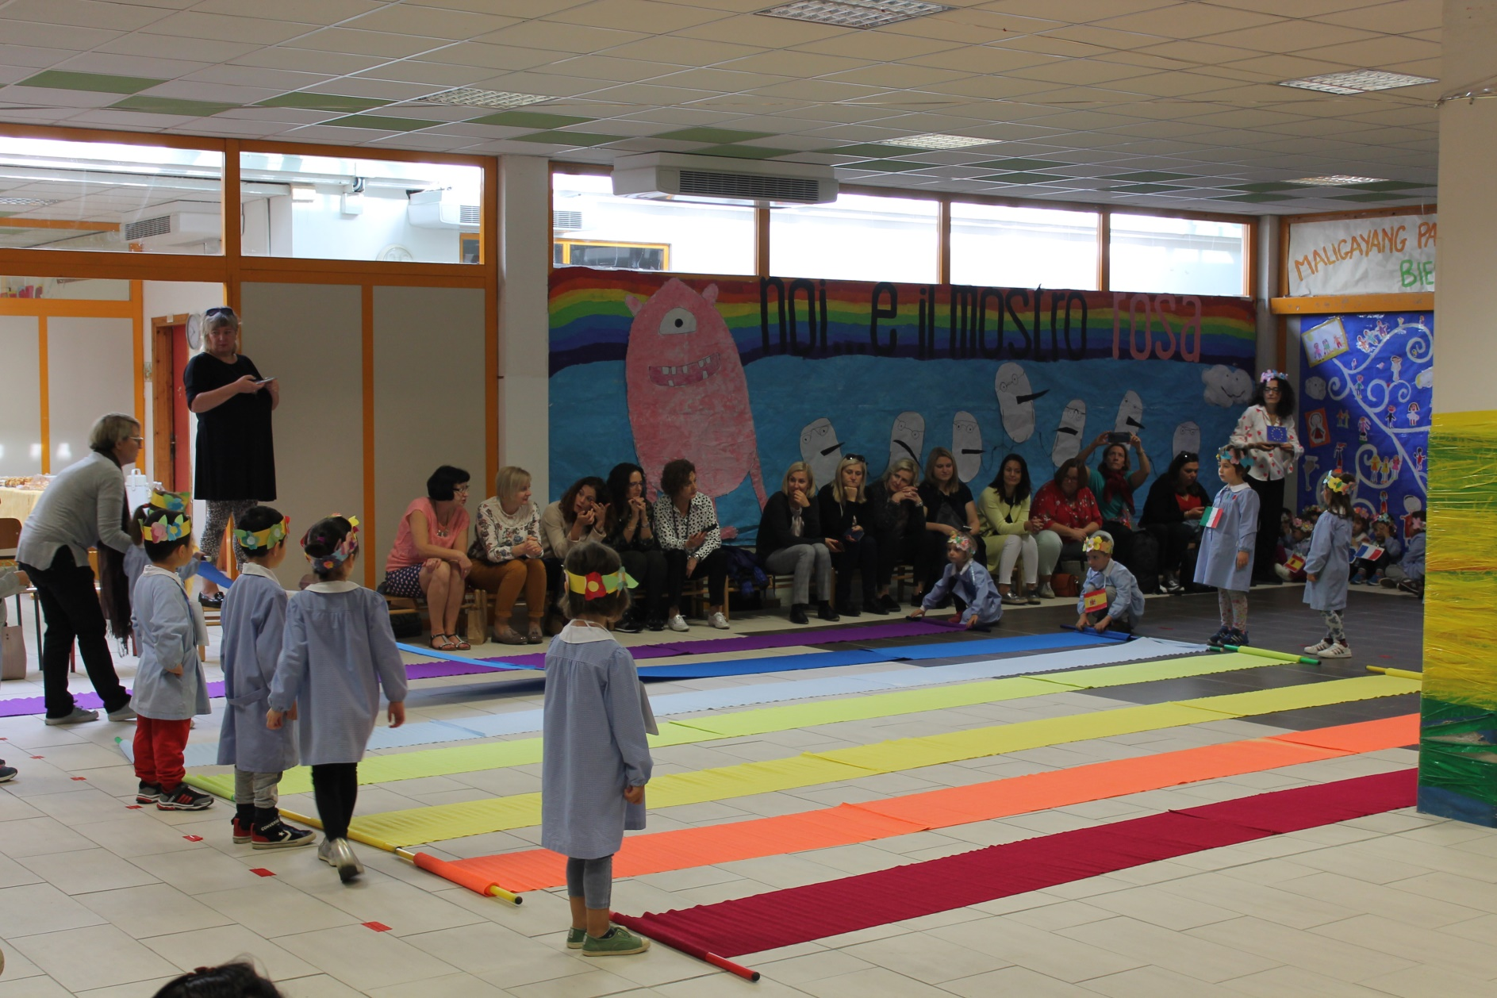
“For a respectful and tolerant school” Welcome ceremony

Slide 15
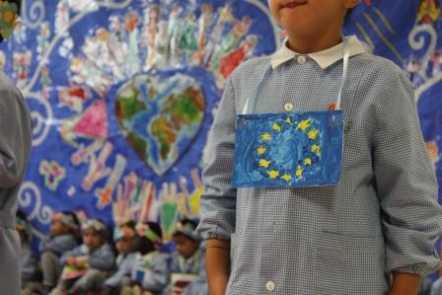
“For a respectful and tolerant school” Welcome ceremony

Slide 16
“For a respectful and tolerant school” Welcome ceremony

Slide 17
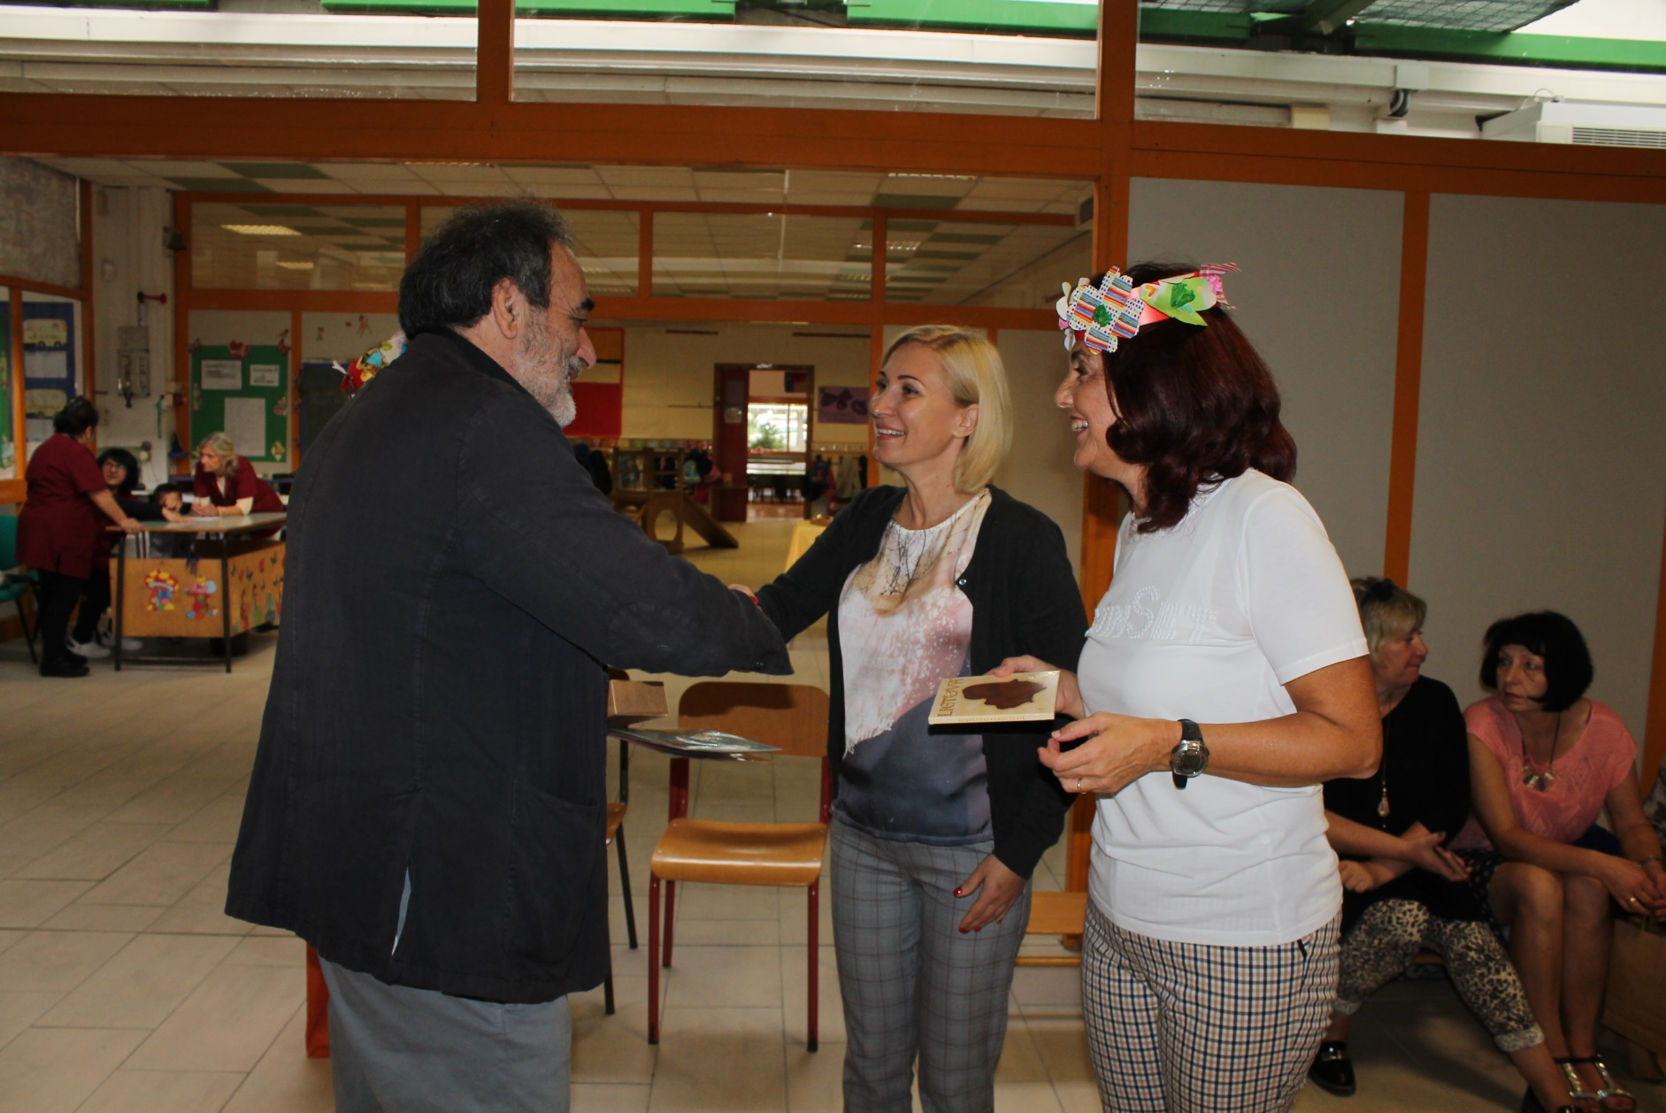
“For a respectful and tolerant school” Welcome ceremony

Slide 18
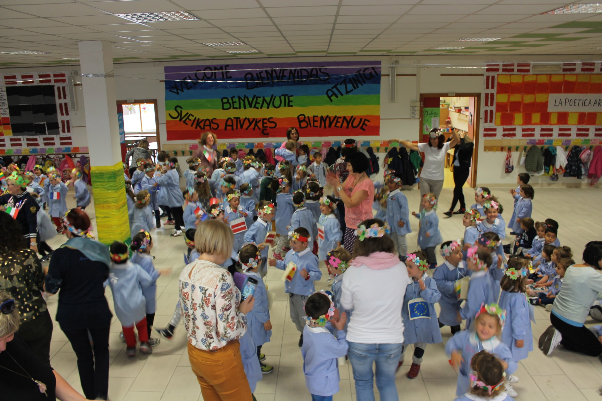
“For a respectful and tolerant school” Welcome ceremony

Slide 19
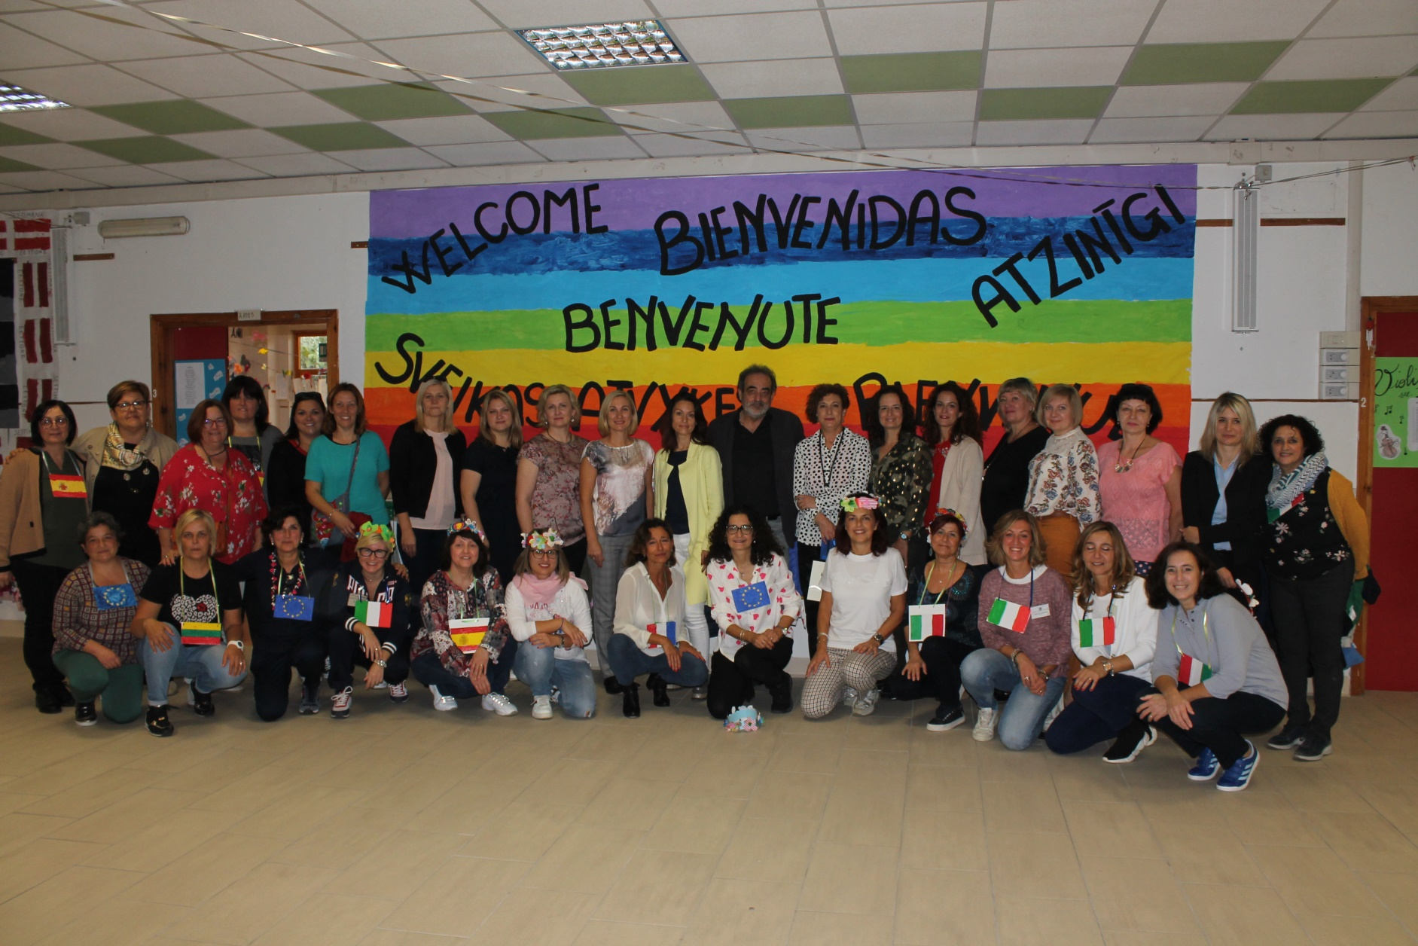
“For a respectful and tolerant school” Welcome ceremony

